Slide 1
An Innovation Framework for Software Defined Networking
Rajesh Narayanan, Technology Strategist
Office of the CTO, Dell Networking
DIMACS Workshop on SDN, Rutgers
December 3-4, 2012

Slide 2
Agenda
  Vision and State
  Challenges
  SDN Innovation Framework
  Status

Slide 3
Vision and State

Slide 4

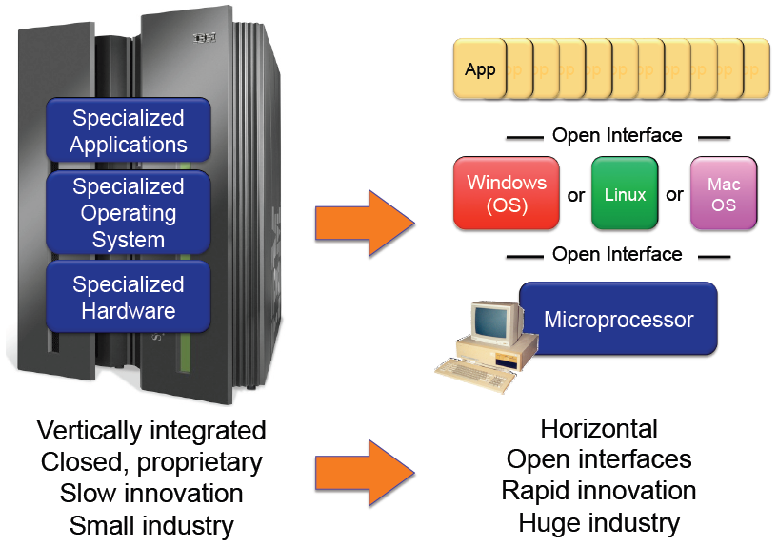
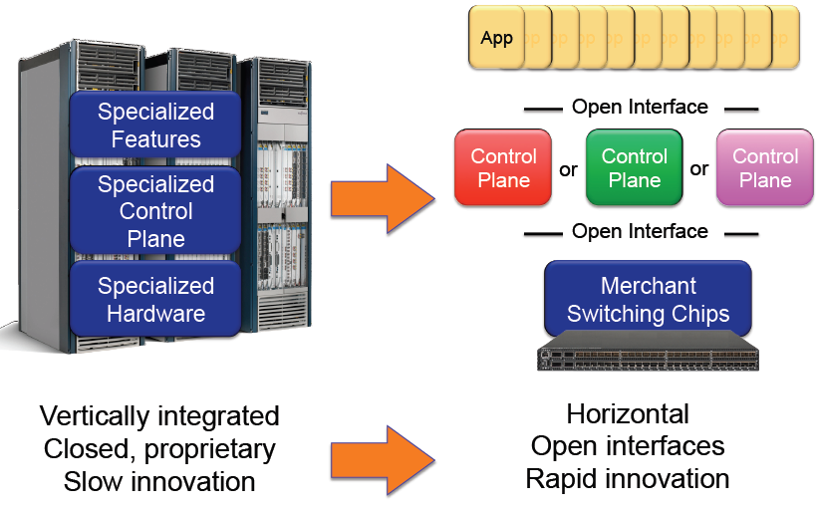
SDN : The Vision
What happened in computing industry
Is SDN’s Promises for the Networking industry
Are we there?
Notes:
The question really is what it takes us to get there?

Slide 5
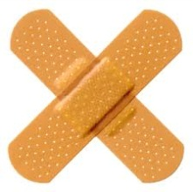
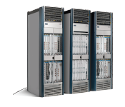
Practical Concerns
  Distributed System Patchwork
    Protocols Based Control Plane
    RFC Soup > 6000
    Only 20% features typically used
  State of the Network
    Mastering complexity
    Feature requests become RFCs
    Monolithic systems.. $$$ ..power hungry
  Resulting in…
    Customers lose... vendor lock-in
    Increased Entry Barrier
    Stifles innovation
Feature
Feature
Feature
Switch Operating System
Switching Hardware
STP VLAN
TRILL SPB
Protocols Maturity
Merchant Silicon
Hardware Commoditized

Slide 6
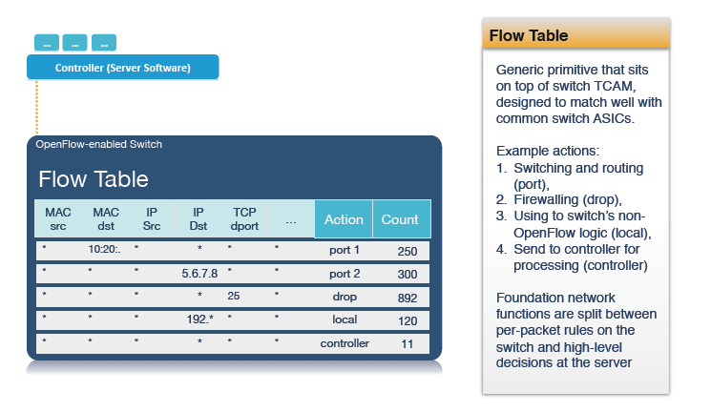
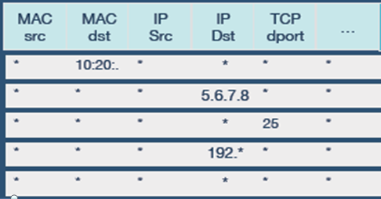
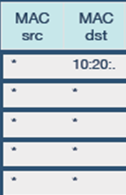
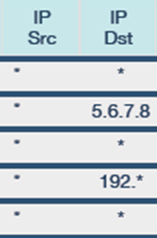
What does the Data Plane look like?
64-128K** 100-500K** 2-4K
** Destination MAC/IP Addresses only

Slide 7
Challenges

Slide 8
Ecosystem Challenges
  Market
  Elusive Proof Points .. Adopting Segments .. Application Diversity
  Technology
  Spec. Maturing .. ‘Feature on the switch’ .. Ignoring NPU Silicon
  Execution
  Prioritization concerns .. Multiple Product lines .. Nimble Towards Customer Needs

Slide 9

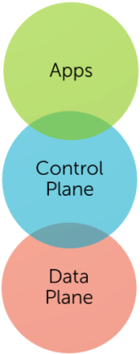
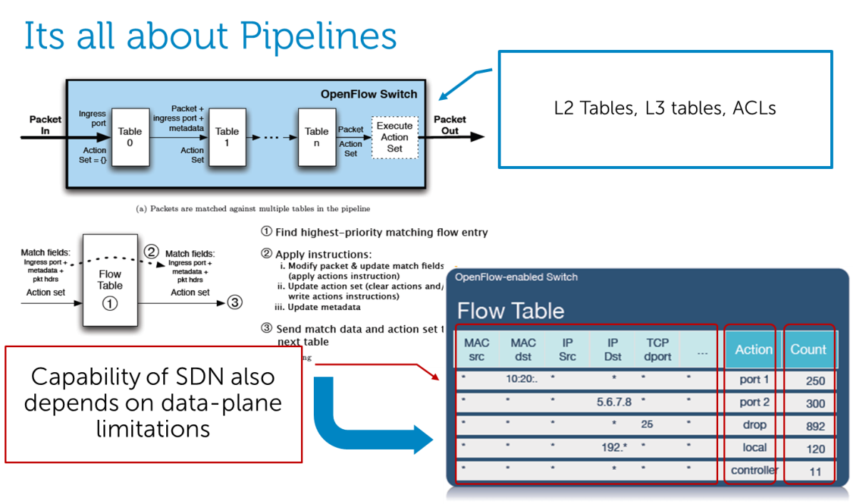
Innovation Challenge
  …our focus…
  ..killer platforms..
  Elusive killer use-case
  ...service oriented architecture…
  ..extensible and programmable data planes..
  Framework Limitations
  Rigid and Permeates all aspects of Networking.

Slide 10
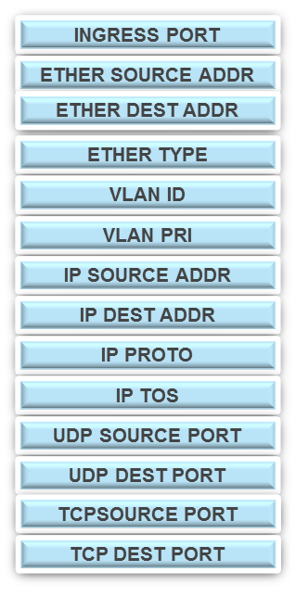
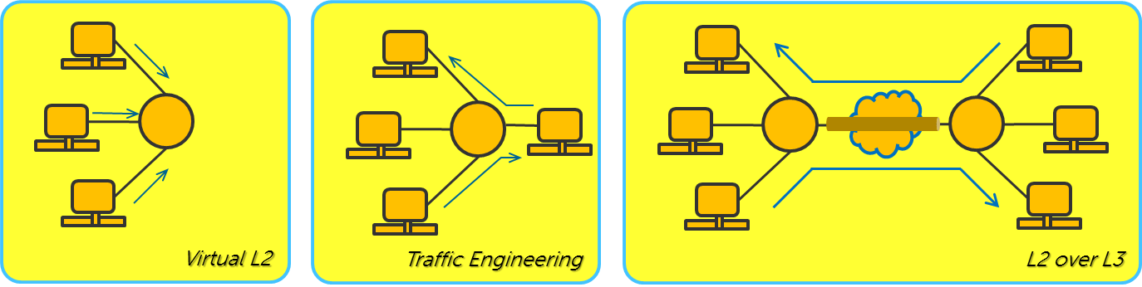
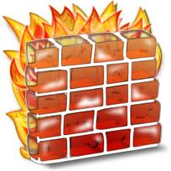




“All Flows are not Created Equal”
  Coarse Flows → MacroFlows
  Granular Flows → MicroFlows
Allow, Drop, Reroute, Multicast
(Essentially PBR)
Encrypt, Compression, Acceleration, Buffering, Watermarking, Custom
(Rich Action-set Missing)

Slide 11
Application Innovation Framework

Slide 12
“Lets Split the Data Plane”

Slide 13


Split SDN-Data-Plane (Divide and Rule)
  Granular Flow Processor – multicore NPU
  With independent OF agent
  Controller Separately manages both OF agents
Identify MacroFlows needing granular Processing
Flows are redirected to subsystem
Flow-explosion of MicroFlow entries in subsystem
SDN Controller
Switch
Module

Slide 14
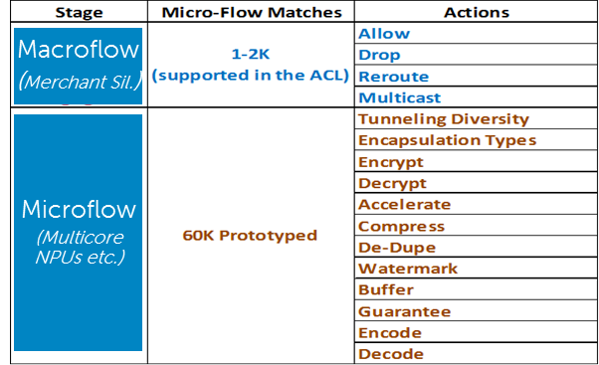
Results/Benchmarks
  Agnostic to OF Spec
  60K Flow entries in a proof-of-concept system
  100x Switch/Controller throughput
  Programmable/Extensible Pipeline
  Leverage Hardware Offload Blocks
  Rapid Dev. → 3 Apps in a month
Paper Presented: European Workshop on SDN, Oct 2012, Darmstadt, Germany
Demo: GEC15 (GENI), Oct 2012, Houston

Slide 15









SDN Application Innovation Framework
Open Control Plane
  New APIs Leverage Extensible data-plane
  Beyond Policy Based Routing
Extensible Data Plane
  Open Data Plane architecture (Split Data Plane)
  New packet processing pipelines
  Dynamically insert data-plane apps
Statistics Plane
  Asynchronous Statistics
  Unlock Volumes of Statistics
  Big Data, Correlate, Visualize
Richer Service Oriented Architecture
Apps
Apps
Control Plane
Control Plane
Stats
Data Plane
Data Plane
Stats Plane
Time Series Database
Implicitly OSI’fied
(Limits App. Diversity)

Slide 16
So where are we?
  Based on Dells Power Connect 7000 series Switches
  Module is a Multicore Cavium Module
  Basic Encryption application available
  Open Framework – work in progress
  SDP Enabled switches available to Select Researchers and academia

Slide 17

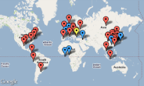


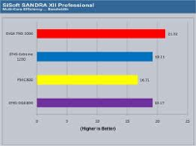

Exercise 1: Hello World (ICMP-Proxy)
Controller Apps
Flow Stats/ Counters
Data Store
“Hello World”
“Hello World”
Controller
“Hello World”
“Hello World”
“Hello World”
“Hello World”
“Hello World”
Management Network
> Hello World 192.168.2.7
> Hello World 10.2.3.4
> Hello World 168.23.18.8 > Hello World 192.168.2.7
> Hello World 10.2.3.4
> Hello World 168.23.18.8 > Hello World 192.168.2.7
> Hello World 10.2.3.4
> Hello World 168.23.18.8
Switch
SDP Apps
C1 C2 C3
W

Slide 18
Thank You!
N_Rajesh@dell.com

