Slide 1

A SOFT Way for OpenFlow Interoperability Testing
[CoNEXT’12]
Marco Canini
TU Berlin / T-Labs

Slide 2
First: my view on SDN
SDN: A role for software engineering
and formal methods
to improve reliability
Today
Evolved
Performance
Simple to manage and program
Less complexity
Deterministic and verifiable behavior
Reliability

Slide 3


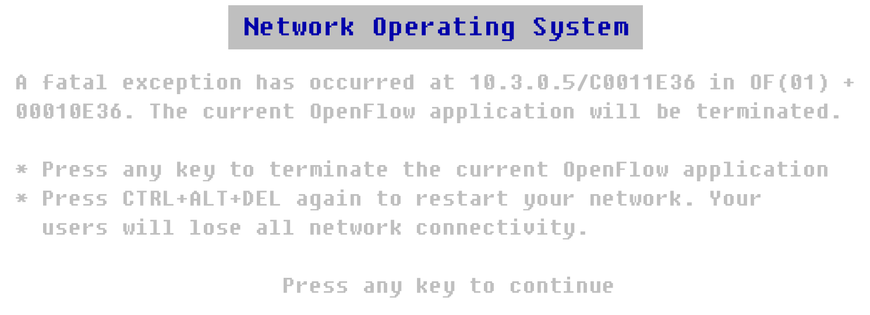
Reduce the risk of bugs!

Slide 4


Software Faults
Will make communication unreliable
Major hurdle for success of SDN
We need effective ways to validate SDN networks

Slide 5
Input
NICE
[NSDI’12]
Output
Unmodified
OpenFlow
program
Traces of property violations
Systematic state-space
exploration
Network
topology
Correctness
properties (e.g., no loops)

Slide 6
Okay,
now back to OpenFlow Interoperability Testing

Slide 7




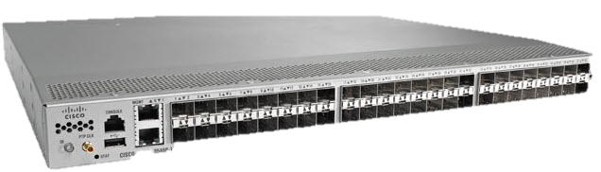
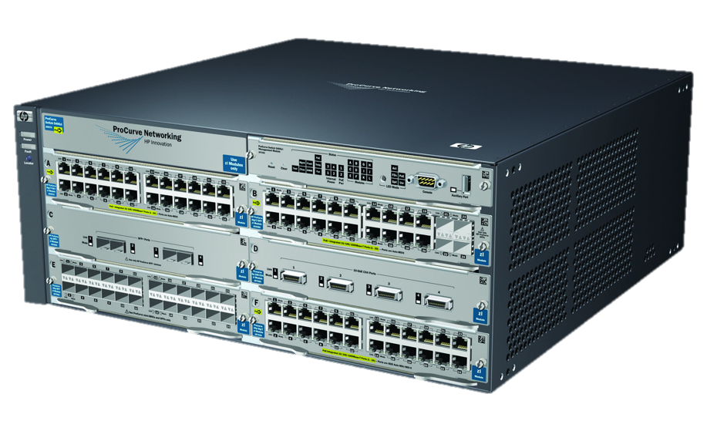
Interoperability at Deployment Time
OpenFlow
program
Release
One OpenFlow API specification…
Are OF switches interoperable?
OpenFlow
messages
Interop is critical for the success of SDN

Slide 8
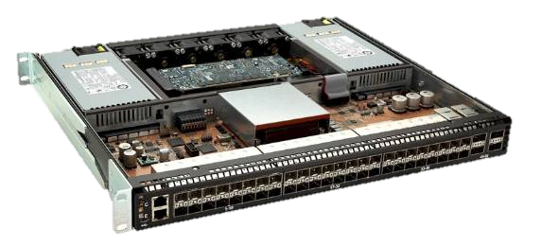
Interop: How Hard Can It Be?
OpenFlow
messages
OpenFlow
interface
Inputs
Likely source of OpenFlow interop issues
OF Switch
OpenFlow Agent
OS
Flow Table
Hardware Abstraction Layer
Packets
ASIC switch chip
Hardware correctness is formally verified
“Forwarding” interface

Slide 9
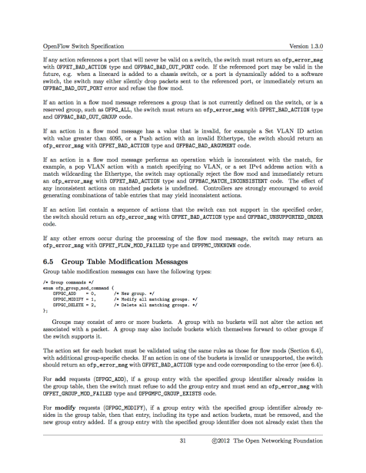
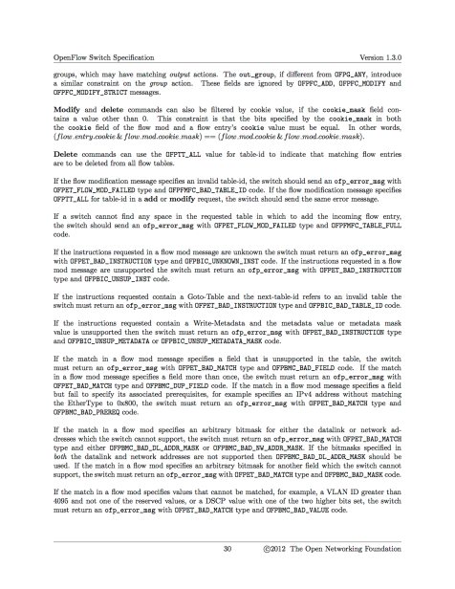
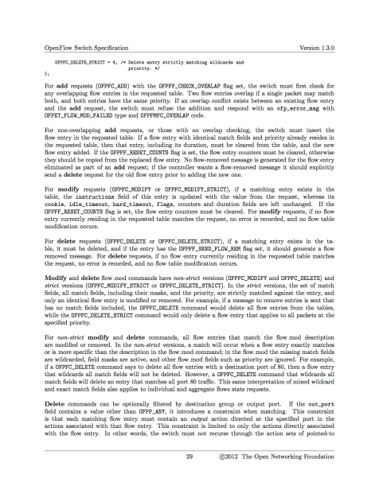

OpenFlow Software Agent
Switch software is not provably correct ☹
Specifications
Rapid flux (3 revisions in ~ 1 year)
Ambiguities
Specifications → Implementation
Implementation freedom
Vendors may not follow the specs
Testing, testing and testing…

Slide 10
Interoperability Event
Gather various vendors
Hook up switches and controllers
Create and run test cases
See what breaks and fix it
Very high manual effort
Test cases are not exhaustive
It is not a one time thing

Slide 11
Automating Interop Testing
Insight:
systematically crosscheck OF implementations

Slide 12

The 10,000 foot view
Test inputs
OF Agent 1
OF Agent 2
Problem I: What inputs should we use?
Input-driven
execution
Observable
behaviors
Inconsistency!

Slide 13
Symbolic Execution
If ( p == OFPP_CTRL )
send_to_ctrl ( )
else if ( p < 25 )
send_to_port( p )
else
error( BAD_PORT )
p
Problem II: Path explosion
p == OFPP_CTRL
p != OFPP_CTRL
send_to_ctrl ( )
Path condition:
p >= 25 & p != OFPP_CTRL
OFPP_CTRL
65535
p < 25
p >= 25
p:
1
24
25
FWD
ERR
CTRL
ERR
send_to_port( p )
error

Slide 14
Challenges
Manage test inputs and coverage efficiently
Capture behaviors
Avoid simultaneous access to all code

Slide 15
SOFT
(Systematic OpenFlow Testing)
Test inputs
Phase 1
Determine mapping
inputs → behaviors through symbolic execution
OF Agent 1
OF Agent 2
Automated solution to interop testing
Systematic code coverage
No simultaneous access to all agents
Input-driven
execution
Identify inconsistencies
Observable
behaviors
Phase 2

Slide 16
Structured Inputs
1.0
FLOW
MOD
N1
*
*
*
*
*
*
*
1.0
STAT
REQ
N2
*
C1
C2
...
*
*
*
*
Further reductions
Some inputs are independent
Many inputs are entirely concrete
Small number of messages
Concrete values at cost of coverage

Slide 17
Capturing Behaviors
Externally observable outputs
  OpenFlow reply messages
  Data plane packets
  Normalize harmless nondeterminism (e.g., Buffer IDs)
Internal state changes affect successive inputs
  Use concrete probe packets

Slide 18
Example
Agent 1
Agent 2
If ( p == OFPP_CTRL )
send_to_ctrl ( )
else if ( p < 25 )
send_to_port( p )
else
error( BAD_PORT )
if ( p < 25 )
send_to_port( p )
else
error( BAD_PORT )
p:
OFPP_CTRL
65535
p:
65535
1
24
25
1
24
25
FWD
ERR
CTRL
ERR
FWD
ERR

Slide 19
N-version Comparison
Agent 1
Agent 2
If ( p == OFPP_CTRL )
send_to_ctrl ( )
else if ( p < 25 )
send_to_port( p )
else
error( BAD_PORT )
if ( p < 25 )
send_to_port( p )
else
error( BAD_PORT )
p:
OFPP_CTRL
65535
p:
65535
1
24
25
1
24
25
FWD
ERR
CTRL
ERR
FWD
ERR

Slide 20

N-version Comparison
p:
OFPP_CTRL
65535
1
24
25
Agent 1
FWD
ERR
CTRL
ERR
Agent 2
FWD
ERR
No false positives
Is there an input subspace that
causes two distinct behaviors?

Slide 21
Limitations
Short sequences of inputs
  Unable to find problems with a complex state
Is an inconsistency harmless?
  Can it affect the controller?
  How to test all initial configurations?
    Agent’s behavior depends on initial config

Slide 22
Prototype & Evaluation
SOFT prototype built on top of Cloud9/Klee
Compared
  OpenFlow 1.0 Reference Switch (55k LoC)
  Open VSwitch 1.0.0 (80k LoC)
Input Sequences containing 1 - 4 messages

Slide 23
Does SOFT Work?
Found 7 classes of inconsistencies
Mostly related to message validation
Result of underspecification
  No expected behavior in the specification
  Inconsistent interpretation of the specification

Slide 24
Inconsistency - Example
FlowMod message
Modify VLAN to value greater than 2¹²
Forward packet
Network in 2 different states
Which one is assumed by the controller?
Reference Implementation
Trim VLAN value to 12 bits
Install the rule
Open VSwitch
Silently ignore the message

Slide 25
Concretizing Tradeoffs
Fully
Symbolic
28h

Slide 26
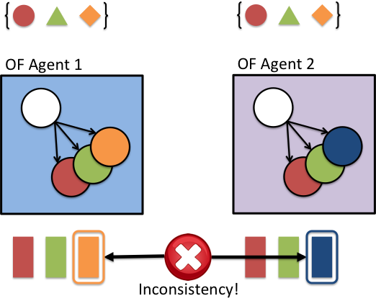
Conclusions
SOFT automates interoperability
testing of OpenFlow Agents
Systematic code coverage
No simultaneous access to
all agents
Also useful for:
Regression testing
Specification improvements

Slide 27
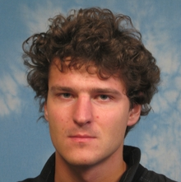



Thanks
Maciej Kuźniar
(EPFL)
Peter Perešíni
(EPFL)
Daniele Venzano
(EPFL)
Dejan Kostić
(EPFL → IMDEA Networks)

Slide 28
Thank you!
SOFT automates interoperability
testing of OpenFlow Agents
Systematic code coverage
No simultaneous access to
all agents
Also useful for:
Regression testing
Specification improvements

