Slide 1

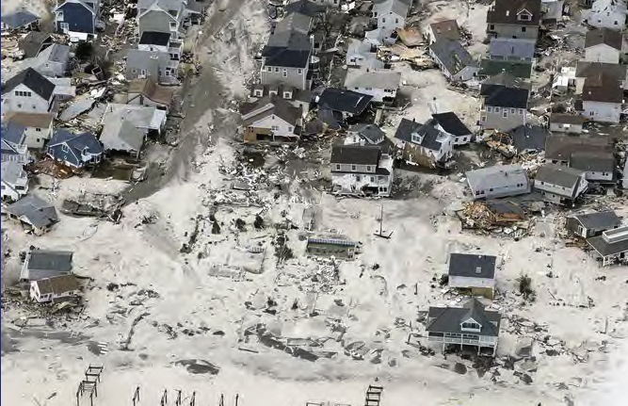
Sandy’s Fury
DIMACS/CCICADA Workshop on S&T Innovations in Hurricane Sandy Research
David A. Robinson
Professor, Department of Geography &
New Jersey State Climatologist
Rutgers University
June 5, 2013

Slide 2
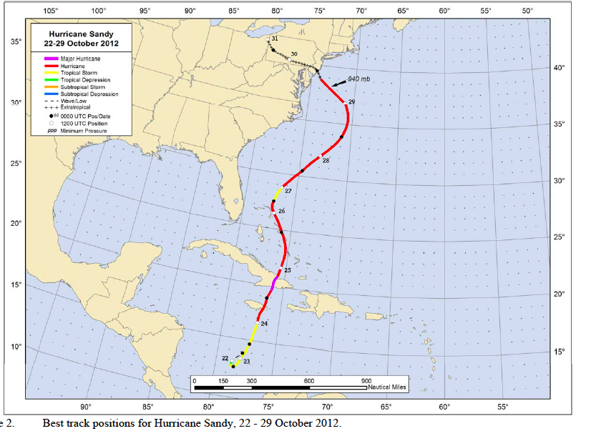

Slide 3
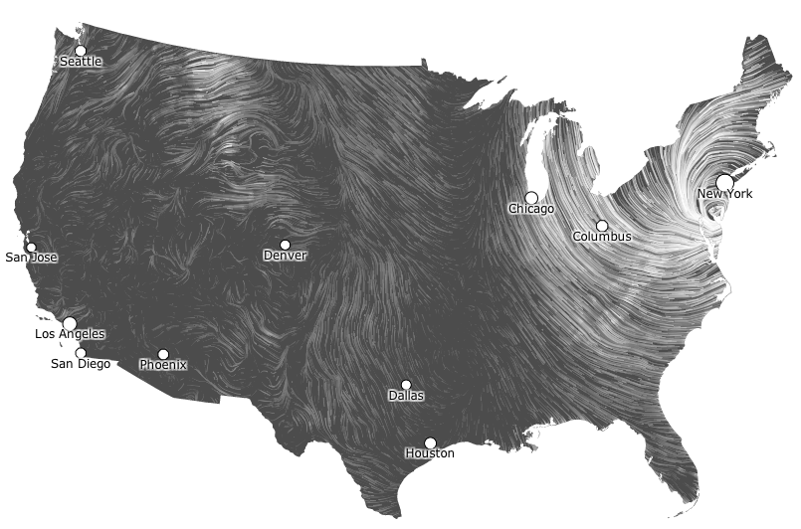
Wind field: October 29

Slide 4
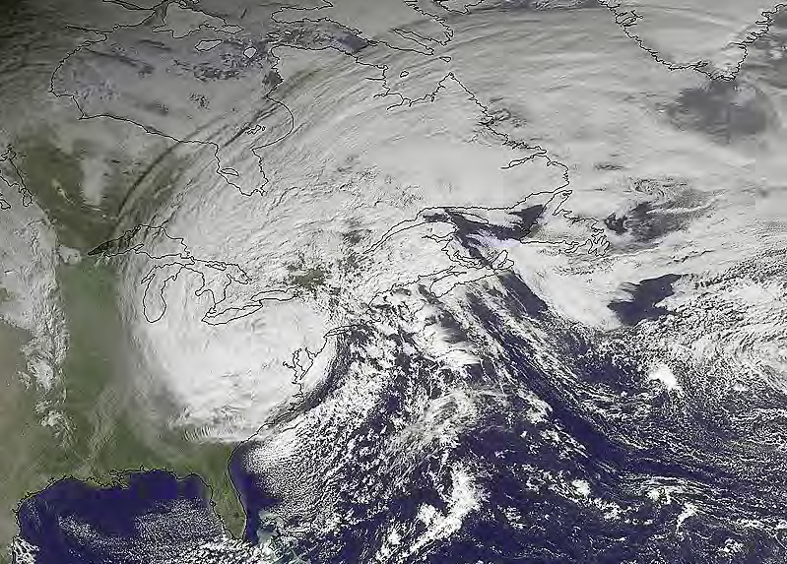
Satellite image Tuesday, Oct. 30, 2012 (AP Photo/NOAA)

Slide 5
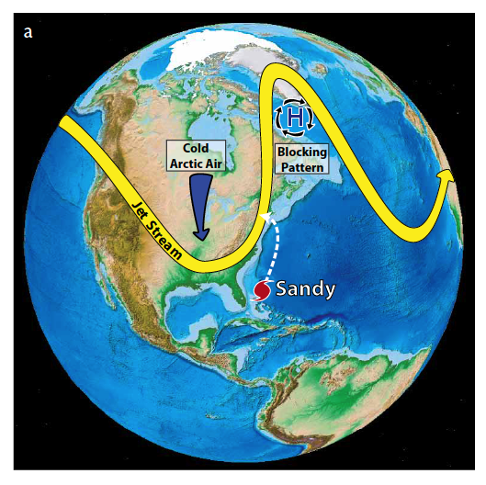
A unique recipe for disaster
Ingredients
Sandy
Wavy jet stream
Blocking high
Deep trough
Greene, C.H., J.A. Francis, and B.C. Monger. 2013. Superstorm Sandy: A series of unfortunate events? Oceanography 26(1):8–9, http://dx.doi.org/10.5670/oceanog.2013.11.

Slide 6
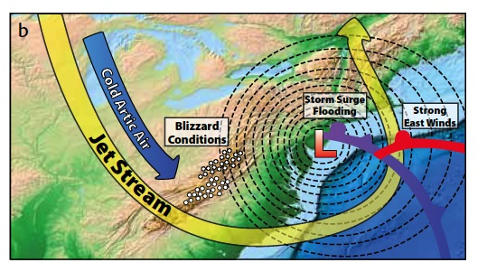
Additional ingredients……adding insult to injury
a. Warmer than average sea surface temperatures
b. Landfall close to high tide
c. Astronomical high tide
d. Higher sea level than 50-100 years ago
Greene, C.H., J.A. Francis, and B.C. Monger. 2013.

Slide 7
Sandy pummels New Jersey
Record low pressure: 946 mb (27.94”)
12.71” of rain at Stone Harbor
Peak gust of 90 mph at Seaside Heights
Record tidal surge at Sandy Hook 4.3 feet above previous record (14.4 feet above mean low low water)
Resulting in approximately 40 deaths, coastal devastation, tens of thousands of downed trees with associated damage, and unprecedented disruptions to power, transportation and communication networks

Slide 8
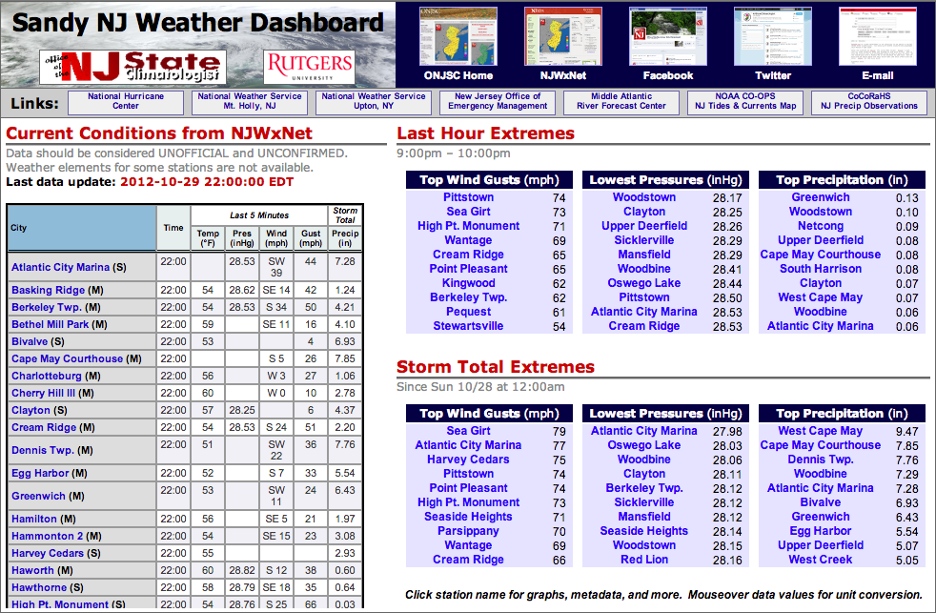
Monitoring Sandy
NJ Weather & Climate Network (including 5 minute updates from 50 stations)
  Special web dashboard: 30,000 unique visitors during storm
Over 200 Community Collaborative Rain, Hail and Snow Network storm obs.

Slide 9
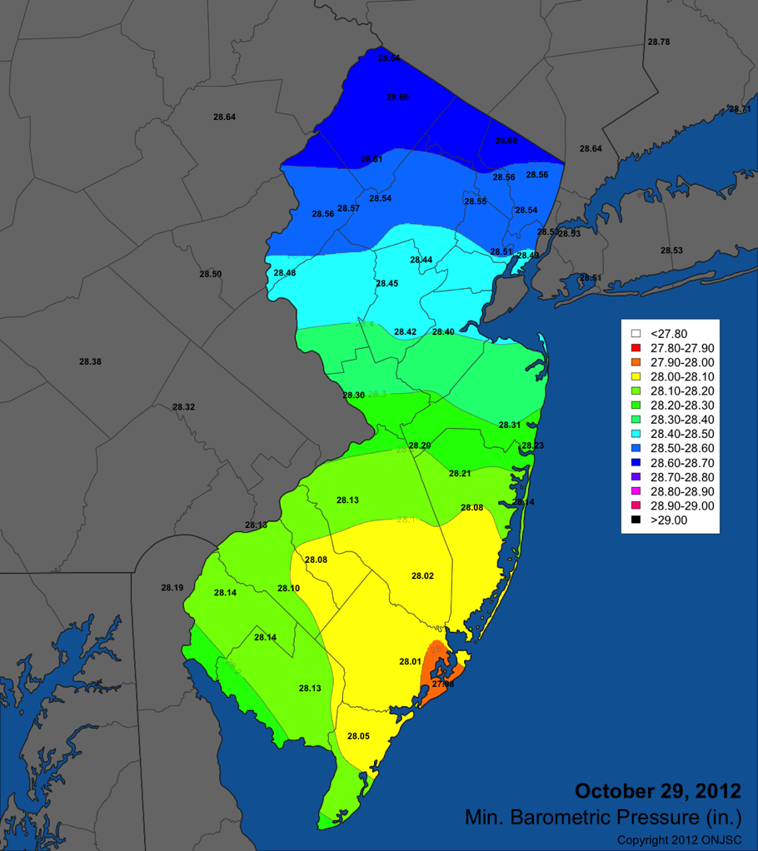
Sandy
Minimum
Pressure
Oct 29, 2012

Slide 10
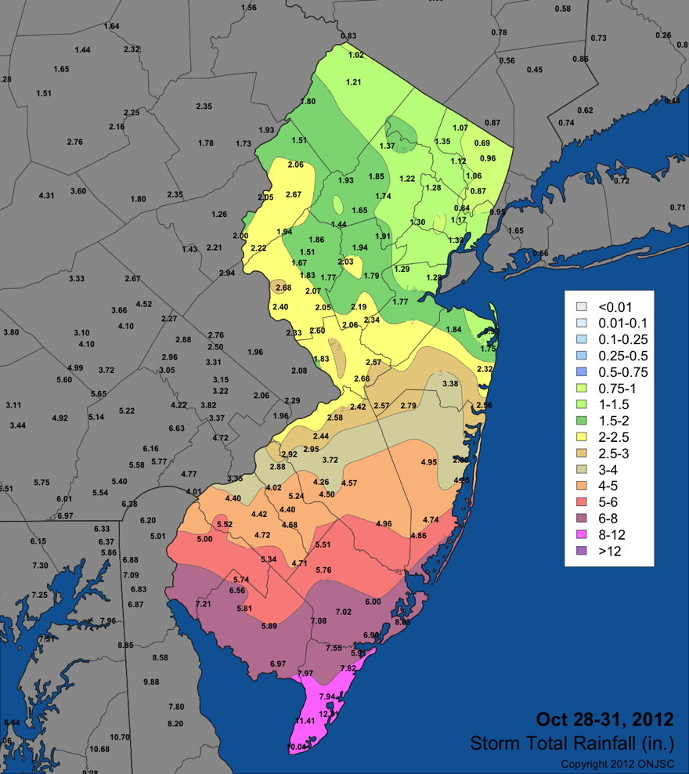
Sandy
Total
Precipitation
Oct 29-31, 2012

Slide 11
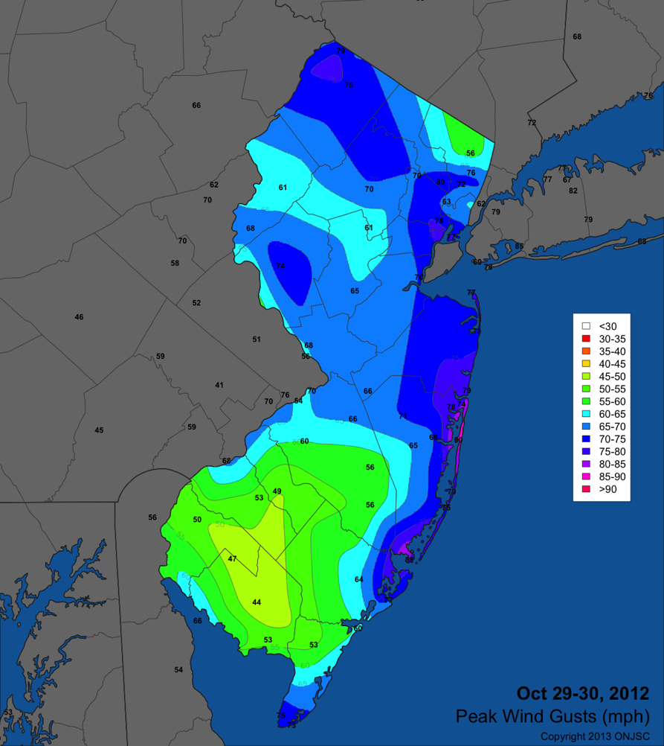
Sandy
Maximum
Wind Gusts
Oct 29-30, 2012

Slide 12
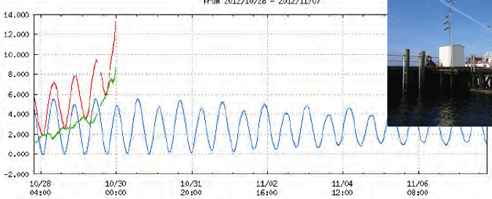
Sandy Hook, NJ
off line at 13.5 feet, estimated surge 14.4 feet

Slide 13
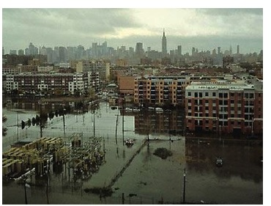
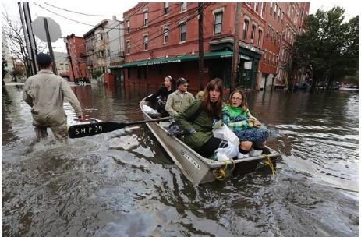
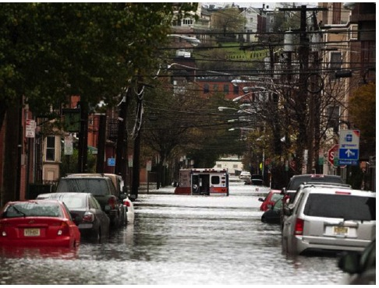
Hoboken

Slide 14
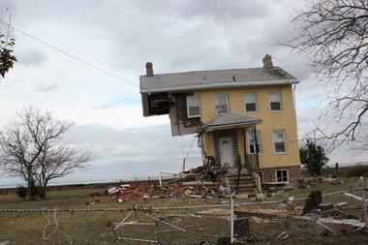
Union Beach
Notes:
14

Slide 15
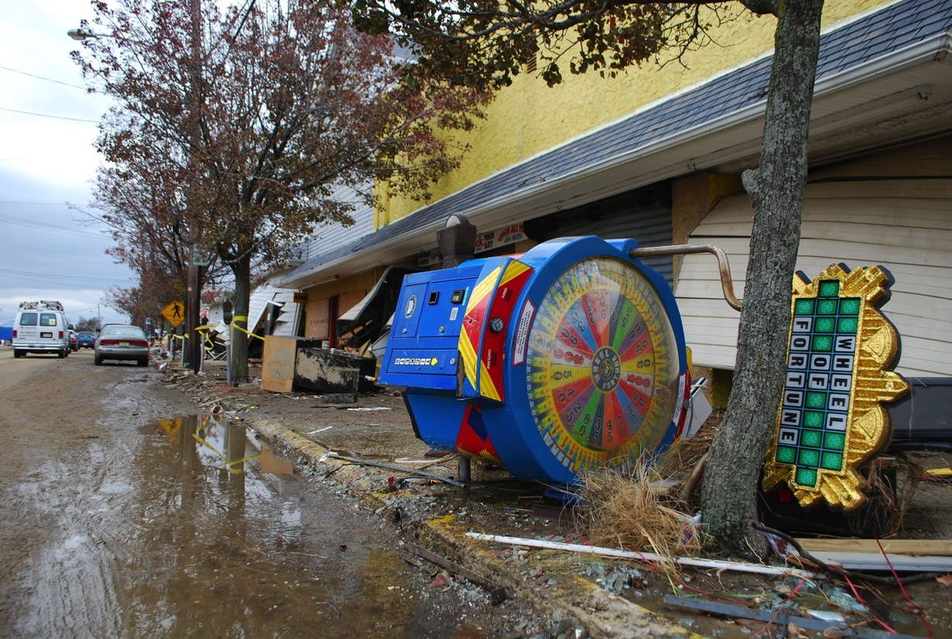
Keansburg
Sonia Szczesna

Slide 16
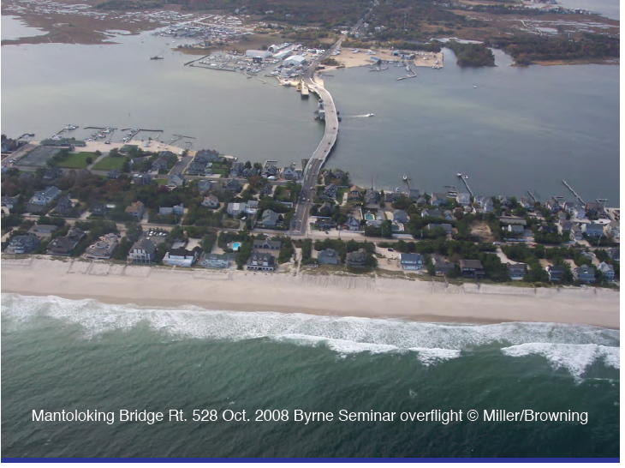

Slide 17
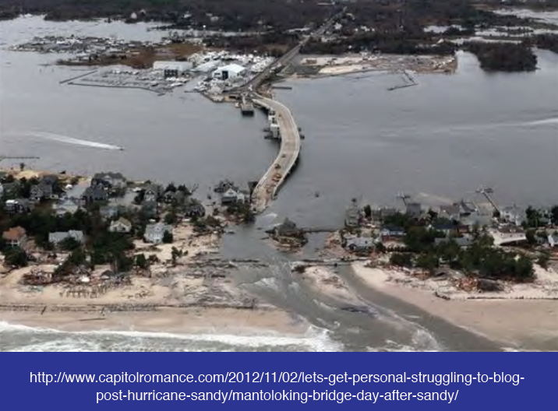

Slide 18
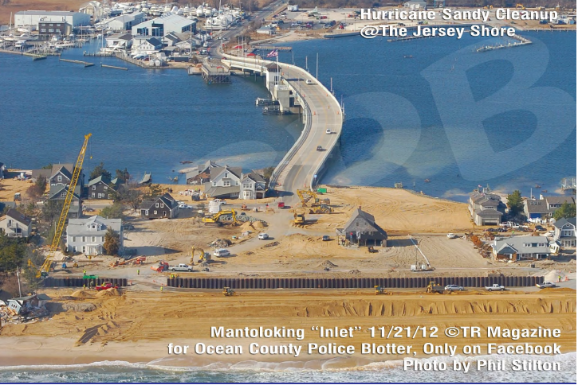

Slide 19
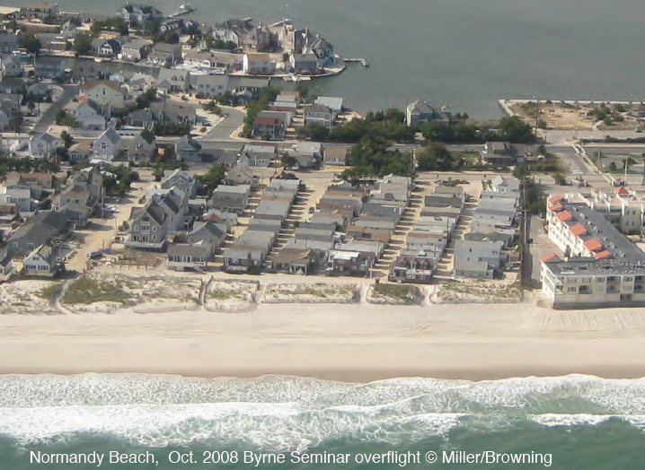

Slide 20
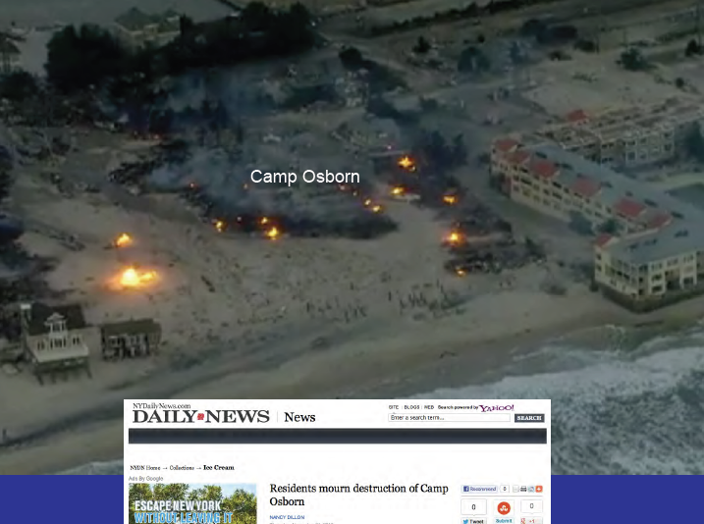

Slide 21
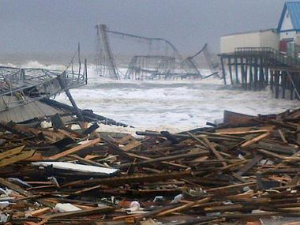
Seaside Heights

Slide 22
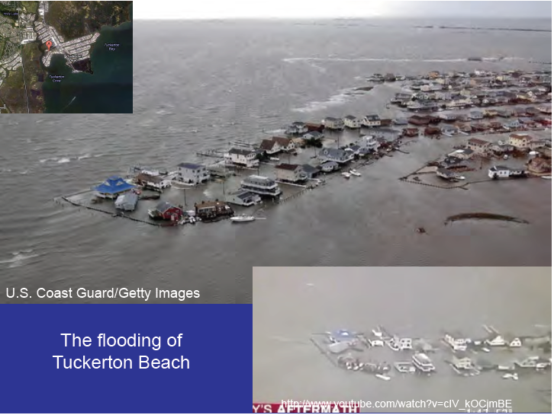

Slide 23
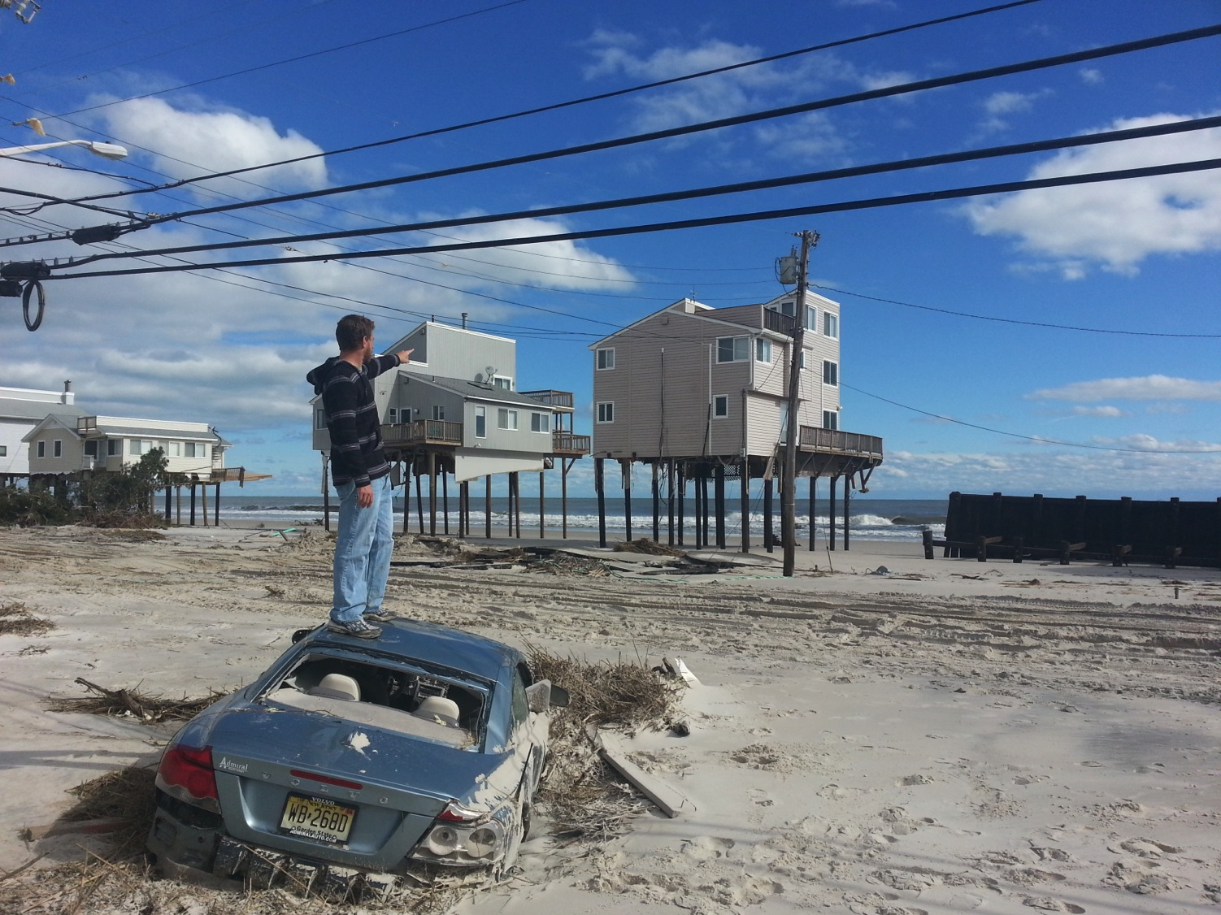
Holgate, LBI
Photo: Will Randall-Goodwin

Slide 24
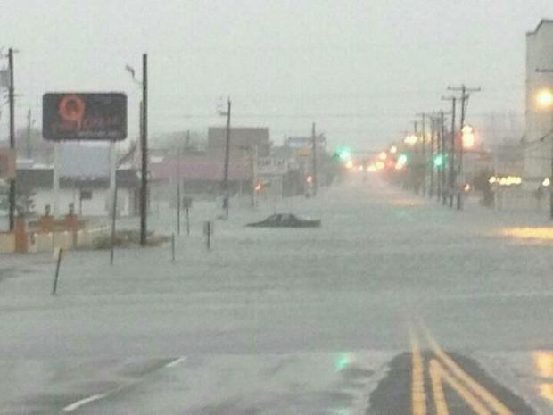
Wildwood

Slide 25
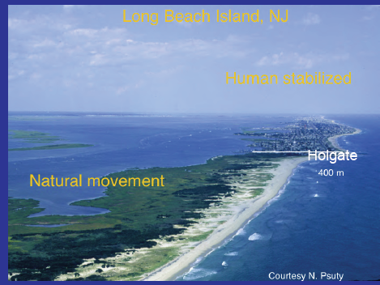
Looking north

Slide 26
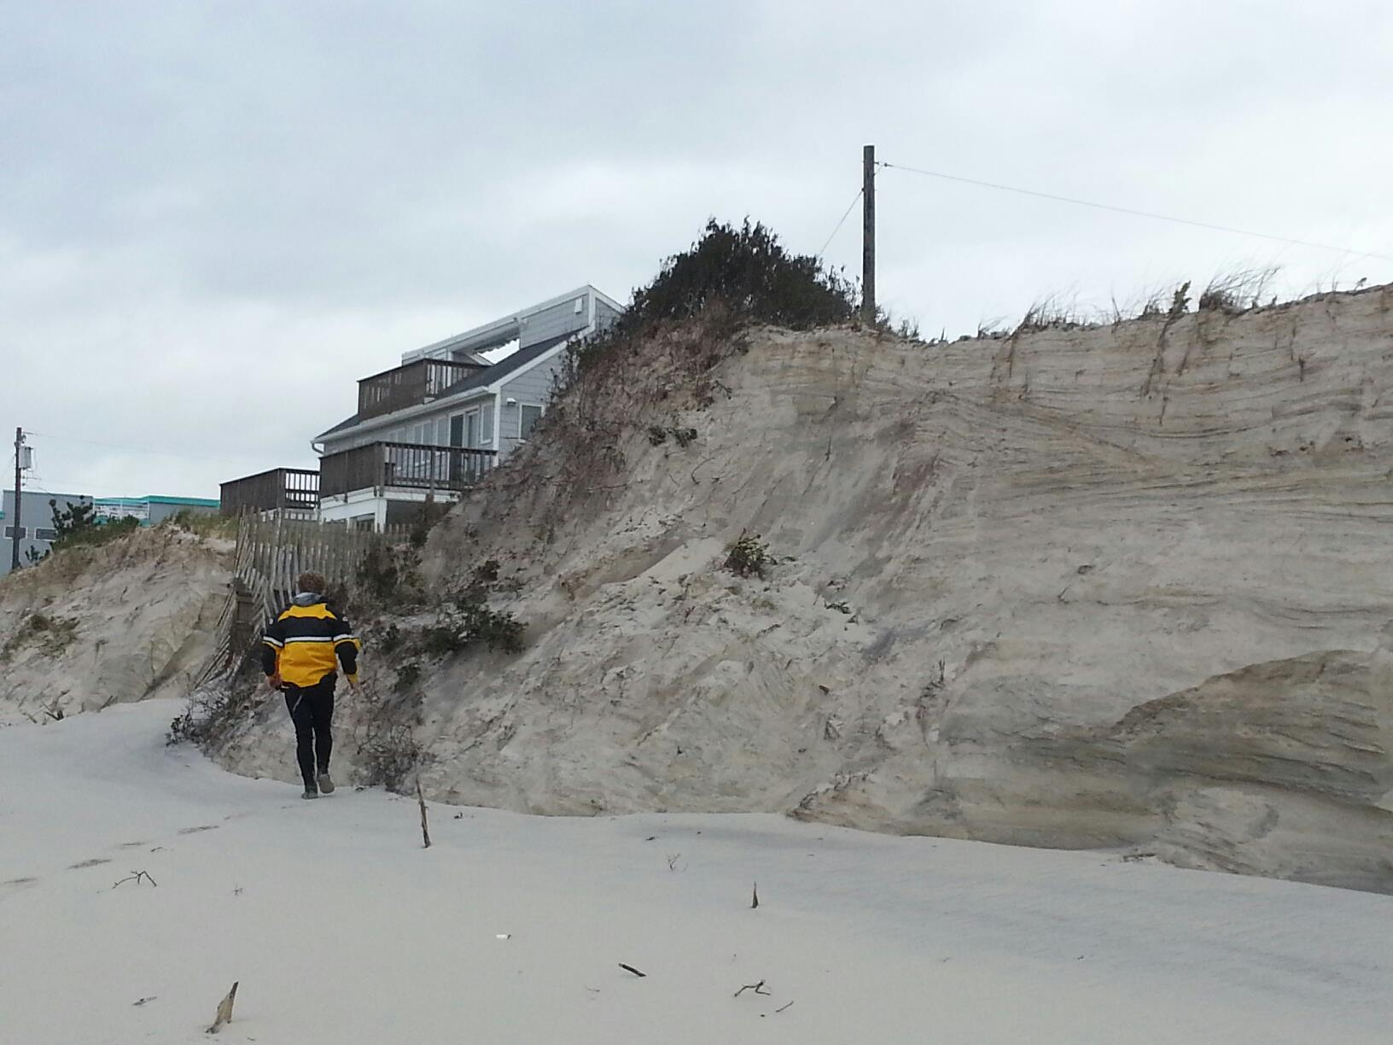
A location on LBI where the dune was established and survived

Slide 27
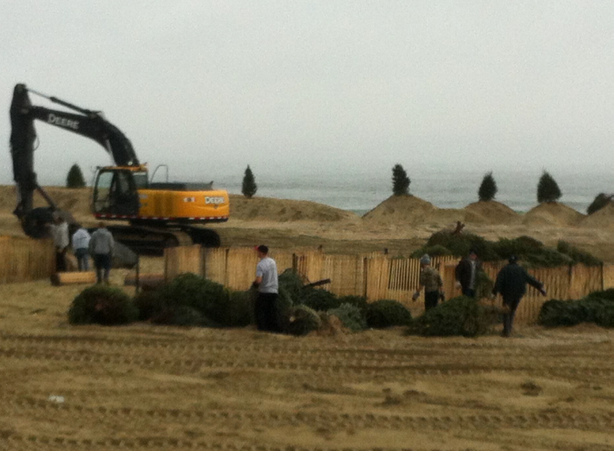
Bradley Beach: reestablishing the dune

Slide 28
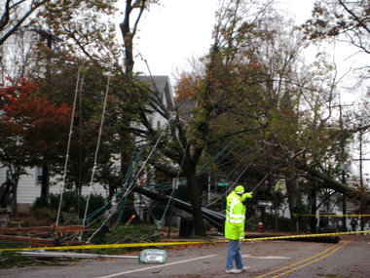
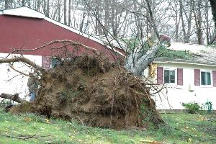
Hundreds of thousands of trees down……

Slide 29
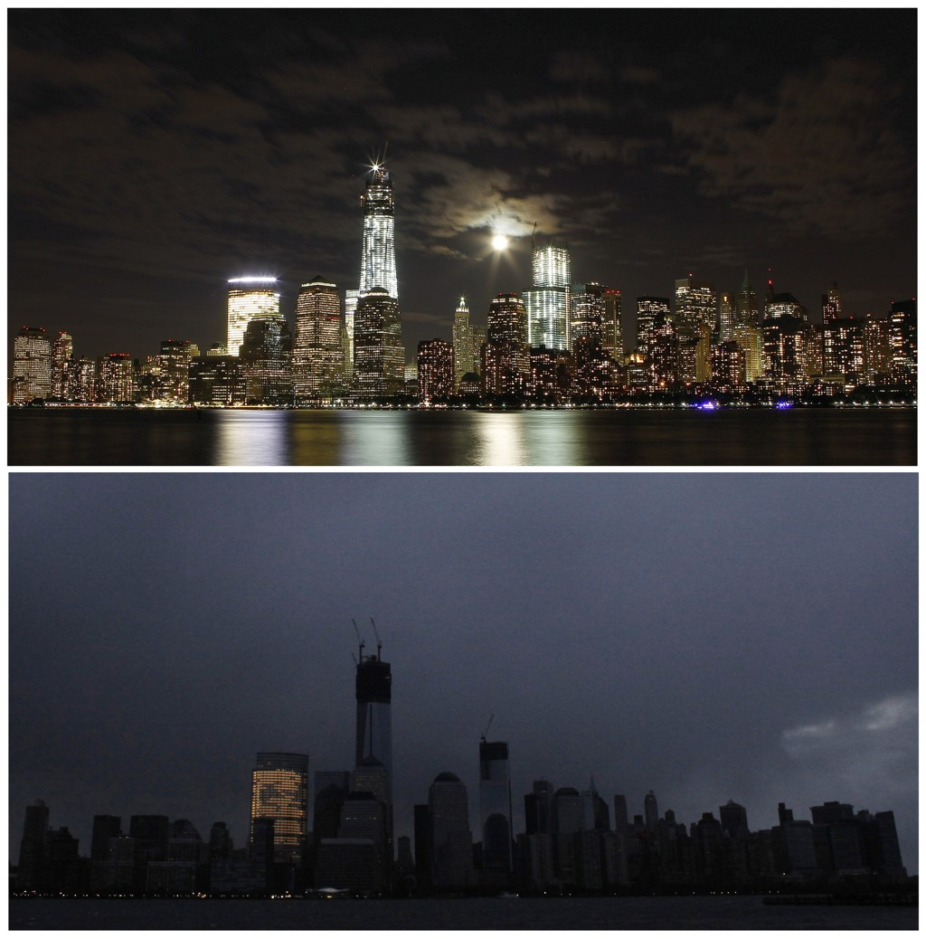

Slide 30
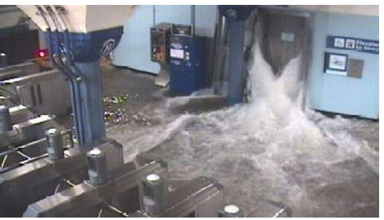
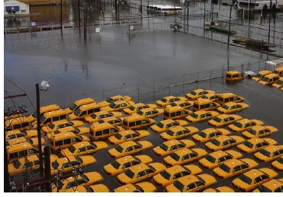
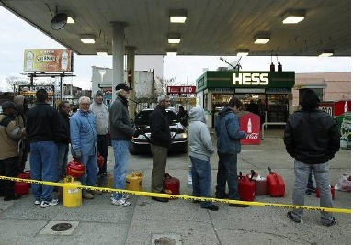
Impacts on transportation

Slide 31
How well was Sandy forecasted?

Slide 32
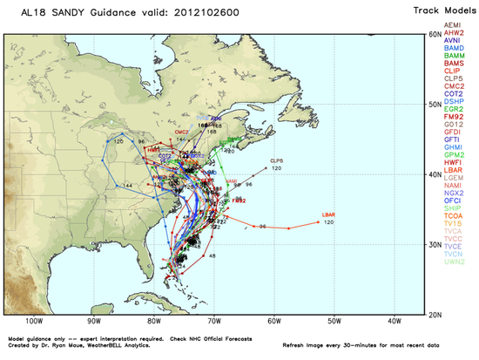
Forecast October 26: 00:00Z

Slide 33
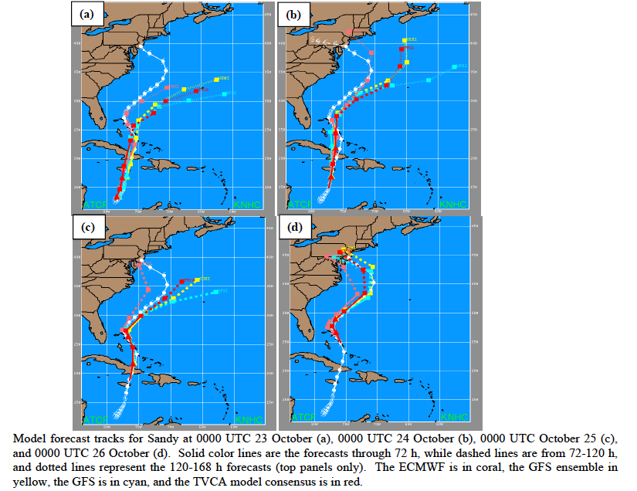
10/23
10/24
10/25
10/26

Slide 34
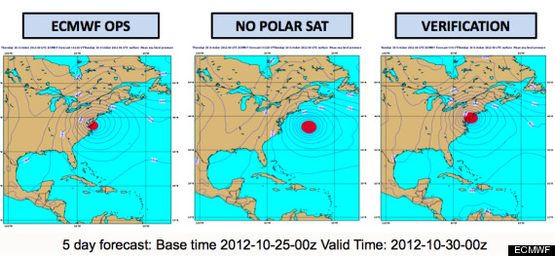

Slide 35

Future Sandys?

Slide 36
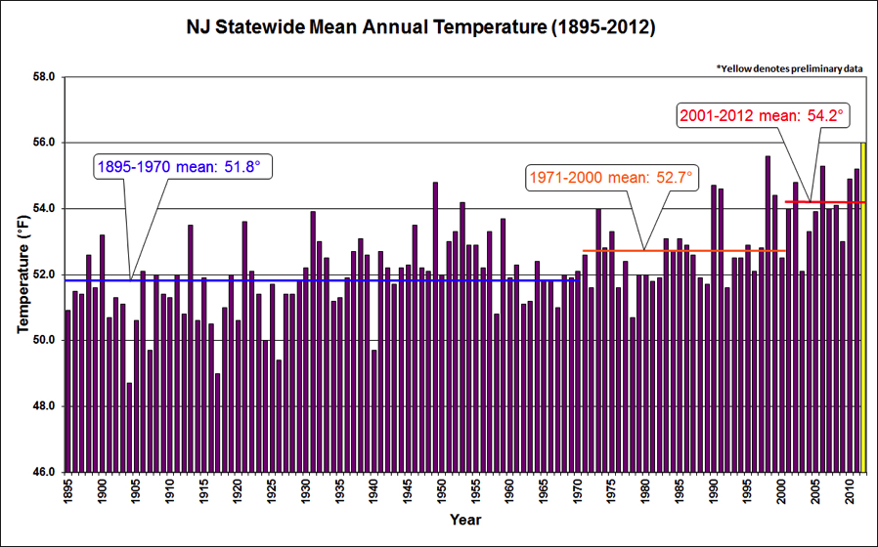
New Jersey's changing and future climate
Rising temperatures

Slide 37
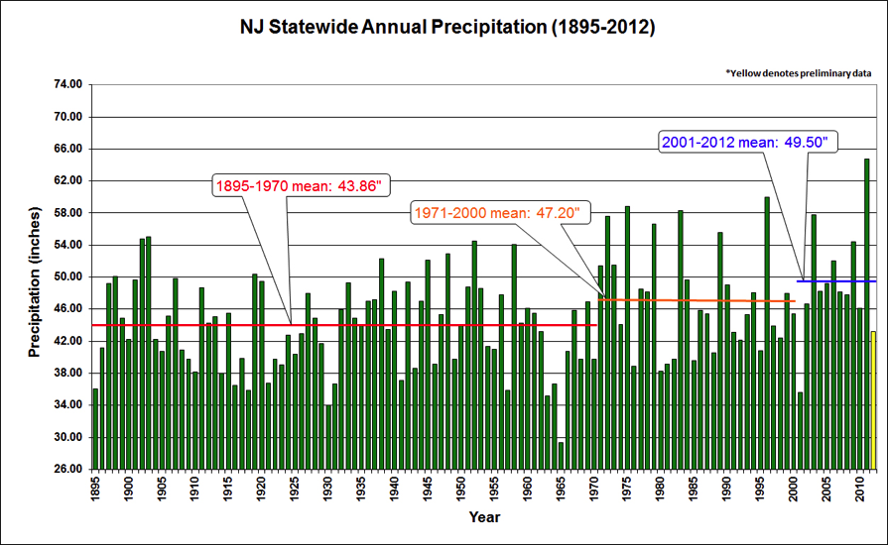
New Jersey's changing and future climate
Steady or increasing precipitation

Slide 38
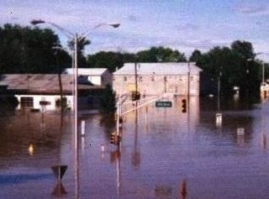
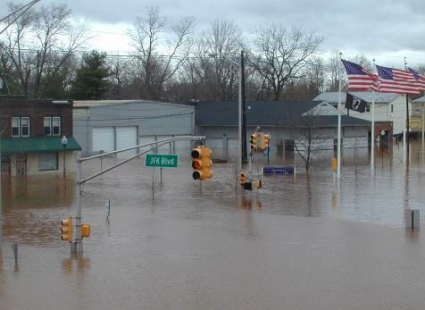
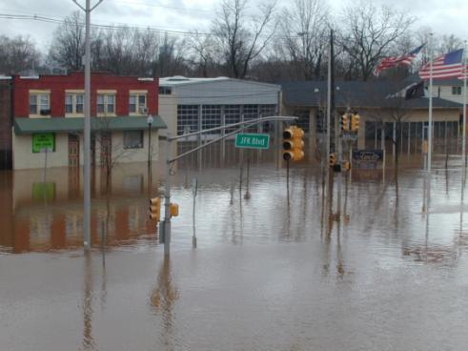
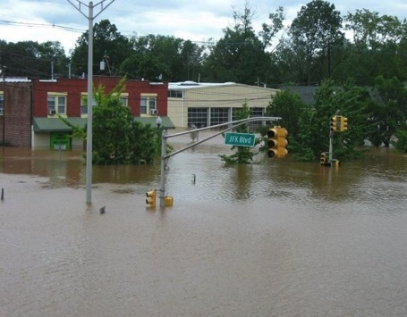
New Jersey's changing and future climate
Increasing variability and extremes
- storms, flood, drought, heat…….
September 17, 1999
April 16, 2007
Manville
March 14, 2010
August 28, 2011

Slide 39
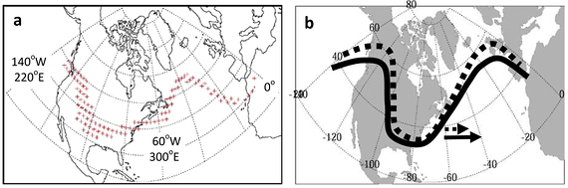
New Jersey's changing and future climate
Atmospheric circulation
  - influences from distant locations
Francis and Vavrus, 2012

Slide 40
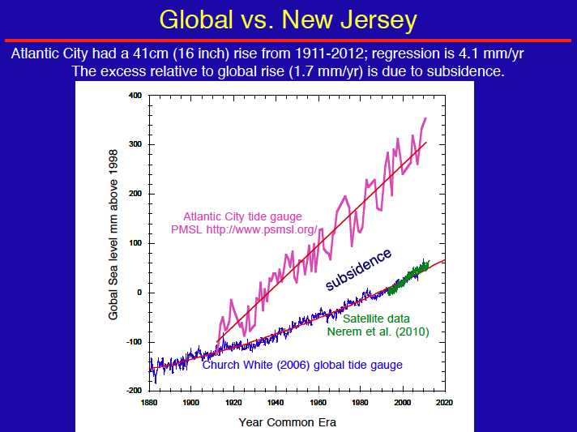
New Jersey's changing and future climate
Rising sea level
Courtesy of
Ken Miller

Slide 41
So…. future destructive coastal storms
are to be expected……
……..with the atmosphere and ocean
becoming primed for a greater frequency
of such events.

Slide 42

May 31, 2012 in North Middletown
http://www.flickr.com/photos/mjs242/
Thanks david.robinson@rutgers.edu
http://njclimate.org
Notes:
42

