Slide 1
Collaborative
Cross-Language Search
Douglas W. Oard
University of Maryland, College Park

Slide 2
Differential Skills
Domain knowledge
Search strategies
System capabilities
Language ability
  Active: ability to select query vocabulary
  Passive: ability to interpret, select, and learn from search results

Slide 3
“The” Language(s)
Language of the user interface
Language and character set(s) of the query
Language(s) and character set(s) of the search results (e.g., snippets)
Language(s) and character set(s) of the document
  Single language
  Mixed languages
Language(s) and modalities of collaborating searcher communication
Preferred vs. acceptable

Slide 4
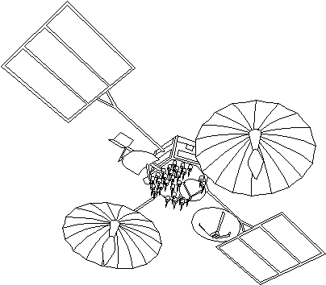
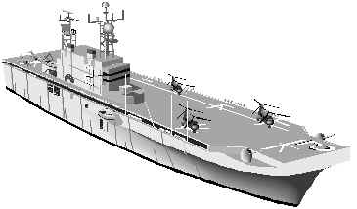

A Collaborative CLIR Scenario
Joint Task Force
Strong situational awareness
Few analysts
Interactive
CLIR System
Rear Support Facility
Many analysts
Robust processing capabilities
Few appropriate linguists

Slide 5



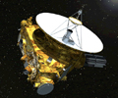
The most recent probe to visit Jupiter was the New Horizons.
Spanish speakers
La prueba más reciente para visitar Júpiter fue la New Horizons.
Machine Translation
1
Mark errors
English speakers
La prueba más reciente para visitar Júpiter fue la New Horizons.
The most recent probe to visit Jupiter was the New Horizons.
2
Correct translation
3
Select best translation
1
Explain phrase
La prueba más reciente para visitar Júpiter fue la New Horizons.
2
Correct back-translation
3
Select best back-translation
La sonda más reciente para visitar Júpiter fue la New Horizons.
repeat …
Translation Quality
Notes:
Prueba means “test”

Slide 6
Toward A Collaborative CLIR Research Agenda
Team structure
  Structured and unstructured
  Large and small
  Distributed and co-located
  Synchronous and asynchronous
Synchronized views in different languages
Translating side channel(s)
  Text, speech, gesture
Multi-community
  SIGIR, ACL, CSCW, CHI

