Slide 1


Collaborative Information Seeking Tasks as Complex Performance Assessment
Simon Knight
Dirk Tempelaar (& team), Matt Mitsui, Chirag Shah, Karen Littleton, Simon Buckingham Shum, Bart Rienties, Fridolin Wild
http://sjgknight.com
@sjgknight

Slide 2

Targets:
Rouet [39] – students should be taught:
Skill of integration: ability to connect: prior and new; competing; and intrer-document information
Skill of sourcing: ability to identify source characteristics
Skill of corroboration: ability to check information against multiple sources
Goldman and Scardamalia [17, p.260]:
Communication – particularly meta-discourse involving exploratory discussion of credentials, sources, etc. – is key to collectively authored written outputs
Notes:
the searching, selecting, and processing of complex documents and multi-media on the web can be seen as a component of literacy (OECD, 2013) and be related to the ways in which students source, corroborate, and integrate claims – key facets of literacy for mature internet use (Rouet, 2006, p. 177). There is thus a growing interest in the learning sciences around how students find information, and how they treat the information that they do find (Barzilai & Zohar, 2009, 2012; Bråten & Samuelstuen, 2007; Bråten & Strømsø, 2006; Chiu, Liang, & Tsai, 2013; Ferguson, Bråten, Strømsø, & Anmarkrud, 2013; Hofer, 2004; C.-Y. Hsu, Tsai, Hou, & Tsai, 2013; L. Hsu, 2014; Lin & Tsai, 2008; Singh, Hsu, & Moon, 2013; Tsai, Hsu, & Tsai, 2012).

Slide 3
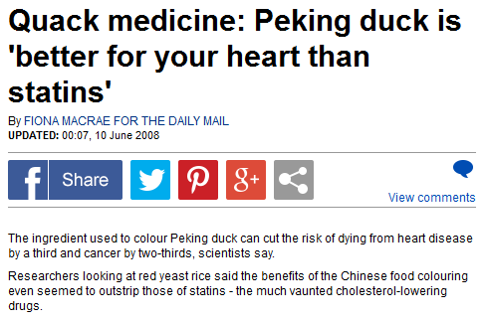

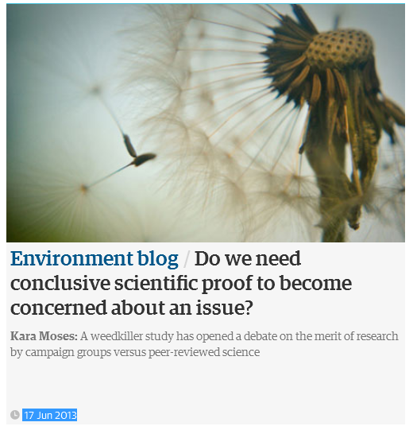
Tasks
Two collaborative tasks facilitated by a browser addon
One group provided with documents; the second group searches on the web
“A review of the best supported claims around the risks” of a substance (herbicide or food supplement)
Notes:
Participants given 2 texts of varying quality are more likely to favor high quality sources,
BUT they make little reference to source features (on average only 1.85 out of 10 features);
and rarely (<6% of the 154 participants) explicitly use source information for justifying their evaluation of the text’s explanation
Kobayashi [26](2014)
http://www.dailymail.co.uk/health/article-1025277/Quack-medicine-Peking-duck-better-heart-statins.html
http://www.theguardian.com/science/controversiesinscience
http://www.theguardian.com/environment/blog/2013/jun/17/wait-conclusive-science-concerned-issue
http://www.nhs.uk/news/2008/06June/Pages/Redyeastriceandheartdisease.aspx

Slide 4
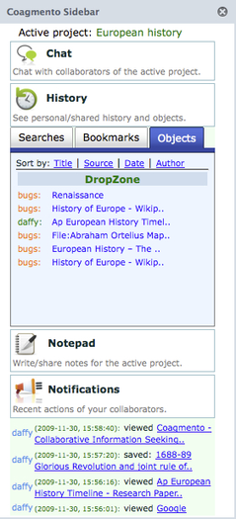


Coagmento Tool
Chat
Foreground searches
Share ‘snippets’
Etherpad – output assessed
Tracks pageviews & copy (/ctrl+c)
Study ‘flow’ website integration – surveys; tasks; assessment
Notes:
https://addons.mozilla.org/ga-ie/firefox/addon/coagmento/

