Slide 1
Collaborative crosschecking
Patients teaching patients how to evaluate health information online

Slide 2
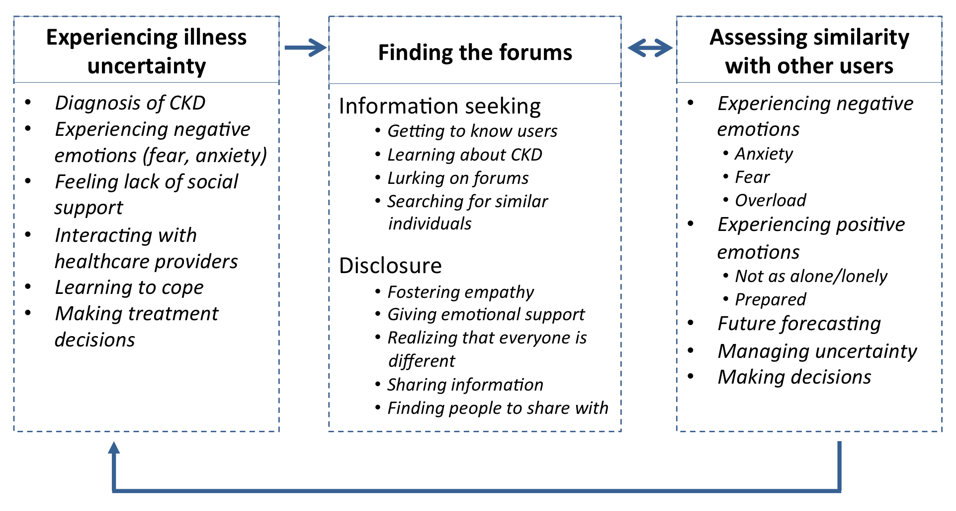
Social information behaviors

Slide 3
Contact:
kaitcost@email.unc.edu
k8lin.com
@k8lin

