Slide 1
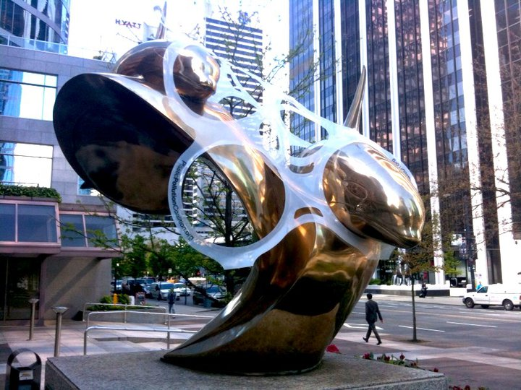
Viral Sagar
Image Source: Plastic Pollution Coalition
Guerrilla stunt at downtown Vancouver on the corner of Georgia and Thurlow st., British Columbia, Canada.
Viral Sagar
(viral.sagar@rutgers.edu)
Graduate Student
Dept of Chemical & Biochemical Engineering
Rutgers, The State University of New Jersey

Slide 2
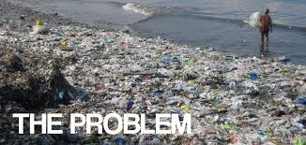
WASTES TO FUEL
Two major problems faced today are shortage of fuel and waste disposal , big disadvantage of modernization.
Waste treatment - incineration, gasification and torrefaction. This paper discusses about the polycrack method
Efficient method of waste disposal, generates fuel, thus solving to an extent the global energy crisis.
Keywords: polycrack method, waste, fuel, waste disposal, waste recycle
Abstract

Slide 3
Introduction
Waste disposal – universal problem which leads to soil degradation.
Shortage of fuel – spikes/lows
Three conventional methods of waste treatment are INCINERATION, TORREFACTION and GASIFICATION
The major advantage of the polycrack method, developed by Sustainable Technology and Environmental Projects Pvt. Ltd. (STEPS), it is a complete recycle process, it is clean and added advantage is the generation of fuel.
Classification of wastes: Mix plastics, Petroleum sludge, Rubber tyres, Organic wastes

Slide 4
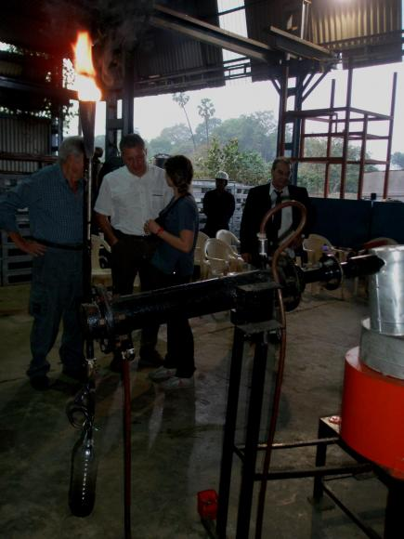

Slide 5
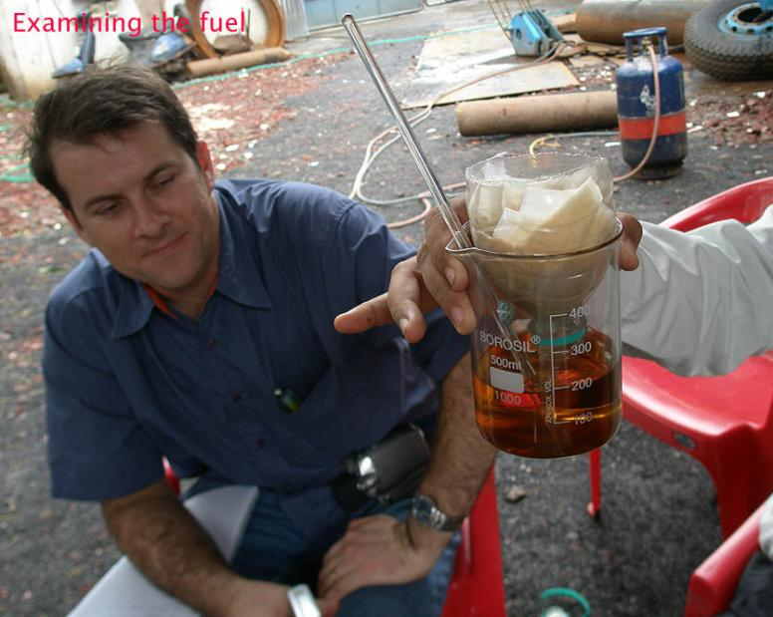
Next Steps
How many reactors do we need for global cities?
Can we make the process continuous?
“There is no panacea for Climate Change.”

