Slide 1

A Simple, Greedy Approximation Algorithm for MAX SAT
David P. Williamson
Joint work with Matthias Poloczek (Frankfurt, Cornell) and Anke van Zuylen (William & Mary)

Slide 2
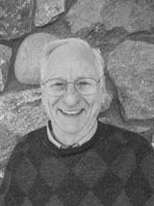

Greedy algorithms
“Greed, for lack of a better word, is good. Greed is right. Greed works.” – Gordon Gekko, Wall Street
“Greedy algorithms work.” – Alan Hoffman, IBM

Slide 3
Another reason
When I interviewed at Watson, half of my talk was about maximum satisfiability, the other half about the max cut SDP result.
I thought, “Oh no, I have to talk about
  Hardness of approximation in front of Madhu Sudan,
  Randomized rounding in front of Prabhakar Raghavan,
  And eigenvalue bounds in front of Alan Hoffman.”
Today I revisit the first part of that talk.

Slide 4
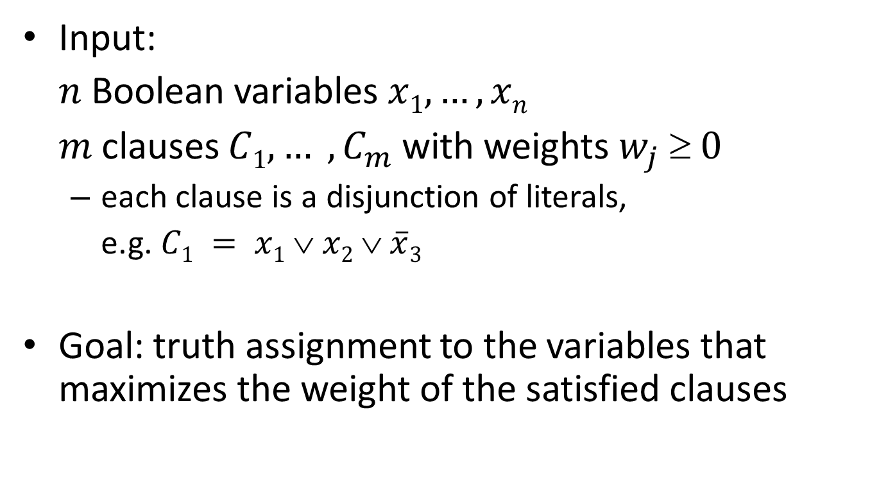
Maximum Satisfiability
Input:
$n$ Boolean variables $x1, …, xn$
$m$ clauses $C1, … , C_{m}$with weights $w_{j}  0$
  each clause is a disjunction of literals,
  e.g. $C1 = x1 ∨ x2 ∨ \overline{x}3$
Goal: truth assignment to the variables that maximizes the weight of the satisfied clauses

Slide 5
Approximation Algorithms
An α-approximation algorithm runs in polynomial time and returns a solution of at least α times the optimal.
For a randomized algorithm, we ask that the expected value is at least α times the optimal.

Slide 6
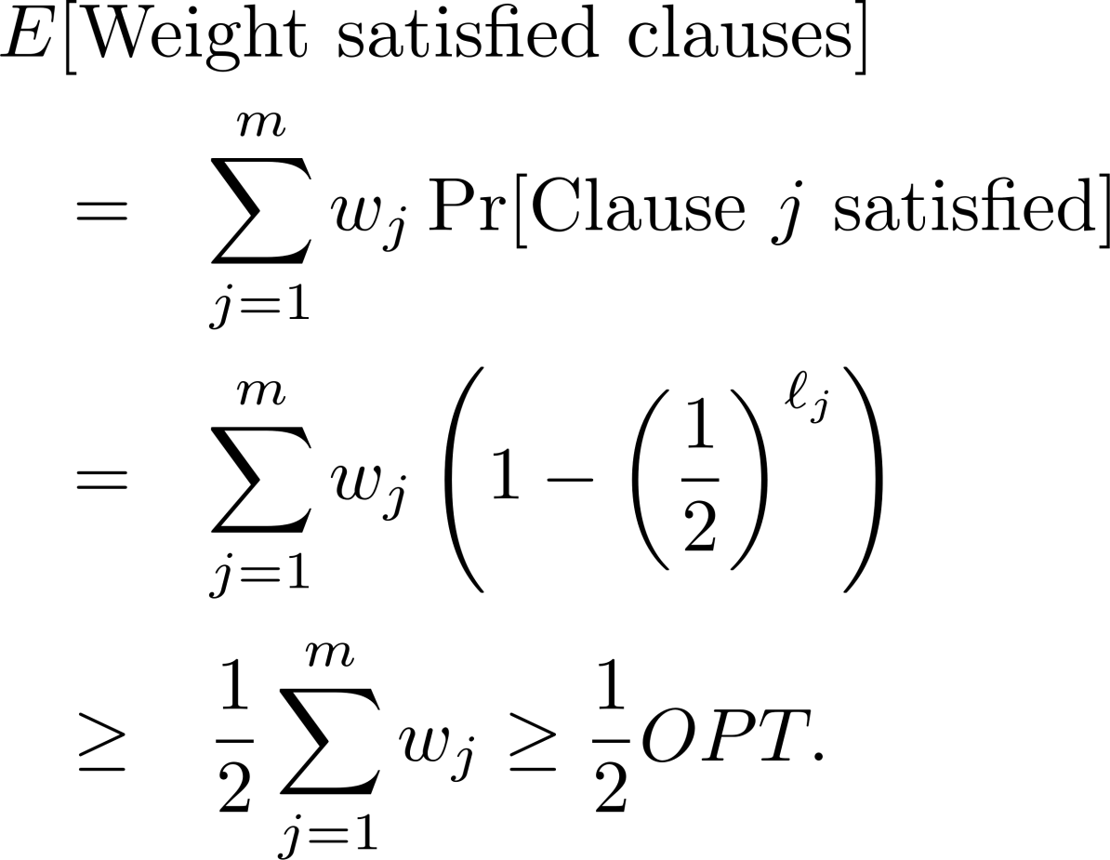

A ½-approximation algorithm
Set each $x_{i}$ to true with probability ½.
Then if $l_{j}$ is the number of literals in clause $j$

Slide 7
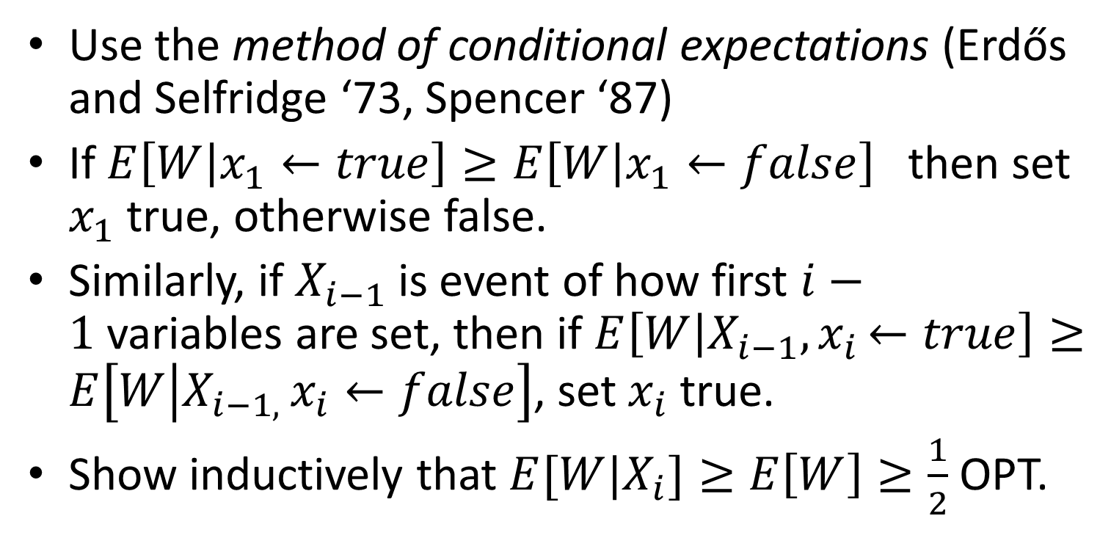
What about a deterministic algorithm?
Use the method of conditional expectations (Erdős and Selfridge ‘73, Spencer ‘87)
If $E\left[W | x_{1}←true\right]≥E\left[W | x_{1}←false\right]$ then set $x_{1}$ true, otherwise false.
Similarly, if $X_{i−1}$ is event of how first $i−1$variables are set, then if $E\left[W | X_{i−1}{,x}_{i}←true\right]≥E\left[W | {X_{i−1, }x}_{i}←false\right]$, set $x_{i}$ true.
Show inductively that $E[W|X_{i}]≥E\left[W\right]≥\frac{1}{2}$ OPT.

Slide 8
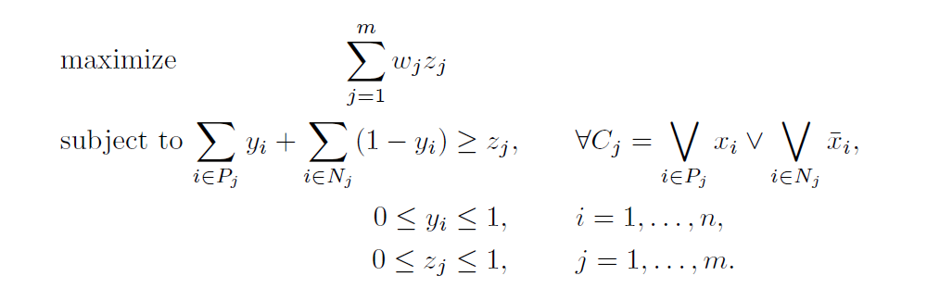
An LP relaxation

Slide 9
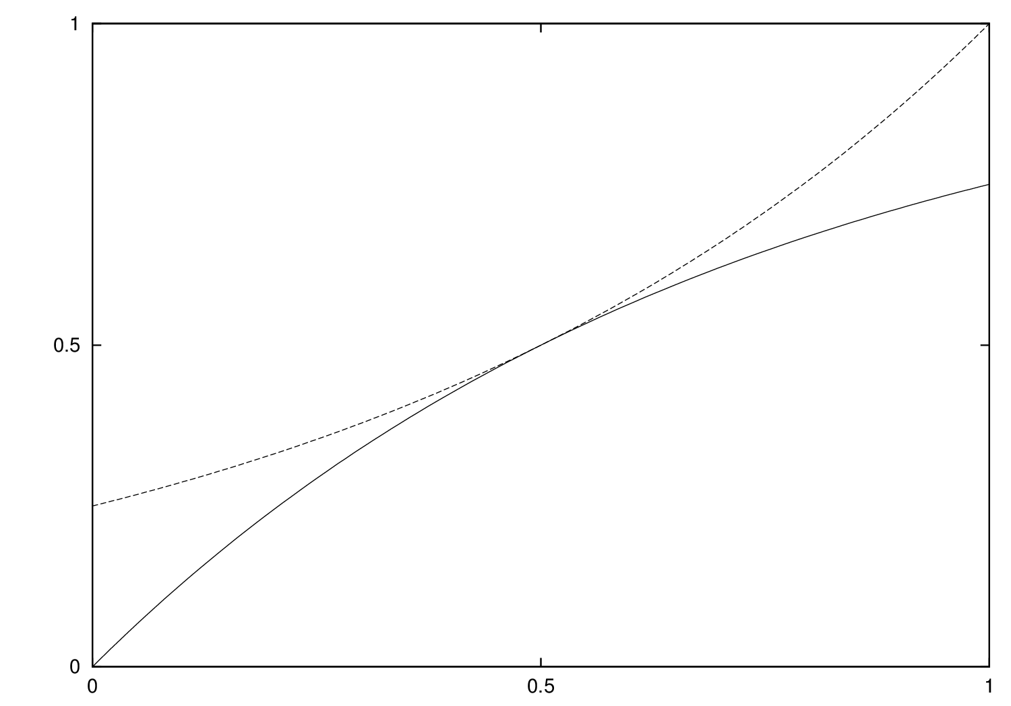
Randomized rounding
Pick any function $f$such that $1−4^{−x}≤f\left(x\right)≤4^{x−1}$. Set $x_{i}$ true with probability $f(y_{i}^{∗})$, where $y^{∗}$ is an optimal LP solution.

Slide 10
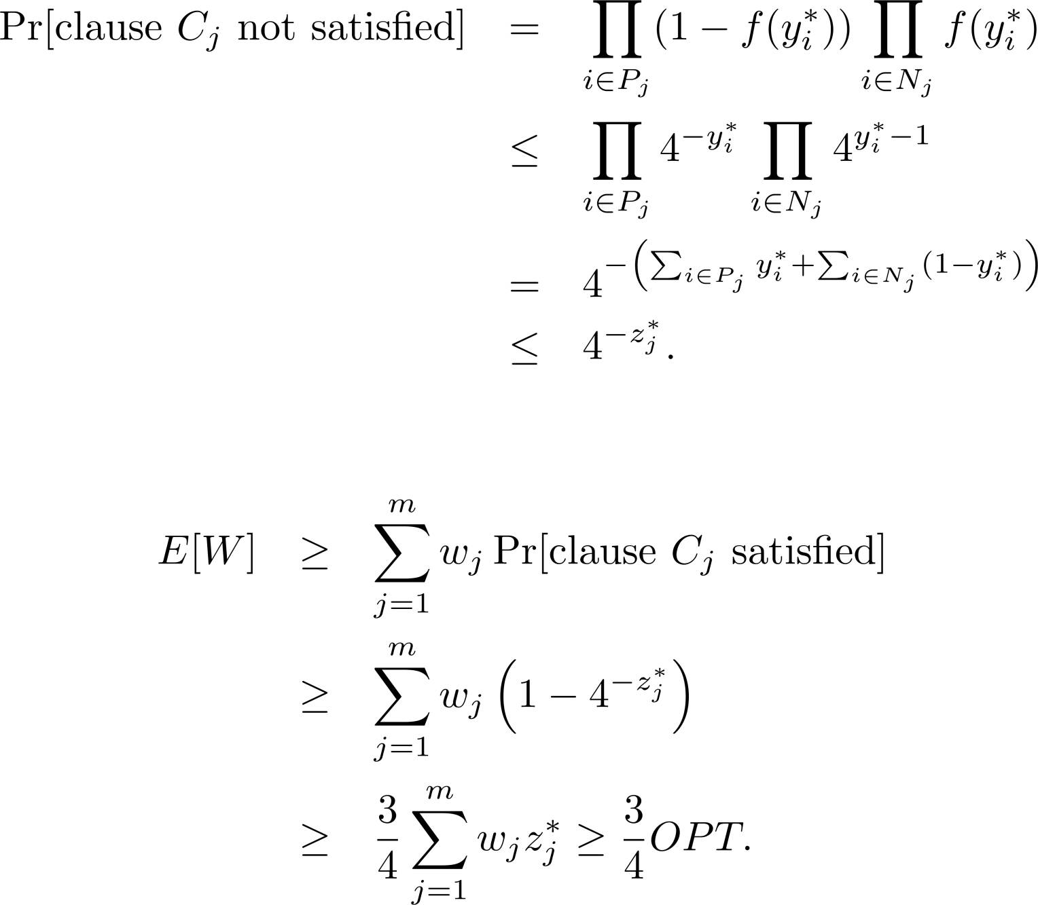
Analysis

Slide 11
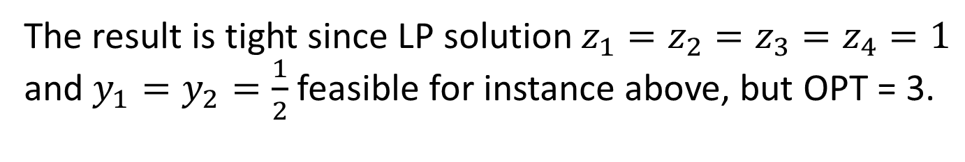
Integrality gap
The result is tight since LP solution $z_{1}=z_{2}=z_{3}=z_{4}=1$ and $y_{1}=y_{2}=\frac{1}{2}$ feasible for instance above, but OPT = 3.

Slide 12
Current status
NP-hard to approximate better than 0.875 (Håstad ’01)
Combinatorial approximation algorithms
  Johnson’s algorithm (1974): Simple ½-approximation algorithm (Greedy version of the randomized algorithm)
  Improved analysis of Johnson’s algorithm: ²/₃-approx. guarantee [Chen-Friesen-Zheng ’99, Engebretsen ’04]
  Randomizing variable order improves guarantee slightly [Costello-Shapira-Tetali ’11]
Algorithms using Linear or Semidefinite Programming
  Yannakakis ’94, Goemans-W ’94:
  ¾-approximation algorithms
  Best guarantee 0.7969 [Avidor-Berkovitch-Zwick ’05]
Question [W ’98]: Is it possible to obtain a 3/4-approximation algorithm without solving a linear program?

Slide 13
(Selected) recent results
Poloczek-Schnitger ’11:
  “randomized Johnson” – combinatorial ¾-approximation algorithm
Van Zuylen ’11:
  Simplification of “randomized Johnson” probabilities and analysis
  Derandomization using Linear Programming
Buchbinder, Feldman, Naor, and Schwartz ’12:
  Another ¾-approximation algorithm for MAX SAT as a special case of submodular function maximization
  We show MAX SAT alg is equivalent to van Zuylen ‘11.

Slide 14
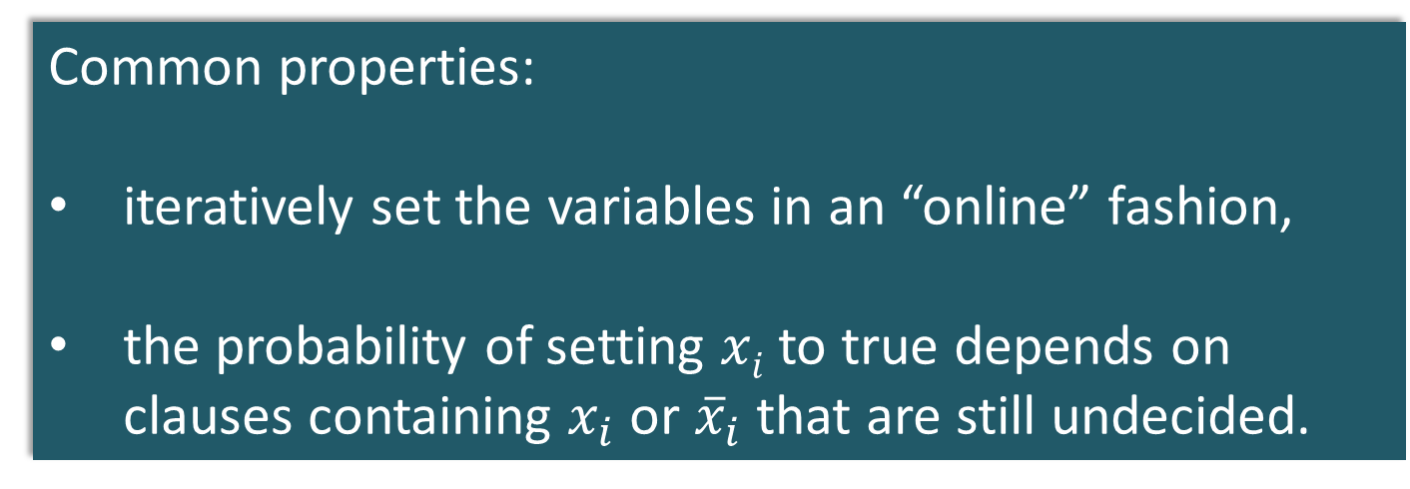
(Selected) recent results
Poloczek-Schnitger’11
Van Zuylen ’11
Buchbinder, Feldman, Naor and Schwartz ’12
Common properties:
iteratively set the variables in an “online” fashion,
the probability of setting $xi$ to true depends on clauses containing $x_{i}$ or ${\overline{x}}_{i}$ that are still undecided.

Slide 15
Today
Give “textbook” version of Buchbinder et al.’s algorithm with an even simpler analysis

Slide 16
Buchbinder et al.’s approach
Keep two bounds on the solution
  Lower bound LB = weight of clauses already satisfied
  Upper bound UB = weight of clauses not yet unsatisfied
Greedy can focus on two things:
  maximize LB,
  maximize UB,
but either choice has bad examples…
Key idea: make choices to increase B = ½ (LB+UB)
Notes:
Bad example for maximizing LB:
C1=x1, C2 = not(x1) or x2. If w(C1)=w(C2)-epsilon, we satisfy only C2.
Bad example for maximizing UB:
C1=x1, c2= not(x1) of x2, C3=not(x2). w(C1)=epsilon, w(C2)=w(C3)=1. Opt is 2, greedy is 1+eps

Slide 17
LB₀
(= 0)
B₀= ½(LB₀+UB₀)
UB₀
(=∑w_{j})

Slide 18


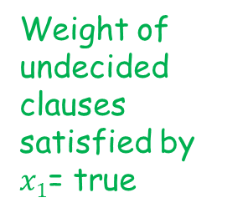
Weight of undecided clauses satisfied by $x1$= true
Weight of undecided clauses unsatisfied by $x1$= true
LB₀
LB₁
B₀= ½(LB₀+UB₀)
UB₁
UB₀
Set $x1$ to true

Slide 19
Weight of undecided clauses satisfied by $x1$= true
Weight of undecided clauses unsatisfied by $x1$= true
B₁
LB₀
LB₁
B₀
UB₁
UB₀
Set $x1$ to true

Slide 20
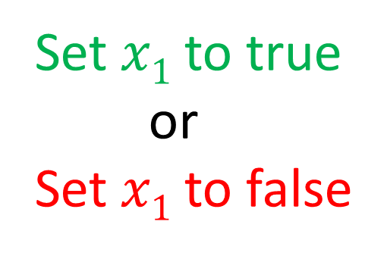
Weight of undecided clauses satisfied by $x1$= true
Weight of undecided clauses unsatisfied by $x1$= true
B₁
LB₀
LB₁
LB₁
B₀
UB₁
UB₁
UB₀
Set $x1$ to true
or
Set $x1$ to false

Slide 21
Weight of undecided clauses satisfied by $x1$= true
Weight of undecided clauses unsatisfied by $x1$= true
B₁
B₁
LB₀
LB₁
LB₁
B₀
UB₁
UB₁
UB₀
Set $x1$ to true
or
Set $x1$ to false
Guaranteed that
(B₁-B₀)+(B₁-B₀) ≥ 0
t₁
f₁

Slide 22

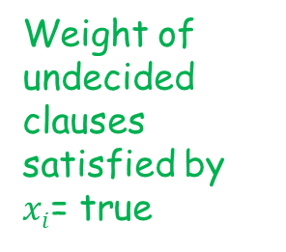
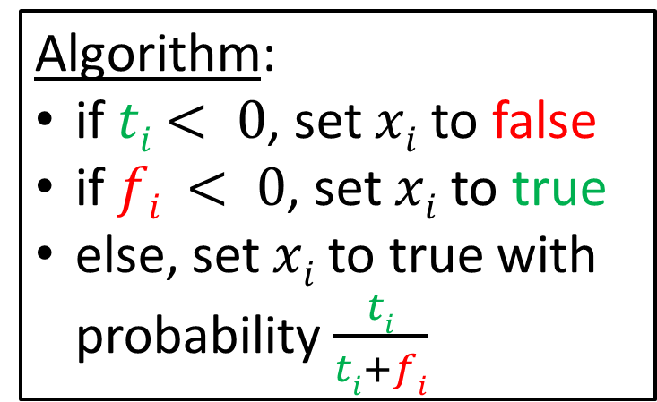
Remark: This is the algorithm proposed independently by BFNS’12 and vZ’11
Weight of undecided clauses satisfied by $xi$= true
Weight of undecided clauses unsatisfied by $xi$ = true
B_{i}
B_{i}
UB_{i}
LB_{i-1}
LB_{i}
LB_{i}
B_{i-1}
UB_{i}
UB_{i-1}
Algorithm:
if $ti$ $< 0$, set $xi$ to false
if $fi < 0$, set $xi$ to true
else, set $xi$to true with probability $\frac{ti}{ti+fi}$
(B_{i}-B_{i-1})+(B_{i}-B_{i-1}) ≥ 0
t_{i}
f_{i}

Slide 23
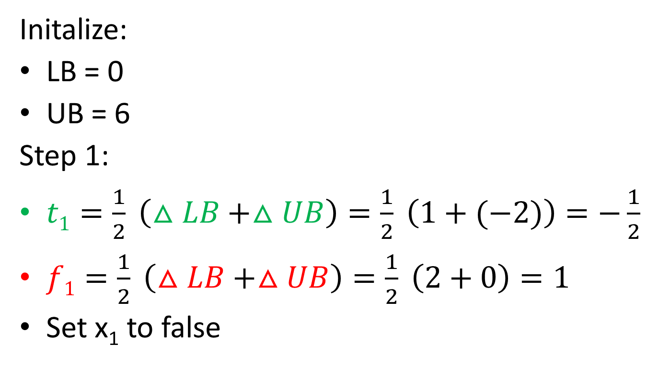
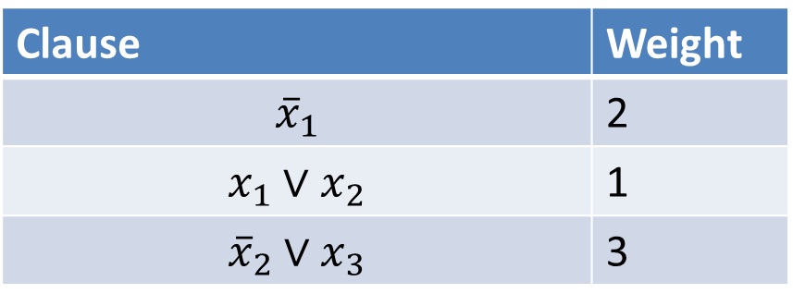
Example
Clause | Weight
$${\overline{x}}_{1}$$ | 2
$$x_{1}∨x_{2}$$ | 1
$${\overline{x}}_{2}∨x_{3}$$ | 3
Initalize:
LB = 0
UB = 6
Step 1:
$t1=\frac{1}{2} \left(△LB+△UB\right)=\frac{1}{2} \left(1+(−2)\right)=−\frac{1}{2}$
$f1=\frac{1}{2} \left(△LB+△UB\right)=\frac{1}{2} \left(2+0\right)=1$
Set x₁ to false

Slide 24
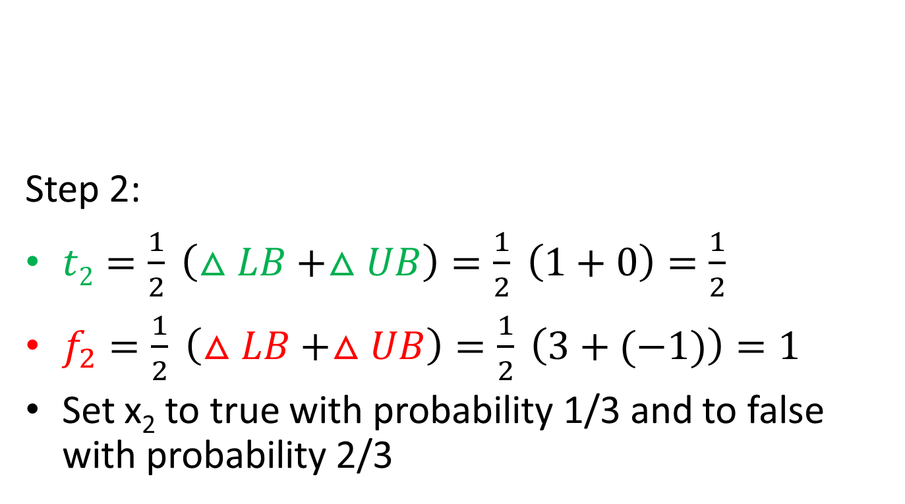
Example
Clause | Weight
$${\overline{x}}_{1}$$ | 2
$$x_{1}∨x_{2}$$ | 1
$${\overline{x}}_{2}∨x_{3}$$ | 3
Step 2:
$t2=\frac{1}{2} \left(△LB+△UB\right)=\frac{1}{2} \left(1+0\right)=\frac{1}{2}$
$f_{2}=\frac{1}{2} \left(△LB+△UB\right)=\frac{1}{2} \left(3+(−1)\right)=1$
Set x₂ to true with probability 1/3 and to false with probability 2/3

Slide 25
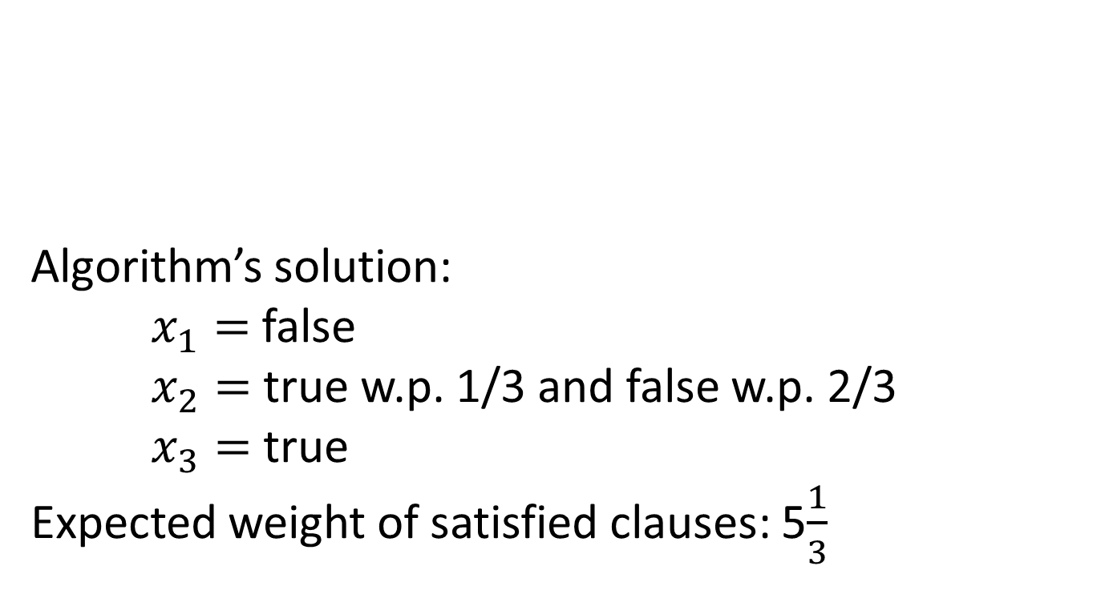
Example
Clause | Weight
$${\overline{x}}_{1}$$ | 2
$$x_{1}∨x_{2}$$ | 1
$${\overline{x}}_{2}∨x_{3}$$ | 3
Algorithm’s solution:
$x_{1}=$ false
$x_{2}=$ true w.p. 1/3 and false w.p. 2/3
$x_{3}=$ true
Expected weight of satisfied clauses: 5$\frac{1}{3}$

Slide 26
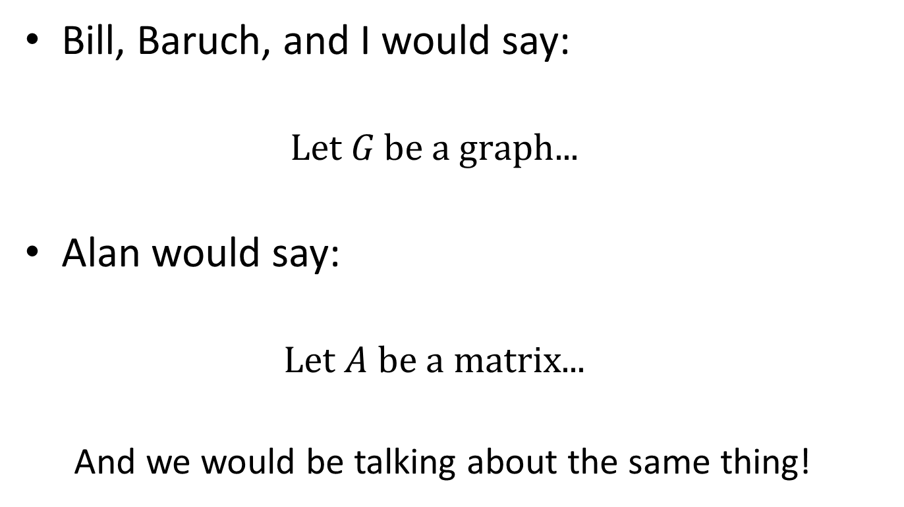
Different Languages
Bill, Baruch, and I would say:
  $$\text{Let} G \text{be} \text{a} \text{graph}\text{...}$$
Alan would say:
  $$\text{Let} A \text{be} \text{a} \text{matrix}\text{...}$$
  And we would be talking about the same thing!

Slide 27
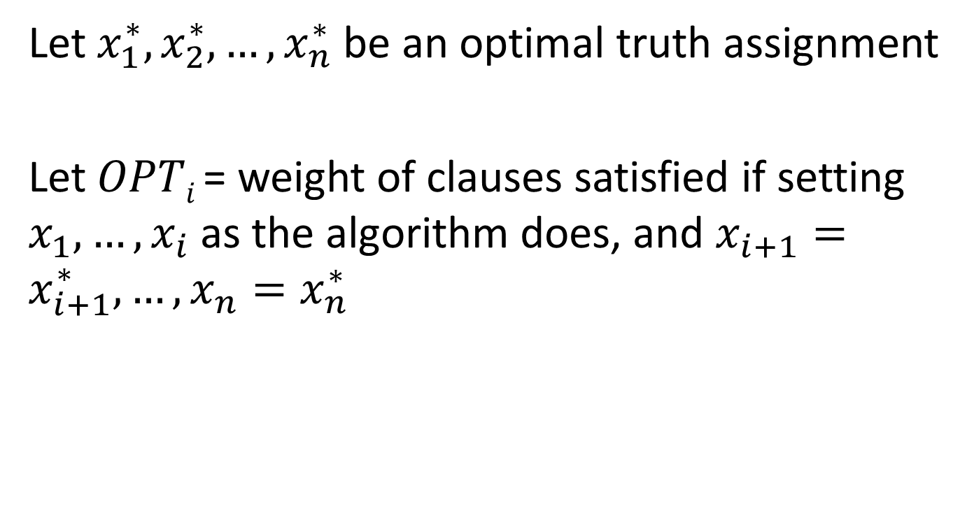

Relating Algorithm to Optimum
Let $x_{1}^{∗}, x_{2}^{∗},…, x_{n}^{∗}$ be an optimal truth assignment
Let $OPTi$ = weight of clauses satisfied if setting $x_{1},…, x_{i}$as the algorithm does, and $x_{i+1}=x_{i+1}^{∗}, …, x_{n}=x_{n}^{∗}$
Key Lemma:
$$E\left[B_{i}−B_{i−1} \right]≥E[OPT_{i−1}−OPT_{i}]$$

Slide 28

OPT
Let $x_{1}^{∗}, x_{2}^{∗},…, x_{n}^{∗}$ an optimal truth assignment
Let $OPTi$ = weight of clauses satisfied if setting $x_{1},…, x_{n}$as the algorithm does, and $x_{i+1}=x_{i+1}^{∗}, …, x_{n}=x_{n}^{∗}$
Key Lemma:
$$E\left[B_{i}−B_{i−1} \right]≥E[OPT_{i−1}−OPT_{i}]$$
LB₀
B₀
B₁
OPT₁
UB₀

Slide 29
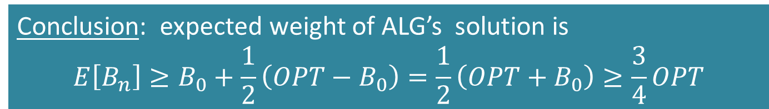
OPT_{n} = B_{n} = weight of ALG’s solution
OPT
Let an optimal truth assignment
Let = weight of clauses satisfied if setting as the algorithm does, and
Key Lemma:
LB₀
B₀
B₁
OPT₁
UB₀
B₀ ≥ ½ OPT
≥ ½ (OPT-B₀)
Conclusion: expected weight of ALG’s solution is
$$E\left[B_{n}\right]≥B_{0}+\frac{1}{2}\left(OPT−B_{0}\right)=\frac{1}{2}\left(OPT+B_{0}\right)≥\frac{3}{4}OPT$$

Slide 30
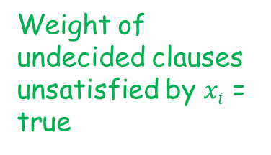
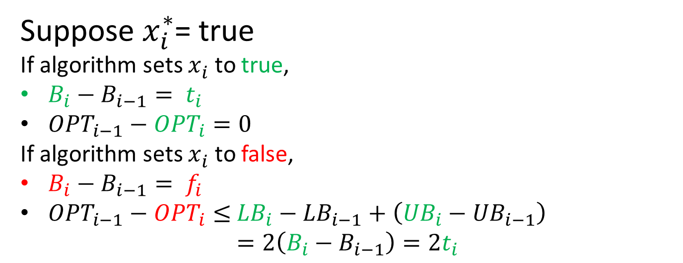
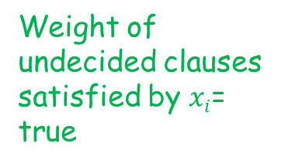
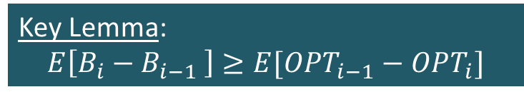
Relating Algorithm to Optimum
Weight of undecided clauses satisfied by $xi$= true
Weight of undecided clauses unsatisfied by $xi$ = true
B_{i}
B_{i}
UB_{i}
LB_{i-1}
LB_{i}
LB_{i}
B_{i-1}
UB_{i}
UB_{i-1}
Suppose $x_{i}^{∗}$= true
If algorithm sets $x_{i}^{}$ to true,
$B_{i}−B_{i−1}= t_{i}$
${OPT}_{i−1}−{OPT}_{i}=0$
If algorithm sets $x_{i}^{}$ to false,
$B_{i}−B_{i−1}= f_{i}$
${OPT}_{i−1}−{OPT}_{i}≤$ ${LB}_{i}−{LB}_{i−1}+\left({UB}_{i}−{UB}_{i−1}\right)$
$$=2\left(B_{i}−B_{i−1}\right)=2t_{i}$$
Want to show:
Key Lemma:
$$E\left[B_{i}−B_{i−1} \right]≥E[OPT_{i−1}−OPT_{i}]$$

Slide 31
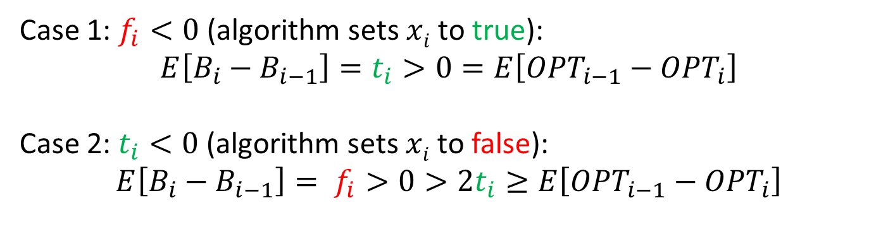

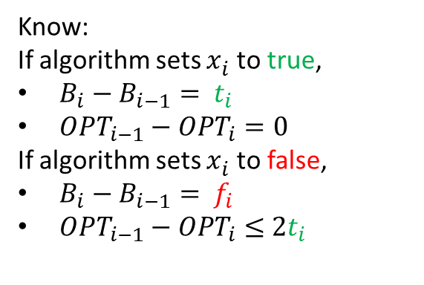
Relating Algorithm to Optimum
Want to show:
Know:
If algorithm sets $x_{i}^{}$ to true,
$B_{i}−B_{i−1}= t_{i}$
${OPT}_{i−1}−{OPT}_{i}=0$
If algorithm sets $x_{i}^{}$ to false,
$B_{i}−B_{i−1}= f_{i}$
${OPT}_{i−1}−{OPT}_{i}≤$ $2t_{i}$
Key Lemma:
$$E\left[B_{i}−B_{i−1} \right]≥E[OPT_{i−1}−OPT_{i}]$$
Case 1: $f_{i}<0$ (algorithm sets $xi$ to true):
$$E\left[B_{i}−B_{i−1}\right]=t_{i}>0=E\left[{OPT}_{i−1}−{OPT}_{i}\right]$$
Case 2: $t_{i}<0$ (algorithm sets $xi$ to false):
$$E\left[B_{i}−B_{i−1}\right]= f_{i}>0>2t_{i}≥E\left[{OPT}_{i−1}−{OPT}_{i}\right]$$

Slide 32

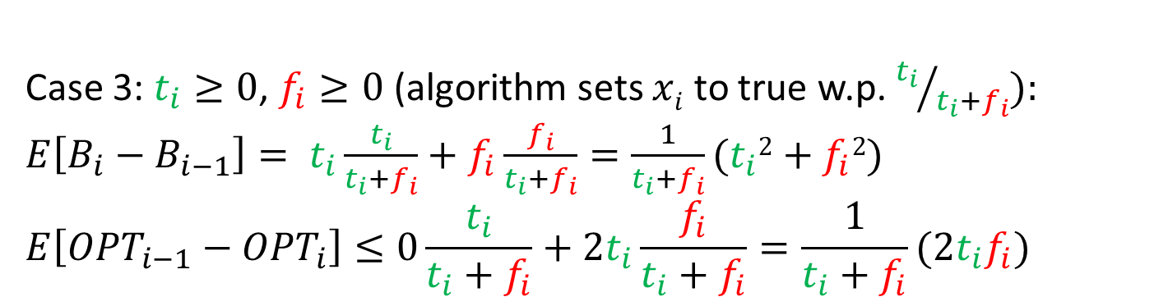
Relating Algorithm to Optimum
Want to show:
Know:
If algorithm sets $x_{i}^{}$ to true,
$B_{i}−B_{i−1}= t_{i}$
${OPT}_{i−1}−{OPT}_{i}=0$
If algorithm sets $x_{i}^{}$ to false,
$B_{i}−B_{i−1}= f_{i}$
${OPT}_{i−1}−{OPT}_{i}≤$ $2t_{i}$
Key Lemma:
$$E\left[B_{i}−B_{i−1} \right]≥E[OPT_{i−1}−OPT_{i}]$$
Equal to
$(t_{i}−f_{i}$)²+2$t_{i}f_{i}$
Case 3: $t_{i}≥0$, $f_{i}≥0$ (algorithm sets $xi$ to true w.p. ${t_{i}}/{t_{i}+f_{i}}):$
$E\left[B_{i}−B_{i−1}\right]= t_{i}\frac{t_{i}}{t_{i}+f_{i}}+f_{i}\frac{f_{i}}{t_{i}+f_{i}}=\frac{1}{t_{i}+f_{i}}(t_{i}2+f_{i}2$)
$$E\left[{OPT}_{i−1}−{OPT}_{i}\right]≤0\frac{t_{i}}{t_{i}+f_{i}}+2t_{i}\frac{f_{i}}{t_{i}+f_{i}}=\frac{1}{t_{i}+f_{i}}(2t_{i}f_{i}\text{)}$$

Slide 33
Email
Hi David,
After seeing your email, the very next thing I did this morning was to read a paper I'd earmarked from the end of the day yesterday:
Walter Gander, Gene H. Golub, Urs von Matt
"A constrained eigenvalue problem"
Linear Algebra and its Applications, vol. 114–115, March–April 1989, Pages 815–839.
"Special Issue Dedicated to Alan J. Hoffman On The Occasion Of His 65th Birthday"
The table of contents of that special issue:
http://www.sciencedirect.com.proxy.library.cornell.edu/science/journal/00243795/114/supp/C
Citations for papers in this issue:
…..
Johan Ugander
Notes:
Volume has 47 papers, 870 pages, 1595 cites

Slide 34
Question
Is there a simple combinatorial deterministic ¾-approximation algorithm?

Slide 35
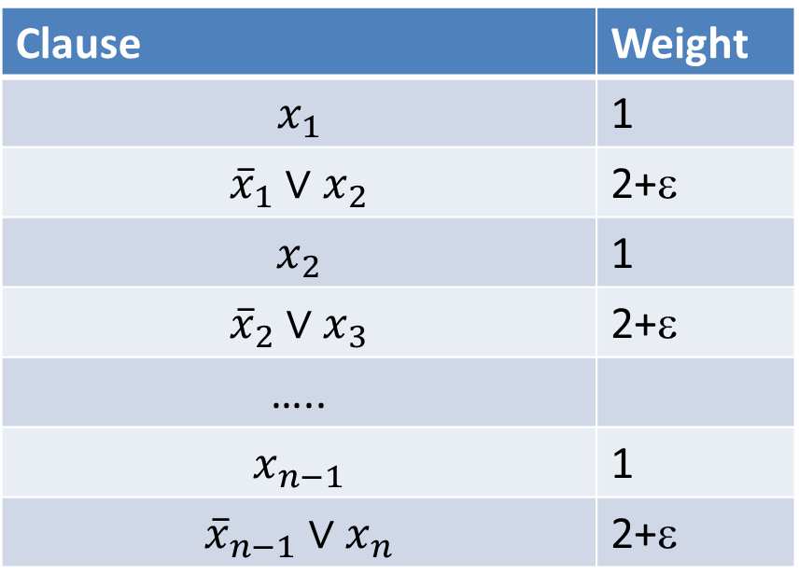
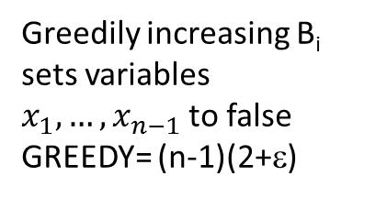
Deterministic variant??
Greedily maximizing B_{i} is not good enough:
Clause | Weight
$$x_{1}$$ | 1
$${\overline{x}}_{1}∨x_{2}$$ | 2+ε
$$x_{2}$$ | 1
$${\overline{x}}_{2}∨x_{3}$$ | 2+ε
…..
$$x_{n−1}$$ | 1
$${\overline{x}}_{n−1}∨x_{n}$$ | 2+ε
Optimal assignment sets all variables to true
OPT = (n-1)(3+ε)
Greedily increasing B_{i} sets variables $x_{1},…,x_{n−1}$to false
GREEDY= (n-1)(2+ε)

Slide 36
A negative result
Poloczek ‘11: No deterministic “priority algorithm” can be a ¾ -approximation algorithm, using scheme introduced by Borodin, Nielsen, and Rackoff ‘03.
Algorithm makes one pass over the variables and sets them.
Only looks at weights of clauses in which current variable appears positively and negatively (not at the other variables in such clauses).
Restricted in information used to choose next variable to set.

Slide 37
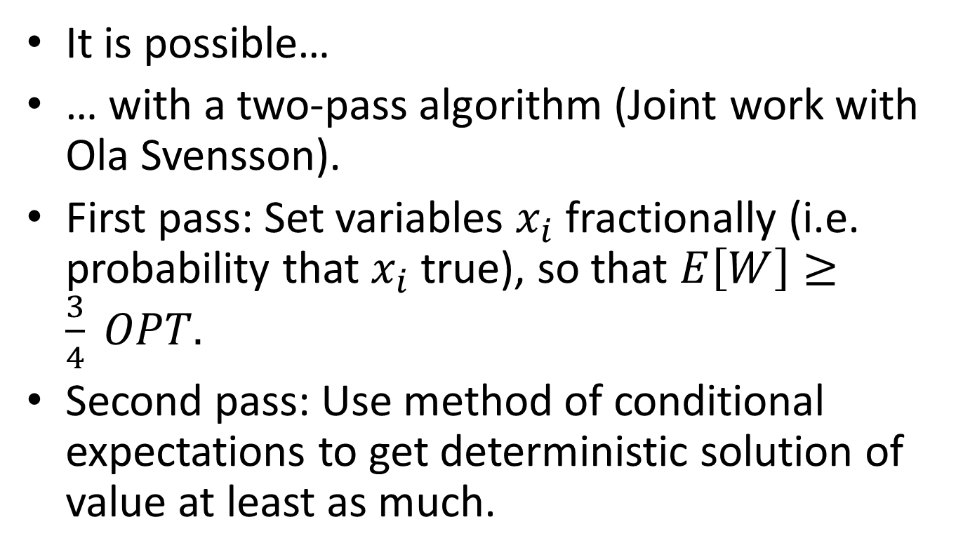
But…
It is possible…
… with a two-pass algorithm (Joint work with Ola Svensson).
First pass: Set variables $x_{i}$ fractionally (i.e. probability that $x_{i}$ true), so that $E\left[W\right]≥\frac{3}{4} OPT.$
Second pass: Use method of conditional expectations to get deterministic solution of value at least as much.

Slide 38
Buchbinder et al.’s approach
expected
Keep two bounds on the fractional solution
  Lower bound LB = weight of clauses already satisfied
  Upper bound UB = weight of clauses not yet unsatisfied
Greedy can focus on two things:
  maximize LB,
  maximize UB,
but either choice has bad examples…
Key idea: make choices to increase B = ½ (LB+UB)
expected
expected
Notes:
Bad example for maximizing LB:
C1=x1, C2 = not(x1) or x2. If w(C1)=w(C2)-epsilon, we satisfy only C2.
Bad example for maximizing UB:
C1=x1, c2= not(x1) of x2, C3=not(x2). w(C1)=epsilon, w(C2)=w(C3)=1. Opt is 2, greedy is 1+eps

Slide 39
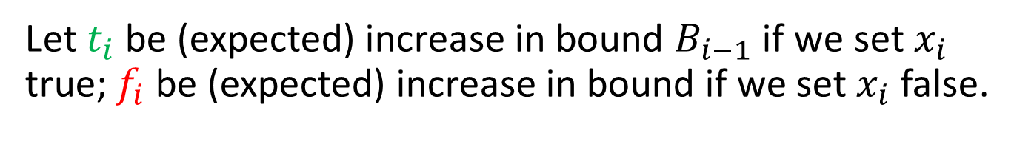
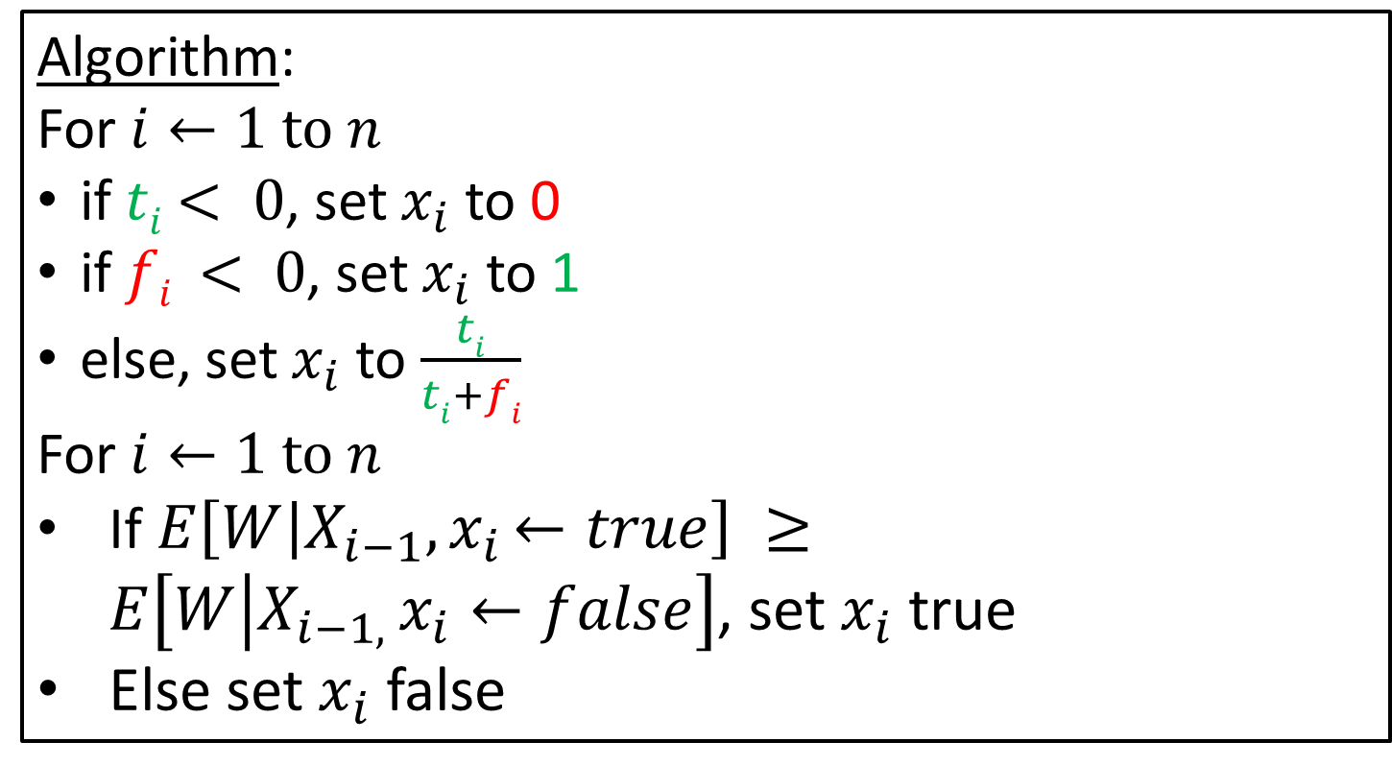
As before
Let $t_{i}$ be (expected) increase in bound $B_{i−1}$ if we set $x_{i}$ true; $f_{i}$ be (expected) increase in bound if we set $x_{i}$ false.
Algorithm:
For $i←1 \text{to} n$
if $ti$ $< 0$, set $x_{i}$ to 0
if $fi < 0$, set $x_{i}$to 1
else, set $x_{i}$to $\frac{ti}{ti+fi}$
For $i←1 \text{to} n$
If$E\left[W | X_{i−1}{,x}_{i}←true\right] ≥E\left[W | {X_{i−1, }x}_{i}←false\right]$, set $x_{i}$ true
Else set $x_{i}$ false

Slide 40
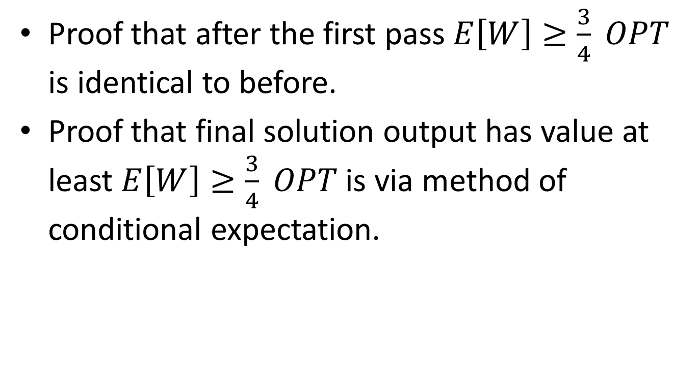
Analysis
Proof that after the first pass $E\left[W\right]≥\frac{3}{4} OPT$ is identical to before.
Proof that final solution output has value at least $E\left[W\right]≥\frac{3}{4} OPT$ is via method of conditional expectation.

Slide 41
Conclusion
We show this two-pass idea works for other problems as well (e.g. deterministic ½-approximation algorithm for MAX DICUT).
Can we characterize the problems for which it does work?

Slide 42
Thank you for your attention
and
Happy Birthday Alan!

