Slide 1
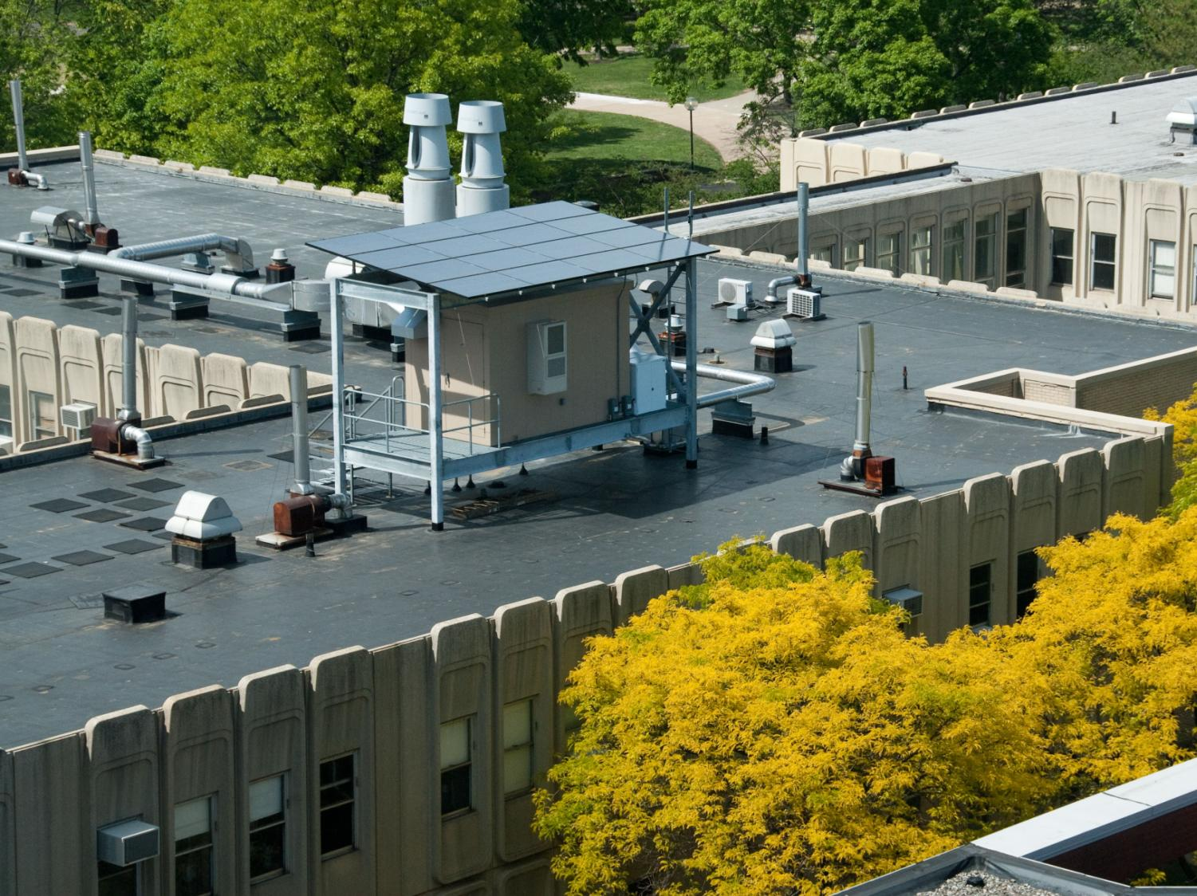

GreenSoftware:
Managing Datacenters Powered by Renewable Energy
Íñigo Goiri, William Katsak, Md E Haque, Kien Le,
Ryan Beauchea, Jordi Guitart, Jordi Torres,
Thu D. Nguyen, Ricardo Bianchini
Department of Computer Science

Slide 2
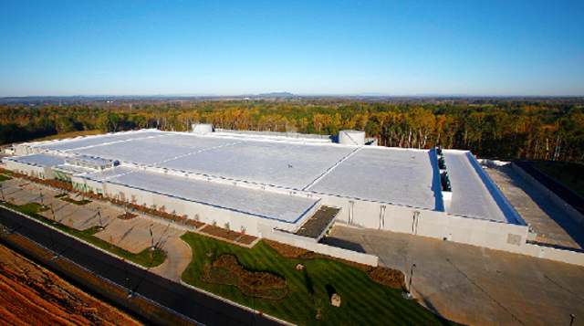
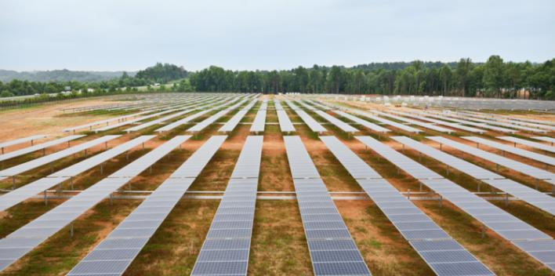
Motivation
Datacenters consume large amounts of energy
High energy cost and carbon footprint
  Brown electricity: coal and natural gas
Connect datacenters to green sources: solar, wind
Apple DC in Maiden, NC
40MW solar farm
Green datacenter

Slide 3
Challenges and opportunities
Variable
Solar power
Load
Power
Workload
Time
Scheduling workload/energy sources
  Lower costs: brown energy, peak brown power, capital
Study opportunities in green datacenters
  Build hardware/software

Slide 4
GreenSoftware
How to build software for green datacenters?
Malleable energy demand
  Idle nodes → Turn off/Sleep (S3) [COLP’01]
  Reduce frequency (DVFS) → Lower quality
Move computation under renewables
  Weather forecast → Green energy forecast
  Delay computation or degrade quality
  Leverage energy storage

Slide 5
Outline
Motivation
GreenSoftware
  GreenSlot
  GreenHadoop
  GreenSwitch
  GreenCassandra
  … and others
Conclusion

Slide 6
GreenSlot [SC’11]
Batch jobs on SLURM (& Hadoop)
Send idle nodes to S3
Predict solar availability
Delay jobs within deadlines
  Known jobs characteristics (length, deadline, size…)
  Heuristic
Job 1
Job 2
Power
Job 3
Job 4
Time
Deadline

Slide 7
GreenSlot [SC’11]
Batch jobs on SLURM (& Hadoop)
Send idle nodes to S3
Predict solar availability
Delay jobs within deadlines
  Known jobs characteristics (length, deadline, size…)
  Heuristic
Job 1
Job 4
Power
Job 2
Job 3
Time
Deadline

Slide 8
GreenHadoop [Eurosys’12]
Batch jobs on Hadoop
Send idle nodes to S3
Make required data available
  Move data blocks
Predict solar availability
Delay jobs within deadlines
  Predict global jobs energy consumption
  Heuristic
Shuffle
1
Map
2
Map
Reduce
6
3
Map
Reduce
7
4
Map
5
Map

Slide 9
GreenHadoop: Data management
Deactivate servers to save energy
  Some data might become unavailable
Prior solution: covering subset [Leverich’09]
  Set of servers always running has ALL data
Covering subset
Server
7
2
1
6
7
3
1
2
3
6
Block
5
7
4
8
3
4
8
1
5
Our approach
  Only required data has to be available
  We usually require fewer active servers
Notes:
We require fewer servers

Slide 10
GreenHadoop: Data management
Server 1
Server 2
Server 3
Active
7
4
6
4
1
2
5
3
6
Running queue:
Non-required file
JobA
4
6
Required file
JobB
5
Decommission
JobC
1
Server 4
Server 5
Down
2
4
3
6
3
8
7

Slide 11
GreenHadoop: Data management
Server 1
Server 1
Server 2
Server 3
Active
7
4
1
7
6
4
1
2
2
5
3
6
Running queue:
Non-required file
JobA
4
6
Required file
JobB
5
Decommission
JobC
1
Server 4
Server 5
Down
2
4
3
6
3
8
7
GreenHadoop (computation) requires only 2 servers

Slide 12
GreenHadoop: Data management
Server 2
Server 3
Active
4
6
4
1
5
3
6
Running queue:
JobA
4
6
Server 1
Replicate
JobB
5
Decommission
7
JobC
1
1
2
Server 4
Server 5
Down
2
4
3
6
3
8
7
Move required files to Active servers

Slide 13
GreenHadoop: Data management
Server 2
Server 3
Active
4
6
4
1
5
3
6
Running queue:
Non-required file
JobA
4
6
Required file
Server 1
JobB
5
Server 1
Decommission
7
1
7
JobC
1
1
2
2
Server 4
Server 5
Down
2
4
3
6
3
8
7
Decommissioned server can be sent to Down

Slide 14
GreenHadoop: Data management
Server 2
Server 3
Active
4
4
6
1
6
4
4
5
3
6
6
Running queue:
Non-required file
JobA
4
6
Required file
JobB
5
Decommission
JobC
1
JobD
8
Required file
Server 1
Server 4
Server 5
Down
2
4
7
4
3
6
1
2
8
6
3
8
7
Jobs to be executed change → Required files change

Slide 15
GreenHadoop: Data management
Server 2
Server 3
Active
4
6
4
1
5
3
6
Non-required file
Running queue:
Required file
JobB
5
Decommission
JobC
1
JobD
8
Required file
Server 1
Server 4
Server 4
Server 5
Down
2
2
4
7
4
3
6
1
2
8
3
8
3
7
Make missing data available

Slide 16
GreenHadoop: Data management
Server 2
Server 3
Active
4
6
4
1
5
3
6
Non-required file
Running queue:
Required file
JobB
5
Server 4
Server 4
Decommission
2
2
4
4
JobC
1
8
3
8
3
JobD
8
Server 1
Server 5
Down
7
3
6
1
2
7
GreenHadoop (computation) requires 3 servers
Notes:
Comment dereplication

Slide 17
GreenSwitch [ASPLOS’13]
Batch jobs on Hadoop
Similar to GreenHadoop
Energy storage
  Battery
  Net metering
Schedule workload and energy sources
  Optimization
Evaluation on Parasol
(Presented on Monday by Thu)

Slide 18
GreenCassandra
Distributed DB/storage on Cassandra
Add an optional ring
Degrade quality when no green
Optional
1
1
Server
6
2
6
2
Double
DHT Ring
DHT Ring
5
3
5
3
A
A
A
A
4
Data
A
4

Slide 19
GreenSoftware summary
 | Type | Malleable energy | Green adaptability
GreenSlot | Batch jobs | Delay jobs Sleep servers | Delay until green
GreenHadoop | Batch jobs | Delay jobs Sleep servers Data management | Delay until green
GreenSwitch | Batch/interactive jobs | Delay jobs Sleep servers | Delay until green Energy storage
GreenCassandra | Distributed storage | Optional ring | Degrade quality
GreenSLA | VMs | Migrate VMs Sleep servers | Route green energy to racks
GreenPar | MPI jobs | Change parallelism Sleep servers | Greater parallelism on green
GreenScale | Non-deferrable jobs | CPU and mem DVFS | Faster on green
GreenNebula | Geo distributed VMs | Migrate VMs | “Follow the renewables”

Slide 20
Conclusions
Green datacenters
  Challenges & opportunities
  Hardware/software solution
GreenSoftware
  Adapt software to green datacenters
  Malleable energy demand
  Match computation and renewables

Slide 21
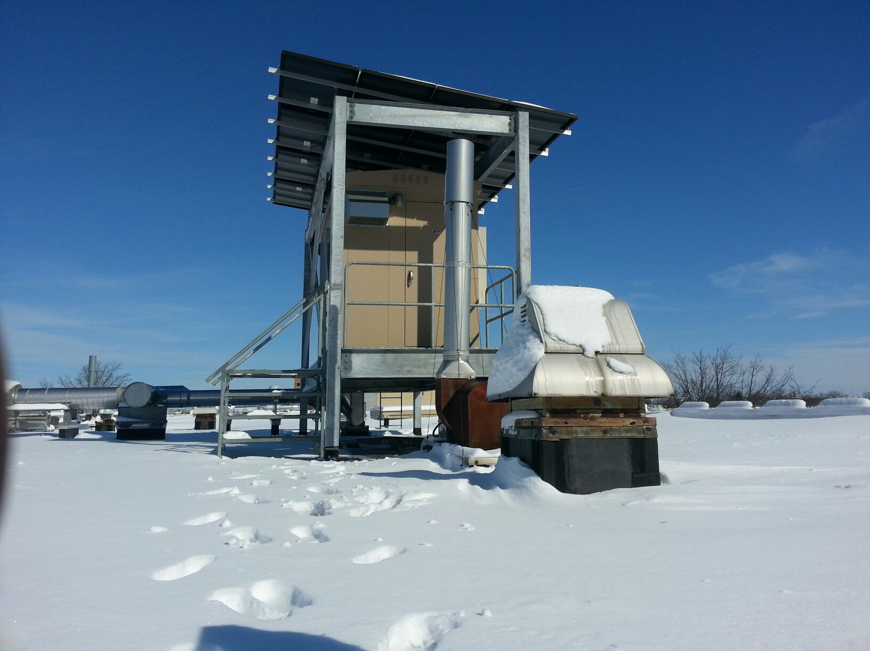
GreenSoftware:
Managing Datacenters Powered by Renewable Energy
Íñigo Goiri, William Katsak, Md E Haque, Kien Le,
Ryan Beauchea, Jordi Guitart, Jordi Torres,
Thu D. Nguyen, Ricardo Bianchini
Department of Computer Science

Slide 22
Other GreenSoftware
GreenSLA [IGCC’13]
  Bringing green energy to users
  New hardware to route green energy
GreenPar
  MPI jobs with sub linear speedup
  Use “Free” green energy
GreenNebula
  VMs in multiple geo distributed datacenters
  Follow the sun
GreenScale
  Change frequency (DVFS)

Slide 23
GreenPar
MPI jobs on VMs
Add more computation capacity
  Lower energy-efficiency
  Use available “green”
Speedup
Power
Computation capacity
Time

Slide 24
GreenSLA [IGCC’13]
HPC jobs on VMs
Users require % of green energy
  Hardware to bring green energy to VMs
Scheduling
  Assign green energy to racks
  Move VMs among racks
  Heuristic

Slide 25
Default Green Datacenter
Solar Inverter
Mixed
Bus
Datacenter Power
Distribution
PDU
PDU
PDU
Rack1
Rack2
Rack3
Notes:
Solar panel → solar to bus → racks and PDUs → Grid controller → battery

Slide 26
GreenSLA:
Proposed Power Distribution
Battery
Solar Inverter
Green
Bus
Charge Controller
Mixed
Bus
Datacenter Power
Distribution
S
S
S
PDU
PDU
PDU
Control Module
Rack1
Rack2
Rack3
Notes:
Green bus → connection to racks → difference in battery

Slide 27
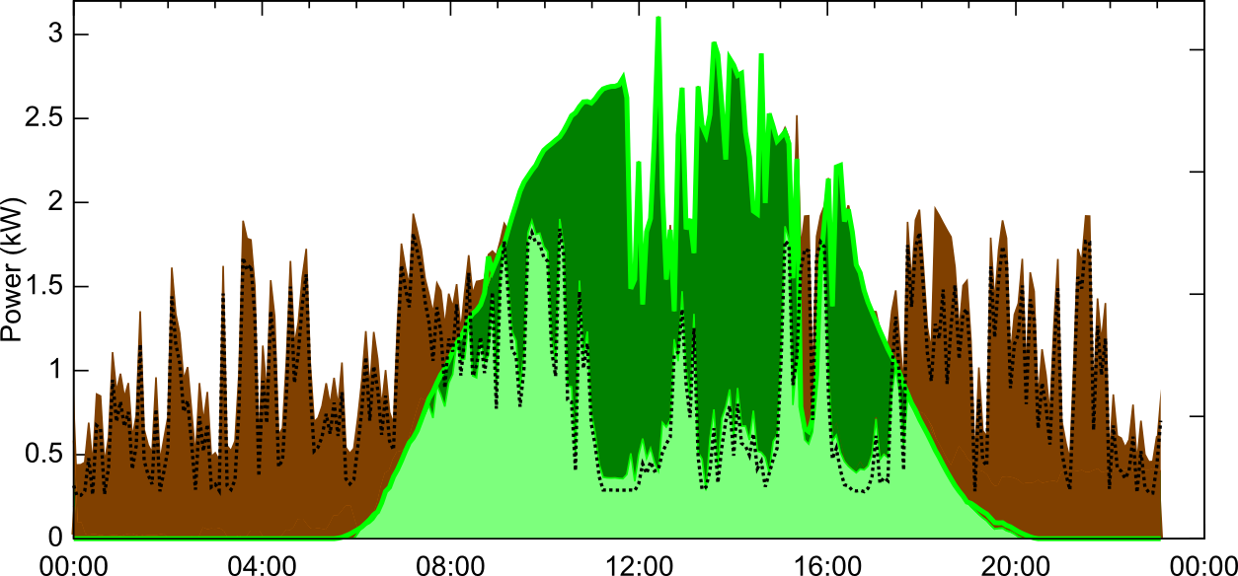
Parasol without GreenSwitch
Green available
Net metering
IT load
Green use
Brown use

Slide 28
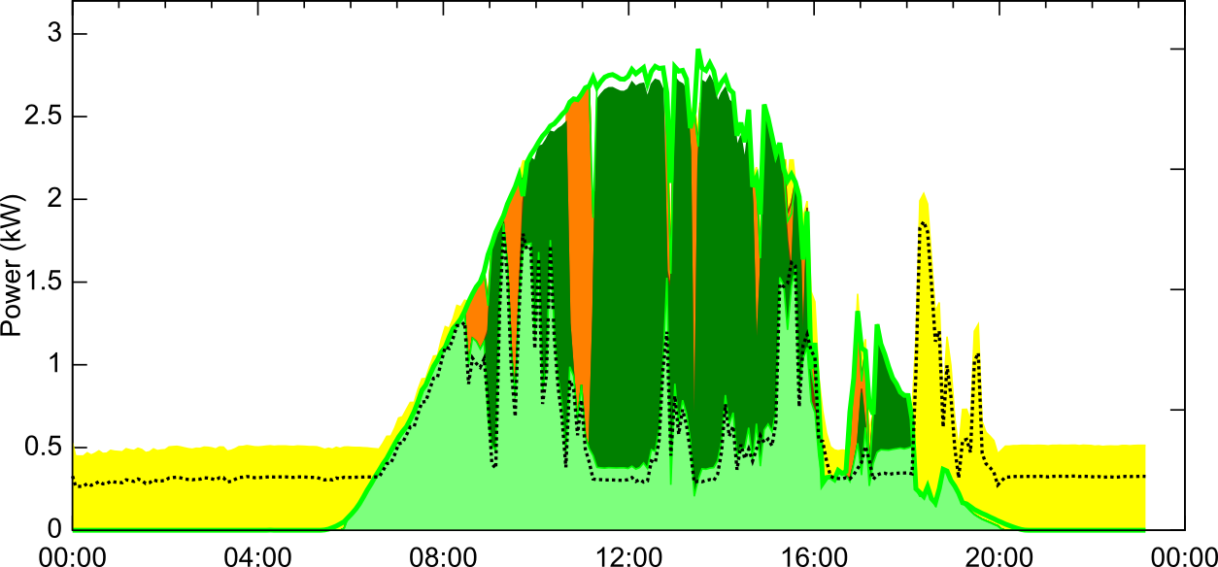
GreenSwitch: deferrable workload
Green available
Net metering
Battery charge
IT load
Battery discharge
Green use

