Slide 1


Data Center Demand Response:
Coordinating IT and the Smart Grid
Zhenhua Liu
zhenhua@caltech.edu
California Institute of Technology
December 18, 2013
Acknowledgements:
Adam Wierman¹, Steven Low¹, Yuan Chen², Minghong Lin¹, Lachlan Andrew^{3,} , Cullen Bash², Niangjun Chen¹, Ben Razon¹, Iris Liu¹
¹California Institute of Technology, ²HP Labs, ³Swinburne University of Technology
Notes:
job market

Slide 2
Sustainable IT
Energy efficiency of IT system
IT for sustainability
IT as a demand response provider
Notes:
broader impacts

Slide 3
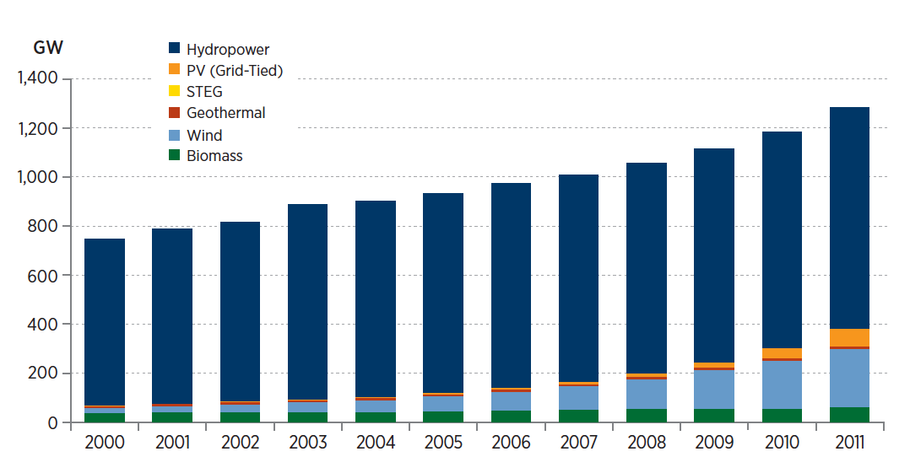
Renewables are coming
Worldwide Renewable Electricity Capacity
Source: Gelman, R. (2012). 2011 Renewable Energy Data Book (Book). Energy Efficiency & Renewable Energy (EERE)
Cumulative capacity has grown by 72% from 2000–2011
Wind and solar grow fastest (13x and 51x)
Notes:
increase in renewable

Slide 4

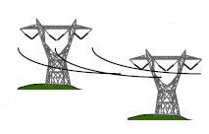
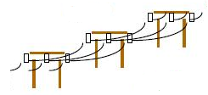

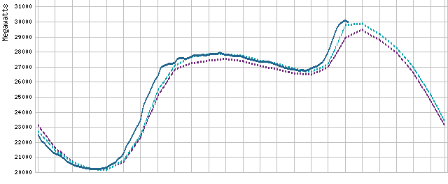
Challenges with renewables
Generation
Demand
Key constraint:
Generation = Demand
at all times
at all locations
Power
Generation follows Demand
Time
12 AM
12 AM
controllable
low uncertainty
predictable
Notes:
traditional approach: generation follows supply

Slide 5


Challenges with renewables
expensive
Generation
Demand
Key constraint:
Generation = Demand
at all times
at all locations
Demand follows Generation
(to some extent)
less controllable
high uncertainty
responsive
Notes:
challenges with renewable integration

Slide 6
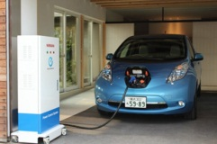


Need huge growth in demand response
Wind and Solar capacities are growing 15~40% per year
Data centers are a promising option
large loads: 500kW~50MW each
increasing fast: 10~15% per year
significant flexibilities
Notes:
Others vs DC

Slide 7
Data center flexibilities
cooling, lighting, …
  5% of consumption can be shed in 2 min [LBNL2012]
  10% of consumption can be shed in 20 min [LBNL2012]
workload management
  Temporal demand shaping [Sigmetrics12][3 patents]
  HP Net-Zero data center, 2013 Computerworld Honors Laureate
  Geographical load balancing [Sigmetrics11][GreenMetrics11][IGCC12]
  Best student paper award at ACM GreenMetrics 2011
  Best paper award at IEEE Green Computing 2012
  Pick of the Month in the IEEE STC on Sustainable Computing
onsite backup generators & storage
Notes:
previous work: design & implementation, distributed and online algorithms with theoretical guarantee

Slide 8
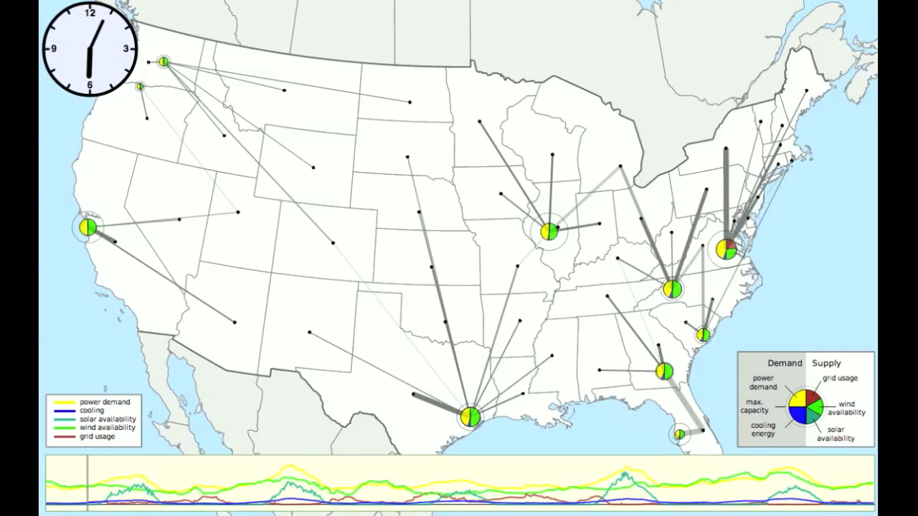
Geographical load balancing
Notes:
power and cooling
spatial flexibility
future: robustness when adding new data center or failure

Slide 9
Data center flexibilities
cooling, lighting, …
  5% of consumption can be shed in 2 min [LBNL2012]
  10% of consumption can be shed in 20 min [LBNL2012]
workload management
  Temporal demand shaping [Sigmetrics12][3 patents]
  HP Net-Zero data center, 2013 Computerworld Honors Laureate
  Geographical load balancing [Sigmetrics11][GreenMetrics11][IGCC12]
  Best student paper award at ACM GreenMetrics 2011
  Best paper award at IEEE Green Computing 2012
  Pick of the Month in the IEEE STC on Sustainable Computing
onsite backup generators & storage
great opportunities

Slide 10
Data center demand response today
Many programs
Time of use (ToU) pricing
  Wholesale market
  Ancillary service market
coincident peak pricing (CPP)
customer’s peak demand
coincident peak demand
customer power usage
system peak hour
(decided by utility)
time
Monthly bill = fixed charge + usage charge + peak charge + coincident peak charge
Notes:
CPP is popular
how CPP works

Slide 11
CPP in practice
Rates at Fort-Collins Utilities, Colorado, USA
fixed charge: $101.92/month
usage charge rate: $0.0245/kWh
peak charge rate: $4.75/kW
coincident peak (CP) charge rate: $12.61/kW
Example: average demand 10MW, peak demand 15MW, CP demand 14MW
Monthly bill = fixed charge + usage charge + peak charge + coincident peak charge
$101.92
$176,400
$71,250
$176,540
CP is very important!
Notes:
CPP is very important

Slide 12
DC management is challenging
Uncertainties in CP
only known at the end of the month
Participating CPP program is risky!
algorithm design
Notes:
challenge

Slide 13
min_{d} f(d; t)
expected cost optimization
robust optimization
min_{d} E_{t}[f(d; t)]
min_{d} max_{t} [f(d; t)]
data mining for patterns
online algorithm
less accurate with renewables
optimal competitive ratio
Extensions
warning signals
backup generator & local renewables
workload & renewable prediction errors
Notes:
what is f
two approaches
performance guarantee
extension

Slide 14
min_{d} f(d; t)
expected cost optimization
robust optimization
Power
Power
Limited demand response
Time
Time
12 AM
12 AM
12 AM
12 AM
periods with high probability to be CP
make the demand flat
market design
Notes:
limited demand response

Slide 15
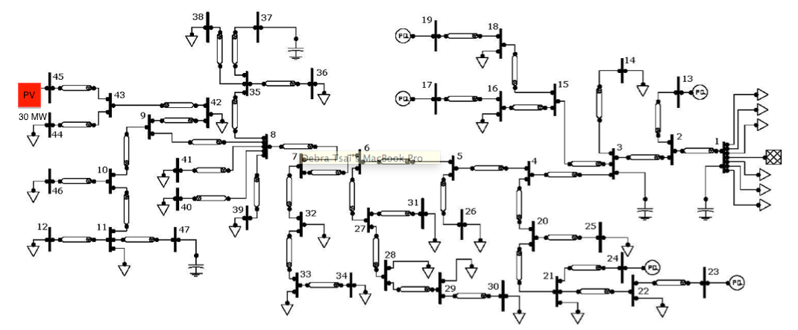
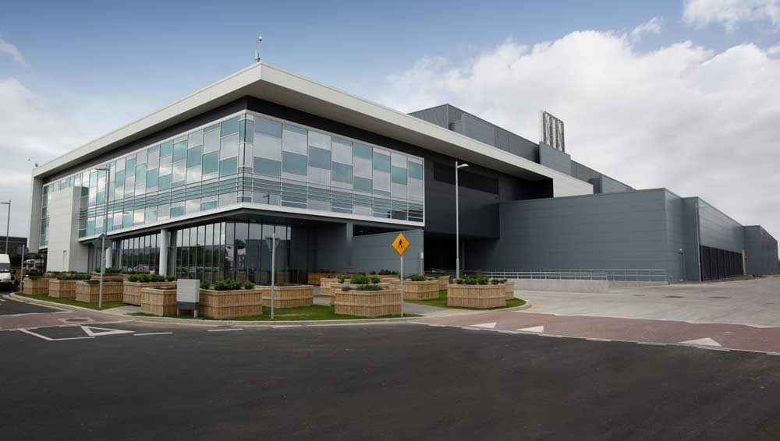
Potential of data center demand response
Goal: minimize voltage violation with large PV generation
voltage violation rate
20MW DC
=
3MWh storage
with 20% flexibility
optimal location & fast charge rate
Notes:
great potential from the society’s perspective

Slide 16

Pricing data center demand response
supply function s_{i}(p)

Slide 17
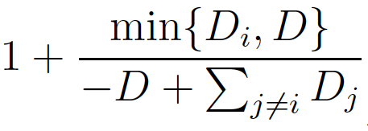
Pricing data center demand response
supply function bidding
market-clearing price p
efficiency loss due to user strategic behavior [XLL2013]
works well when no user has large market power
but when we have data centers …

Slide 18

Pricing data center demand response
prediction-based pricing
price p
supply function

Slide 19
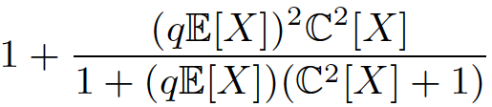
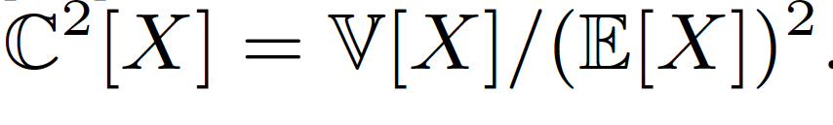
Pricing data center demand response
prediction-based pricing
supply s_{i}(p)
efficiency loss is independent of market power
but depends on prediction accuracy
for quadratic cost function
parameter in supply function

Slide 20
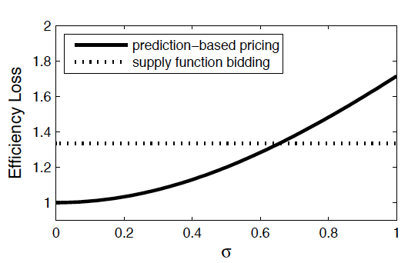
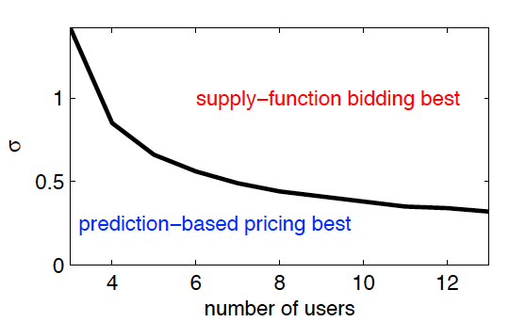
vs
prediction-based pricing
supply function bidding
efficiency loss depends on market power
efficiency loss depends on prediction accuracy
supply function bidding
supply function bidding
prediction-based pricing
prediction-based pricing

Slide 21
vs
prediction-based pricing
supply function bidding
incorporating power network
learning from user response
value of location
exploitation vs exploration
optimal power flow
theory of quantization
[BSXY2012]
Pick of prices during learning stage
Design demand response “menu”
Notes:
future work
connection

Slide 22
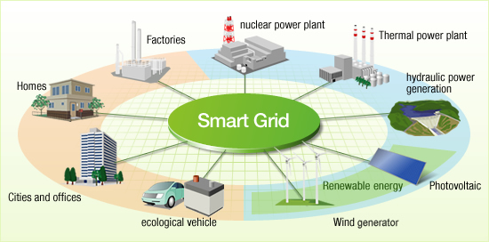


demand response
cloud platform
flexibilities

Slide 23
Thank you!

Slide 24
References
[LBNL2012] Ghatikar, Girish, et al. "Demand response opportunities and enabling technologies for data centers: Findings from field studies." LBNL-5763E. 2012.
[XLL2013] Yunjian Xu, Lina Li, Steven Low. “On the Eciency of Parameterized Supply Function Bidding with Capacity Constraints”. 2013.
[BSXY2012] Bergemann, Dirk, et al. "Multi-dimensional mechanism design with limited information." Proceedings of the 13th ACM Conference on Electronic Commerce. ACM, 2012.

Slide 25
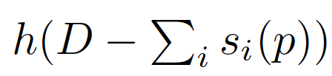

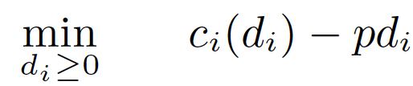
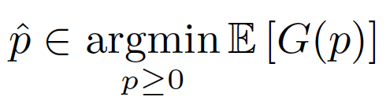

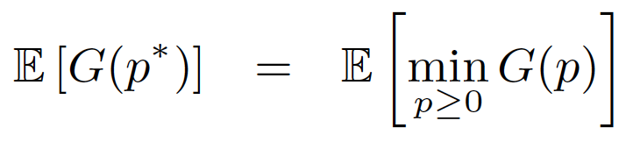
Model for prediction based pricing
utility
user
penalty
cost function
for each realization
social objective
supply
offline optimal

Slide 26
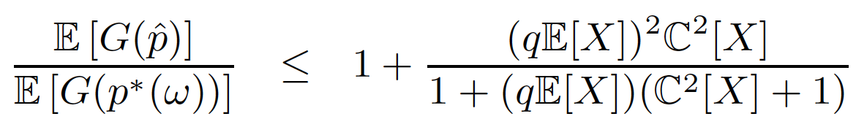
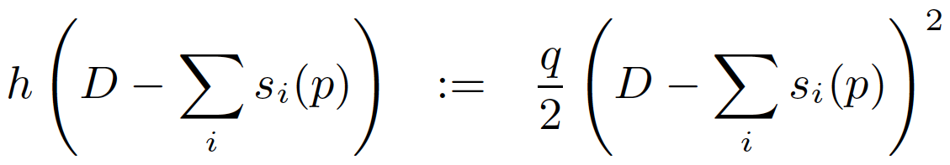
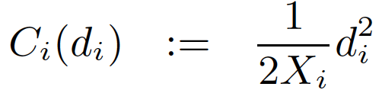

Model for prediction based pricing
utility
penalty
Theorem
social objective
performance evaluation
competitive ratio
offline optimal

