Slide 1
Demystifying and Controlling the Performance of Big Data Jobs
Theophilus Benson
Duke University

Slide 2
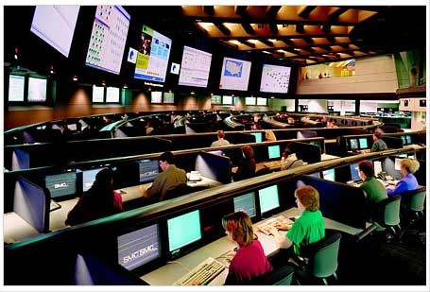








Why are Data Centers Important?
Internal users
  Line-of-Business apps
  Production test beds
External users
  Web portals
  Web services
  Multimedia applications
  Chat/IM

Slide 3
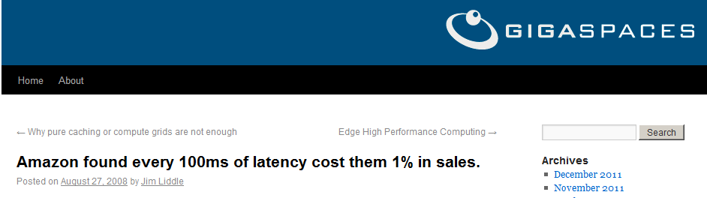
Why are Data Centers Important?
Poor performance ➔ loss of revenue
Understanding traffic is crucial
Traffic engineering is crucial

Slide 4






Canonical Data Center Architecture
Core (L3)
Aggregation (L2)
Edge (L2)
Top-of-Rack
Application
servers
Notes:
Rack of application servers
Point out 3 layers (core, gag, edge), show how 2-Tier and 3-Tier are different
Show links captured by SNMP
Show links captured by packet sniffers

Slide 5
Dataset: Data Centers Studied
DC Role | DC Name | Location | Number Devices
Universities | EDU1 | US-Mid | 22
 | EDU2 | US-Mid | 36
 | EDU3 | US-Mid | 11
Private Enterprise | PRV1 | US-Mid | 97
 | PRV2 | US-West | 100
Commercial Clouds | CLD1 | US-West | 562
 | CLD2 | US-West | 763
 | CLD3 | US-East | 612
 | CLD4 | S. America | 427
 | CLD5 | S. America | 427
10 data centers
3 classes
  Universities
  Private enterprise
  Clouds
Internal users
  Univ/priv
  Small
  Local to campus
External users
  Clouds
  Large
  Globally diverse
Notes:
Data from 10 date centers -- 5 clouds, 3 uni, 2 enterprise
Big data centers used for clouds
Enterprise/uni data located closer to premise of users

Slide 6
Dataset: Collection
SNMP
  Poll SNMP MIBs
  Bytes-in/bytes-out/discards
  > 10 Days
  Averaged over 5 mins
Packet Traces
  Cisco port span
  12 hours
Topology
  Cisco Discovery Protocol
DC Name | SNMP | Packet Traces | Topology
EDU1 | Yes | Yes | Yes
EDU2 | Yes | Yes | Yes
EDU3 | Yes | Yes | Yes
PRV1 | Yes | Yes | Yes
PRV2 | Yes | Yes | Yes
CLD1 | Yes | No | No
CLD2 | Yes | No | No
CLD3 | Yes | No | No
CLD4 | Yes | No | No
CLD5 | Yes | No | No

Slide 7
Canonical Data Center Architecture
Core (L3)
Aggregation (L2)
Packet
Sniffers
Edge (L2)
Top-of-Rack
Application
servers
Notes:
Rack of application servers
Point out 3 layers (core, gag, edge), show how 2-Tier and 3-Tier are different
Show links captured by SNMP
Show links captured by packet sniffers

Slide 8
Applications
Start at bottom
  Analyze running applications
  Use packet traces
BroID tool for identification
  Quantify amount of traffic from each app

Slide 9
Applications
CLD4, CLD5
  Map-Reduce applications
CLD1, CLD2, CLD3
  MSN, Mail
Notes:
App mix found in the dc impact the results we look at next

Slide 10
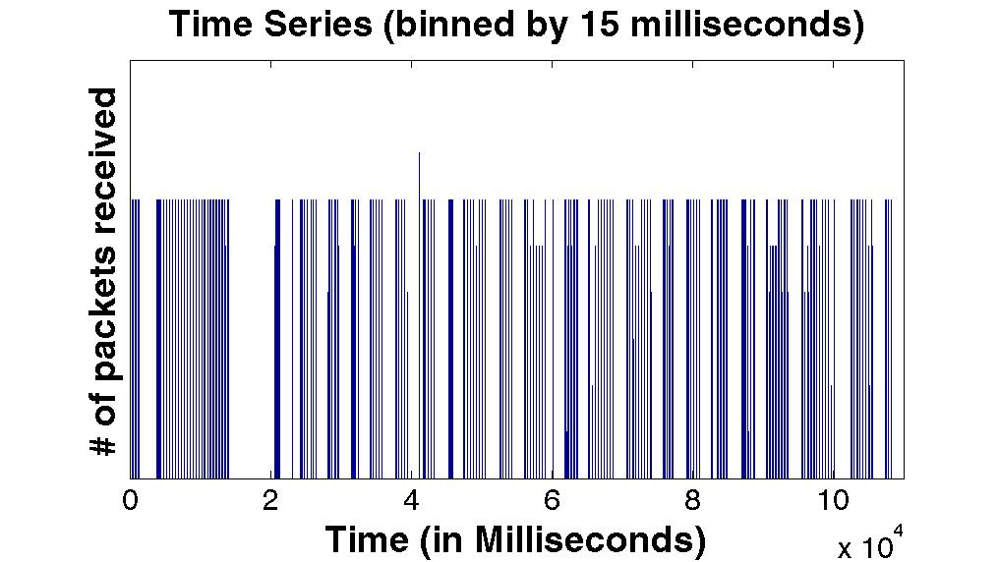
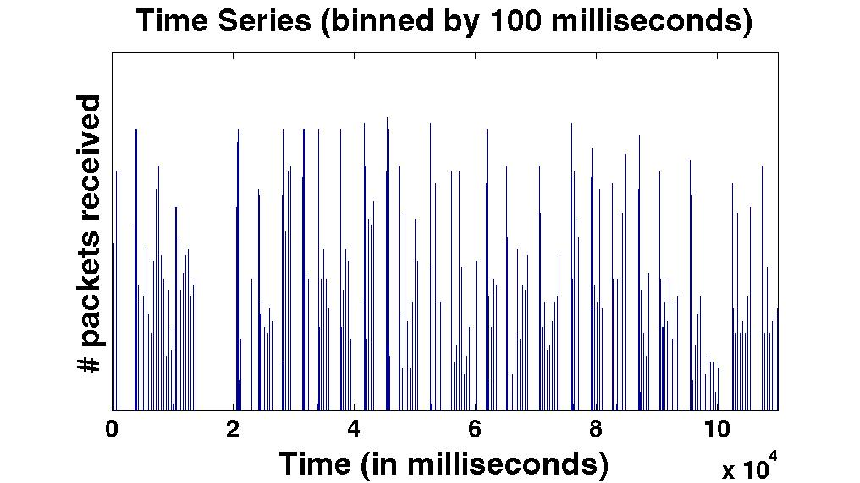
Analyzing Packet Traces
Transmission patterns of the applications
Properties of packet crucial for
  Understanding effectiveness of techniques
ON-OFF traffic at edges
  Binned in 15 and 100 m. secs
  We observe that ON-OFF persists
Routing must react quickly to overcome bursts
Notes:
Important for understanding effective assumptions and types of techniques that can be used

Slide 11
Possible Causes of Burstiness
Transport level: TCP delayed ACK
  Ideal: one ACK release one data packet
Data 2
Data 1
Ack 2
Ack 1

Slide 12
Possible Causes of Burstiness
Transport level: TCP delayed ACK
  Reality: one ACK release multiple packets
  Delayed ACK phenomenon
    Optimization to reduce network load
Data 4
Data 2
Data 1
Data 3
Ack 1 & 2

Slide 13
Possible Causes of Burstiness
Physical level: Interrupt Coalescing
  Ideal: each packet is processed when it comes in
Application
Data 1
OS
Driver
NIC

Slide 14
Possible Causes of Burstiness
Physical level: Interrupt Coalescing
  Reality: O.S. batches packets to network card
Application
Data 1
Data 2
Data 3
OS
Driver
NIC

Slide 15
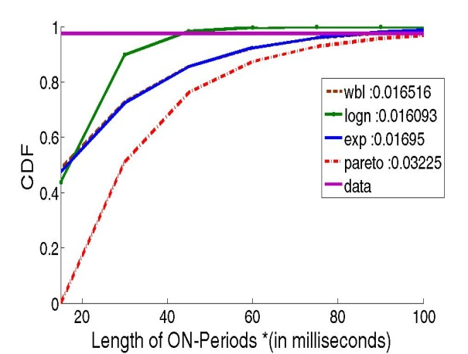
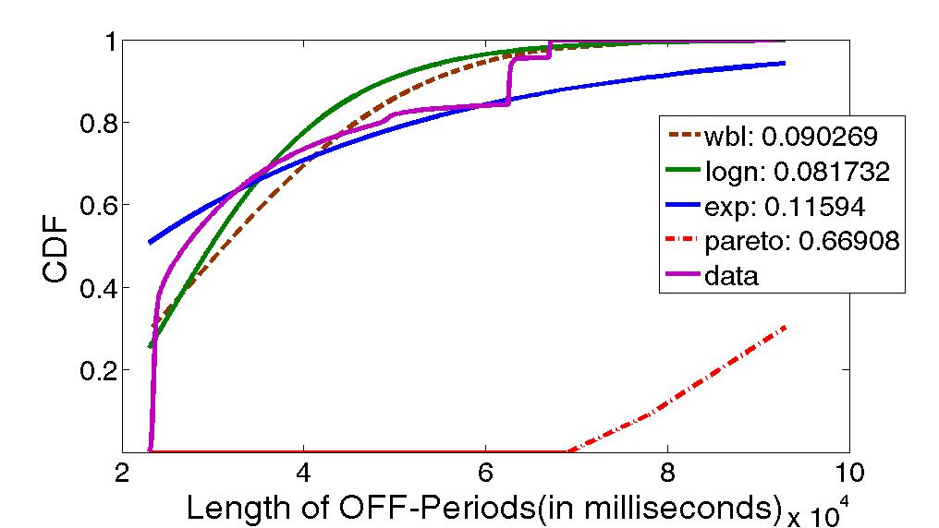
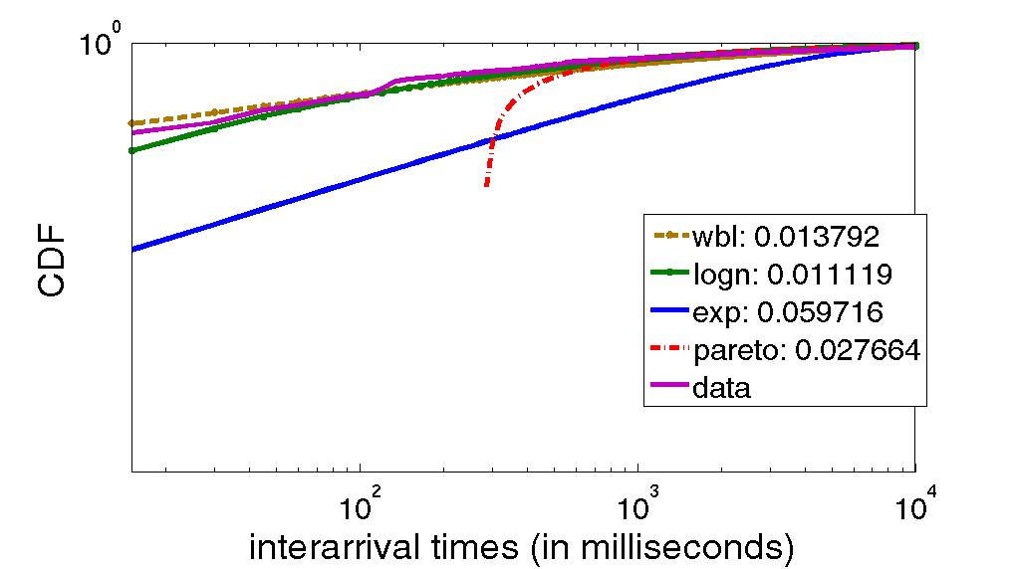
Data-Center Traffic is Bursty
Understanding arrival process
  Range of acceptable models
What is the arrival process?
  Heavy-tail for the 3 distributions
    ON, OFF times, Inter-arrival,
  Lognormal across all data centers
Different from Pareto of WAN
  Need new models
Data Center | Off Period Dist | ON periods Dist | Inter-arrival Dist
Prv2_1 | Lognormal | Lognormal | Lognormal
Prv2_2 | Lognormal | Lognormal | Lognormal
Prv2_3 | Lognormal | Lognormal | Lognormal
Prv2_4 | Lognormal | Lognormal | Lognormal
EDU1 | Lognormal | Weibull | Weibull
EDU2 | Lognormal | Weibull | Weibull
EDU3 | Lognormal | Weibull | Weibull
Need new models to generate traffic
Notes:
What are you curvingfitting for log normal parameters or the actual distributions
Not fit == different
We == conventionally

Slide 16
Possible Causes for Heavy Tail
Distribution of files in a file system
  NFS → Log-Normal
Distribution of files on the web
  HTTP files → Log-Normal

Slide 17
Implications of distribution
Lognormal V. Pareto
  Both heavy tail distributions
  Differences is in length of tail
99Th percentile used to determine SLA
  Length of tail impacts 99th percentile
  Modeling with wrong distribution → SLA violations

Slide 18
Canonical Data Center Architecture
Core (L3)
Aggregation (L2)
Edge (L2)
Top-of-Rack
Application
servers
Notes:
Rack of application servers
Point out 3 layers (core, gag, edge), show how 2-Tier and 3-Tier are different
Show links captured by SNMP
Show links captured by packet sniffers

Slide 19
Data Center Interconnect Questions
How much locality exists in data centers?
What does utilization at the core look like?

Slide 20
Intra-Rack Versus Extra-Rack
Quantify amount of traffic using interconnect
  Perspective for interconnect analysis
Extra-Rack
Edge
Intra-Rack
Application
servers
Extra-Rack = Sum of Uplinks
Intra-Rack = Sum of Server Links – Extra-Rack
Notes:
intra-rack - traffic within
extra-rack – traffic leaving
Use equation to show how derived

Slide 21
Intra-Rack Versus Extra-Rack Results
Clouds: most traffic stays within a rack (75%)
  Colocation of apps and dependent components
Other DCs: > 50% leaves the rack
  Un-optimized placement

Slide 22
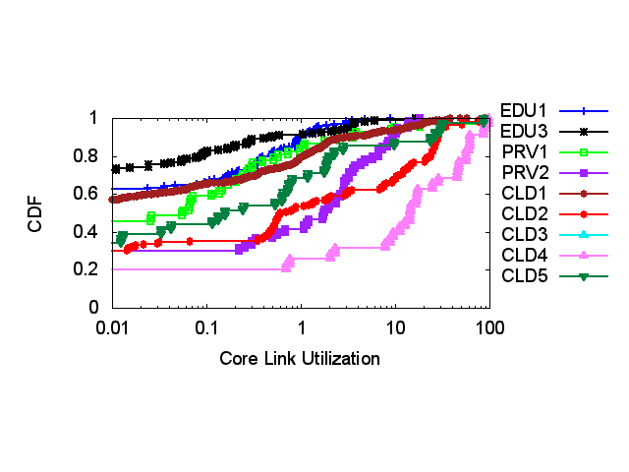
Extra-Rack Traffic on DC Interconnect
Utilization: core > agg > edge
  Aggregation of many unto few
Tail of core utilization differs
  Hot-spots → links with > 70% util
  Prevalence of hot-spots differs across data centers

Slide 23
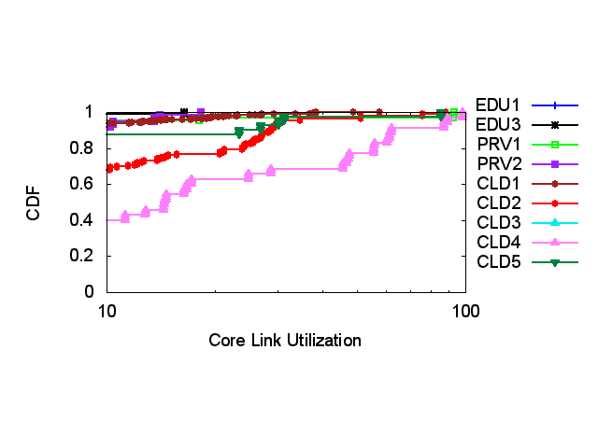
Extra-Rack Traffic on DC Interconnect
Utilization: core > agg > edge
  Aggregation of many unto few
Tail of core utilization differs
  Hot-spots → links with > 70% util
  Prevalence of hot-spots differs across data centers

Slide 24
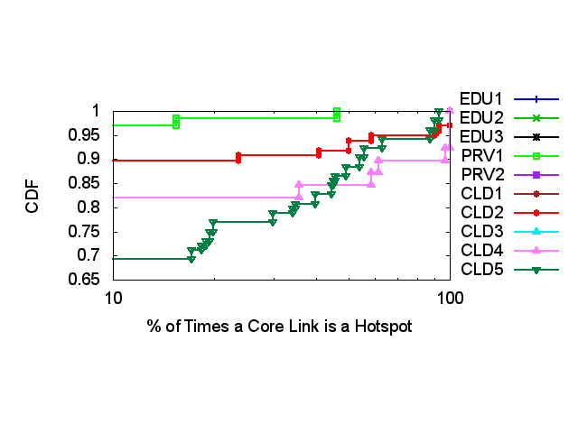
Persistence of Core Hot-Spots
Low persistence: PRV2, EDU1, EDU2, EDU3, CLD1, CLD3
High persistence/low prevalence: PRV1, CLD2
  2-8% are hotspots > 50%
High persistence/high prevalence: CLD4, CLD5
  15% are hotspots > 50%

Slide 25

Traffic Matrix Analysis
 | A | B | C | D
A
B
C
D
A
B
C
D
Predictability:
5% difference across a set of time periods

Slide 26
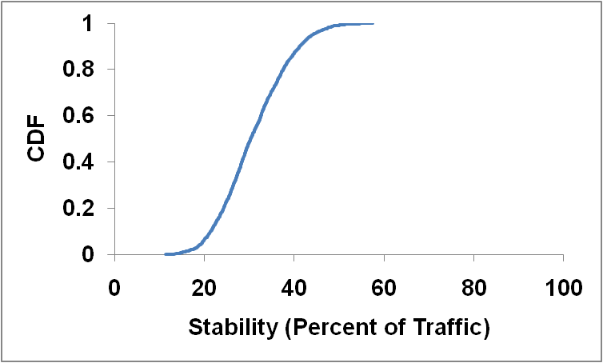
Is Data Center Traffic Predictable?
27%
99%

Slide 27
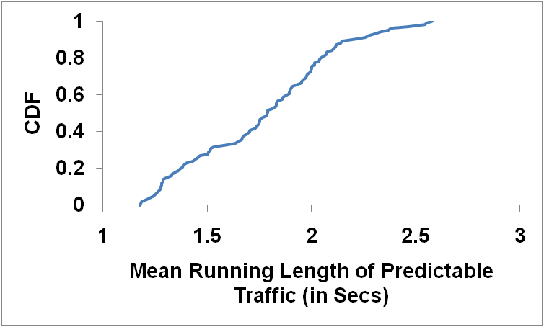
How Long is Traffic Predictable?
1.5 – 5.0
1.6 - 2.5
Different patterns of predictability
1 second of historical data able to predict future

Slide 28
Observations from Study
Links utils low at edge and agg
Core most utilized
  Hot-spots exists (> 70% utilization)
  < 25% links are hotspots
  Loss occurs on less utilized links (< 70%)
    Implicating momentary bursts
Time-of-Day variations exists
  Variation an order of magnitude larger at core
Packet sizes follow a bimodal distribution

Slide 29
Retrospective Remarks
New age of data center networks
  Bing deploying Clos style networks

Slide 30
Future Data Center Networks
Larger bisection→ less contention for network resources

Slide 31
Retrospective Remarks
New age of data center networks
  Bing deploying Clos style networks
  Server links → 10Gig
Implications for results:
  Burstiness at edge holds: perhaps grows
  Flow characteristics remain unchanged
  Core utilization likely to change
    More evenly distributed
Applications are still the same
More NIC optimizations
Traffic more evenly distributed across core layers

Slide 32
Insights Gained
75% of traffic stays within a rack (Clouds)
  Applications are not uniformly placed
At most 25% of core links highly utilized
Data center traffic is partially predictable

Slide 33
End of the Talk!
Please turn around and proceed to a safe part of this talk

