Slide 1
Sparsity-Eager SVM for Audio Classification
Kamelia Aryafar & Ali Shokoufandeh
Department of Computer Science
Drexel University, Philadelphia, PA
Presented by Ali Shokoufandeh, 11 October 2014

Slide 2
Connection to Paul Kantor
I have known Paul since my graduate school time at Rutgers.
As a junior faculty, I was part of an NSF project managed by Paul.
Paul was an unofficial mentor during my early Career as Assistant Professor.
I also had the honor of collaborating with Paul on numerous research problem.

Slide 3
Goal
Build a robust supervised audio classifier by fusing SVM and regression classifiers:
  Avoid suffers from over-fitting
  Obtain higher generalization on new test examples.
  Provide scalability in terms of classification complexity.
The subspace model assumption [Donoho 06]:
  For a sufficiently large number of training instances per class, unseen instance lies on the subspace spanned by training examples.
D. L. Donoho. Compressed sensing. IEEE Transactions on Information Theory , 52:1289–1306, 2006.

Slide 4


Support Vector Machine (SVM)
SVM is a maximum margin threshold classifier, w(x) = sign(w^{t}.x ), consistent with training examples.
If the training data is not linearly separable, soft-margin can be used:
  Define a Hinge Function:
  Find w that minimizes the empirical loss
(1)

Slide 5
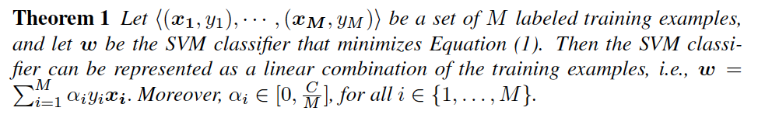
What is known:

Slide 6
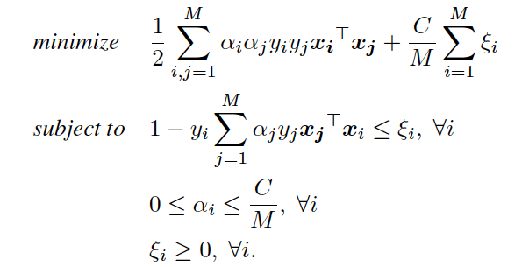
What is known:

Slide 7
What is known:
SVM provides an efficient minimum margin classifier but it suffers from over fitting.

Slide 8


Sparse Regression
We are given a matrix X of samples for k classes (r sample per class).
We would like to find a classifier for an unknown f:
The sparse-approximation classifier will output its prediction as

Slide 9
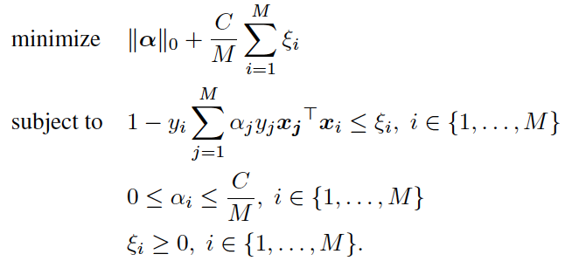
Fusion: l₁-SVM
Change the objective function of l₂-SVM while avoiding the curse of dimensionality and over-fitting:

Slide 10
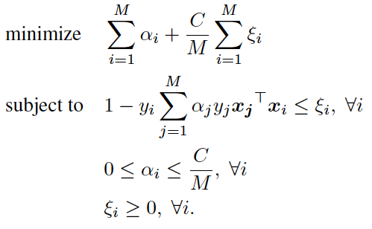
Fusion: l₁-SVM
Change the objective function of l₂-SVM while avoiding the curse of dimensionality and over-fitting:
K. Aryafar, S. Jafarpour, and A. Shokoufandeh. “Automatic musical genre classification using sparsity-eager support vector machines”, ICPR 2012.

Slide 11
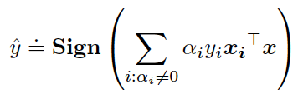
Fusion: l₁-SVM
Change the objective function of l₂-SVM while avoiding the curse of dimensionality and over-fitting:
Classifier:

Slide 12
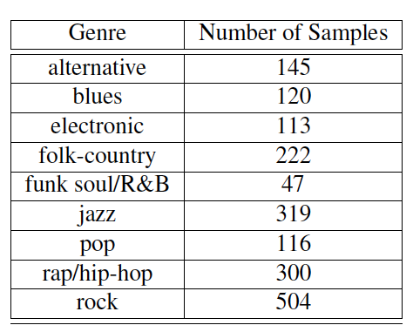
Experiments:
1886 songs and is comprised of nine music genres: pop, rock, folk-country, alternative, jazz, electronic, blues, rap/hip-hop, and funk soul/R&B:

Slide 13
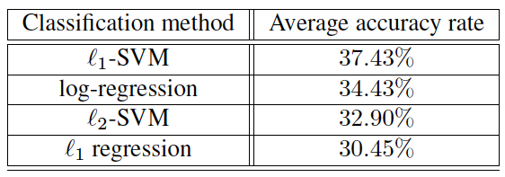
Experiments:
1886 songs and is comprised of nine music genres: pop, rock, folk-country, alternative, jazz, electronic, blues, rap/hip-hop, and funk soul/R&B:

Slide 14
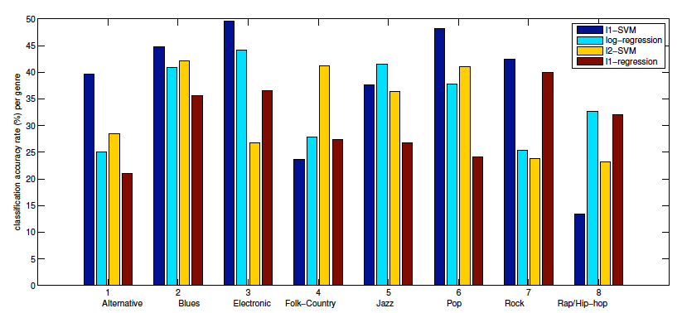
Experiments:
1886 songs and is comprised of nine music genres: pop, rock, folk-country, alternative, jazz, electronic, blues, rap/hip-hop, and funk soul/R&B:

Slide 15
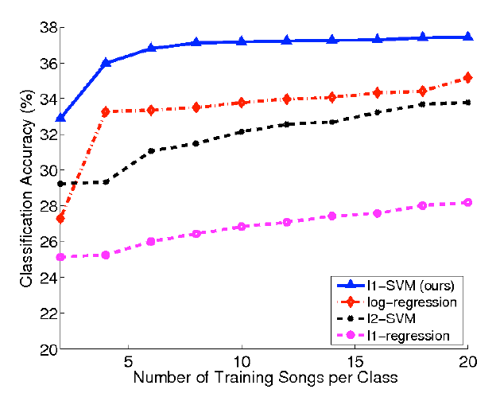
Experiments:
1886 songs and is comprised of nine music genres: pop, rock, folk-country, alternative, jazz, electronic, blues, rap/hip-hop, and funk soul/R&B:

Slide 16
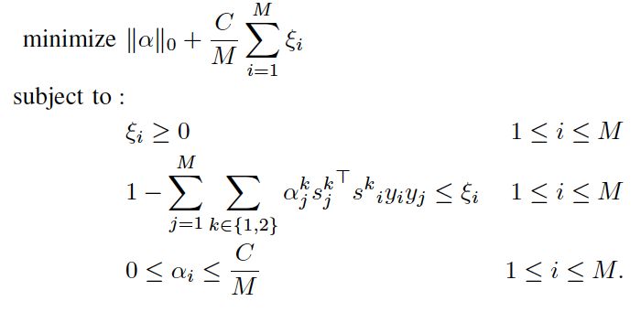
Generalization
The model can be generalized to multi-modal classification:
K. Aryafar and A. Shokoufandeh. “Multimodal sparsity-eager support vector machines for music classification”, ICMLA 2014 13th, 2014.

Slide 17
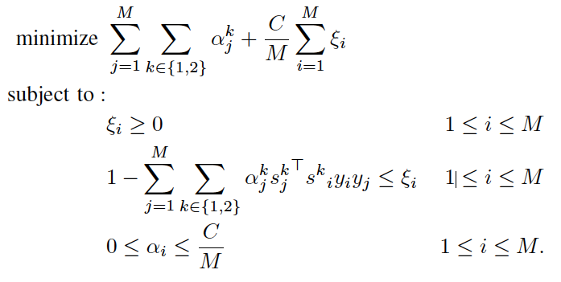
Generalization
The model can be generalized to multi-modal classification:

Slide 18
Final Thoughts
Fusing ideas form two distinct class of methods (in this case) made multi-class classification more accurate, and added scalability in terms of classification complexity.

