Slide 1
Combinatorial Fusion on
Multiple Scoring Systems
D. Frank Hsu
Clavius Professor of Science
Fordham University
New York, NY 10023
hsu (at) cis (dot) fordham (dot) edu
DIMACS Workshop on Algorithmic
Aspect of Information Fusion
Rutgers University, New Jersey
Nov. 8-9, 2012

Slide 2
Outline
(A) The Landscape
(1) Complex world, (2) The Fourth Paradigm,
(3) The fusion imperative,(4) Examples.
(B) The Method
(1) Multiple scoring systems and RSC function
(2) Combinatorial fusion, (3) Cognitive diversity,
(4) Diversity vs. correlation.
(C) The Practices
(1) Retrieval-related domain, (2) Cognition-related domain,
(3) Other domains
(D) Review and Remarks

Slide 3
(A) The (Digital) Landscape
(1) It is a complex world.
Interconnected Cyber-Physical-Natural (CPN) Ecosystem
DNA-RNA-Protein-Health-Spirit
  (Biological science and technology in the physical-natural world.)
  (molecular networks; Brain connectivity and cognition.)
Data-Information-Knowledge-Wisdom-Enlightenment
(Information science and technology in the cyber-physical world.)
(Social networks; network connectivity and mobility.)
Enablers: sensors, imaging modalities, etc.
Notes:
Wisdom-Enlightenment : difference . Lao Zi

Slide 4
(2) The Fourth Paradigm
Empirical - Theoretical - Modeling – Data-Centric(e-science) ;
Jim Gray’s; Computational-x and x-informatics
The Big Data: Volume, Velocity, Variety and Value ;
structured vs. unstructured, spatial vs. temporal, logical vs. perceptive,
data-driven vs. hypothesis-driven, etc.
(3) The Fusion Imperative
Reduction vs. Integration
Data Fusion - Variable Fusion - System Fusion ;
Variables (cues, parameters, indicators, features) and
Systems (decision systems, forecasting systems, information systems,
machine learning systems, classification systems, clustering systems,
hybrid systems, heterogeneous systems).

Slide 5


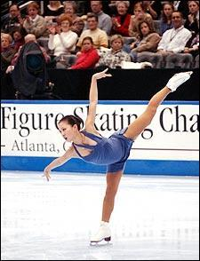

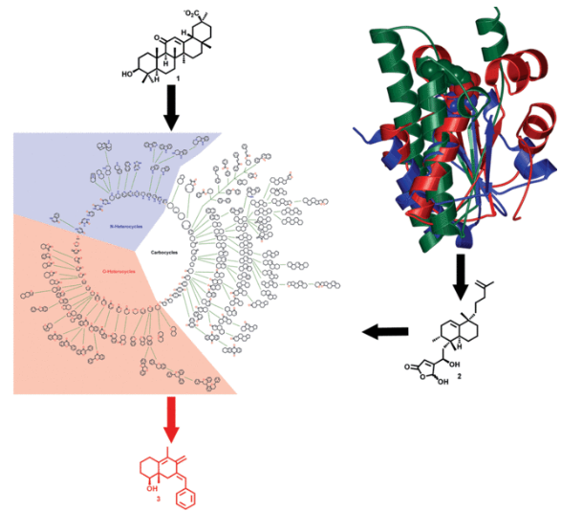
(4) Examples
Crossing the Street
Figure Skating Judgment
Internet Search Strategy
Active Searching in Chemical Space

Slide 6
6
Figure Skating Judgment
 | J1 | J2 | J3 | SC | D |  | J1 | J2 | J3 | RC | C
d₁ | 9.6 | 9.7 | 9.8 | 29.1 | 2 |  | 5 | 3 | 3 | 11 | 3
d₂ | 9.8 | 9.2 | 9.9 | 28.9 | 3 |  | 3 | 8 | 2 | 13 | 4
d₃ | 9.7 | 9.9 | 10 | 29.6 | 1 |  | 4 | 2 | 1 | 7 | 1
d₄ | 9.5 | 9.3 | 9.7 | 28.5 | 6 |  | 6 | 7 | 4 | 17 | 7
d₅ | 9.9 | 9.4 | 9.5 | 28.8 | 4 |  | 2 | 6 | 6 | 14 | 5
d₆ | 9.4 | 9.6 | 9.6 | 28.6 | 5 |  | 7 | 4 | 5 | 16 | 6
d₇ | 9.3 | 9.5 | 9.4 | 28.2 | 7 |  | 8 | 5 | 7 | 20 | 8
d₈ | 10 | 10 | 7 | 27 | 8 |  | 1 | 1 | 8 | 10 | 2

Slide 7
7
Internet Search Strategy
 | A |  | B |  | C Rank Comb |  | D Score Comb
d₁ | 1.00 | 1 | 0.80 | 2 | 1.5 | 1 | 0.90 | 1
d₂ | 0.40 | 7 | 1.00 | 1 | 4.0 | 4 | 0.70 | 3
d₃ | 0.70 | 4 | 0.35 | 5 | 4.5 | 5 | 0.525 | 5
d₄ | 0.90 | 2 | 0.60 | 3 | 2.5 | 2 | 0.75 | 2
d₅ | 0.80 | 3 | 0.40 | 4 | 3.5 | 3 | 0.60 | 4
d₆ | 0.60 | 5 | 0.25 | 7 | 6.0 | 6 | 0.425 | 6
d₇ | 0.20 | 9 | 0.30 | 6 | 7.5 | 8 | 0.25 | 8
d₈ | 0.50 | 6 | 0.20 | 8 | 7.0 | 7 | 0.35 | 7
d₉ | 0.30 | 8 | 0.10 | 10 | 9.0 | 9 | 0.20 | 9
d₁₀ | 0.10 | 10 | 0.15 | 9 | 9.5 | 10 | 0.125 | 10

Slide 8
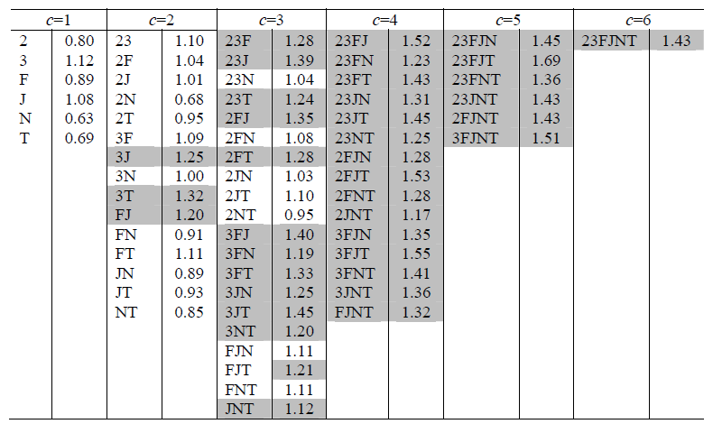
Combining Molecular Similarity Measures
Mean number of actives found in the ten nearest neighbors when combining various numbers, c, of different similarity measures for searches of the dataset. The shading indicates a fused result at least as good as the best original similarity measure.
Ref: Ginn, C.M.R., Willett, P. and Bradshaw, J. (2000) Combination of molecular similarity measures using data fusion, Perspectives in Drug Discovery and Design, Volume 20 (1), pp. 1-16.

Slide 9
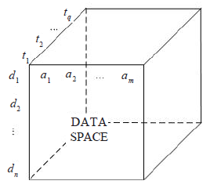
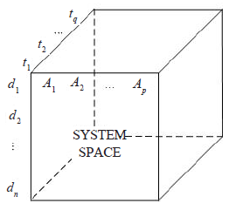
(B) The Method
1. Different methods / systems are appropriate for different features / attributes / indicators / cues and different temporal traces.
2. Different features / attributes / indicators / cues may use different kinds of measurements.
3. Different methods/systems may be good for the same problem with different data sets generated from different information sources/experiments.
4. Different methods/systems may be good for the same problem with the same data sets generated or collected from different devices/sources.
Rationale for Combinatorial Fusion Analysis (CFA)
Data space G(n, m, q)
System space H(n, p, q)

Slide 10
Multiple Scoring Systems (MSS)
  Multiple scoring systems A₁, A₂,…, A_{p} on the set .
  Score function, rank function, and rank/score function of system A:
  s_{A} , s_{A} → r_{A}, by sorting s_{A}, r_{A} → f_{A}?
  Score combination and rank combination:
  e.g. :Scoring Systems A, B: SC(A,B) = C, RC(A,B) = D
  Performance evaluation (criteria) : P(A), P(B), etc.
  Diversity measure: Diversity between A and B, d(A, B), can be measured as d(s_{A}, s_{B}), d(r_{A}, r_{B}), or d(f_{A}, f_{B}).
  Four main questions:
  (1) When is P(C) or P(D) greater than or equal to the best of P(A) and P(B)?
  (2) When is P(D) greater than or equal to P(C)?
  (3) What is the “best” number p in order to combine variables v₁, v₂,…, v_{p} or to fuse systems A₁, A₂,…, A_{p} ?
  (4) How to combine (or fuse) these p systems (or variables)?

Slide 11
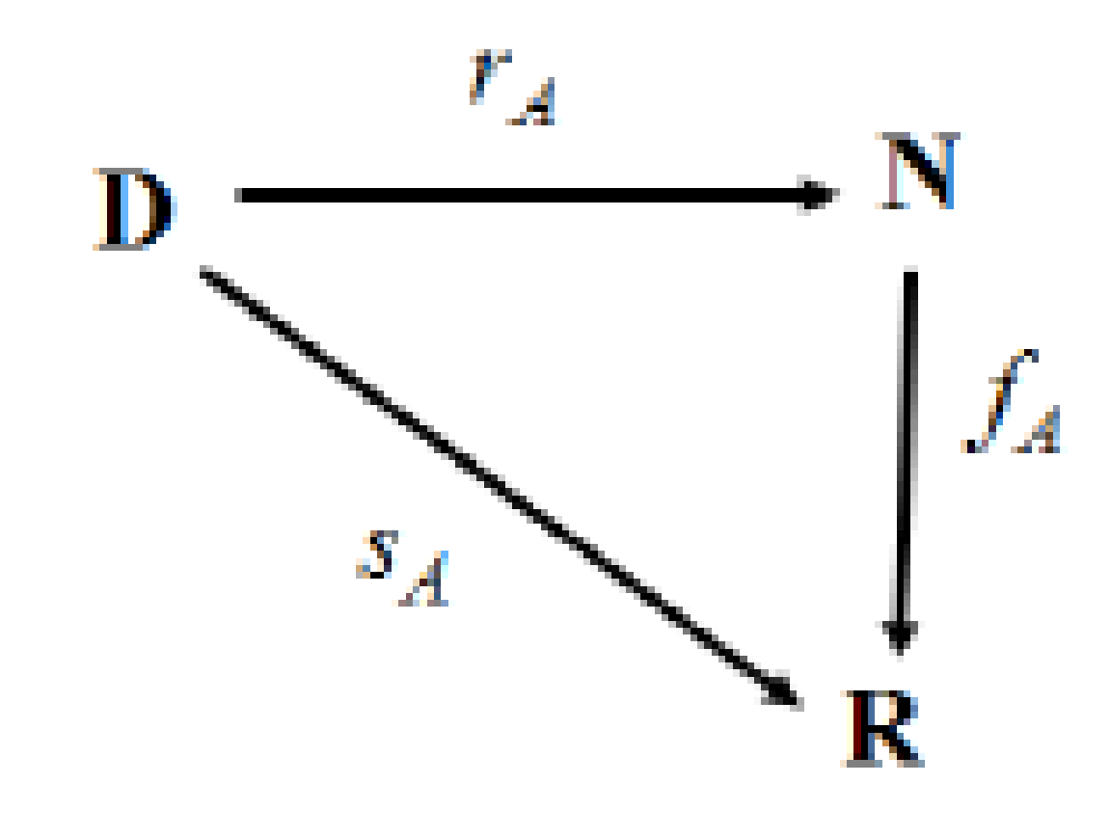
The Rank Score Characteristic Function
= set of classes, documents, forecasts, price ranges
with |D| = n.
N= the set {1,2,….,n}
R= a set of real numbers
Rank score characteristic function f: N-> R
f(i)=(s o r⁻¹) (i)
=s (r⁻¹(i))
Ref: Hsu, D.F., Kristal, B.S., Schweikert, C. Rank-Score Characteristics (RSC) Function and Cognitive Diversity. Brain Informatics 2010, Lecture Notes In Artificial Intelligence, (2010), pp. 42-54.
Ref: Hsu, D.F., Chung, Y.S. and Kristal B.S.; Combinatorial fusion analysis: methods and practice of combining multiple scoring systems, in : H. H. Hsu (Ed.), Advanced Data Mining Technologies in Bioinformatics, Odeal Group, (2006), pp. 32-62.

Slide 12
RSC Functions and Cognitive Diversity
100
80
60
40
20
f_{C}
Score
f_{A}
f_{B}
1 5 10 15 20
Rank
Three RSC functions: f_{A}, f_{B} and f_{C}
Cognitive Diversity between A and B = d(f_{A}, f_{B})

Slide 13
How to compute The RSC Function ?
Scoring system A
D | Score function s_{A}:D→R | Rank function r_{A}:D→N |  | RSC function f_{A}:N→R
d₁ | 3 | 10 |  | 1 | 10
d₂ | 8.2 | 3 |  | 2 | 9.8
d₃ | 7 | 4 |  | 3 | 8.2
d₄ | 4.6 | 7 |  | 4 | 7
d₅ | 4 | 8 |  | 5 | 5.4
d₆ | 10 | 1 |  | 6 | 5
d₇ | 9.8 | 2 |  | 7 | 4.6
d₈ | 3.3 | 9 |  | 8 | 4
d₉ | 1 | 12 |  | 9 | 3.3
d₁₀ | 2.5 | 11 |  | 10 | 3
d₁₁ | 5 | 6
 |  |  |  | 11 | 2.5
d₁₂ | 5.4 | 5 |  | 12 | 1
The RSC function can be computed efficiently:
Sorting the score value by using
its rank value as the key.

Slide 14
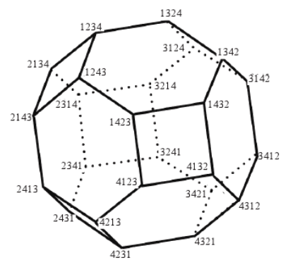
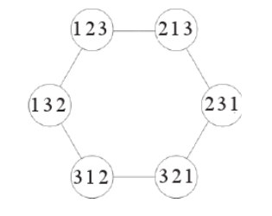
CFA and the rank space Symmetric Group S_{n}
A rank function r_{A} of the scoring system A on D, |D| = n, can be viewed as a permutation of N = [1,n] and is one of the n! elements in the symmetric group S_{n}.
Metrics between two permutations in S_{n} have been used in various applications: Footrule, Spearman’s rank correlation, Hamming distance, Kendall’s tau, Ceyley distance, and Ulam distance.
Schematic diagram of the permutation vectors and rank vectors for n=3
Sample space of permutations of 1234. The graph has 24 vertices, 36 edges, 6 square faces and 8 hexagonal faces.
Ref: Diaconis, P.; Group Representations in Probability and Statistics, Lecture Note-Monograph Series V.11, Institute of Mathematical Statistics, 1988.
Ref: McCullagh, P.; Models on spheres and models for permutations, In Probability Models and Statistical Analyses for Ranking Data, Springer Lecture Notes 80, (1993), pp. 278-283.
Ref: Ibraev, U., Ng, K.B., and Kantor, P. B. ; Exploration of a geometric model of data fusion, ASIST 2002, p. 124-129.

Slide 15
The CFA Approach
The CFA framework, combinatorial fusion on multiple scoring systems, represents each scoring system A as three functions: score function s_{A}, rank function r_{A}, and rank-score characteristic (RSC) function f_{A}. The CFA approach consists of both exploration and exploitation.
Exploration:
Explore a variety of scoring systems (variables or systems). Use performance (in supervised learning case) and /or cognitive diversity (or correlation) to select the “best” or an “optimal” set of p systems.
Exploitation:
Combine these p systems using a variety of methods. Exploit the asymmetry between score function and rank function using the rank-score characteristic (RSC) function.

Slide 16
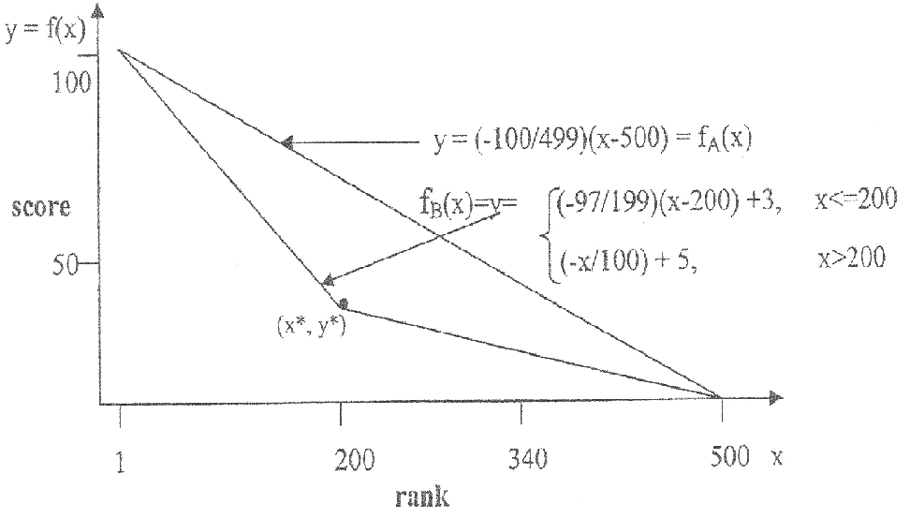
(C) The Practices
(1) Retrieval-related domain
Rank combination vs. score combination
Ref: Hsu, D.F., Taksa, I. Information Retrieval 8(3), pp. 449–480, 2005.

Slide 17
The Performance of Thymidine Kinase (TK)
Structure-based virtual screening
Combinations of different methods improve the performances
The combination of B and D works best on thymidine kinase (TK)
Ref: Yang et al. Journal of Chemical Information and Modeling. 45, pp. 1134-1146, 2005.

Slide 18
The Performance of Dihydrofolate Reductase (DHFR)
Structure-based virtual screening
Combinations of different methods improve the performances
The combination of B and D works best on dihydrofolate reductase (DHFR)

Slide 19
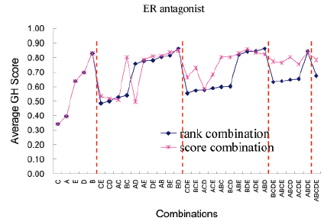
The Performance of ER-Antagonist Receptor (ER)
Structure-based virtual screening
Combinations of different methods improve the performances
The combination of B and D works best on ER-antagonist receptor (ER)

Slide 20
The Performance of ER-Agonist Receptor (ERA)
Structure-based virtual screening
Combinations of different methods improve the performances
The combination of B and D works best on ER-agonist receptor (ERA)

Slide 21
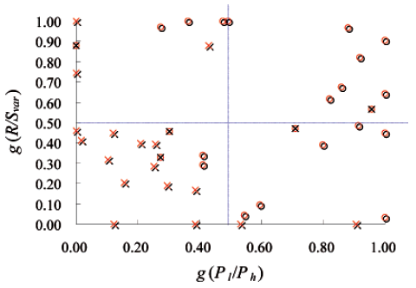
Structure-based virtual screening

Slide 22

22
(c)(2) Cognition-related domain
We use three features:
  Color – average normalized RGB color.
  Position – location of the target region centroid
  Shape – area of the target region.
Target tracking and computer vision
Color
Position
+
Shape
Ref: Lyons, D.M., Hsu, D.F. Information Fusion 10(2): pp. 124-136, 2009.

Slide 23
23
Target tracking and computer vision
Experimental Results
Seq. | RUN2 Score fusion MSSD Avg. MSSD Var. |  | RUN3 Score and rank fusion using ground truth to select MSSD Avg. MSSD Var. |  | RUN4 Score and rank fusion using rank-score function to select MSSD Avg. MSSD Var.
1 | 1537.22 | 694.47 | 1536.65 | 695.49 | 1536.9 | 694.24
2 | 816.53 | 8732.13 | 723.13 | 3512.19 | 723.09 | 3511.41
3 | 108.89 | 61.61 | 108.34 | 60.58 | 108.89 | 61.61
4 | 23.14 | 2.39 | 23.04 | 2.30 | 23.14 | 2.39
5 | 334.13 | 120.11 | 332.89 | 119.39 | 334.138 | 120.11
6 | 96.40 | 119.22 | 66.9 | 12.91 | 67.28 | 13.38
7 | 577.78 | 201.29 | 548.6 | 127.78 | 577.78 | 201.29
8 | 538.35 | 605.84 | 500.9 | 57.91 | 534.3 | 602.85
9 | 143.04 | 339.73 | 140.18 | 297.07 | 142.33 | 294.94
10 | 260.24 | 86.65 | 252.17 | 84.99 | 258.64 | 85.94
11 | 520.13 | 2991.17 | 440.98 | 2544.69 | 470.27 | 2791.62
12 | 1188.81 | 745.01 | 1188.81 | 745.01 | 1188.81 | 745.01
RUN4 is as good or better (highlighted in gray) than RUN2 in all cases
RUN4 is, predictably, not always as good as RUN3 (‘best case’).
Note: Lower MSSD implies better tracking performance.

Slide 24
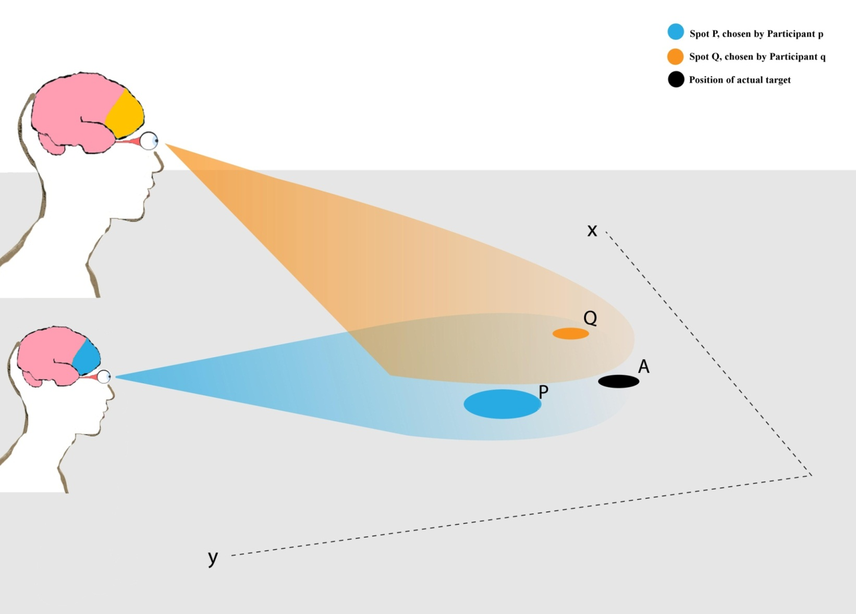
24
Combining two visual cognitive systems
Ref: C. McMunn-Coffran, E. Paolercio, Y. Fei, D. F. Hsu: Combining multiple visual cognition systems for joint decision-making using combinatorial fusion. ICCI*CC, pp. 313-322, 2012.

Slide 25
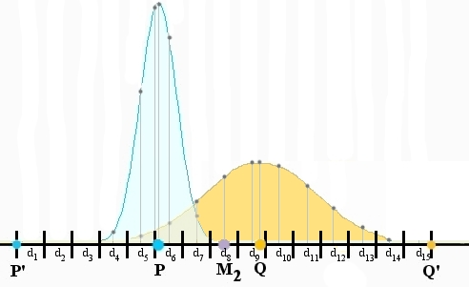
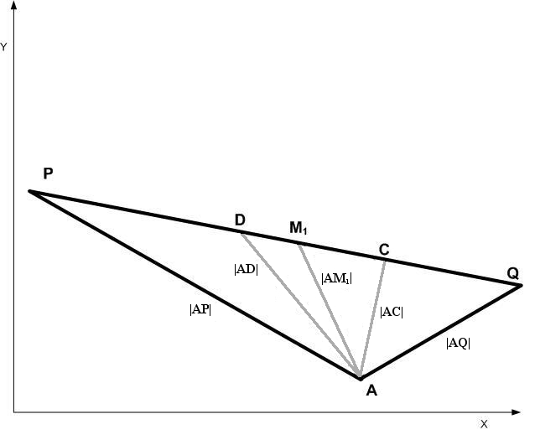
25
Combining two visual cognitive systems

Slide 26
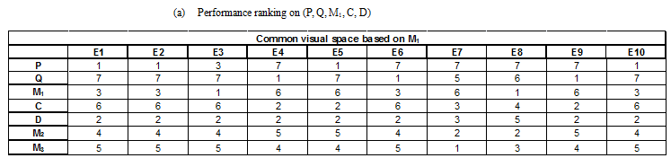
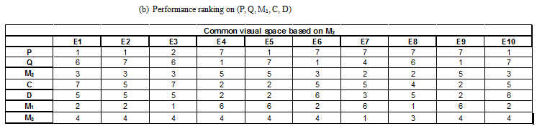
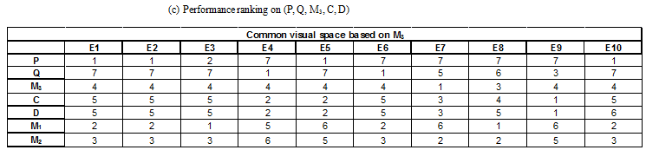
26
Combining two visual cognitive systems
Performance ranking of P, Q, M_{i,} C, and D on scoring system P and Q using 127 intervals on the common visual space based on statistical mean: (a) M₁, (b) M₂, and (c) M₃ for each experiment E_{i}, i=1, 2, ..., 10.

Slide 27
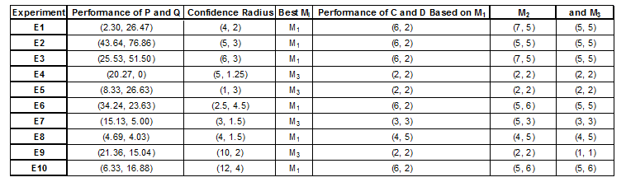
27
Combining two visual cognitive systems
Comparison between performance and confidence radius of (P, Q), best performance of M_{i}, and performance ranking of C and D, (C, D), when using common visual space based on M₁, M₂, and M₃.

Slide 28
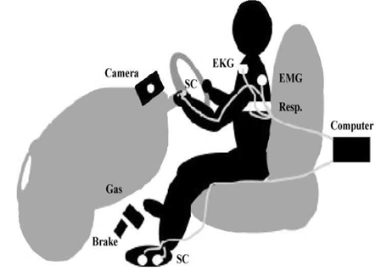
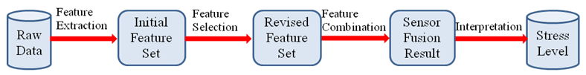
28
Feature selection and combination for stress identification
Procedure of multiple sensor feature selection and combination
Placement of sensors in driving stress identification
Ref: J. A. Healy and R. W. Picard; Detecting stress during real world driving tasks using physiological sensors, IEEE Transaction on Intelligent Transportation System, 6(2), pp. 156-166, 2005.
Ref: Y. Deng, D. F. Hsu, Z. Wu and C. Chu; Feature selection and combination for stress identification using correlation and diversity, I-SPAN’ 12, 2012.

Slide 29
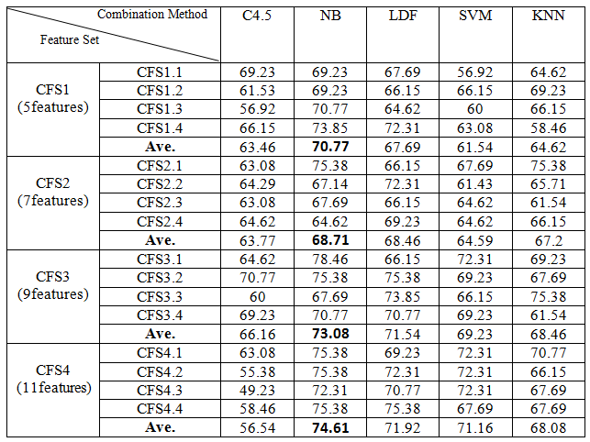
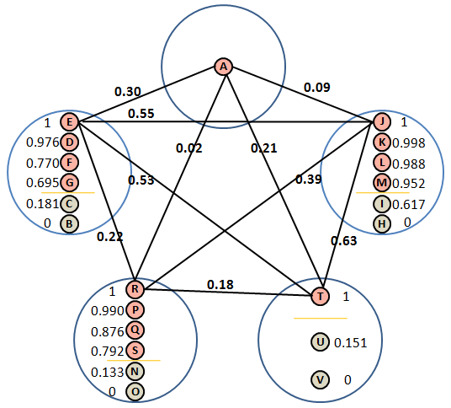
29
Feature selection and combination for stress identification
CFS schematic diagram
Feature combination results for feature sets
obtained by CFS

Slide 30
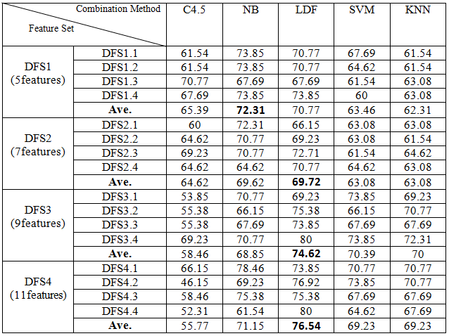
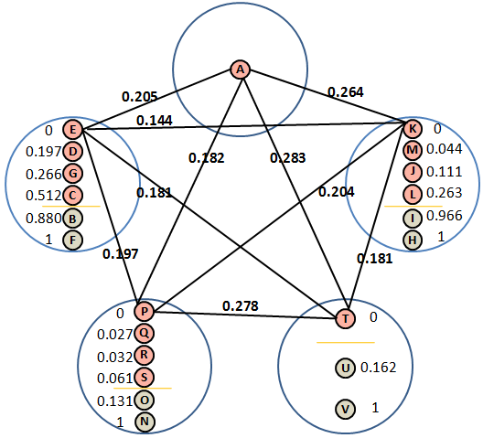
30
Feature selection and combination for stress identification
DFS schematic diagram
Feature combination results for feature sets
obtained by DFS

Slide 31



(c)(3) Other domains
31
In regression, Krogh and Vedelsby (1995):
Ensemble generalization error:
Weighted average of generalization errors:
Weighted average of ambiguities:
In classification, Chung, Hsu, and Tang (2007):
Ref: Chung et al in Proceedings of 7th International Workshop on Multiple Classifier Systems, LNCS, Springer Verlag, 2007.

Slide 32
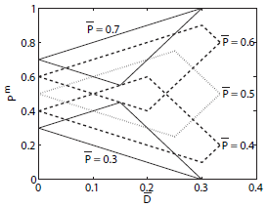

32
Classifier Ensemble

Slide 33
33
On-line Learning
GOAL: The goal is to learn a linear combination of the classifier predictions that maximizes the accuracy on future instances.
* Sub-expert conversion
* Hypothesis voting
* Instance recycling
Ref: Mesterharm, C., Hsu, D.F. The 11th International Conference on Information Fusion, pp. 1117-1124, 2008.

Slide 34
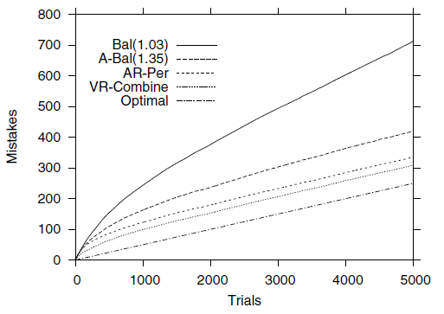
34
On-line Learning
Mistake curves on majority learning problem with r = 10, k = 5,
n = 20, and p = .05

Slide 35
35
(D) Review and Remarks
(1) When are two systems better than one and why?
Ref: A. Koriat; When are two heads better than one and why? Science, April 2012.
Ref: C. McMunn-Coffran, E. Paolercio, Y. Fei, D. F. Hsu: Combining multiple visual
cognition systems for joint decision-making using combinatorial fusion. ICCI*CC,
pp. 313-322, 2012.
(2) When is rank combination better than score combination?
Ref:Hsu and Taksa; Comparing Rank and Score Combination Methods for Data Fusion in Information Retrieval. Inf. Retr. 8(3): 449-480 (2005)
(3) How to “best” measure similarity between two systems?
Ref: Hsu, D.F., Chung, Y.S. and Kristal, B.S.; Combinatorial fusion analysis: methods
and practice of combining multiple scoring systems, in : H. H. Hsu (Ed.), Advanced
Data Mining Technologies in Bioinformatics, Odeal Group, (2006), pp. 32-62.
Ref: Hsu, D. F., Kristal, B. S. and Schweikert, S: Rank-Score Characteristics (RSC)
Function and Cognitive Diversity. Brain Informatics 2010: 42-54
(4) What is the “best” combination method?
A variety of good combination methods including Max, Min, average, weighted combination,
voting, POSet, U-statistics, HMM, combinatorial fusion, C4.5, kNN, SVM, NB, boosting, and
rank aggregate.

