Slide 1


Publishing Microdata with a Robust Privacy Guarantee
Jianneng Cao, National University of Singapore, now at I²R
Panagiotis Karras, Rutgers University

Slide 2
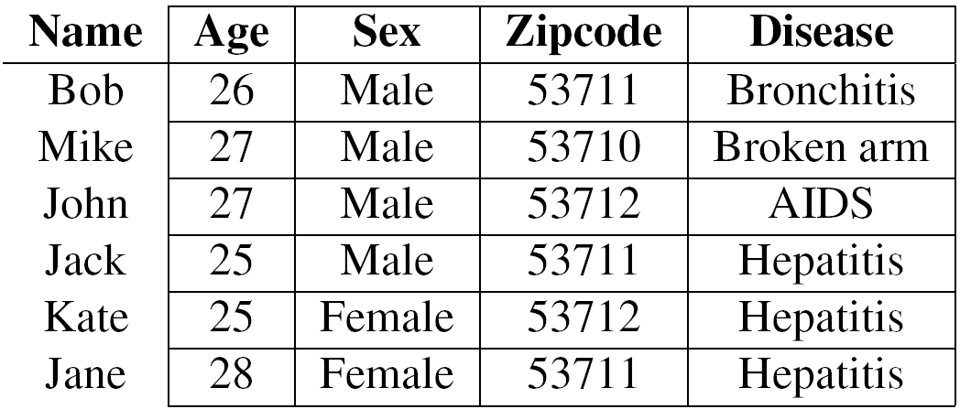
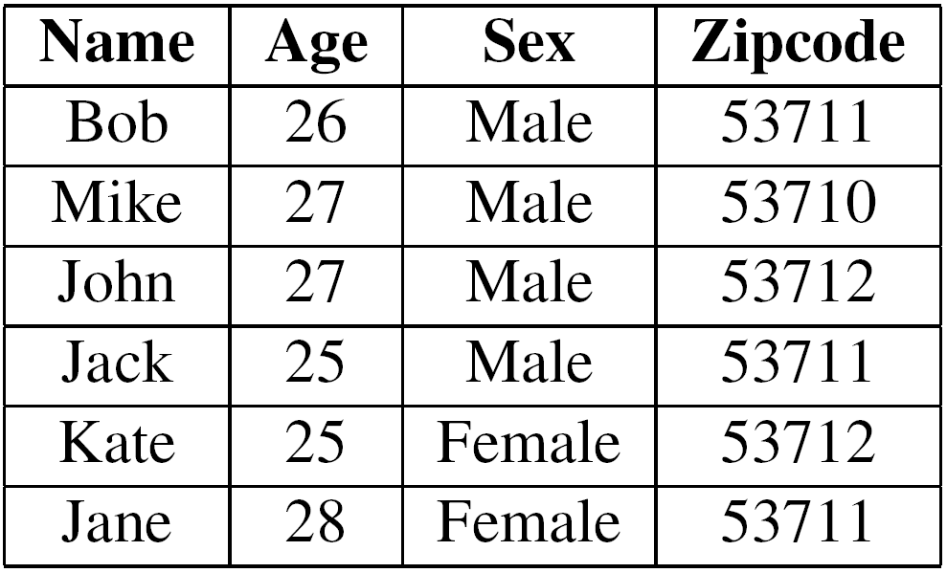
Background: QI & SA
Table 1. Microdata about patients
Table 2. Voter registration list
Quasi-identifier (QI): Non-sensitive attribute set like {Age, Sex, Zipcode}, linkable to external data to re-identify individuals
Sensitive attribute (SA): Sensitive attribute like Disease, undesirable to be linked to an individual

Slide 3
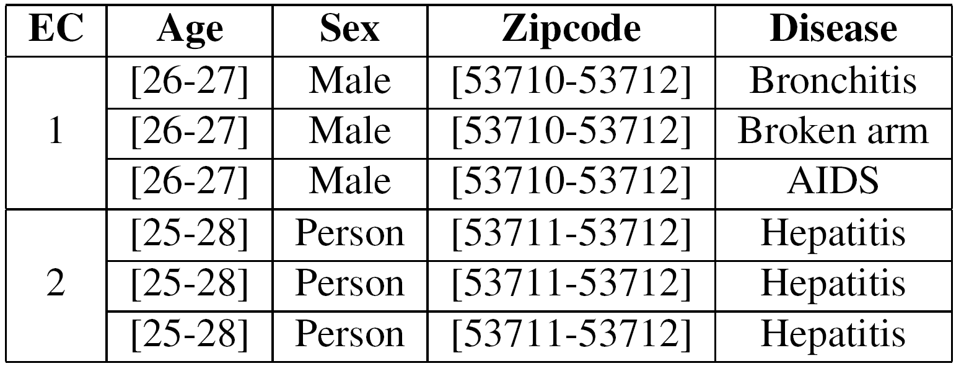
Background: EC & information loss
Equivalence class (EC): A group of records with the same QI values
Table 3. Anonymized data in Table 1
QI space
Sex
An EC
  Minimum bounding box (MBR)
  Smaller MBR; less distortion
EC 2
Female
Male
25
28
53711
Age
53712
Zipcode

Slide 4
Background: k-anonymity & l-diversity
Equivalence class (EC): A group of records with the same QI values
Table 3. Anonymized data in Table 1
k-anonymity: An EC should contain at least k tuples
  Table 3 is 3-anonymous
  Prone to homogeneity attack
l-diversity: … at least l “well represented” SA values

Slide 5


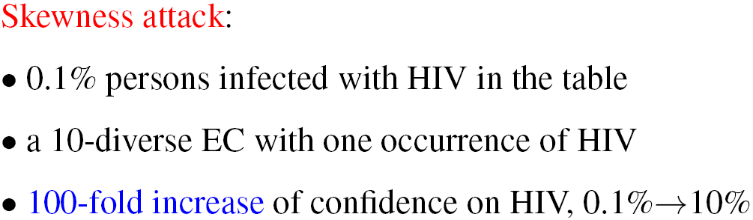
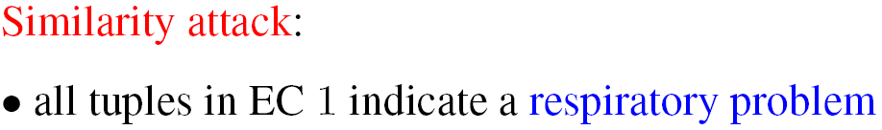
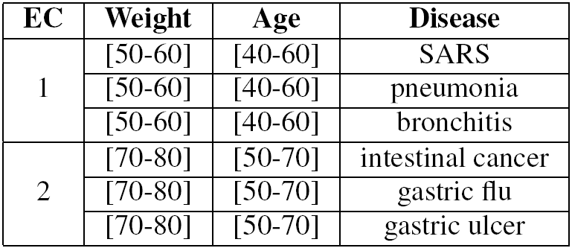
Background: limitations of l-diversity
(High diversity!)
l-diversity does not consider unavoidable background knowledge: SA distribution in whole table
Table 4. A 3-diverse table

Slide 6
Background: t-closenesss and EMD
t-closeness (the most recent privacy model) [1] :
  SA = {v₁, v₂, …, v_{m}}
  P=(p₁, p₂, …, p_{m}): SA distribution in the whole table
    Prior knowledge
  Q=(q₁, q₂, …, q_{m}): SA distribution in an EC
    Posterior knowledge
  Distance (P, Q) ≤ t
    Information gain after seeing an EC
Earth Mover’s Distance (EMD):
  P, set of “holes”
  Q, piles of “earth”
  EMD is the minimum work to fill P by Q
[1] Li et al. t-closeness: Privacy beyond k-anonymity and l-diversity. ICDE, 2007

Slide 7
Limitations of t-closeness
Relative individual distances between p_{j} and q_{j} are not clear.
t-closeness cannot translate t into clear privacy guarantee

Slide 8







t-closeness instantiation, EMD [1]
Case 1:
Case 2:
By EMD, both cases assume the same privacy
However
[1] Li et al. t-closeness: Privacy beyond k-anonymity and l-diversity. ICDE, 2007.

Slide 9
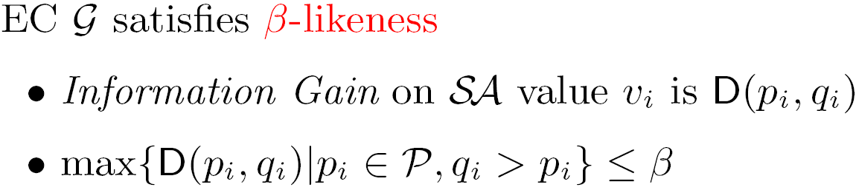
β-likeness
q_{i} ≤ p_{i}
Lowers correlation between a person and p_{i}
Privacy enhanced
We focus on q_{i} > p_{i}

Slide 10




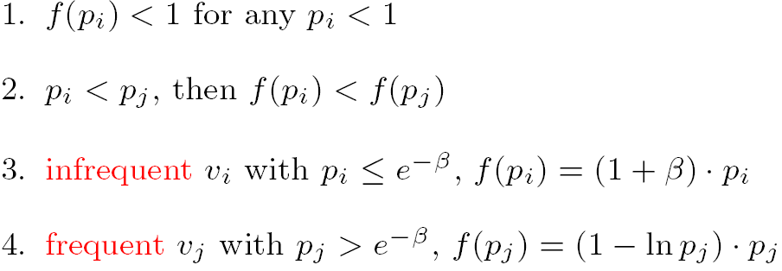
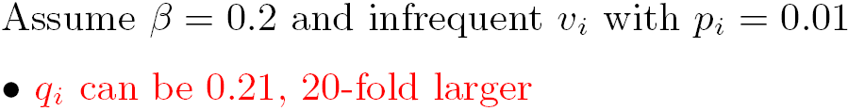

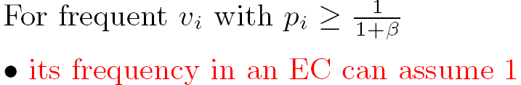

Distance function
Attempt 1:
Attempt 2:
Attempt 3:

Slide 11
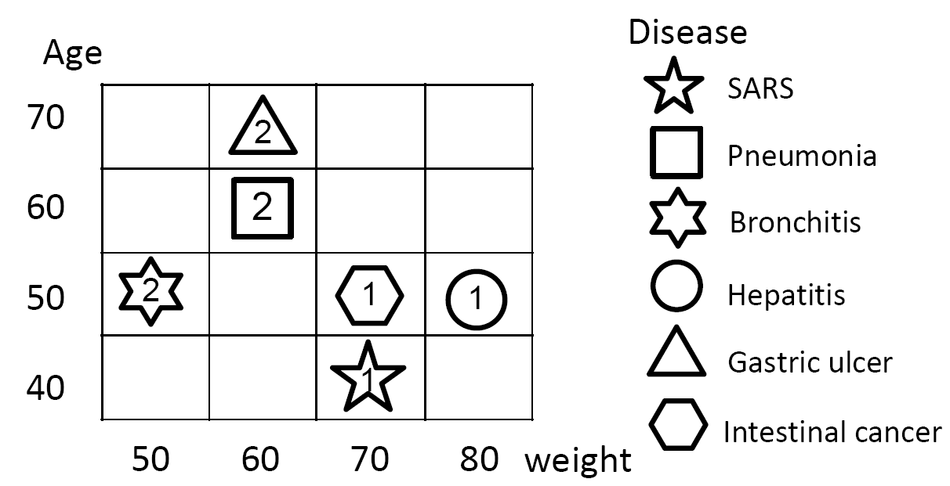
An observation
B₁
B₂
B₃
0-likeness: 1 EC with all tuples
  Low information quality
1-likeness: 2 ECs
  Higher information quality
  Higher privacy loss for β ≥ 1

Slide 12






BUREL
3/19 +3/19<f(3/19)≈0.45
β = 2
B₁
B₂
B₃
2 SARS
3 Pneumonia
3 Bronchitis
3 Hepatitis
4 Gastric ulcer
4 Intestinal cancer
2/19 +3/19<f(2/19)≈0.31
x₁
x₂
x₃
4/19 +4/19<f(4/19)≈0.54
Tuples drawn proportionally to bucket sizes
Step 1: Bucketization
Step 2: Reallocation
Determines # of tuples each EC gets from each bucket in top-down splitting process approximately obeying proportionality; terminates when eligibility violated
Step 3: Populate ECs
Process guided by information loss considerations
Build partition satisfying this condition by DP

Slide 13
More material in paper
Perturbation-based scheme.
Arguments about resistance to attacks.

Slide 14
Summary of experiments
CENSUS data set:
  Real, 500,000 tuples, 5 QI attributes, 1 SA
SABRE & tMondrian [1]:
  Under same t-closeness (info loss)
  BUREL: higher privacy in terms of β-likeness
Benchmarks
  Extended from [2]
  BUREL: best info quality & fastest
[1] Li et al. Closeness: A new privacy measure for data publishing. TKDE, 2010
[2] LeFevre et al. Mondrian Multidimensional K-Anonymity. ICDE 2006

Slide 15
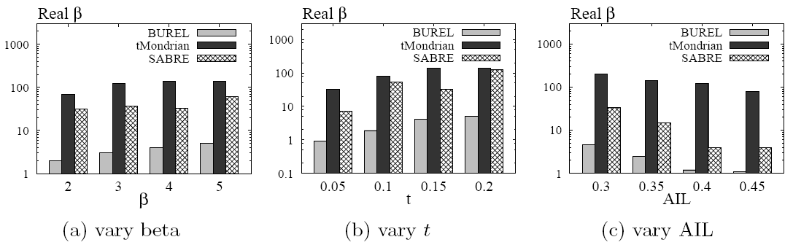
Figure. Comparison to t-closeness
(a) Given β and dataset DB
  BUREL(DB, β)=DB_{β}, following t_{β}-closeness
  All schemes are t_{β}-closeness
  Comparison in terms of β-likeness
(c) Given AIL (average information loss) and DB
  All schemes have same AIL
  Comparison in terms of β-likeness
(b) Given t and DB
  BUREL finds β_{t} by binary search
  BUREL(DB, β_{t}) follows t-closeness
  All schemes are t-closeness
  Comparison in terms of β-likeness

Slide 16
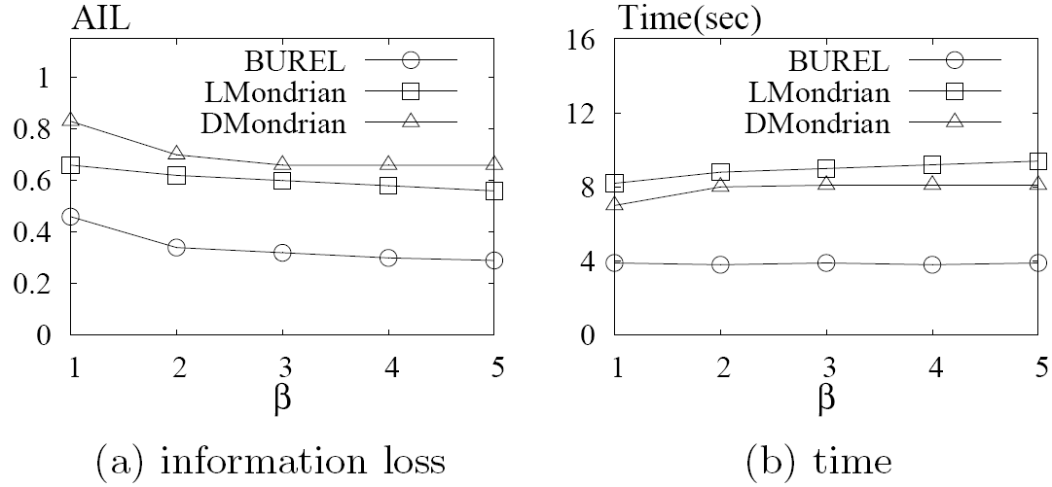
LMondrian: extension of Mondrian for β-likeness
DMondrian: extension of δ-disclosure to support β-likeness
BUREL clearly outperforms the others

Slide 17
Conclusion
Robust model for microdata anonymization.
Comprehensible privacy guarantee.
Can withstand attacks proposed in previous research.

Slide 18

Thank you! Questions?

Slide 19


t-closeness instantiation, KL/JS-divergence
Case 1:
Case 2:
Case 1: 0.0290 (0.0073)
Case 2: 0.0133 (0.0038)
Privacy: Case 2 is higher than Case 1
But
[1] D. Rebollo-Monedero et al. From t-closeness-like privacy to postrandomization via information theory. TKDE 2010.
[2] N. Li et al. Closeness: A new privacy measure for data publishing. TKDE 2010.

Slide 20
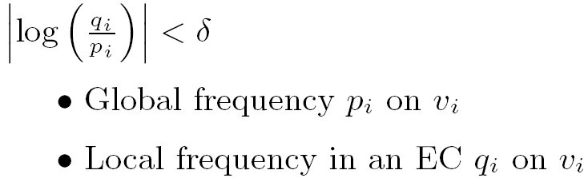
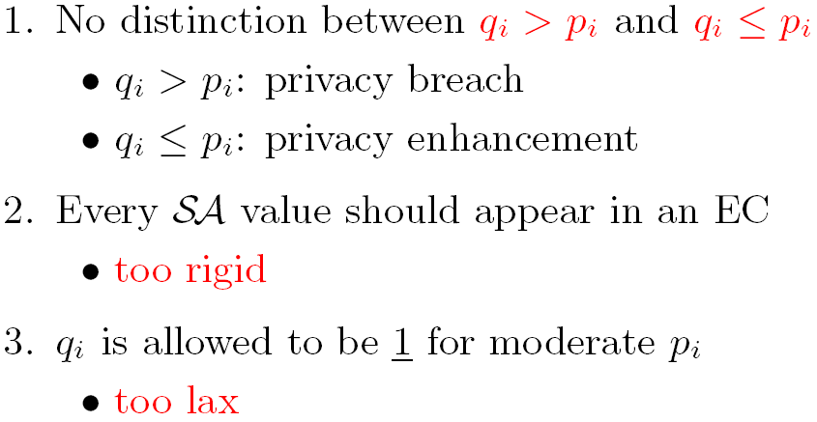
δ-disclosure [1]
Clear privacy guarantee defined on individual SA values
But:
[1] J. Brickell et al. The cost of privacy: destruction of data-mining utility in anonymized data publishing. In KDD, 2008.

