Slide 1
DIMACS Workshop
on
Perspectives and Future Directions in Systems and Control Theory
Rutgers
May 25, 2011
TexPoint fonts used in EMF.
Read the TexPoint manual before you delete this box.: AAAAAAAAAAAAA

Slide 2
DIMACS Workshop
on
Perspectives and Future Directions in Systems and Control Theory
你好
Good Day!
A. S. Morse
Yale University
Rutgers
May 25, 2011
TexPoint fonts used in EMF.
Read the TexPoint manual before you delete this box.: AAAAAAAAAAAAA

Slide 3
DIMACS Workshop
on
Perspectives and Future Directions in Systems and Control Theory
Deterministic Distributed Averaging
Deterministic Gossiping
A. S. Morse
Yale University
Rutgers
May 25, 2011
TexPoint fonts used in EMF.
Read the TexPoint manual before you delete this box.: AAAAAAAAAAAA

Slide 4


Dedicated to
Eduardo Sontag

Slide 5









Oren Mangoubi
Brian Anderson
Ali Jadbabaie
Ming Cao
Jie {Archer} Lin
Shaoshuai Mou
Fenghua He
Ji Liu
Changbin {Brad} Yu

Slide 6
Prior work by
Boyd, Ghosh, Prabhakar, Shan
Cao, Spielman, Yeh
Muthukrishnan, Ghosh, Schultz
Olshevsky, Tsitsiklis
Liu, Anderson
Mehyar, Spanos, Pongsajapan, Low, Murray
Benezit, Blondel, Thiran, Tsitsiklis, Vetterli
and many others

Slide 7
ROADMAP
Consensus and averaging
Linear iterations
Gossiping
Double linear iterations

Slide 9


CRAIG REYNOLDS - 1987
BOIDS
The Lion King

Slide 10
Consensus Process
Consider a group of n agents labeled 1 to n
The groups’ neighbor graph N is an undirected, connected graph with vertices
labeled 1,2,...,n.
1
2
3
4
5
7
6
The neighbors of agent i, correspond to those vertices which are adjacent to vertex i
Each agent i controls a real, scalar-valued, time-dependent, quantity x_{i} called an
agreement variable.
The goal of a consensus process is for all n agents to ultimately reach a consensus by
adjusting their individual agreement variables to a common value.
This is to be accomplished over time by sharing information among neighbors in
a distributed manner.

Slide 11
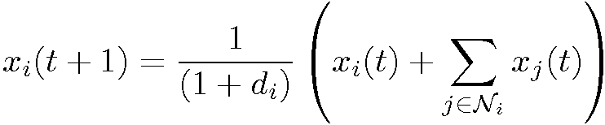
Consensus Process
A consensus process is a recursive process which evolves with respect to a discrete
time scale.
In a standard consensus process, agent i sets the value of its agreement variable at
time t +1 equal to the average of the current value of its own agreement variable
and the current values of its neighbors’ agreement variables.
N_{i} = set of indices of agent i⁰s neighbors.
d_{i} = number of indices in N_{i}
Average at time t of values of agreement variables of agent i and the neighbors
of agent i.

Slide 12
Averaging Process
An averaging process is a consensus process in which the common value to
which each agreement variable is suppose to converge, is the average of the initial
values of all agreement variables:
Application: distributed temperature calculation
Generalizations:
Time-varying case - N depends on time
Integer-valued case - x_{i}(t) is to be integer-value
Asynchronous case - each agent has its own clock
Implementation Issues:
How much network information does each agent need?
To what extent is the protocol robust?
Performance metrics:
Convergence rate
Number of transmissions needed
General Approach:
Probabilistic
Deterministic
Standing Assumption: N is a connected graph

Slide 13
ROADMAP
Consensus and averaging
Linear iterations
Gossiping
Double linear iterations

Slide 14
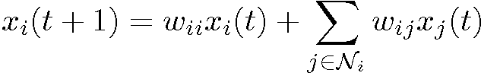
Linear Iteration
N_{i} = set of indices of agent i’s neighbors.
w _{j} = suitably defined weights
Want x(t) ! x_{avg}1
If A is a real n £ n matrix, then A^{t} converges to a rank one matrix of the form qp⁰
if and only if A has exactly one eigenvalue at value 1 and all remaining n -1
eigenvalues are strictly smaller than 1 in magnitude.
If A so converges, then Aq = q, A⁰p = p and p⁰q = 1.
Thus if W is such a matrix and then

Slide 15
x(t) ! x_{avg}1
iff W1 = 1, W⁰1 =1 and all n - 1 eigenvalues of W, except for W’s single eigenvalue
at value 1, have magnitudes less than 1.
Linear Iteration with Nonnegative Weights
A square matrix S is stochastic if it has
only nonnegative entries and if its
row sums all equal 1.
A square matrix S is doubly stochastic if it has
only nonnegative entries and if its row and
column sums all equal 1.
S1 = 1
S1 = 1 and S⁰1 = 1
||S||₁ = 1
Spectrum S contained in the closed unit circle
All eignvalue of value 1 have multiplicity 1
For the nonnegative weight case, x(t) converges to x_{avg}1 if and only if
W is doubly stochastic and its single eigenvalue at 1 has multiplicity 1.
How does one choose the w_{ij} ¸ 0 so that W has these properties?

Slide 16
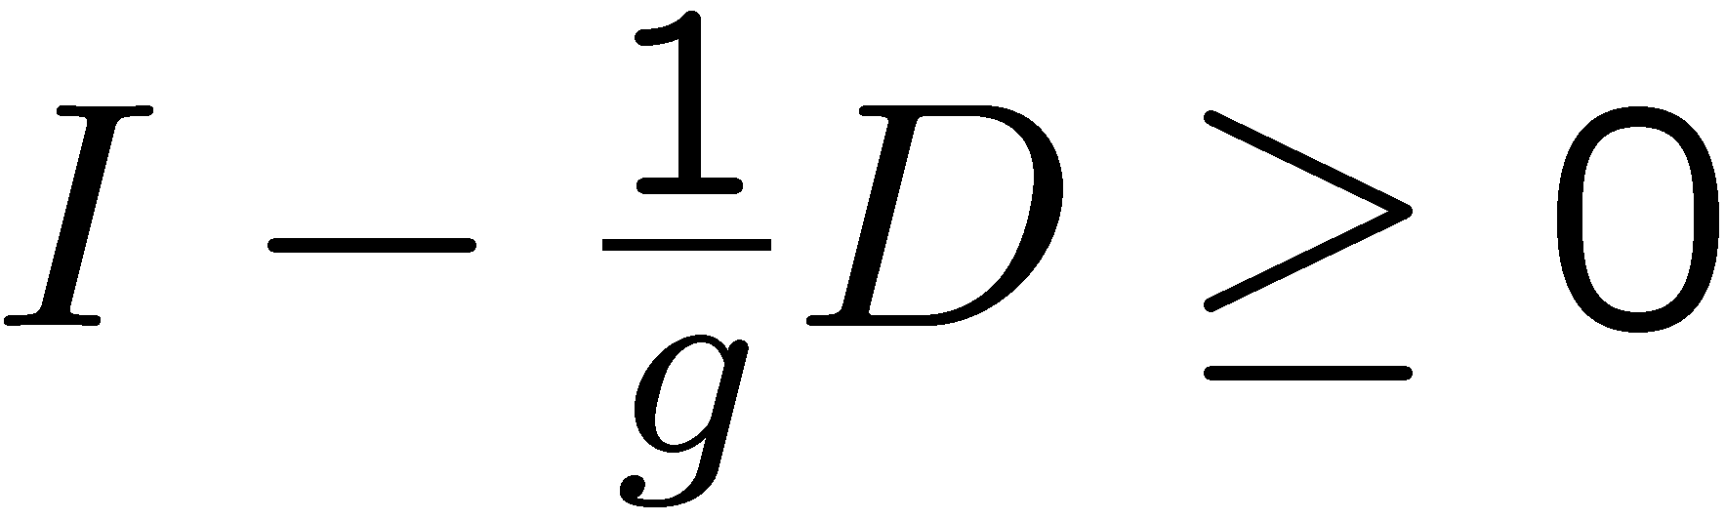
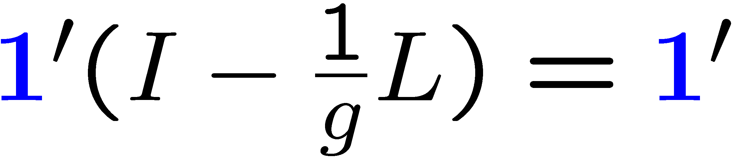
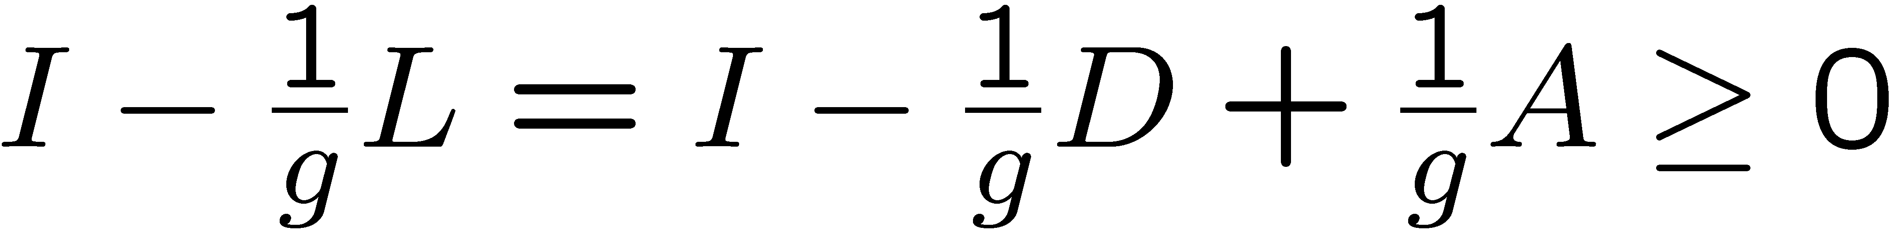
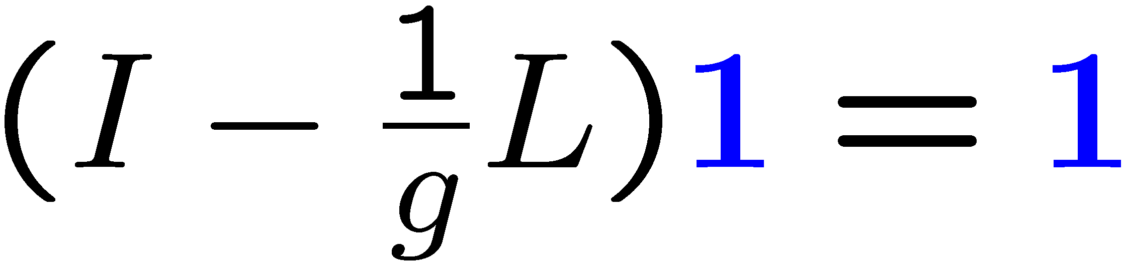
L = D - A
Adjacency matrix of N: matrix of ones and zeros
with a_{ij} = 1 if N has an edge between vertices i and j.
g > max {d₁,d₂ ,…d_{n}}
L1 = 0
doubly stochastic
single eigenvalue at 1
has multiplicity 1
The eigenvalue of L at 0 has multiplicity 1 because N is
connected
Each agent needs to know max {d₁,d₂ ,…d_{n}} to implement this

Slide 17
A Better Solution
{Boyd et al}
L = QQ’
Q is a -1,1,0 matrix with rows indexed by vertex labels in N and columns indexed by
edge labels such that q_{ij} = 1 if edge j is incident on vertex i, and -1 if edge i is
incident on vertex j and 0 otherwise.
I – Q¤ Q⁰
Metropolis Algorithm
Each agent needs to know the number of neighbors of each of its neighbors.
Total number of transmissions/iteration:

Slide 18
Agent i’s queue is a list q_i(t) of agent i’s neighbor labels.
Modification
Agent i’s preferred neighbor at time t, is that agent whose label is in the front of q(t).
M_{i}(t) = is the set of the label of agent i’s preferred neighbor together with the
labels of all neighbors who send agent i their agreement variables at time t.
m_{i}(t) = the number of labels in M_{i}(t)
Between times t and t+1 the following steps are carried out in order.
Agent i transmits its label i and x_{i}(t) to its current
preferred neighbor.
n transmissions
At the same time agent i receives the labels and agreement variable values of
those agents for whom agent i is their current preferred neighbor.
Agent i transmits m_{i}(t) and its current agreement variable value to each
neighbor with a label in M_{i}(t).
at most 2n transmissions
Agent i then moves the labels in M _{i}(t) to the end of its queue maintaining their relative order and updates as follows:
d_{avg} > 3
3n
nd_{avg}

Slide 19
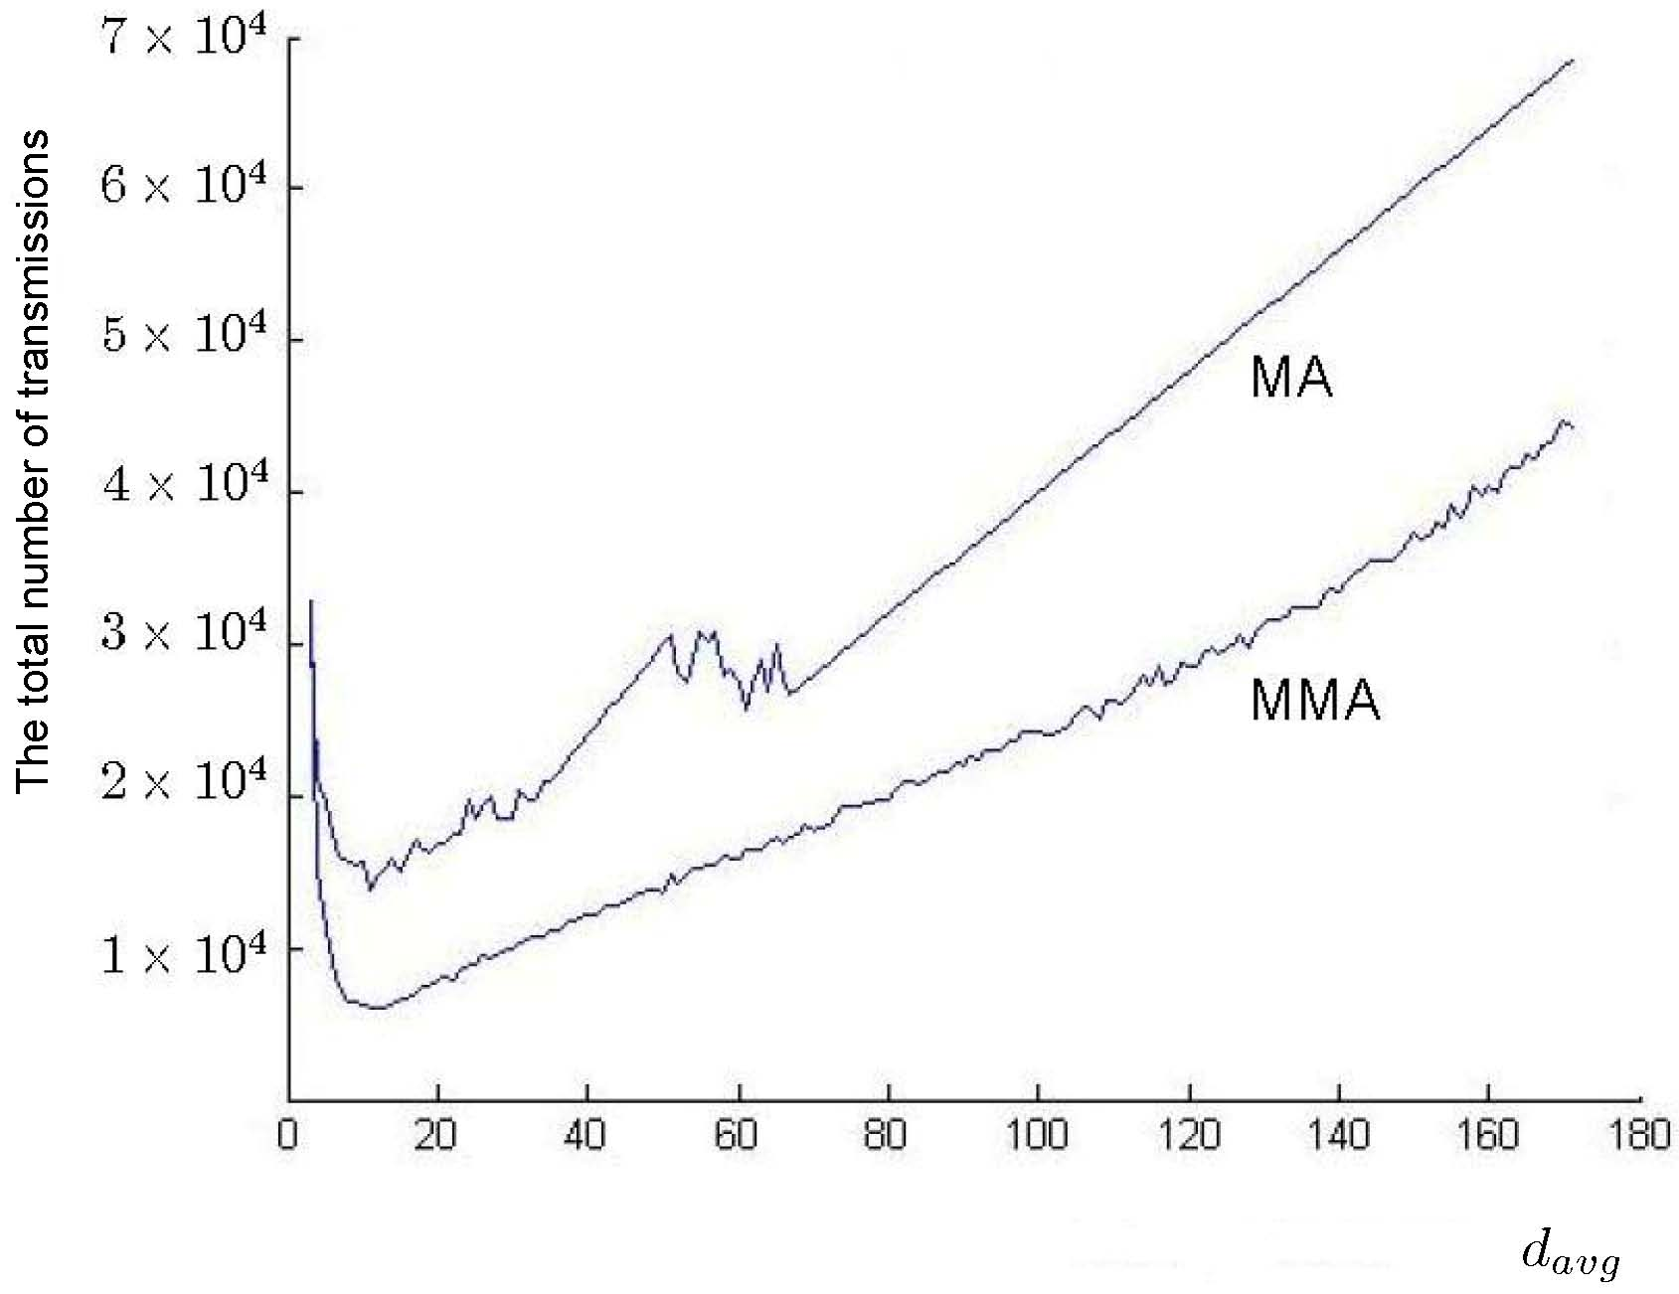
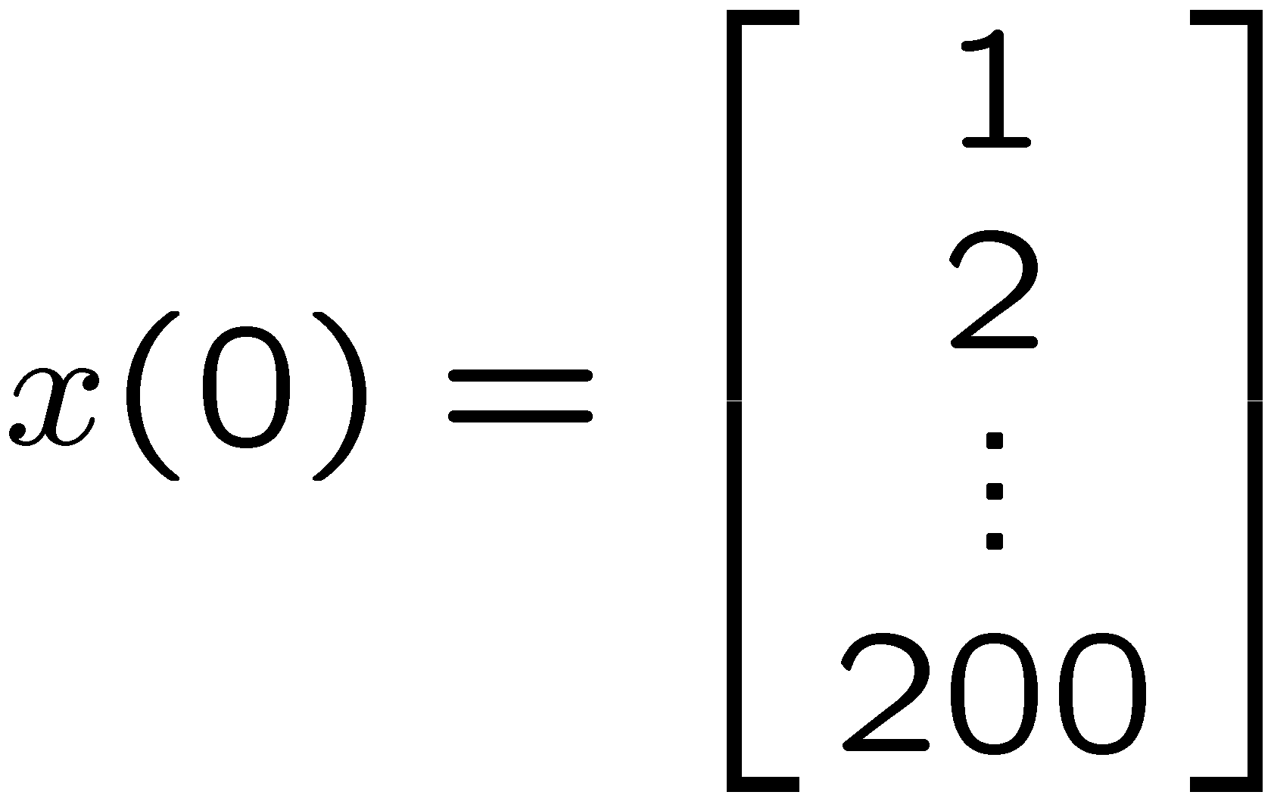
Metropolis Algorithm vs Modified Metropolis Algorithm
Randomly chosen graphs with 200 vertices.
10 random graphs for each average degree.

Slide 20
ROADMAP
Consensus and averaging
Linear iterations
Gossiping
Double linear iterations

Slide 21


Gossip Process
A gossip process is a consensus process in which at each clock time, each agent
is allowed to average its agreement variable with the agreement variable of at most
one of its neighbors.
The index of the neighbor of agent i which agent i gossips with at time t.
If agent i gossips with neighbor j at time t, then agent j must gossip with agent
i at time t.
This is called a gossip and is denoted by (i, j).
In the most commonly studied version of gossiping, the specific sequence of
gossips which occurs during a gossiping process is determined probabilistically.
In a deterministic gossiping process, the sequence of gossips which occurs is
determined by a pre-specified protocol.

Slide 22
Gossip Process
A gossip process is a consensus process in which at each clock time, each agent
is allowed to average its agreement variable with the agreement variable of at most
one of its neighbors.
1. The sum total of all agreement variables remains constant at all clock steps.
2. Thus if a consensus is reached in that all agreement variables reach the
same value, then this value must be the average of the initial values of all
gossip variables.
3. This is not the case for a standard consensus process.

Slide 23
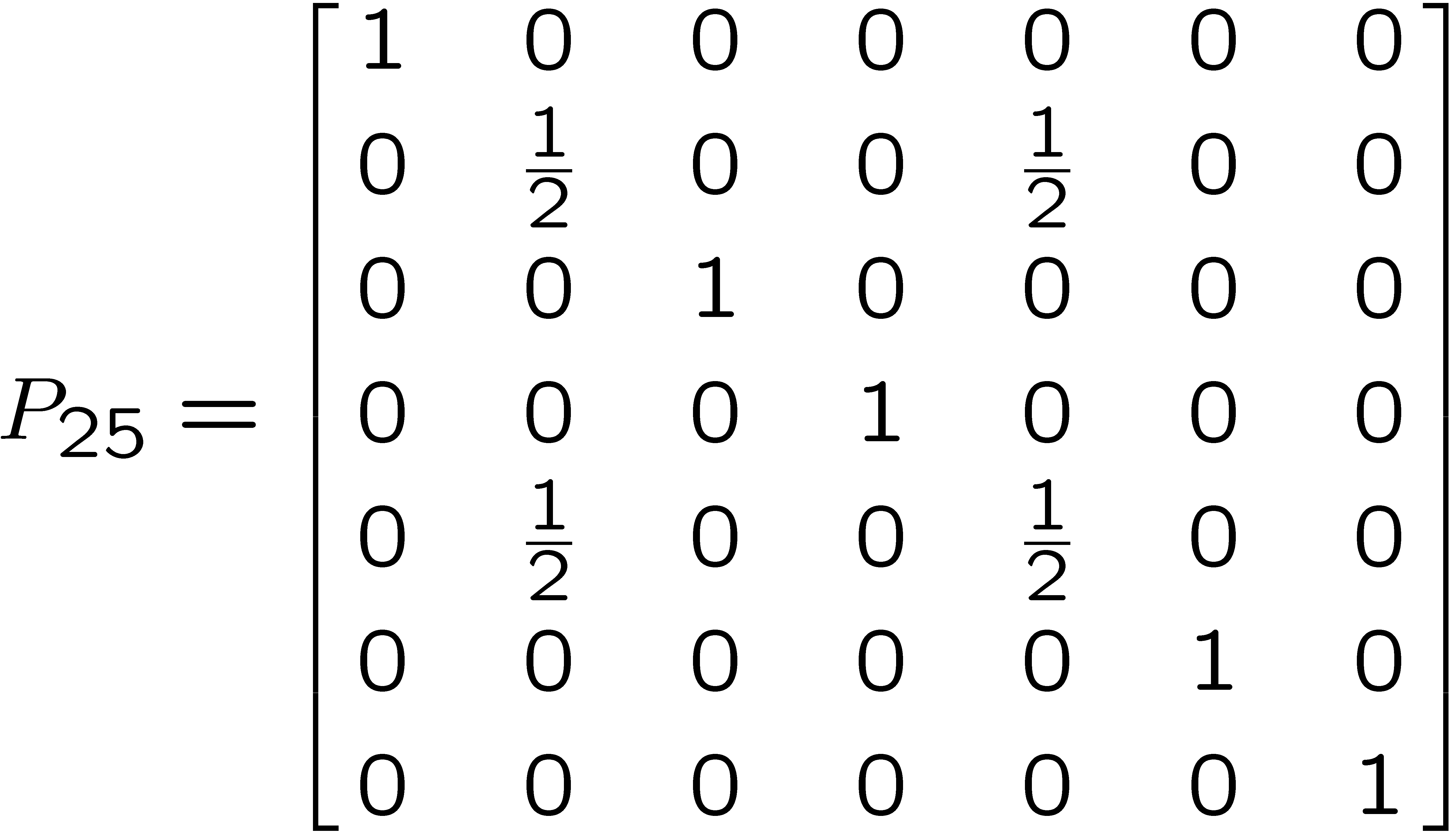
primitive gossip matrix P_{ij}
State Space Model
A gossip (i, j)
For n = 7, i = 2, j = 5
A doubly stochastic matrix

Slide 24
Periodic Gossiping
1
2
3
4
5
7
6
(5,7)
(5,6)
(3,2)
(3,5)
(3,4)
(1,2)
(5,7)
(5,6)
(3,2)
(3,5)
(3,4)
(1,2)
(5,7)
(5,6)
T
T
T = 6
Can be shown that because the subgraph in re is a connected spanning subgraph of N
as fast as ¸^{i} ! 0 where ¸ is the second largest eigenvalue {in magnitude} of A.
convergence rate =

Slide 25
1
2
3
4
5
7
6
(5,7)
(5,6)
(3,2)
(3,5)
(3,4)
(1,2)
(5,7)
(5,6)
(3,2)
(3,5)
(3,4)
(1,2)
(5,7)
(5,6)
6
6
(5,7)
(3,4)
(1,2)
(3,2)
(5,6)
(3,5)
(5,7)
(3,4)
(1,2)
(3,2)
(5,6)
(3,5)
(5,7)
(3,4)
How are the second largest eigenvalues {in magnitude} related?
If the neighbor graph N is a tree, then the spectrums of all possible
minimally complete gossip matrices determined by N are the same!

Slide 26
Modified Gossip Rule
Suppose agents i and j are to gossip at time t.
Standard update rule:
Modified gossip rule:
0 < ® < 1

Slide 27
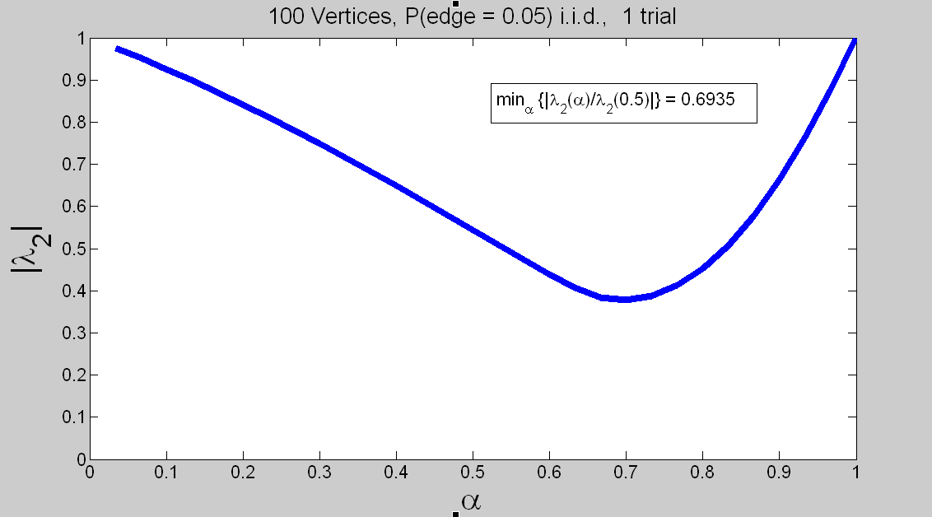
|¸₂| vs ®
Notes:
27

Slide 28
ROADMAP
Consensus and averaging
Linear iterations
Gossiping
Double linear iterations

Slide 29
Benezit, Blondel, Thiran, Tsitsiklis, Vetterli -2010
Double Linear Iteration
y_{i} = unscaled agreement variable
z_{i} = scaling variable
left stochastic
S⁰(t) = stochastic
Suppose
Suppose each S(t) has positive diagonals
z(t) > 0 8 t < 1
Suppose q > 0
z(t) > 0 8 t · 1

Slide 30
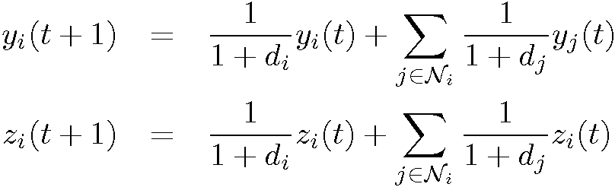
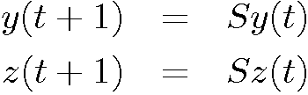
Broadcast-Based
Double Linear Iteration
Initialization: y_{i}(0) = x_{i}(0) z_{i}(0) = 1
Transmission: Agent i broadcasts the pair {y_{i}(t), z_{i}(t)} to each of its neighbors.
Update:
Agent’s require same network information as Metropolis
n transmissions/iteration
Works if N depends on t
Why does it work?
y(0) = x(0)
z(0) = 1
A = adjacency matrix of N
S = (I+A) (I+D)⁻¹
D = degree matrix of N
S = left stochastic with positive diagonals

Slide 31
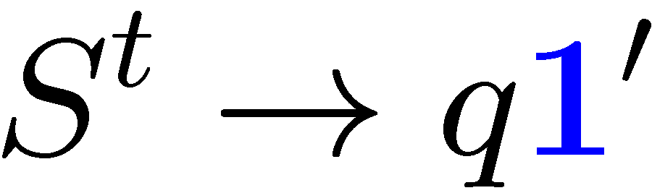
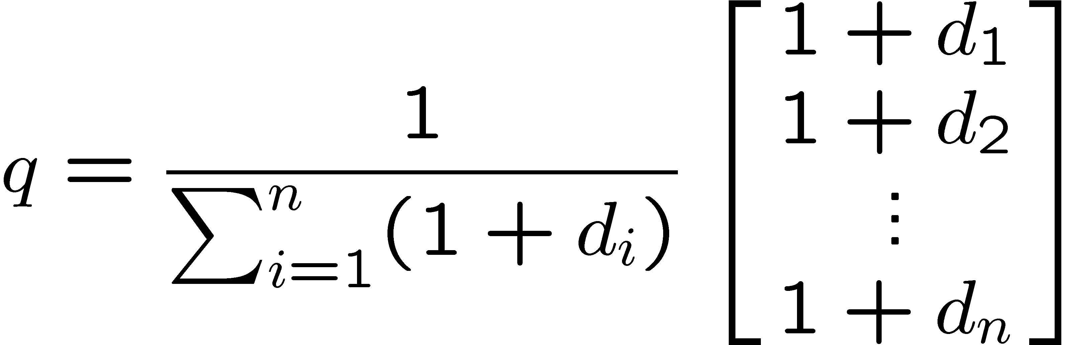
because N is connected
z(t) > 0 , 8 t < 1
because S has positive diagonals
z(t) > 0 , 8 t · 1
because z(1) = nq and q > 0
So is well-defined
y(0) = x(0)
z(0) = 1
S = left stochastic with positive diagonals

Slide 32
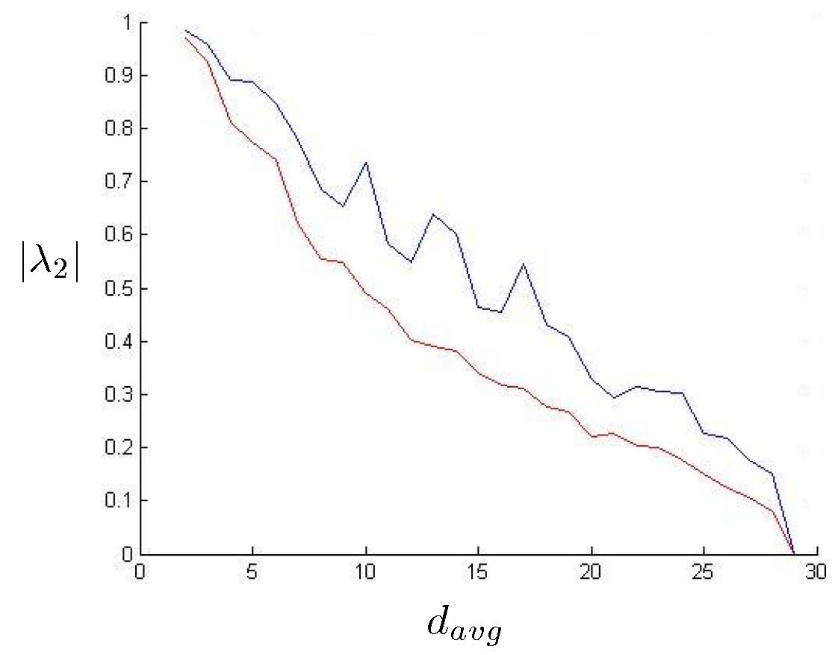
Metropolis Iteration vs Double Linear Iteration
Metropolis
Double Linear
30 vertex random graphs

Slide 33
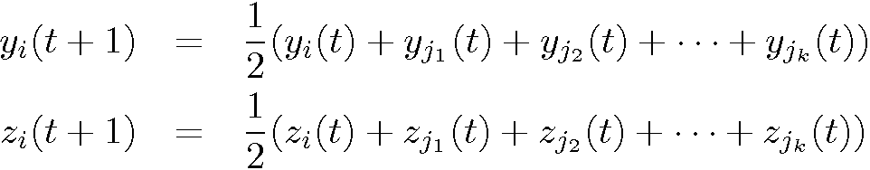
Round Robin - Based Double Linear Iteration
Initialization: y_{i}(0) = x_{i}(0) z_{i}(0) = 1
Transmission: Agent i transmits the pair {y_{i}(t), z_{i}(t)} its preferred neighbor.
At the same time agent i receives the values
from the agents j₁, j₂, … j_{k} who have chosen agent i as their current preferred neighbor.
Update: Agent i then moves the label of its current preferred neighbor to the
end of its queue and sets
No required network information
n transmissions/iteration
Why does it work?

Slide 34
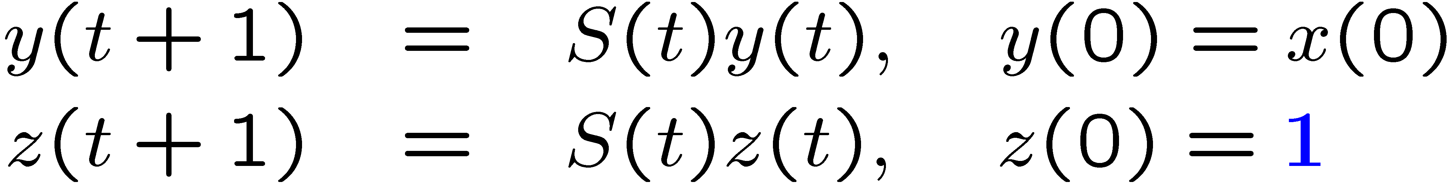

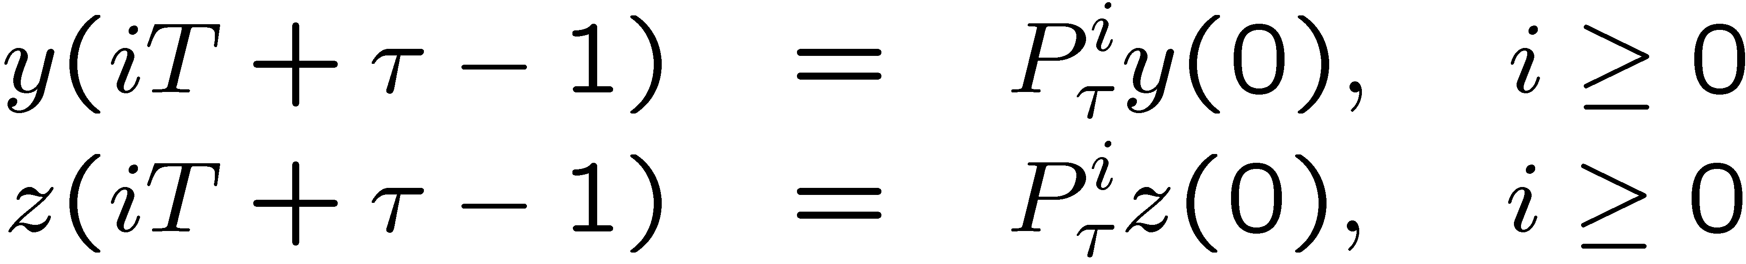
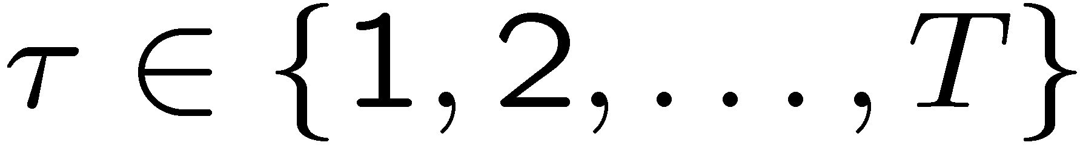
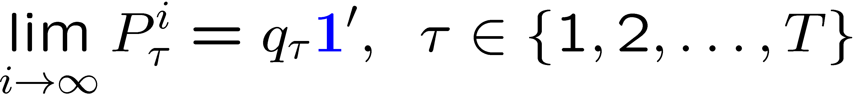
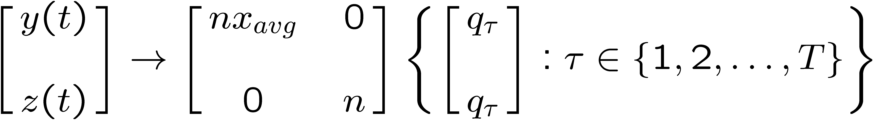
S(t) = left stochastic,
positive diagonals
S(0), S(1), ...is periodic with period T = lcm {d₁, d₂, ..., d_{n}}.
P¿ is primitive
P¿^{k} > 0 for some k > 0
Perron-Frobenius:
P¿ has single eigenvalue at 1 and it has multiplicity 1.
q¿ > 0
z(t) > 0, 8 t < 1
because each S(t) has positive diagonals
z(t) > 0 , 8 t · 1
because z(t) ! {nq₁, nq₂, ... ,nq_{T}} and q¿ > 0

Slide 35

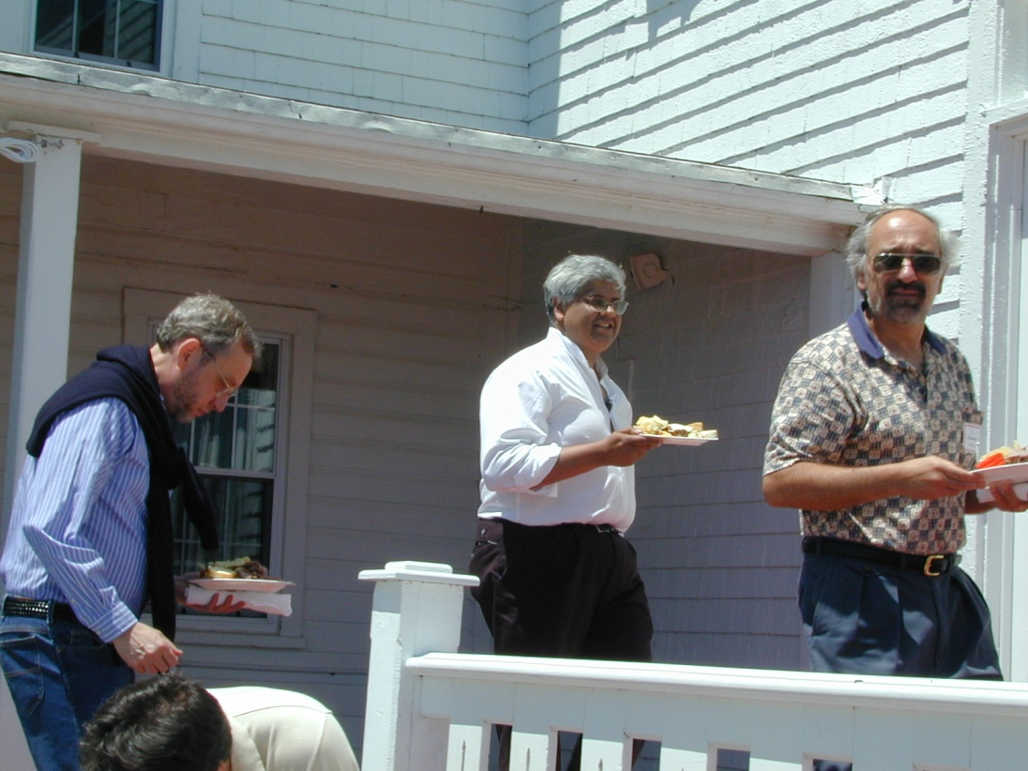
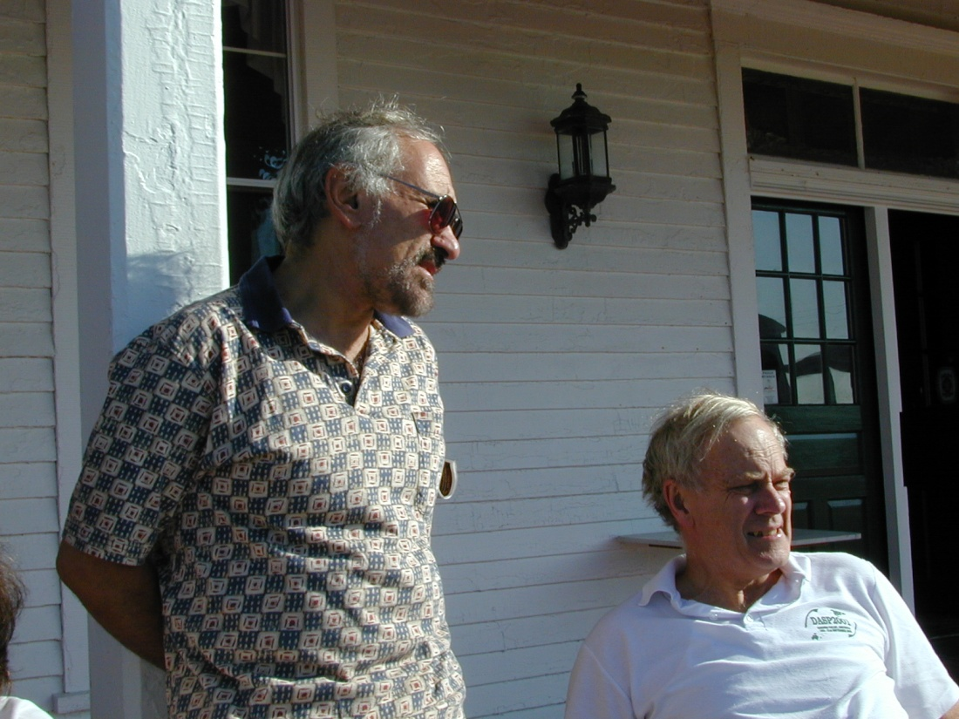

Happy Birthday Eduardo!

