Slide 1

Introduction to Synthetic Biology: Challenges and Opportunities for Control Theory
Domitilla Del Vecchio
Department of Mechanical Engineering
MIT
May 24th 2011, Sontagfest

Slide 2
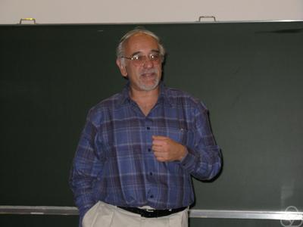
Molecular Systems Biology and Eduardo
CDC 2005 Tutorial Session an EJC 2005: Molecular Systems Biology and Control
IET 2004: Some New Directions in Control Theory Inspired by Biology

Slide 3
Outline
What is synthetic biology?
Examples of working circuit modules
Challenges/opportunities

Slide 4
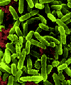
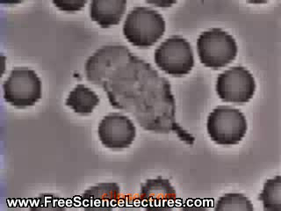
Why to Design Synthetic Bio-molecular Systems?
ALTERNATIVE ENERGY
(e.g. bio-fuels)
  Making bacteria that…
  - Produce hydrogen or ethanol
- Transform waste into energy
MEDICAL APPLICATIONS
(e.g. targeted drug delivery)
COMPUTING APPLICATIONS
(e.g. molecular computing)
BIO-SENSING
(e.g. detecting pathogens or toxins)

Slide 5
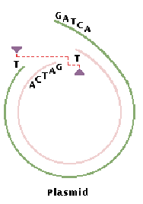
Synthetic Biology: A Historical Perspective
Birth of Genetic
Engineering
Birth of Synthetic
Biology?
recombinant DNA
1961
1968
1978
1980s
1983
2000
Insulin became first
recombinant DNA drug
K. Mullis: Polymerase
Chain Reaction (PCR)
(exponential amplification
of DNA)
Early ``working’’ synthetic
circuits in E coli: Gardner
et al. toggle switch, Elowitz
and Leibler repressilator
W. Arber discovers
restriction enzymes
(Nobel Prize winner)
First reporter gene
was isolated: green
fluorescent protein (GFP)
Jacob and Monod introduce for the first time the concept of operon regulation
gene

Slide 6

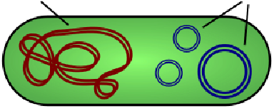
Key Enabling Technology
Recombinant DNA technology: allows to cut and paste pieces of DNA at
desired locations cleaved by restriction enzymes
Chromosome
Chromosome
Plasmids
recombinant DNA
Bacterium
Extraneous DNA
Fluorescent Proteins: allow through fluorescence microscopy to measure the
concentration of a protein and thus the level of expression of the corresponding gene
gene
gfp

Slide 7
Outline
What is synthetic biology?
Examples of working circuit modules
Challenges/opportunities

Slide 8
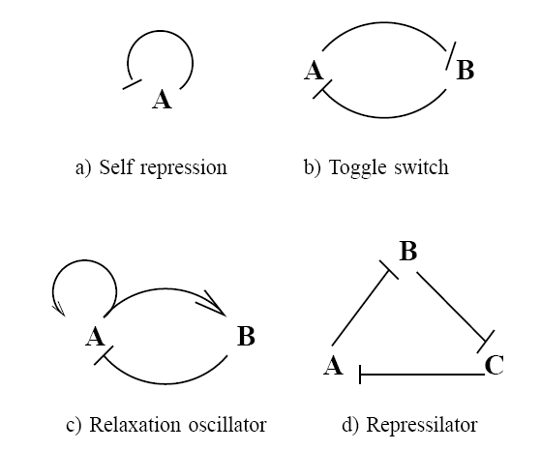
Early modules fabricated in vivo
Rosenfeld et al 2002
Becskei and Serrano 2000
Gardner et al 2000
Bistable
modules
Autoregulated
modules
Atkinson et al 2003
Elowitz and Leibler 2000
Relaxation
oscillators
Loop
oscillators

Slide 9
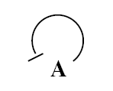
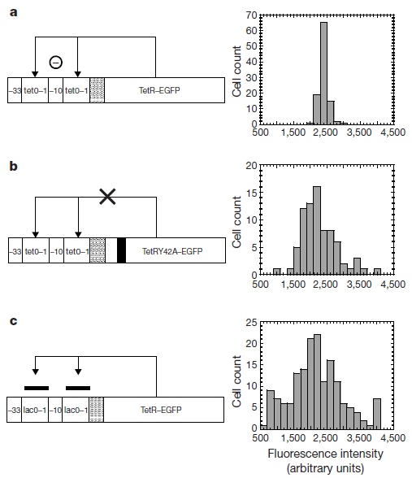
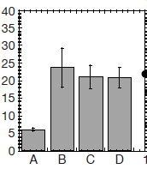
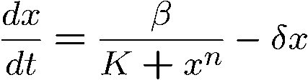
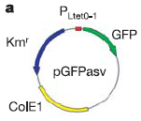
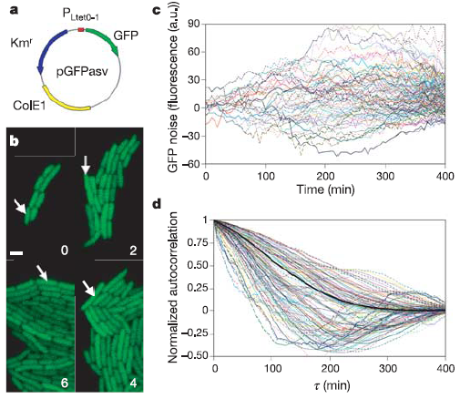
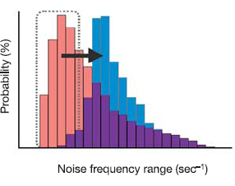
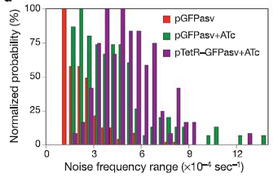
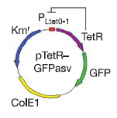
Self repressed gene: Noise properties
x
Negative autoregulation decreases noise on the steady state value
autoregulated
Coefficient of variation
negative
feedback
Becskei and Serrano, Nature 2000
Math analysis in
Singh and Hespanha, CDC 2008
Negative autoregulation shifts frequency content to high frequency
Simulation data (SSA)
Experimental data
Austin, Allen, McCollum, Dar, Wilgus, Sayler, Samatova, Cox and Simpson.
Nature 2006

Slide 10
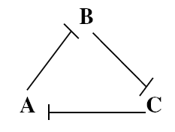
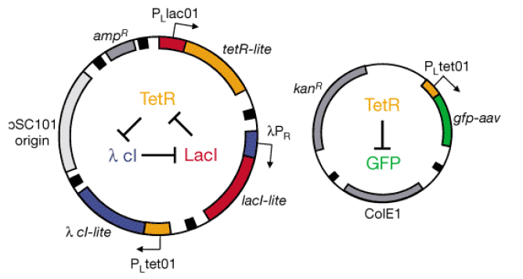

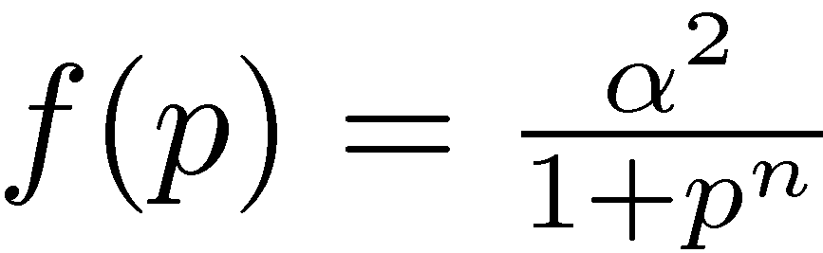
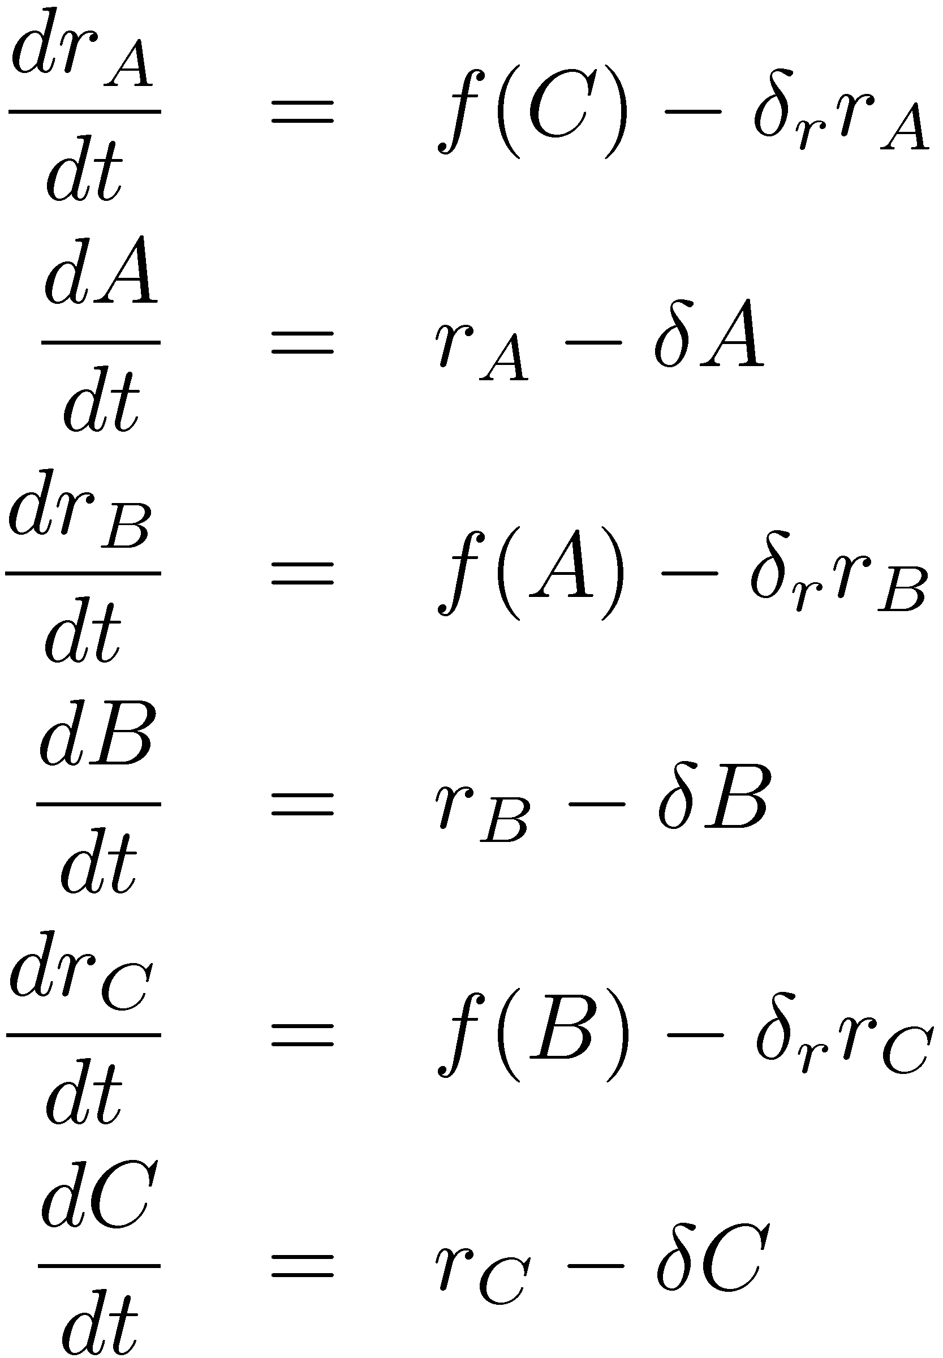
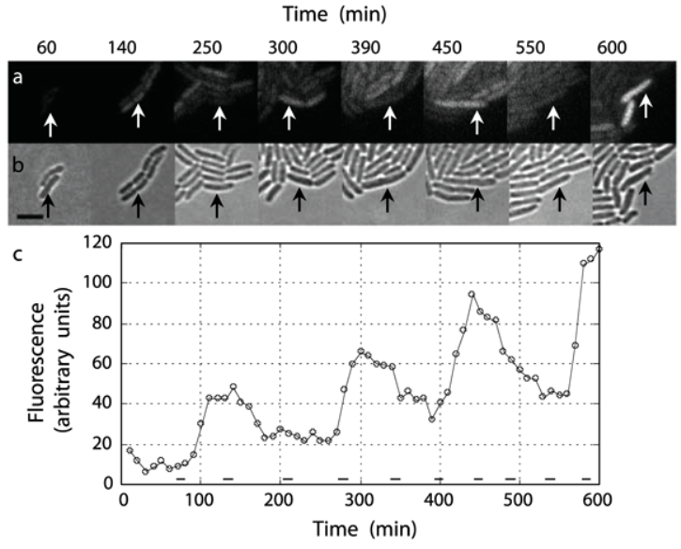
Loop oscillators: The repressilator
Cyclic feedback system: Can use
- Mallet-Paret and Smith (1990)
- Hastings, J. Tyson, D. Webster (1977)
El Samad, Del Vecchio
and Khammash, ACC 2004
Elowitz and Leibler, Nature 2000

Slide 11
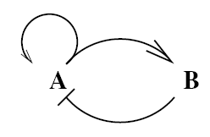
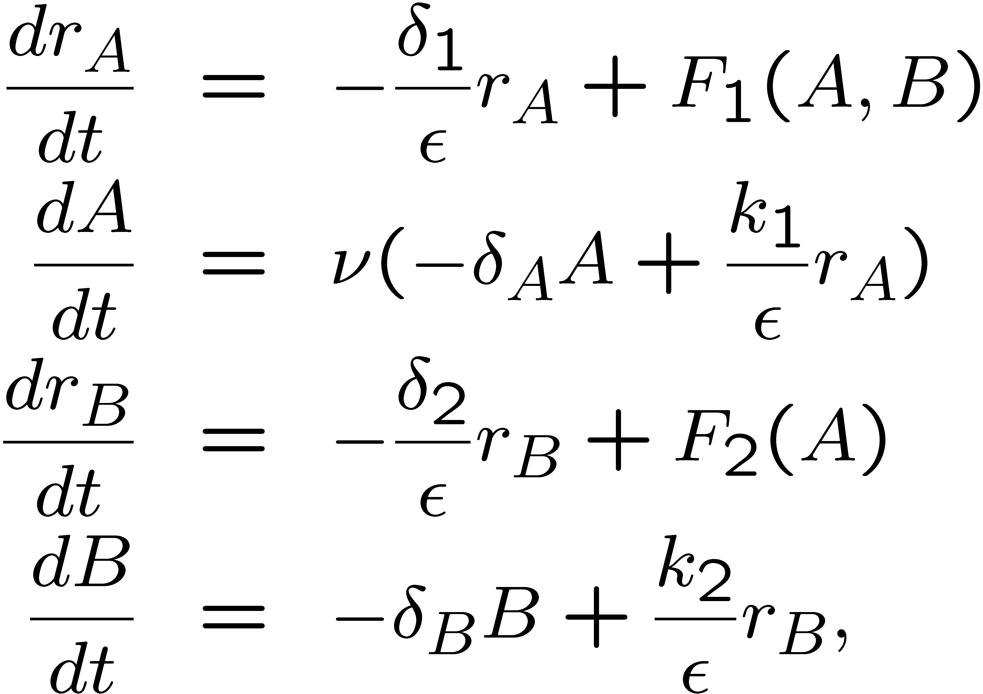


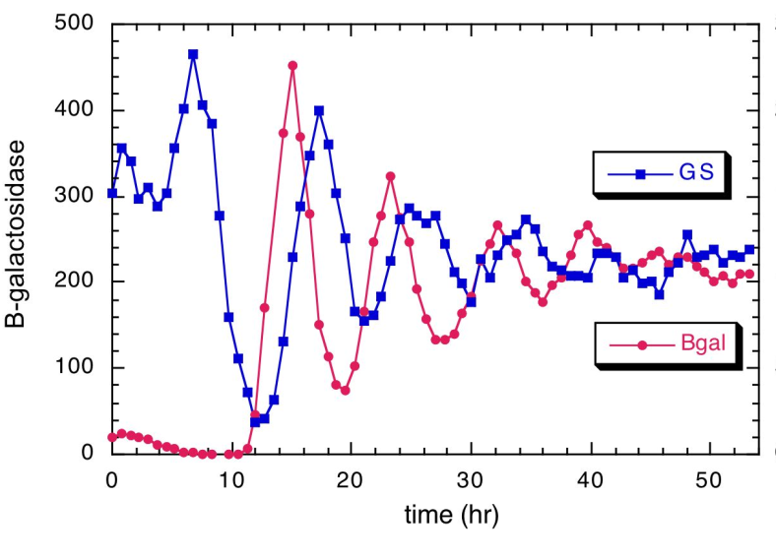
Activator-Repressor Clock
A
B
LacI-rep
NRI-act
glnG
glnKp
lacI
IPTG
Atkinson, Savageau, Myers,
and Ninfa, Cell 2003
Experimental data
(Courtesy of Ninfa Lab at Umich)
(Cell population measurements)
Key design principle: sufficiently fast
activator dynamics compared to
repressor dynamics
Del Vecchio, ACC 2007

Slide 12
Outline
What is synthetic biology?
Examples of working circuit modules
Challenges/opportunities

Slide 13
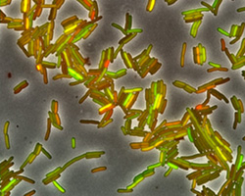
Challenges
Circuits are intrinsically stochastic and there is cell-cell variability
How to design circuits that are robust to stochastic
fluctuations?
What are the fundamental limits of feedback?
How to enforce cell-cell synchronization?
Courtesy of Elowitz Lab
Limited measurements. Problems:
Where to locate the sensors (reporters) to obtain state information?
What are the limits to what can be identified about the state and parameter values?
Most microscopic rates are unknown:
Given a desired behavior, what is the most robust topology that
realizes it?
How do we over-design systems? (need find parameter
space where prescribed behavior is attained)

Slide 14
Challenges
How to handle metabolic burden by synthetic circuits on the cell?
Need for control of “biomolecular power networks” and adaptation/robustness to demand of new synthetic circuits
WORKING “MODULES”
NOT WORKING INTERCONNECTIONS !
Retroactivity
Unfortunately, modular composition fails: Why? How to enforce it?

Slide 15
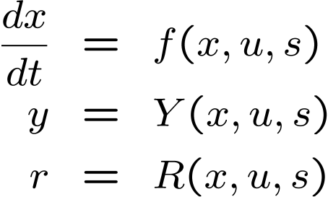
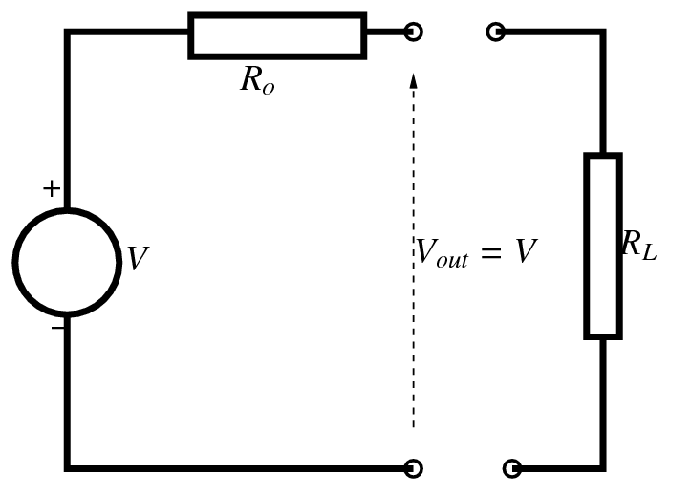
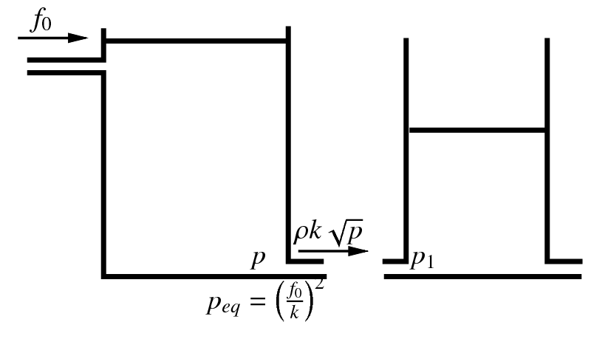
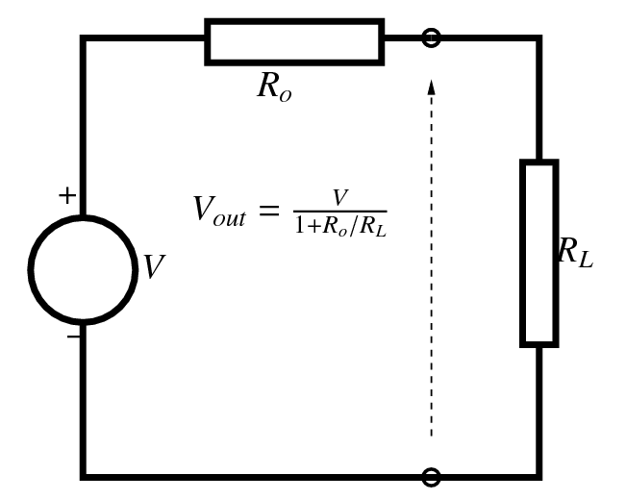
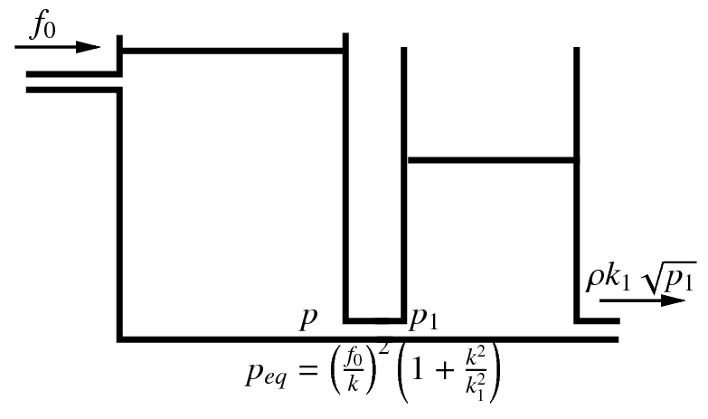
A “system concept” to explicitly model retroactivity
u
y
r
s
Retroactivity to the input
Retroactivity to the output
The interconnection
changes the behavior
of the upstream system
Familiar
Examples:
Related works:
Willem’s work and
Paynter formalism
D. Del Vecchio, A. J. Ninfa, and E. D. Sontag, Molecular Systems Biology, 2008

Slide 16
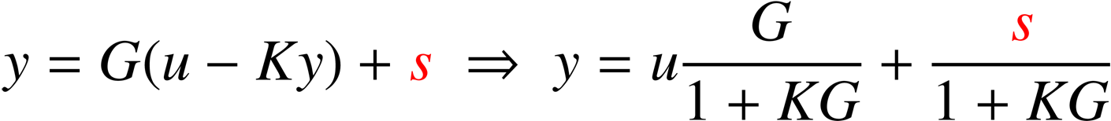
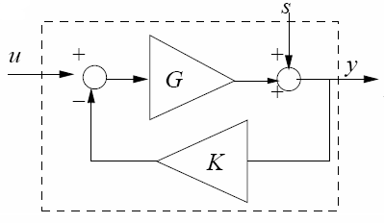
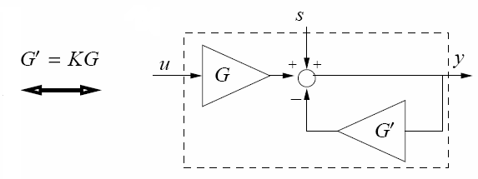
Insulation devices for attenuating retroactivity
In general, we cannot design the downstream system (the load) such that it
has low retroactivity. But, we can design an insulation system to be placed
between the upstream and downstream systems.
u
y
r≈ 0
s
The retroactivity to the input is approx zero: r≈0
2. The retroactivity to the output s is attenuated
The basic feedback scheme:
0 as G → infinity

Slide 17
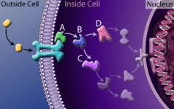
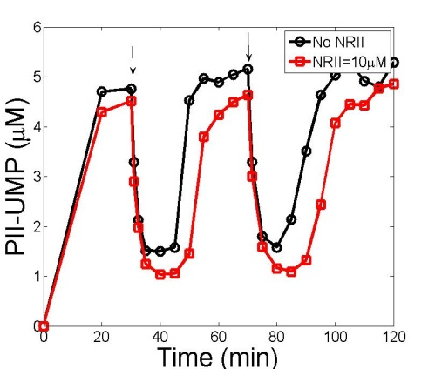
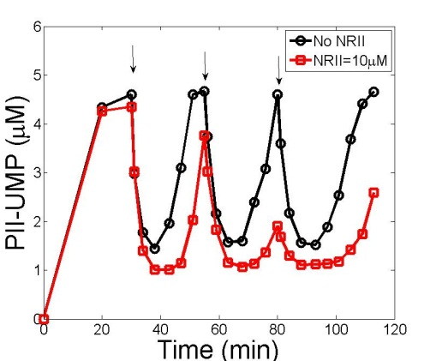
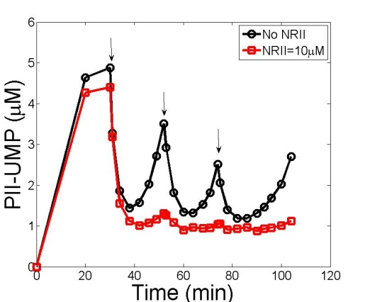
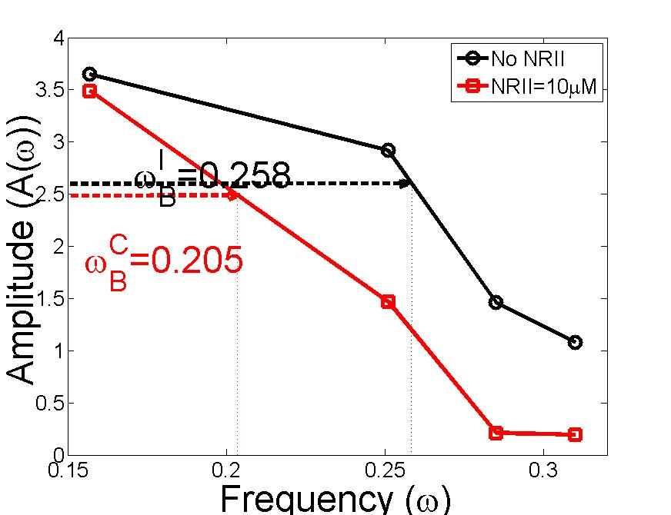

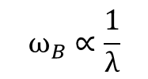
Effect of retroactivity on the dynamics: Experimental results
UT
Gln
PII
PII-UMP
$$ω_{B}∝\frac{1}{λ}$$
λ$=\frac{N}{k_{D}}$
(effective load)
UR
Isolated Connected
NRII
C
Retroactivity decreases the bandwidth
of the cycle. Hence, the information processing
ability is deteriorated while the noise filtering
ability is improved.
Experimental system: Ventura, Jiang, Van Wassenhove, Del Vecchio, Merajver, and Ninfa, PNAS, 2010

Slide 18
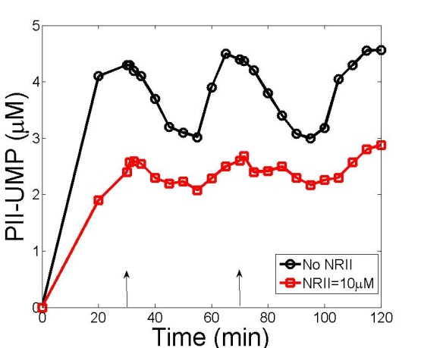
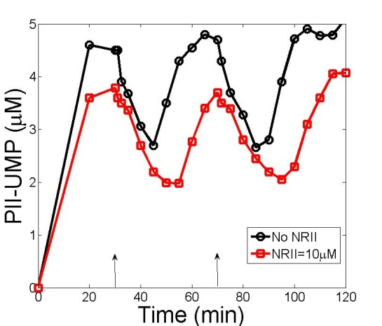

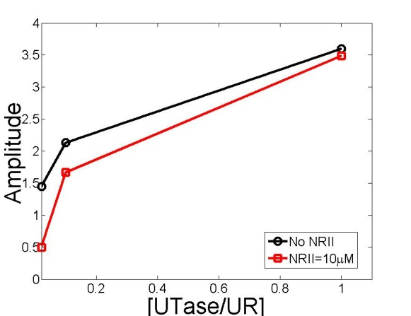

Insulation is reached by increasing the gain: Experimental results
UT
Gln
PII
PII-UMP
Recall:
G$∝k_{1} UT$
G’$∝k_{2} UR$
UR
NRII
By theory: increasing the amounts of UT and UR enzymes, the effect
of retroactivity should be attenuated
C
Experimental Results
Isolated
Connected
UT, UR=0.03 μM
UT, UR=0.1 μM
UT, UR=1 μM
Covalent modification cycles can be re-engineered to function as insulation devices!
Under Review

Slide 19









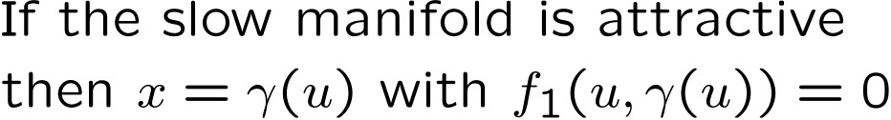
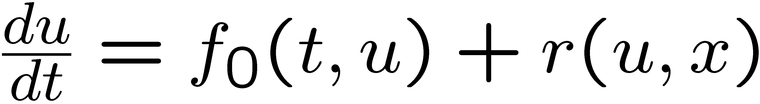
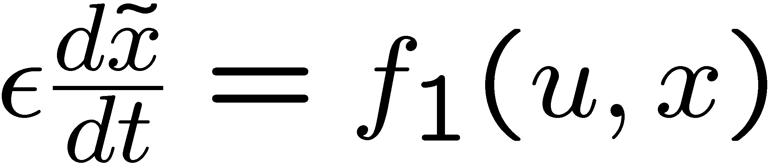

New mechanism for insulation enabled by system structure
Large
Interconnection
through binding/
unbinding
Claim: Under stability assumptions on the x dynamics,
if G is large enough then (after a short initial transient) the
effect of s on x is arbitrarily attenuated (independently of G’)
“Proof”
x(t) does not depend on y on the slow manifold
Can be applied to easily tune most signaling networks
so they work as insulators, including MAPK cascades and
phosphotransfer systems (Ypd1-Skn7 pathway)
Jayanthi and Del Vecchio, IEEE TAC 2010

Slide 20
Happy Birthday Eduardo!

Slide 21
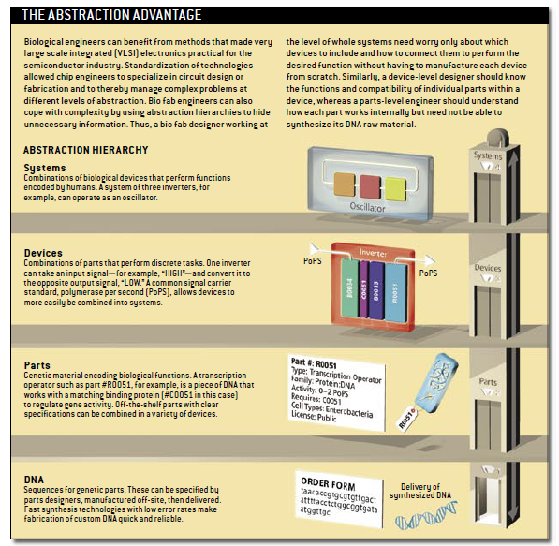
Parts, Devices, Systems: Synthetic Biology as an Engineering Discipline
Baker, Church, Collins, Endy, Jacobson, Keasling, Modrich, Smolke, and Weiss. Scientific American, 2006

Slide 22
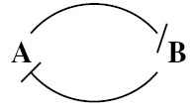
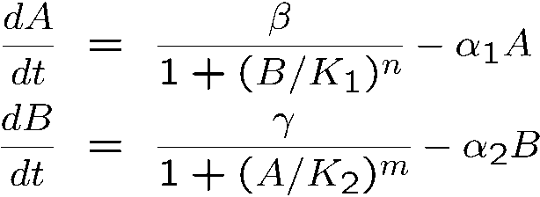
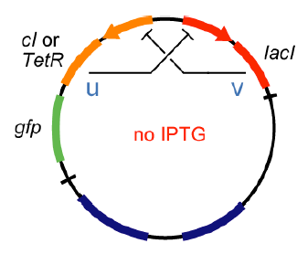
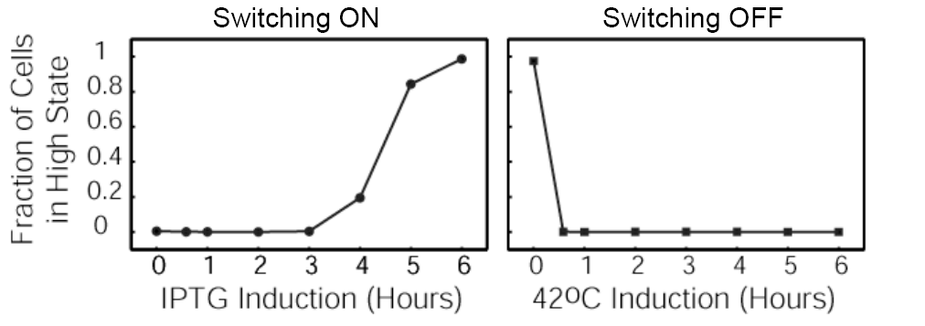

Toggle switch
B
A
B
A
1
Iptg
temperature
Symmetric design
2
Gardner et al., Nature 2000

Slide 23








Retroactivity has dramatic effects on the dynamics of biomolecular modules
Downstream
component
(isolated)
(connected)
s
Reduced System
Retroactivity
measure
D. Del Vecchio, A. J. Ninfa, and E. D. Sontag, Molecular Systems Biology, 2008

Slide 24


A phosphorylation-based design for a bio-molecular insulation device
Amplification through
phosphorylation
Insulation Device
p
Downstream system
How does it attenuate the retroactivity from downstream systems?
Feedback through
dephosphorylation
Assume one-step reaction model for phosphorylation
Weakly activate pathway
Use time-scale separation
As G, G’ increase,
retroactivity is attenuated
Small gains G and G’
Large gains G and G’
Isolated
Connected
time
time

Slide 25

Modularity is not a natural property of bio-molecular circuits
A
B
Activator/Repressor Clock
(Experimental Results)
LacI-rep
NRI-act
glnG
glnKp
lacI
IPTG
(Atkinson et al, Cell 2003)
Retroactivity!
LOAD
Courtesy of Ninfa Lab at Umich
How do we model these effects? How do we prevent them?

Slide 26


Synthetic Biology: A Historical Perspective
Ampere,
Coulomb,
Faraday,
Gauss,
Henry,
Kirchhoff
Maxwell
Ohm
William Shockley explains
how the bipolar junction
transistor works (BJT)
December 1947,
Bell Laboratories
(Nobel Prize in Physics in 1956)
+
Operational Amplifier
(OPAMP)
1964 Wildar at
Fairchild
Semiconductor
Fleming invented the diode
(a two-terminal device)
-
Electronic
Engineering
Transistor era To Electronic
computers
1904
1948
1964
Electrical
Engineering
Vacuum Tube era
(Physics)
(Information)
Birth of Genetic
Engineering
Birth of Synthetic
Biology?
recombinant DNA
1961
1968
1978
1980s
1983
2000
Jacob and Monod introduce
for the first time the concept
of operon regulation
W. Arber discovers
restriction enzymes
(Nobel Prize winner)
Insulin became first
recombinant
DNA drug
K. Mullis: Polymerase
Chain Reaction (PCR)
(exponential amplification
of DNA)
Early ``working’’ synthetic
circuits in E coli: Gardner
et al. toggle switch, Elowitz
and Leibler repressilator
First reporter gene
was isolated: green
fluorescent protein (GFP)
gene
26

