Slide 1

NSF Funding Opportunities for Cybersecurity Education and Workforce Development
Victor Piotrowski
Program Director
CyberCorps® (SFS) and SaTC
Division of Graduate Education
National Science Foundation

Slide 2
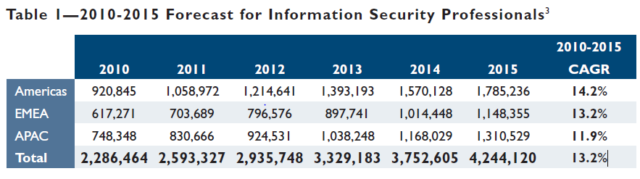
Estimate of the number of information security professionals (Frost & Sullivan)
Table 1 on page 9 of the 2011 (ISC)² Global Information Security Workforce Study (https://www.isc2.org/uploadedFiles/Industry_Resources/FS_WP_ISC%20Study_020811_MLW_Web.pdf) “Forecast for Information Security Professionals”.

Slide 3
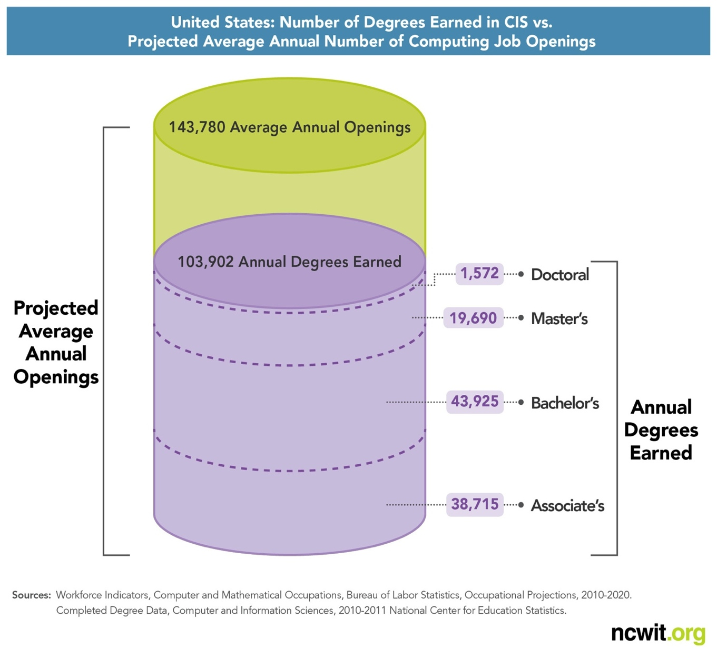
Challenge: Computer and IS Degrees in 2010-2020

Slide 4
Challenge: Cybersecurity and Big Data
“By 2018 the United States alone faces a shortage of 140,000 to 190,000 people with analytical expertise and 1.5 million managers and analysts with the skills to understand and make decisions based on the analysis of big data.”¹
McKinsey & Company
¹McKinsey&Company (May 2011), “Big data: The next frontier for innovation, competition, and productivity.” Available at: http://www.mckinsey.com/Insights/MGI/Research/Technology_and_Innovation/Big_data_The_next_frontier_for_innovation

Slide 5
Cybersecurity Education - Funding Opportunities at NSF
CyberCorps®:Scholarship for Service (SFS) –$300-900K per Capacity project; $1-5M per Scholarship project
Secure and Trustworthy Cyberspace (SaTC) – up to $300K/project

Slide 6

CyberCorps®:
Scholarship For Service (SFS)

Slide 7
CyberCorps®: SFS Mission and Structure
The CyberCorps(R): Scholarship for Service (SFS) program seeks to increase the number of qualified students entering the fields of information assurance and computer security and to increase the capacity of the United States higher education enterprise to continue to produce professionals in these fields to meet the needs of our increasingly technological society.
The SFS program is composed of two tracks:
  The Scholarship Track provides funding to colleges and universities to award scholarships to students.
  The Capacity Building Track providing funds to support curriculum, outreach, faculty, institutional, and/or partnership development.

Slide 8
CyberCorps®: SFS Scholarship Track
Scholarship Component:
Funding: tuition, fees, and stipends ($20K/$32K per year)
Length: 2-3 year scholarship for final years of undergraduate or graduate (master’s or doctoral) education
Obligation: Summer internship, post-graduation service requirement (work in Federal agency equal to scholarship length)
Student Eligibility:
U.S. Citizen
Enrolled in IA program, within 2-3 years of graduation
Eligible for Federal employment (must be able to acquire security clearance)
Awardee institutions set additional selection criteria
Institution Eligibility:
National CAE/IAE designation or equivalent (DC3 Forensics, NSA Cyber Ops or alternative evidence)
Offer full-time program of study in IA field(s)

Slide 9
SFS Capacity Building - Myths
Institutions need to be NSA/DHS designated as CAE (False)
Projects must build capacity for Scholarship proposals (False)
Projects are not allowed to target K-12 space (False)
Identical projects may be submitted to both, SFS and SaTC-EDU (False)

Slide 10
NSF SaTC Education Perspective – 2013 Awards
PI | Institutions | Title
Hu Morris | U of Alabama Mississippi State | A Multimedia-based Virtual Classroom for Cyber-Physical Systems Security Education
Murphy | Marymount U | Cybersecurity Competitions in the Healthcare Environment
Du Yang Yuan | Syracuse U U of Tennessee N Carolina A&T | Bolstering Security Education through Transiting Research on Browser Security
Williams | N Carolina SU | Software Security Education
Li | U of Georgia | Stepwise and Reusable Problem-solving Challenges
Chandy | U of Connecticut | A Virtual Lab for a Hardware Security Curriculum
Goel | SUNY at Albany | Flipping the Security Classroom
Hicks | U of Maryland CP | Build it, Break it, Fix it - A new security contest
Manson | Cal Poly Pomona | National Cybersecurity Sports Federation
Qaissaunee | Brookdale CC | New Jersey CyberCenter
Dark | Purdue U | Information Security Research and Education (INSuRE)
Bashir Memon | U of Illinois U-C | Enhancing the Cyber Security Workforce - The Human Angle

Slide 11
Proposal Deadlines
CyberCorps® (SFS)
  Scholarships – October, 2014
  Capacity – November, 2014
SaTC
  EDU Perspective – December, 2014

Slide 12


Questions?
Comments…

