Slide 1
Cost-effectiveness Analysis:
A practical primer
Eran Bendavid

Slide 2
CEA is a comparative analysis
First step is to identify your alternatives
Second step is to identify your alternatives
  Clinical management: medication vs. surgery, medication A vs. B
  Prevention: program vs. no program, or universal vs. targeted to high risk individuals, or vs. treatment
Focus your question
When you’re done, start over and see if more alternatives popped up while you were completing your analysis

Slide 4
CEA is a comparative analysis
Alternatives can be treatment options, prevention strategies, or any combination.
Example: How to address a pandemic influenza threat…
  Do nothing
  Treat everyone
  Treat only confirmed cases
  Close schools
  Home quarantine for suspected cases
  Combinations of pharmacological and non-pharmacological strategies

Slide 5
Steps in conducting a cost-effectiveness analysis
  (1) Define analysis: explicit and specific statement of the problem being tackled.
  (2) Construct conceptual model: allow for all relevant alternatives

Slide 6
Steps in conducting a cost-effectiveness analysis (cont’d)
  (3) Determine input values: identify all costs; decide on measure of effectiveness.
  (4) Collect costs and health outcomes; summarize by incremental values; plot on graph
  (5) Prepare manuscripts. You’re nearly done.

Slide 8
Construct conceptual model
How do alternatives affect your model?
“Make things as simple as possible, but not simpler”…AE
How will you model be affected if you are considering mass treatment versus treatment of confirmed cases only?

Slide 9
Treat +s
Mass Rx
Treat -s
Pandemic threat
True +, Rx
Test +
False +, Rx
Rx confirmed
True -, no Rx
Test -
False -, no Rx

Slide 10
S, no Rx
I, no Rx
R, no Rx
S, yes Rx
I, yes Rx
R, yes Rx

Slide 11
S, true + (rx)
I, true + (rx)
R, yes Rx
S, false+ (rx)
I, false + (rx)
S, true -
I, true -
R, no Rx
S, false -
I, false -

Slide 12
Costs
Which costs do you count?
  All direct costs:
    Hospitalizations
    Medications
    Vaccinations
    Diagnostics

Slide 13
Costs
Which costs do you count?
  Indirect costs:
    Time costs
    Cost of lost productivity
    Opportunity cost
  Careful of double counting:
    Double counting indirect costs
    Indirect costs and quality of life adjustments

Slide 14
Measures of Effectiveness
  Mortality (deaths or deaths averted)
  Morbidity: e.g., episodes of illness, infections, duration of disability (e.g., years of sight)
  Life years: expected duration of life
  Quality-adjusted life years (QALYs): life years
  x utility scores
  Disability-adjusted life years (DALYs): YLL+YLD
  Why are DALYs and QALYs best?

Slide 16
Here’s an example
Aneurysm: clinical situation = woman, aged 50, with unruptured cerebral aneurysm found incidentally.
Options = no treatment or surgery (clipping).
Perspective = societal. i.e., economic effects on patients, providers, insurers, etc not separated. All costs counted, regardless of who pays.
Effectiveness measure is QALY gained.
    This CEA compares surgical clipping to no treatment
    for the management of an asymptomatic cerebral
    aneurysm, for a 50 year old woman, estimating the societal
    cost per QALY gained.

Slide 17
Cost inputs
Cost input Value (range) Source
Clipping $25,150 (18,000-35,000) Cohort study – cost accounting system
Moderate/severe
disability $20,000/yr (13,000-30,000) Published estimate
SAH hospitalization $47,000 ($33,000-$67,000) Cohort study – cost accounting system
Discount rate 3% (0-5) CEA guidelines

Slide 18
Tally costs and effectiveness
Each health state in the model is associated with unique costs and effectiveness
Sum up the costs and benefits of strategies
Put it in a table and on a graph

Slide 19
This CEA compares surgical clipping to no treatment for the management of an asymptomatic cerebral aneurysm, for a 50 year old woman, estimating the societal cost per QALY gained.

Slide 20
The cost per QALY gained is defined as:
  Cost with surgery - cost with no surgery
  QALYs with surgery - QALYs with no surgery
I.e.,
Δ Cost
Δ QALYs
Formulation must be incremental: from no intervention to intervention, or from lower cost to higher cost intervention.

Slide 21
CEA Framework
Costs
Effectiveness

Slide 22
CEA Framework
Costs
CE ratio relevant
CE ratio irrelevant and not interesting
Effectiveness
CE ratio irrelevant and interesting

Slide 23
Treat everyone vs. confirmed cases for H1N1
$12k
Comparator: Confirmed cases
$1000 per DALY
$6k
$500 per DALY
Change in costs
$100 per DALY
$0
0
5
10
Gain in health benefit (DALYs)
Notes:
Explain that the slope of the dashed line reflects a CER of $100k. How to pick the threshold is a value judgement.

Slide 24
Treat everyone vs. confirmed cases for H1N1
$12k
Comparator: Confirmed cases
Treat everyone
$1000 per DALY
$6k
$500 per DALY
Change in costs
Change in cost: $11,600
Change in benefit: 4 DALYs
Incremental CER: $2,900/DALY
$100 per DALY
$0
0
5
10
Gain in health benefit (DALYs)
Notes:
Explain that the slope of the dashed line reflects a CER of $100k. How to pick the threshold is a value judgement.

Slide 25
Treat everyone vs. confirmed cases for H1N1
$12k
Comparator: Confirmed cases
Treat everyone
$1000 per DALY
Assumption: At high-risk for infection
$6k
$500 per DALY
Change in costs
High risk
Change in cost: $4,720
Change in benefit: 8 DALYs
Incremental CER: $560/DALY
$100 per DALY
$0
0
5
10
Gain in health benefit (DALYs)
Notes:
Explain that the slope of the dashed line reflects a CER of $100k. How to pick the threshold is a value judgement.

Slide 26
Base case graphically
$
$39,666
$534
QALYs
19.74
21.37

Slide 27
Base case graphically
$39,666
$
$534
QALYs
0
19.74
21.37

Slide 28
In manuscript, the results might be presented as follows.
QALYs Costs
Scenario Total Incremental Total Incremental $ / QALY
No symptoms, <10 mm, no past SAH
No treatment 21.37 -- $534 -- --
Clipping 19.74 -1.63 $39,666 $39,132 Dominated

Slide 29
CEA is iterative
  Steps usually in order, more or less.
  Often desirable to refine or redefine the analysis as it progresses
  Good news: Until published, can revise.
  Bad news: Until published, can revise.

Slide 30
Dominance
$10k
ICERs:
Comparator vs A: Dominated (strictly)
Strategy C
B vs A: ($2,800-$1,000) / (5-2)
=$600/QALY
Strategy D
$5k
C vs B: ($9,000-$2,800) / (7-5)
=$3,100/QALY
Costs
Comparator
Strategy B
D vs B: ($6,200-$2,800) / (5.5-5)
=$4,800/QALY
Dominated by extended dominance
Strategy A
$0
0
5
10
Gain in health benefit (QALYs)

Slide 31
CEA of HIV prevention strategies
QALYs Program Costs
Scenario Total Added Total Added $ / QALY
No prevention 20,000 -- $0 -- --
Targeted 20,025 25 $20,000 $20,000 $800
Universal 20,027 2 $200,000 $180,000 $90,000

Slide 32
WRONG!!!

Slide 33
WRONG!!!

Slide 35
RIGHT
Dominated

Slide 36
Sensitivity analysis: the last step

Slide 37
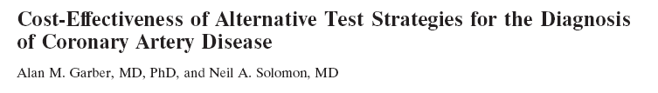
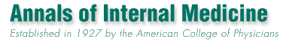

Putting it all together

Slide 38
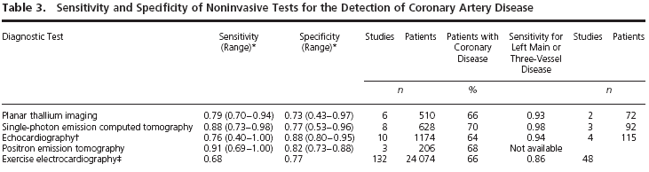
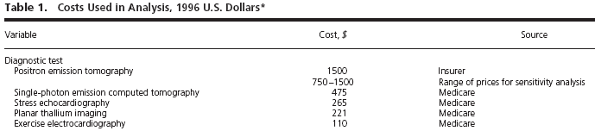
Putting it all together

Slide 39
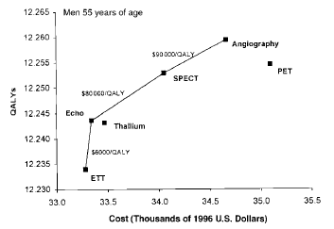
Putting it all together

Slide 40
What does CEA say about value of life?
A cost-effectiveness threshold is one way to use CEA to determine which interventions represent good value.
In the US and OECD countries, that threshold is somewhere between $50,000-$100,000/QALY.
What is the threshold in other countries?
  Related to per-capita GDP as a proxy for income
  Less that 1 x pcGDP: very good value
  1-3 x pcGDP: acceptable

Slide 41
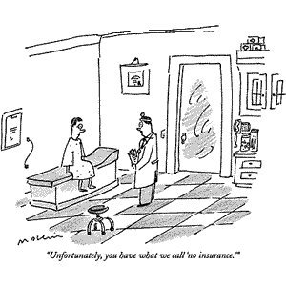

Slide 42
CEA can be misused
  Defend policies deemed unacceptable for other reasons (depriving of rights, unfair, cruel, etc)
  Methods correct, interpretation skewed
  Methods incorrect or strategies not considered

