Slide 1
Venue Public Security & Stadium Access Security
  Fred S. Roberts
  CCICADA Director
  Dennis Egan
  CCICADA Assistant Director

Slide 2
CCICADA
Founded 2009 as DHS University COE
Based at Rutgers, but many partners
Data analysis, modeling, and simulation for homeland security
Information-based decision making and planning
Here a selection of CCICADA projects
Then more detail

Slide 3

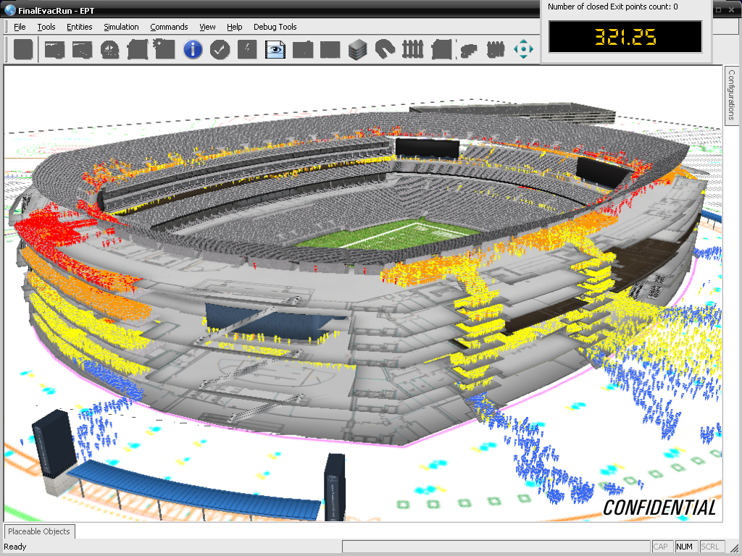
Evacuation Planning Tool
Work with 6 NFL teams & Super Bowl
CCICADA component of the work:
behavioral aspects of stadium evacuation

Slide 4
CCICADA: From Evacuation to a Large Stadium Security Program
Engagement with stadiums and Super Bowl through “sport evac” process led to connections to stadium security.
Inspection processes at stadiums
“Best Practices for Stadium Security” with DHS Office of SAFETY Act Implementation (OSAI)
OSAI II: Metrics, Effectiveness, and Training for Inspections and Credentialing
Crowd Management
Prevention of Human Trafficking – Engagement with FBI, local agencies in connection with
Super Bowls

Slide 5
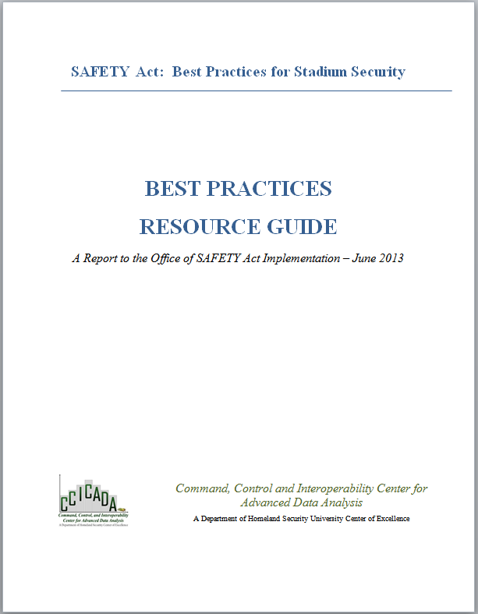
SAFETY Act Project I
Best Practices Resource Guide
On OSAI website
Used by all major sports leagues
Used to design new sports arenas
Applied to other venues (e.g., convention centers)
5

Slide 6
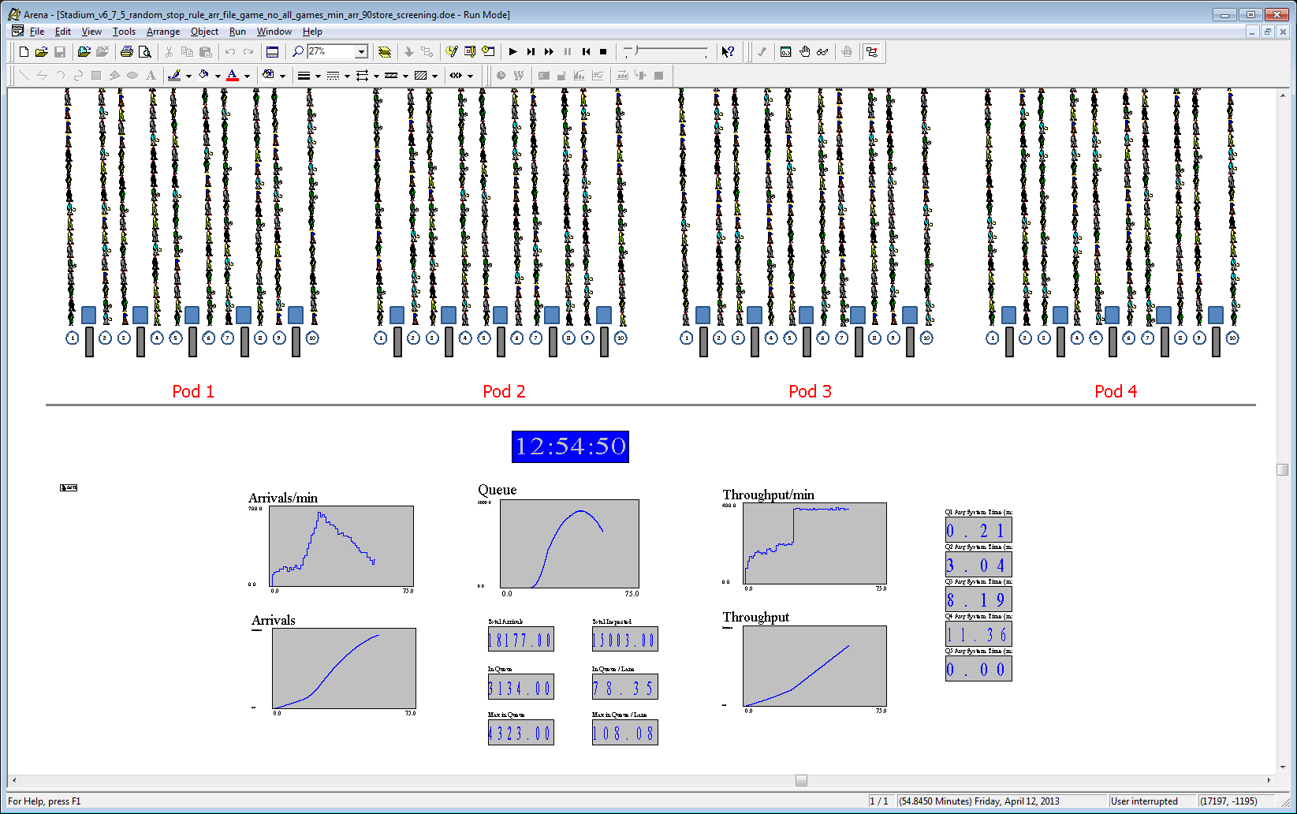
CCICADA’s Stadium Simulator
Most of the parameters can be obtained by choosing a representative game
Parameters
  Arrival rates
  Number of lanes
  Wanding times
  Pat-down times
  WTMD times
Screening Strategy
  Switching inspection type (Y/N)
    Number of patrons in queue to switch the process, or
    Time of switch
  Does phase 2 include randomization? (Y/N)
    Ratio of patrons in each type of inspection in the randomization
The model output file includes
  In Queue @ kickoff
  Queue clearance timer
  Max Waiting Time per patron
6

Slide 7
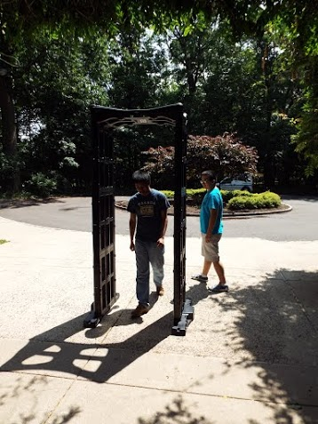
WTMD Experiments
Found difference in WTMD performance under different conditions.
Varies per
  Brand
  Height & Orientation
  Proximity of outside sources
  Human gait
  Speed
Notes:
Vijay

Slide 8
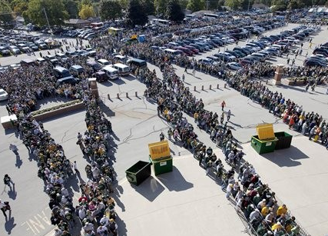
OSAI Project III: Economics of Security & Randomization
Economic costs and benefits of security at stadiums
Randomization designs
Practical implementation of simple randomization for patron screening
Lambeau Field – Mike Roemer/AP

Slide 9
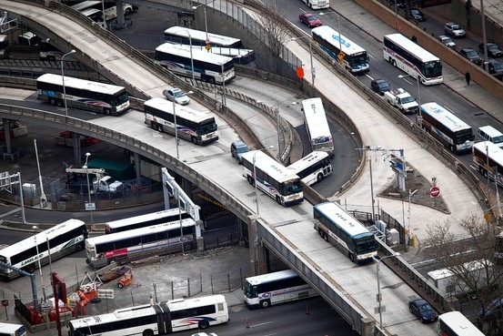
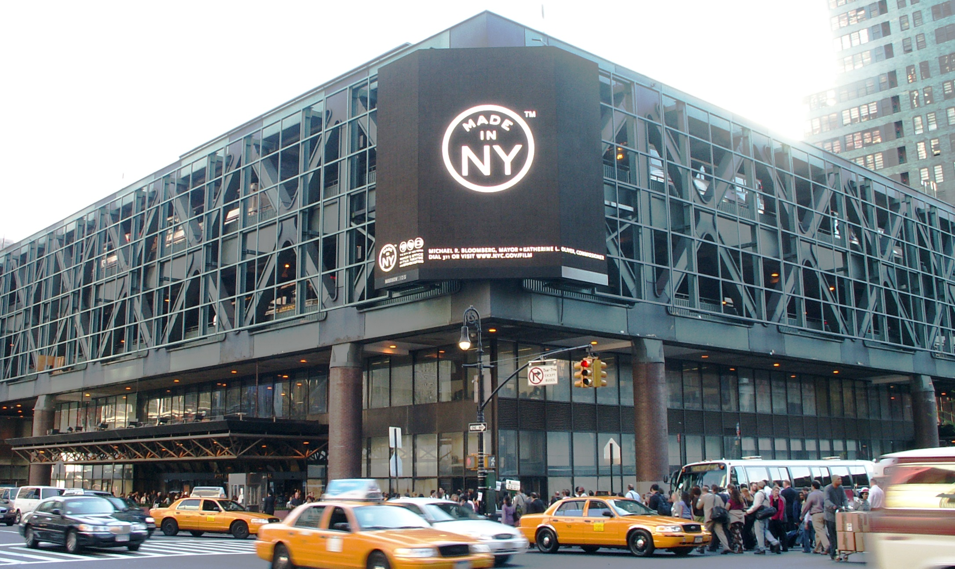
Port Authority Bus Terminal
PABT in NYC: world’s busiest bus terminal
Critical transit facility to move people between NYC and NJ
Central part of any emergency evacuation scenario for Manhattan
Our stadium work led to a project for PABT:
  LiDAR to produce Building Information Model
  Crowd Management Simulation Software
Dust storm in Mali
Credit: online.WSJ.com
Credit: Wikipedia

Slide 10
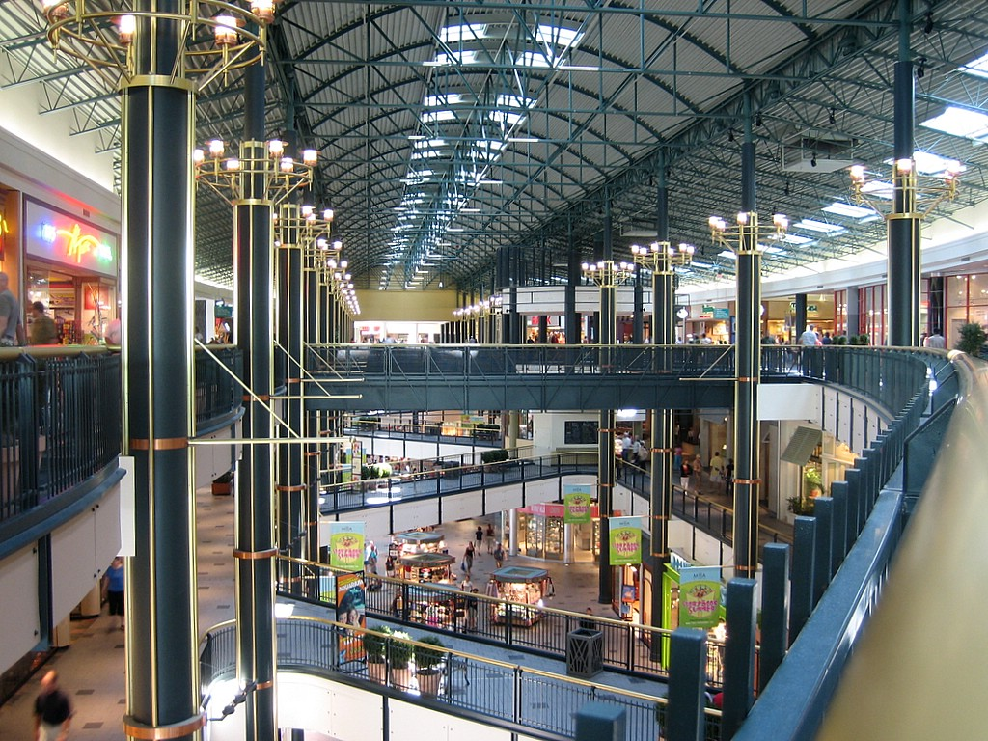
Extension to Other Facilities
Mall security
Hotels, theatres, amusement parks, convention centers etc.
Scheduling and placement of security guards in buildings
Dust storm in Mali
Mall of America

Slide 11
Crowd Simulation for the
Port Authority Bus Terminal

Slide 12
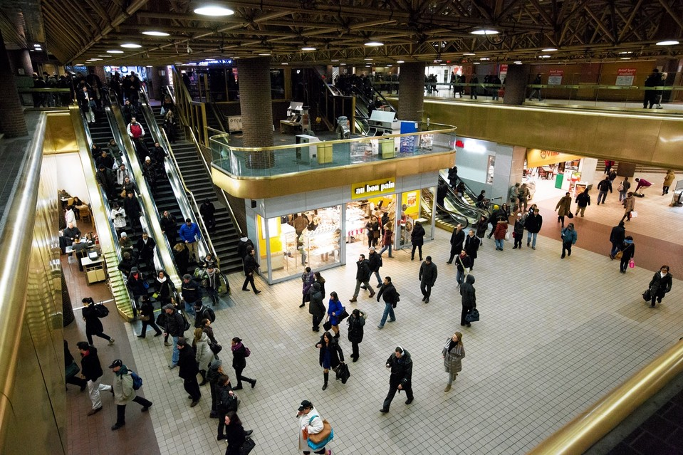
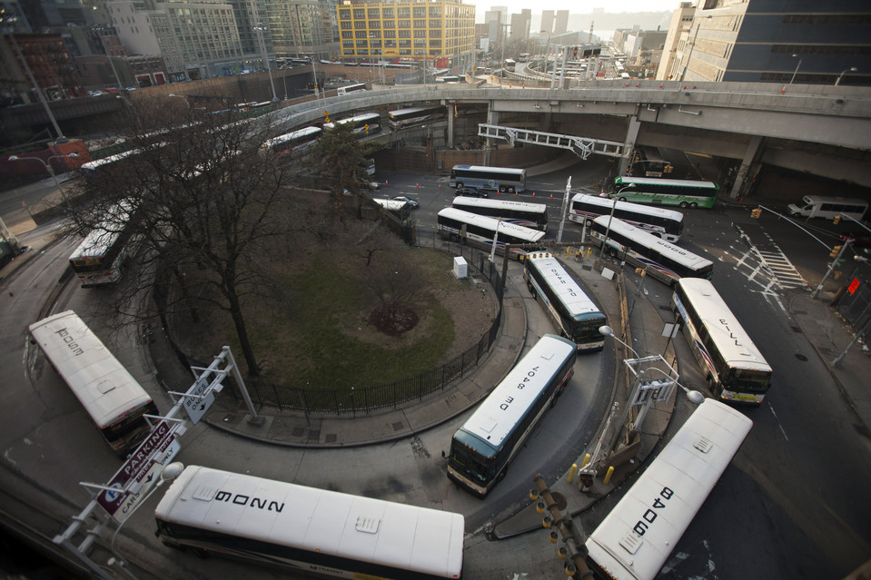
Port Authority Bus Terminal
A prototypical transportation hub
Largest terminal in the United States
Busiest in the world by volume or traffic
  It has reached peak hour capacity
8,000 buses - 225,000 people on ordinary weekday - 65,000,000 people per year
- 223 different departure gates - 1,250 parking spots - commercial and retail space
(2013 statistics)

Slide 13

Why Crowd Simulation?
Evaluate surveillance and inspection strategies
Evacuation scenarios and extreme conditions
Study queuing and crowd management strategies
Structural changes, construction and gate reassignment
Impact on retail and commercial venues
Notes:
Surveillance and inspection – emphasize
Identify paths/behaviors that are not typical

Slide 14
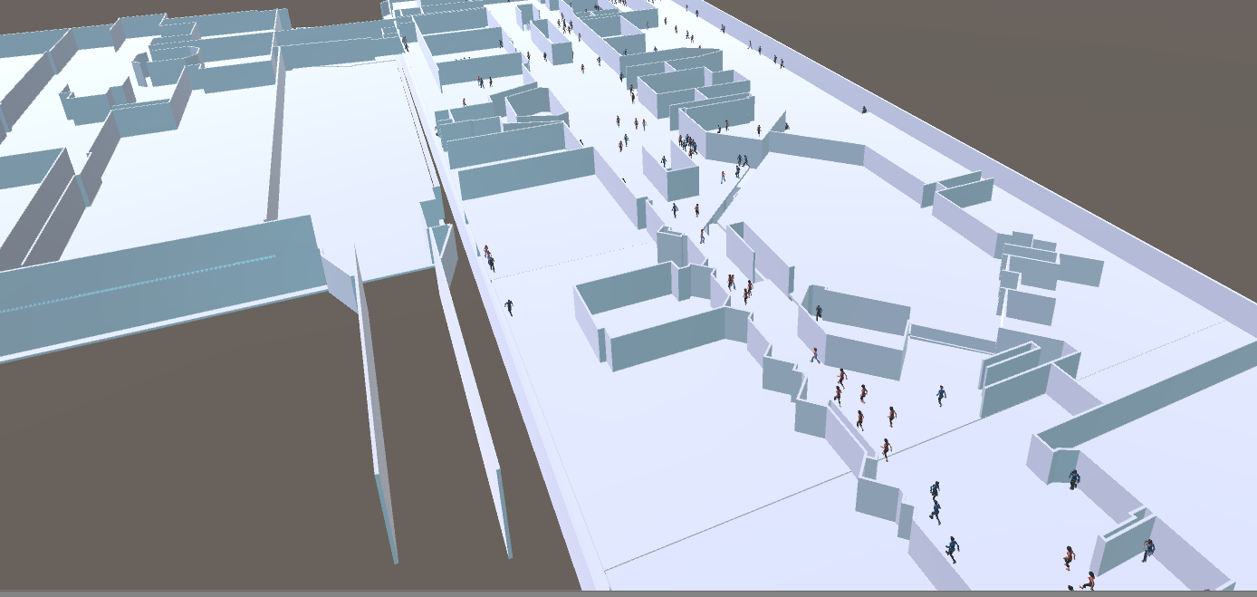
CCICADA: Agent-based Simulation for Transportation Hubs
Approach: Agent-based simulation
  the system is composed of interacting agents;
  allows for complex interactions among terminal users and between pedestrians and the terminal
  allows parametrization
  it exhibits emergent properties

Slide 15
Port Authority - Afternoon Scenario

Slide 16
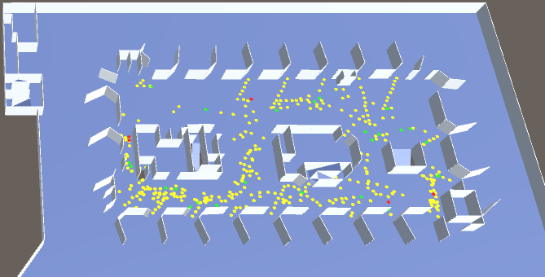
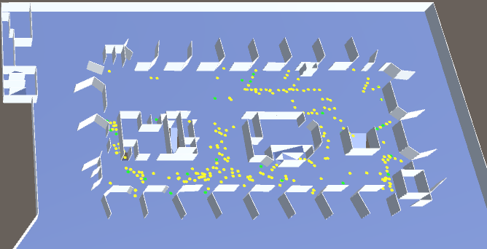
Delayed Departures Scenario
Vs. normal

Slide 17
Evacuation Scenario

Slide 18


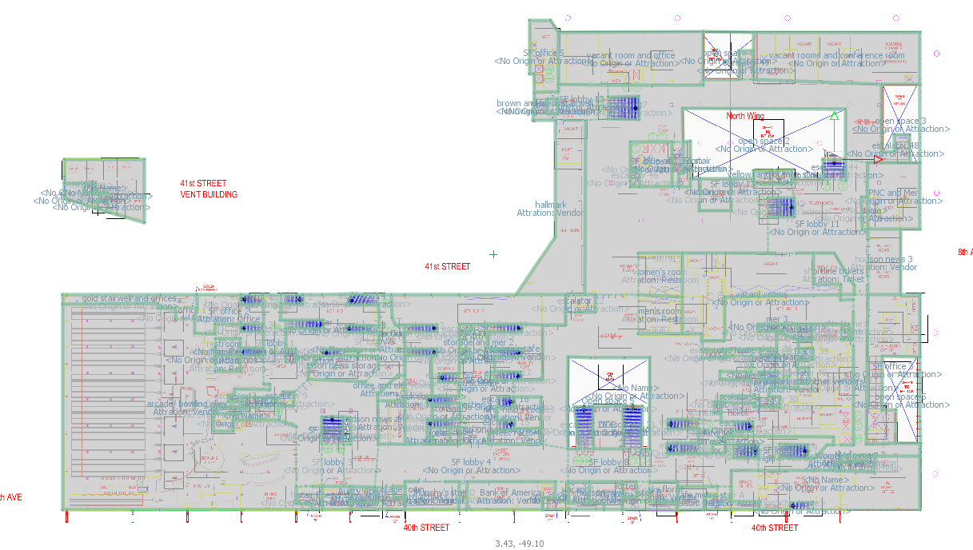
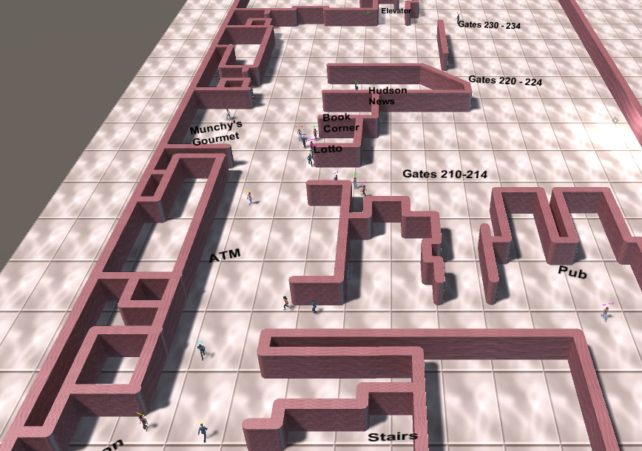
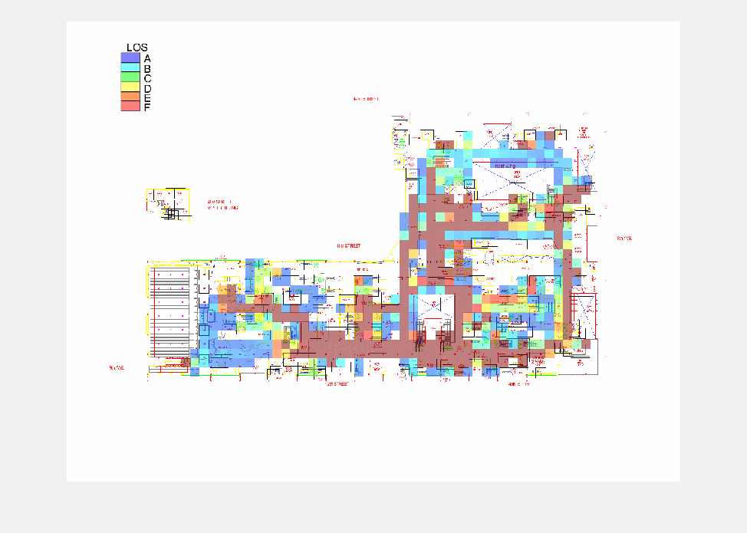
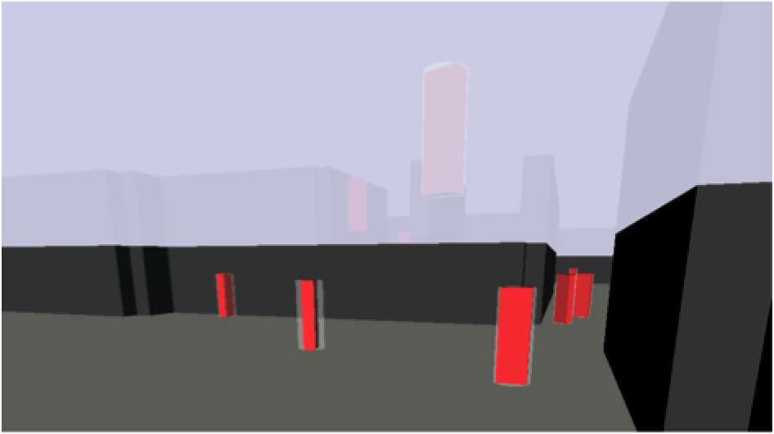
e.g., CAD, Bus Schedules,
Door counts
Data
    Statistics
User
Default large-scale scenario:
(Full day ~300K people)
What if scenario
Visualization
User
Interface
C. Visualization & Statistics
B. Fast Core Simulation

Slide 19
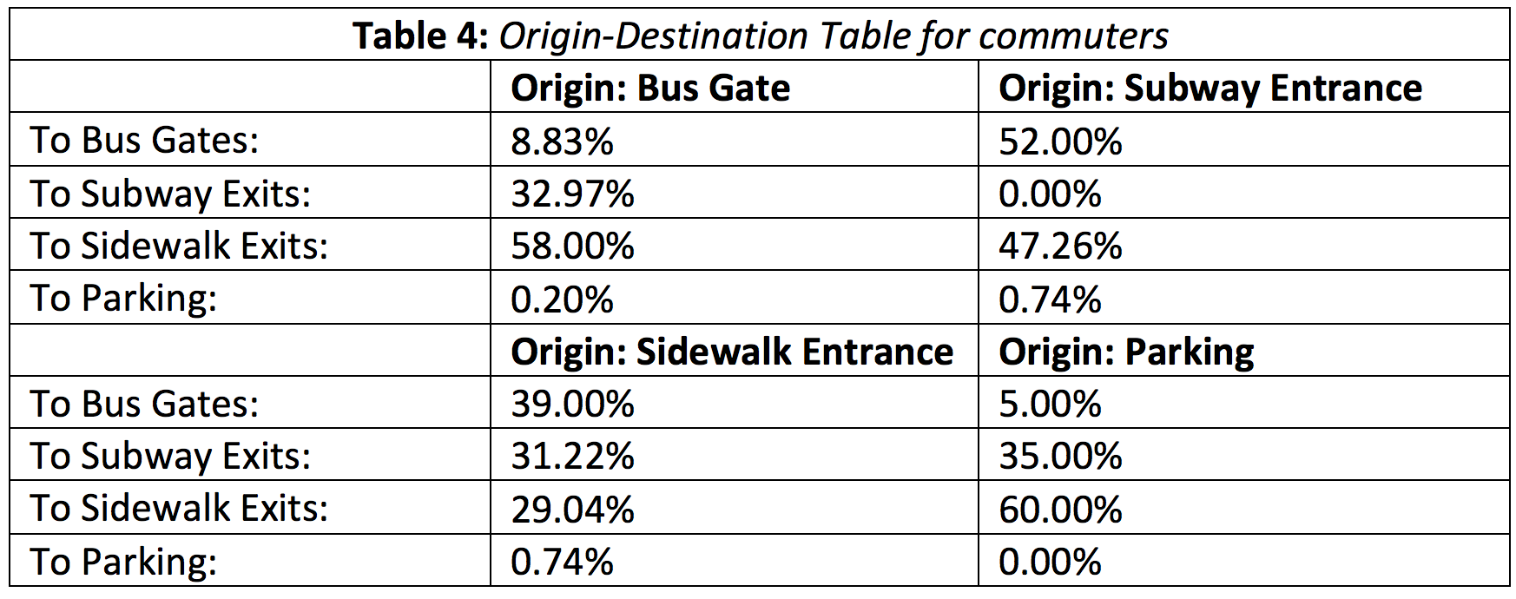
Default Values Matched Data

Slide 20
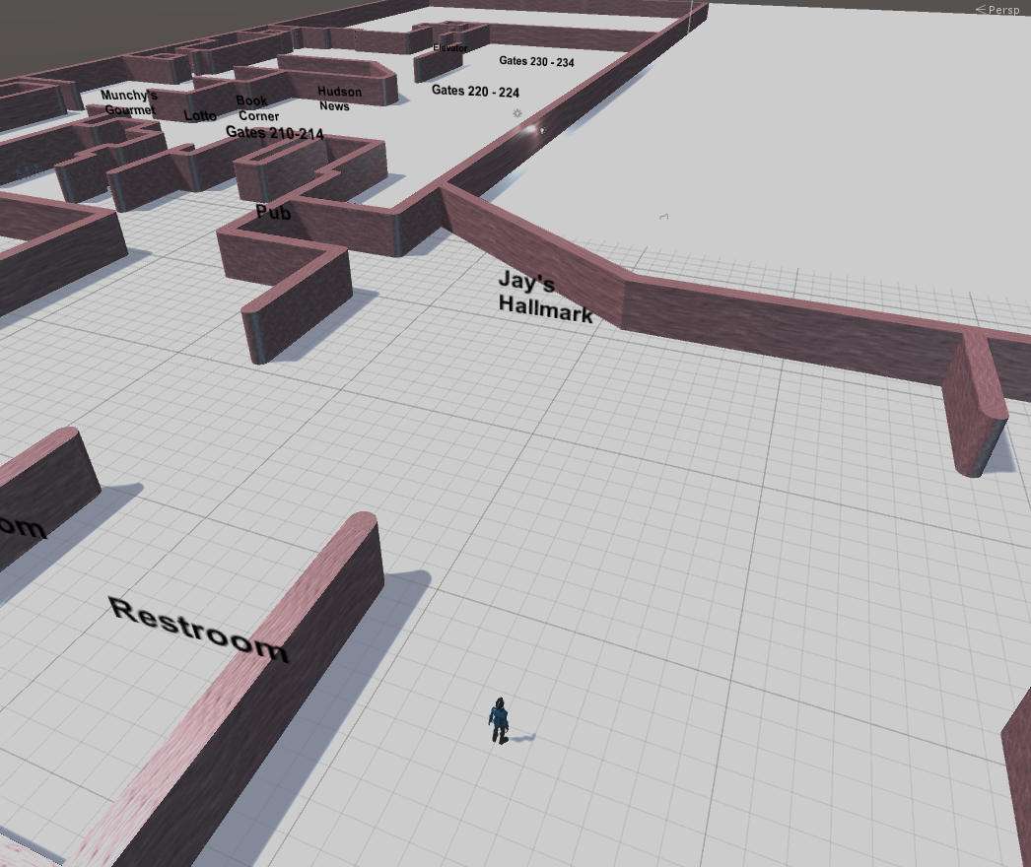
Computing Next Target
Preferences:
  Food
  Vendor
  Tickets
  Restroom
Factors:
  Distance
  Capacity
  Time
    To final destination vs
    To the attractor
Leaving Path
Reached capacity:
Low desire for the agent to go there
Based on preferences, the agent may deviate from the original path

Slide 21
Example
Notes:
Move the videos first

Slide 22
Simulation-based
Crowd Management and Environment Design

Slide 23
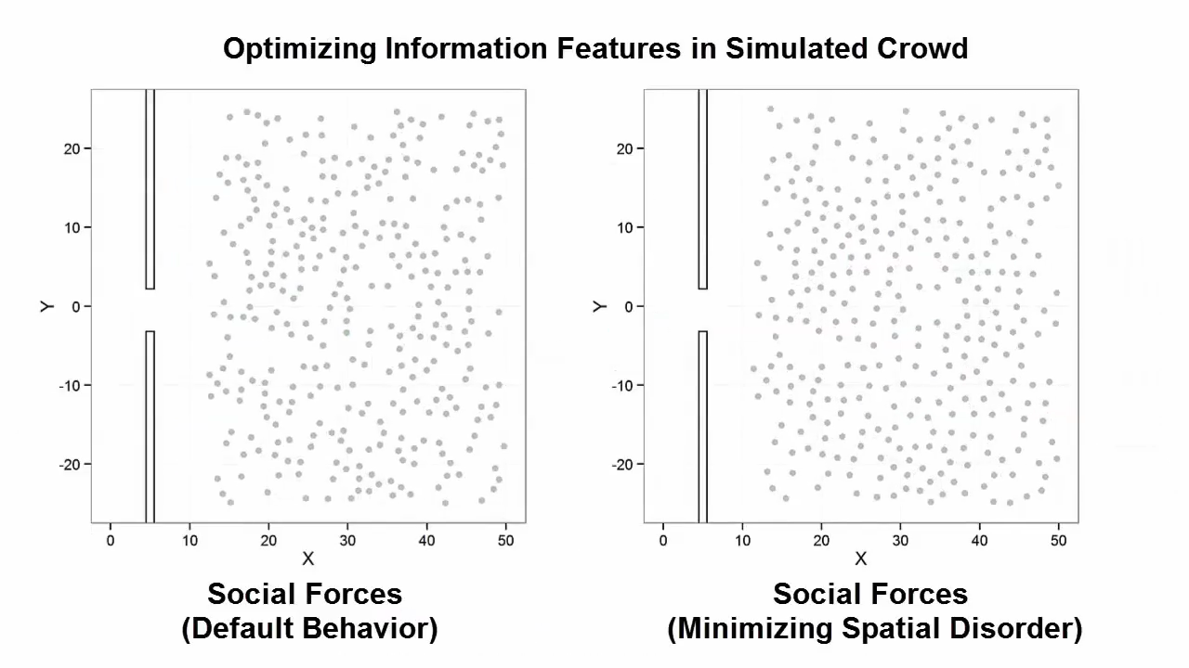
Notes:
We have developed solutions to automatically explore how altering the behavioral characteristics of an individual can dramatically impact the aggregate dynamics of a crowd. For example, collaboration while evacuating a building can dramatically reduce exit times and minimizes turbulence and potential casualties.

Slide 24
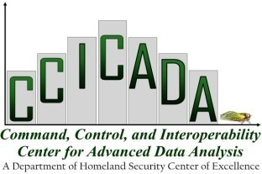
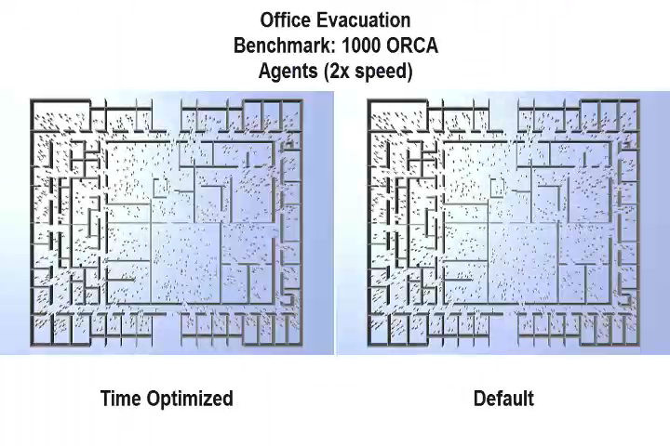
Notes:
We can apply these management strategies to study real world scenarios such as an office building.
Minor alterations to the individual behavior reduces the time to evacuate this office by a factor of 10.

Slide 25
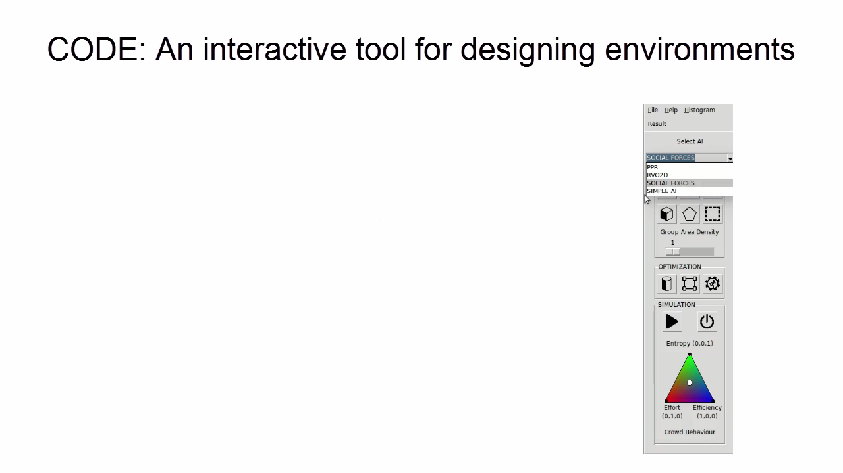
Notes:
In addition to managing crowd behavior, we are also developing tools for designing environments while accounting for the presence and movement of crowds.
In this simple prototype, a designer can interactively design a building floorplan and study the impact of how placing a pillar close to an exit can affect the flow of the crowd.

Slide 26
Notes:
We have integrated these solutions in professional architectural CAD pipelines.
In this example, we demonstrate how our tool can be used to automatically reconfigure an airport concourse to maximize the visibility of the space with respect to the surveillance cameras.

Slide 27
CCICADA’s Stadium Simulator

Slide 28
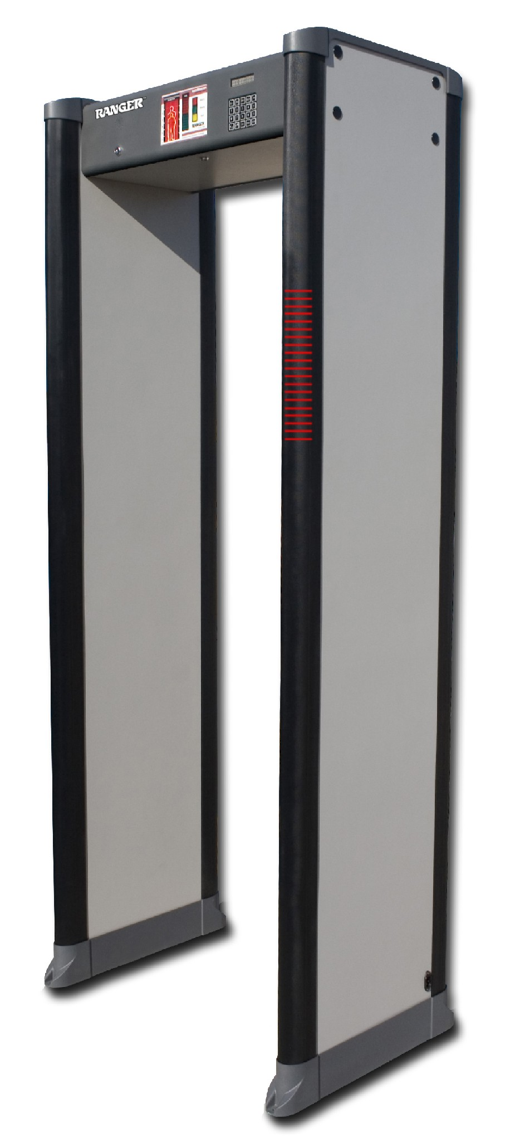
CCICADA Stadium Simulator
  Developed to simulate patron screening processes when MetLife Stadium investigated WTMD Issues:
                How many WTMDs needed?
                How many screeners needed?
                What is the “throughput”?
        Performance in bad weather?
        Training
  Observed experimental WTMD use at MetLife in December 2012
  Preliminary conclusion: Small # of WTMDs unlikely to get everyone through quickly enough.
28

Slide 29
CCICADA Stadium Simulator
  The simulator is a patron screening tool that can consider
    Variety of inspection methods
    Know for each the “throughput,” the arrival rates at different times, the error rates, etc.
    Have goals such as:
      Getting everyone in by certain time
      Not letting queues get too long – this produces vulnerabilities (and patron dissatisfaction)
      Keeping maximum wait time low
    Can you model which inspection process to use when and for how long?
29

Slide 30
Using CCICADA’s Stadium Simulator
The parameters inputted into the model:
  Arrival rates (which could differ for each game)
  Number of lanes
  Wanding times (these and other times could depend on type of clothing worn, e.g., function of weather)
  Pat-down times
  WTMD times
  Number of patrons in line before switching screening processes
Model allows you to use any numbers that make sense for a given arena.
The user can specify which screening
method (or combination of methods) to use.
30

Slide 31
Stadium Simulator Output
The simulator output file includes the following; each can be used to make decisions about screening policy:
  Total arrivals
  Total arrivals at kick-off
  Max number of patrons in line
  Number of patrons in line at kick-off
  Line “clearance” time
  Screening switch time
  Number of patrons inspected by each method
  Max waiting time per patron
31

Slide 32
The Stadium Simulator
Most of the parameters can be obtained by choosing a representative game
Parameters
  Arrival rates
  Number of lanes
  Wanding times
  Pat-down times
  WTMD times
Screening Strategy
  Switching inspection type (Y/N)
    Number of patrons in queue to switch the process, or
    Time of switch
  Does phase 2 include randomization? (Y/N)
    Ratio of patrons in each type of inspection in the randomization
The model output file includes
  In Queue @ kickoff
  Queue clearance timer
  Max Waiting Time per patron
  Max queue length
32

Slide 33
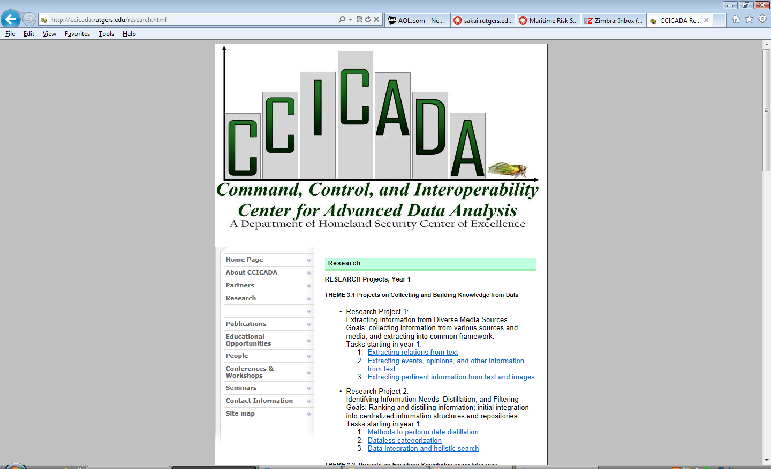
CCICADA’s Stadium Simulator
The simulation tool can be tuned for use at different venues and has been developed with input from various venues
The model can help answer many questions. For example:
    How many WTMDs would be needed to ensure the queue clears by 5 minutes after game time?
    If we have 60 lanes of wanding at a gate, how long will the queue get?
    If we switch from wanding to pat-downs when the lines get too long, what should the length be in order to get everyone in by 5 minutes after game time?
This helped MetLife decide on different screening protocols and they still use our advice regularly.
33

Slide 34
What if you Cannot Get Everyone through with WTMDs (or Wanding)?
Randomization
  Randomization is a possible policy.
  Various ideas:
    Select some patrons for WTMDs and others for pat-down – at random
    At some point, randomly select lanes to shut down WTMDs and start pat-downs
  CCICADA’s inspection tool allows us to test any of these policies too
34

Slide 35
Other Features of the CCICADA Stadium Simulator
Some of the new features added:
  Additional WTMDs can be rolled out during inspection if lines get too long
  Additional WTMDs can be rolled out at prescribed time based on planning for arrival rates and minimizing staff time
  Reversing inspection and ticket scanning to gain information about patrons
  Extra perimeter for bag-check
  Change security settings on WTMDs at random times
  Randomly select patrons for secondary screening
  Check impact of incentives to get patrons in early
35

Slide 36
CCICADA’s Stadium Simulator

Slide 37
Walk-Through Metal Detectors in Stadium Environments

Slide 38
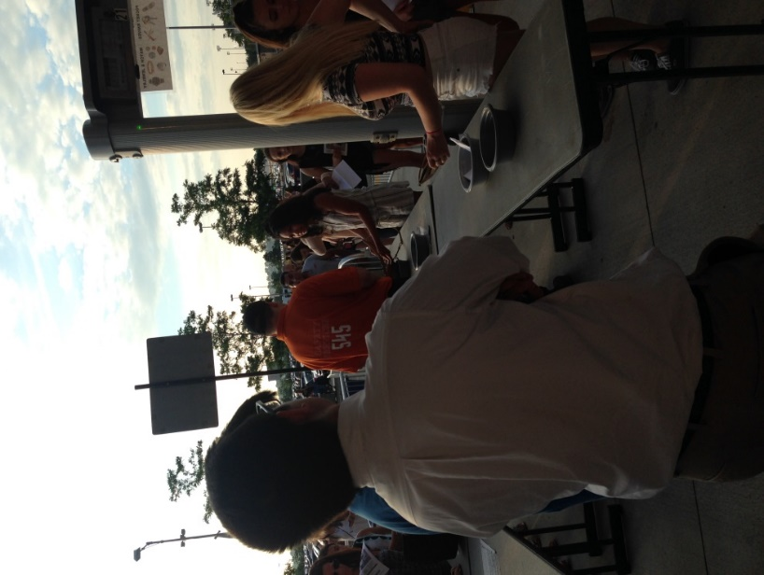
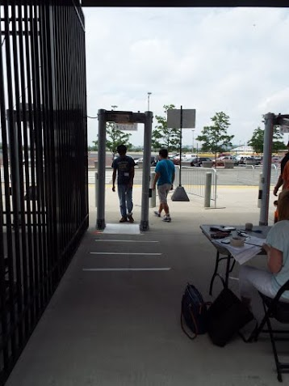
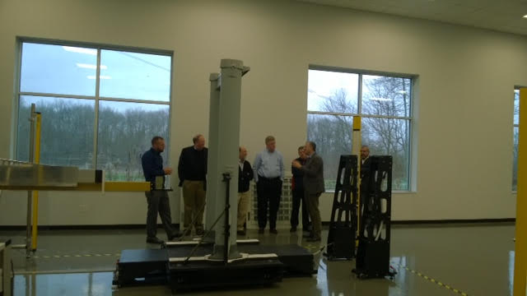
Introduction
Many experiments were performed on walk-through metal detectors (WTMDs) involving:
  How a person walks through a WTMD, and if this will impact detection
  If speed of walking or height/orientation impacts detection
  If nearby metallic objects can cause false alarms (patrons, bags, etc)
These findings may impact the next round of WTMD standards
This project with large stadiums to help gain understanding of how WTMDs perform in real settings compared to lab testing.
  Stadiums have thousands of patrons arriving in a short time
  Many must deal with weather as security is outside
  Fan experience is valued in addition to security
Notes:
Vijay

Slide 39
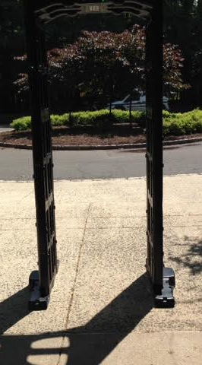
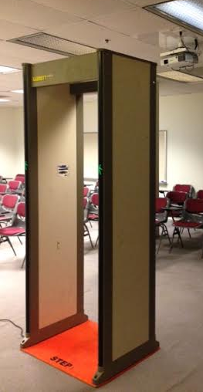
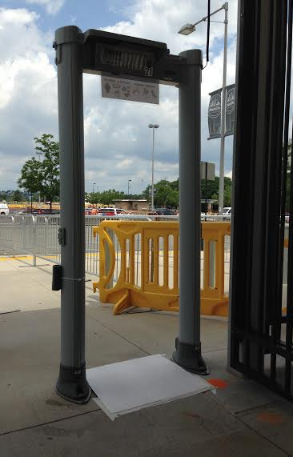
Background
Portable WTMD provided by RUPD
Medium Setting
Provided by RUPD
Calibrated WTMD to medium level
Outdoors
Medium Setting
Notes:
Vijay

Slide 40
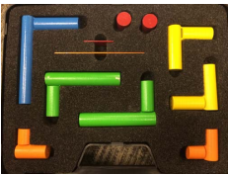
Background:
Standards for WTMDs
NILECJ 0601.00 (1974)
Series of tests to ensure WTMD works properly
Security Levels
  Level 1 (Low) – Level 5 (High)
  WTMDs can ALARM when an object passes through the portal (we call a "PASS") or NOT ALARM when an object passes through ("FAIL")
Notes:
Johnny

Slide 41
Experiment Overview
Height & Orientation
Proximity
Human gait
Speed
Notes:
Vijay

Slide 42
Experimental Design Overview
Purpose
  To gain understanding about performance of WTMDs, typically outside of the matched test objects meeting NILECJ 0601.00 standards, focusing only on those settings useful in a stadium environment
Hypotheses
  Experiment 1: Detection will change based on height and orientation of test object moving through WTMD
  Experiment 2: Proximity outside WTMD portal will impact false alarm rate
  Experiment 3: Human gait will impact detection
  Experiment 4: Speed of test object moving through WTMD portal will impact detection
Data
  We are collecting our own data using standard test objects and multiple WTMDs
Notes:
Johnny

Slide 43
Height/Orientation Experiment
Hypothesis: Detection will change based on height and/or orientation of test object moving through WTMD
Results:
If an object ALARMS, it's shown as GREEN, if it DOES NOT ALARM, it's shown as RED in results
Summary of results consider the combined trials as pass if they are > 95% passes, and fails otherwise
Notes:
Vijay

Slide 44
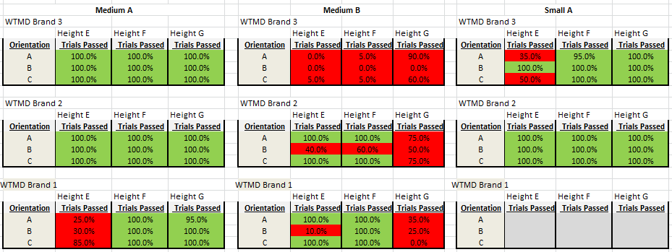
Height and Orientation Results
Summary of Medium sized NILECJ test objects (A & B) and Small test object (A) – WTMD Brand anonymized here for security reasons
Notes:
Vijay

Slide 45
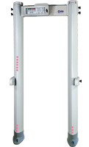
Proximity Experiment
Examined objects nearby WTMD portal (not the traditional use case of walking through the portal)
Examined distance away from WTMD – both left/right and front/back
Experiment designed with the knowledge that a lot of venues have at least one of the following potential issues in their security screening setup:
  Patron queue near WTMD entrance
  Bag check table near WTMD side
  WTMDs inches apart
  In these trials only, a PASS is only if the WTMD
  does NOT alarm
Left/Right
Front/Back
Notes:
Johnny

Slide 46
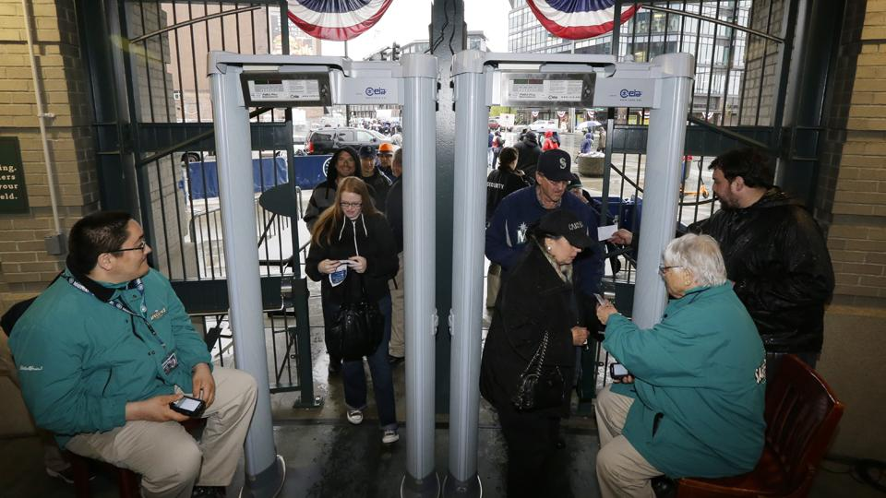
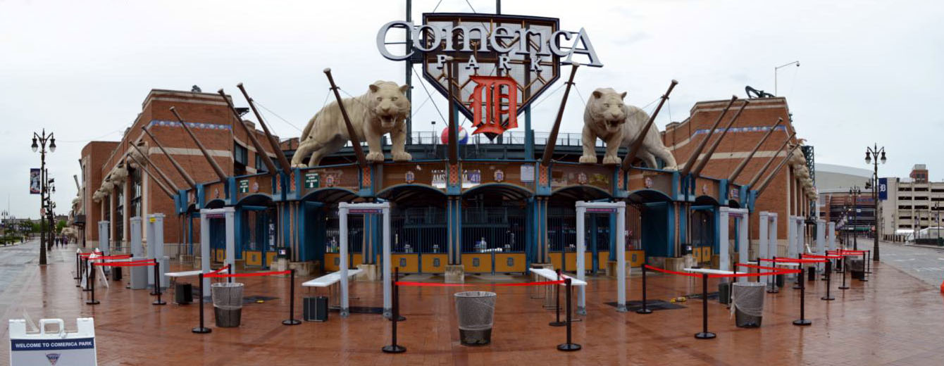
Sports Illustrated
The Ballpark Guide
Notes:
Johnny

Slide 47
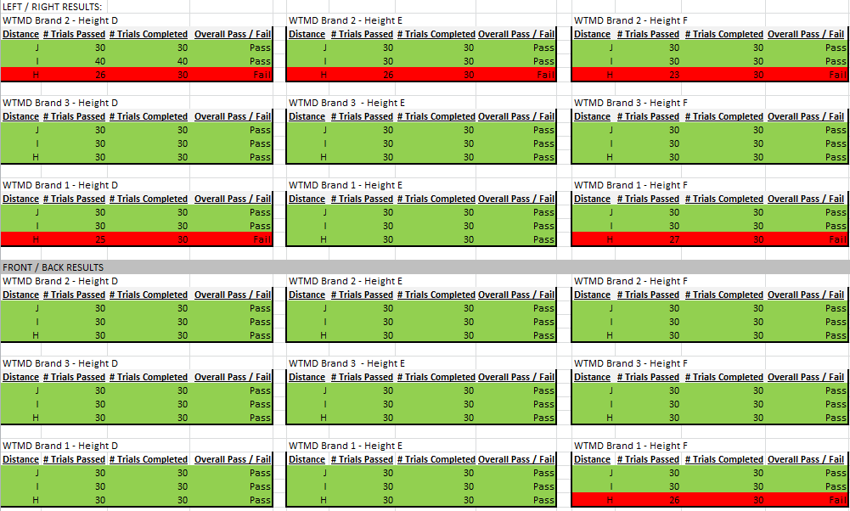
Proximity Results
Notes:
Johnny

Slide 48
Speed Experiment
Intended to examine if speed of patron impacts detection rate
Used a subset of conditions from our height/orientation experiment that had the poorest performance
Looked at 3 orientations, 2 heights, 3 speeds
Notes:
Vijay

Slide 49
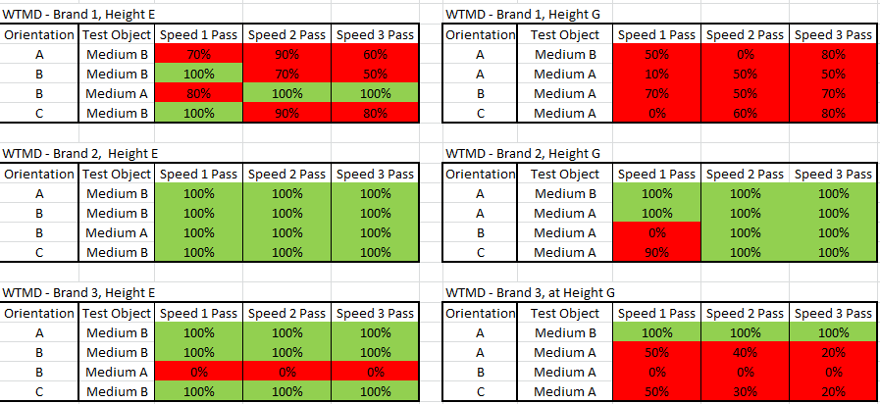
Speed Results
Notes:
Vijay

Slide 50
Concluding Thoughts
Experiments led to some intriguing findings that may lead to the re-writing of WTMD standards (either for stadium settings or possibly for WTMDs in all environments)
  How a person walks through a WTMD may impact their detection
  Alarms can be delayed, causing screeners to miss them
WTMD standards were not written the way that WTMDs are used in the field
  Robot testers
We plan to work with NIST to continue these experiments in a more formal lab environment
Notes:
Johnny

Slide 51
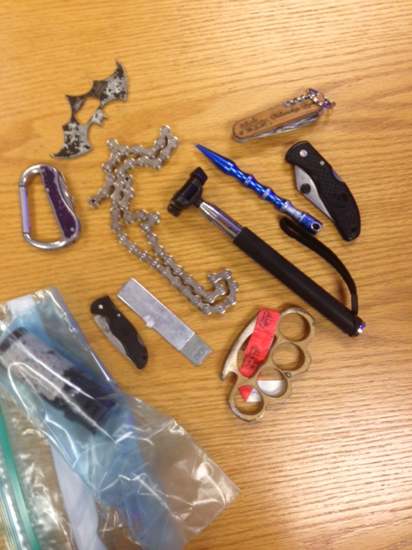
Continued & Future Work
Plan to continue this work at invitation of the Subject Matter Expert at NIST who created the metal detector standards
  Goal is to update the standards
Other research questions we are continuing to explore at Rutgers:
  What are realistic test objects for today’s stadium environment?
  How well do the WTMDs actually detect contraband that experts deem important?
  Do other methods of walking impact detection as seen in our pilot study? We plan to continue this research

Slide 52
Acknowledgements
DHS Office of University Programs
DHS Office of SAFETY Act Implementation
Port Authority of NY/NJ
CCICADA REU program for financial support
MetLife Stadium
Rutgers University Police Department and Rutgers OEM
Kostas Bekris for PABT slides
Mubbasir Kapadia for Crowd Management & Environmental Design Slides
Christie Nelson, Jon Erdman, Vijay Chaudhary for WTMD slides
Kostas Bekris, Mubbasir Kapadia, Thanasis Konriris, Andrew Dobson, Brian Ricks, Trefor Williams, Jie Gong, Peter Jin, Jim Wojtowicz, and many others for PABT research
Brian Nakamura, Thanasis Krontiris, Kevin McInerny for stadium simulation work
Notes:
Vijay

