Slide 1
Power Management in Data Centers: Theory & Practice
Mor Harchol-Balter
Computer Science Dept
Carnegie Mellon University
Anshul Gandhi, Sherwin Doroudi,
Alan Scheller-Wolf, Mike Kozuch

Slide 2
Power is Expensive
Annual U.S. data center energy consumption
100 Billion kWh or 7.4 Billion dollars
Electricity consumed by 9 million homes
As much CO₂ as all of Argentina
Sadly, most of this energy is wasted
[energystar.gov], [McKinsey & Co.], [Gartner]

Slide 3
Most Power is Wasted
Servers only busy 5-30% time on average,
but they’re left ON, wasting power. [Gartner Report] [NYTimes]
Setup
time
260s
200W
BUSY server: 200 Watts
IDLE server: 140 Watts
OFF server: 0 Watts
Intel Xeon E5520
2 quad-core 2.27 GHz
16 GB memory
ALWAYS ON:
Provision for Peak
Load
?
Time
Don’t know future load
3

Slide 4
Talk Thesis
Response
Time, T
Power, P
Key
Setup
Cost
ALWAYS ON
+ Low response time
- Wastes power
ON/OFF
- High response time
+ Might save power
x
x
x
?
x
x
?
x
x
x
x
x
x
x
x
x
x
4

Slide 5
Outline
Part I: Theory – M/M/k
Understanding the challenges:
-- What is the effect of setup time?
Part II: Systems Implementation
Dynamic power management in practice
5

Slide 6
M/M/1/Setup
Server
turns off
when idle.
Setup ~ Exp(α)
λ
jobs/sec
μ
jobs/sec
# jobs in system
λ
λ
λ
0,0
0,1
0,2
0,3
# busy servers
α
α
α
μ
λ
λ
1,1
1,2
1,3
μ
μ
[Welch ’64]
6

Slide 7
M/M/k/Setup (k=4)
# jobs in system
λ
λ
λ
λ
λ
0,0
0,1
0,2
0,3
0,4
0,5
α
2α
3α
4α
4α
λ
λ
λ
λ
μ
1,1
1,2
1,3
1,4
1,5
μ
μ
μ
μ
α
2α
3α
3α
λ
λ
λ
2μ
2,2
2,3
2,4
2,5
2μ
2μ
2μ
α
2α
2α
3μ
λ
λ
# busy servers
3,3
3,4
3,5
μ
3μ
3μ
α
α
λ
μ
4μ
λ
4,4
4,5
μ
4μ
Setup ~ Exp(α)
μ

Slide 8
M/M/k/Setup (k=4)
# jobs in system
λ
λ
λ
λ
λ
0,0
0,1
0,2
0,3
0,4
0,5
α
2α
3α
4α
4α
λ
λ
λ
λ
μ
1,1
1,2
1,3
1,4
1,5
μ
μ
μ
μ
α
2α
3α
3α
λ
λ
λ
2μ
2,2
2,3
2,4
2,5
2μ
2μ
2μ
α
2α
2α
3μ
λ
λ
# busy servers
3,3
3,4
3,5
μ
3μ
3μ
α
α
λ
μ
4μ
λ
4,4
4,5
μ
4μ
Setup ~ Exp(α)
μ
Open for 50 years

Slide 9
M/M/k/Setup (k=4)
# jobs in system
λ
λ
λ
λ
λ
0,0
0,1
0,2
0,3
0,4
0,5
α
2α
3α
4α
4α
λ
λ
λ
λ
μ
1,1
1,2
1,3
1,4
1,5
μ
μ
μ
μ
α
2α
3α
3α
λ
λ
λ
2μ
2,2
2,3
2,4
2,5
2μ
2μ
2μ
α
2α
2α
3μ
λ
λ
# busy servers
3,3
3,4
3,5
μ
3μ
3μ
α
α
λ
μ
4μ
λ
4,4
4,5
μ
4μ
Setup ~ Exp(α)
μ
Solvable only Numerically
Matrix-Analytic (MA)

Slide 10
M/M/k/Setup (k=4)
# jobs in system
λ
λ
λ
λ
λ
0,0
0,1
0,2
0,3
0,4
0,5
α
2α
3α
4α
4α
λ
λ
λ
λ
μ
1,1
1,2
1,3
1,4
1,5
μ
μ
μ
μ
α
2α
3α
3α
λ
λ
λ
2μ
2,2
2,3
2,4
2,5
2μ
2μ
2μ
α
2α
2α
3μ
λ
λ
# busy servers
3,3
3,4
3,5
μ
3μ
3μ
α
α
λ
μ
4μ
λ
4,4
4,5
μ
4μ
Setup ~ Exp(α)
μ
Wide Open

Slide 11
New Technique: RRR [Sigmetrics 13]
Finite
portion
Infinite repeating portion
Recursive Renewal Reward (RRR)
Exact. No iteration. No infinite sums.
Yields transforms of response time & power.
Closed-form for all chains that are skip-free in horizontal
direction and DAG in vertical direction.

Slide 12
New Technique: RRR [Sigmetrics 13]
Finite
portion
Infinite repeating portion
N = # jobs

Slide 13
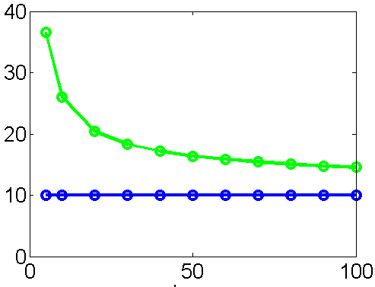
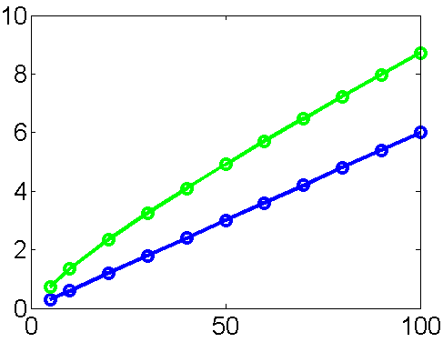
Results of Analysis
E[T] (s) →
ON/OFF
μ
λ
μ
OPT (ON/OFF with 0 setup)
μ
k →
E[P] (kW) →
ON/OFF
OPT
k →

Slide 14
Outline
Part I: Theory – M/M/k
What is the effect of setup time?
-- Setup hurts a lot when k: small
-- But setup much less painful when k: large
-- ON/OFF allows us to achieve near optimal power
Part II: Systems Implementation
Dynamic power management in practice
-- Arrivals: NOT Poisson
Very unpredictable!
-- Servers are time-sharing
-- Job sizes highly variable
-- Metric: T₉₅ < 500 ms
-- Setup time = 260 s
?
Demand
Time
14

Slide 15
Our Data Center
Power
Aware
Load
Balancer
Unknown
Load
Balancer
500 GB
DB
key-value workload
mix of CPU & I/O
1 Request = 120ms, 3000 KV pairs
Provision capacity to meet SLA
SLA: T₉₅ < 500 ms
Setup time: 260 s
7 Memcached
28 Application
servers
Notes:
I’m going to start by describing our data center. We’ve built our data center to look like a miniature version of Facebook’s data center. The incoming workload varies over time and is unknown a priori. Requests arrive into a front-end load balancer and are immediately dispatched to an application server. There is no central queue. Several hundred requests arrive each second, and each application server is time-sharing among many requests. This is not the theoretical model I showed you before. The servers are the Intel Xeon E5520 servers that I described earlier. There is also a memache layer and a database.
We’re mimicking a Facebook key-value type workload, which allows us to explore a mix of CPU and I/O. There are a billion key-value pairs in our database, many of which are cached in the memcache.
Each request at the application server starts by looking up a key in the memcache. Think of this as a person’s facebook page. This key returns a value which consists of some number of keys, 3 on average. Think of this as the person’s friends, which must be uploaded. Each of these are then looked up in memcache servers, and they each return values consisting of more keys, like the messages posted on their pages. This process repeats itself on average 8 times. Thus each request actually corresponds to anywhere from 1 key-value lookup to 3^8 or about 3500 key-value lookups, which are grouped, so that there are actually fewer.
And remember we have several hundred requests arriving each second, and immediately being dispatched to the application servers.
The application layer has many more servers than the memcache, actually in Facebook the ratio is even greater. We apply dynamic power management only to the application servers, which are stateless, so it’s easier to turn them on and off. Point: These are the servers that we’re going to turn on and off in response to changes in load.
[Requests generated by httperf according to trace-based arrivals.
Load balancer runs Apache.
App-level servers run Apache and parse PHP requests
Memcached servers have 16GB memory.
DB is BerkeleyDB]
[app servers turned on and off via SNMP communication protocol via PDU (power distribution unit)]
[power values read off the PDU]
Explain bullets
Our first step in building our data center was provisioning the data center. Remember that we said that each app server can handle multiple requests at once.

Slide 16
Provisioning
At Single Server
At Single Server
T₉₅
T₉₅
450 ms
450 ms
arrival rate
arrival rate
60 req/s
60 req/s
AlwaysOn
ON/OFF
x
r(t)
?
r(t)
x
x
x
x
?
x
x
x
x
x
x
x
x
x
x
t
t

Slide 17
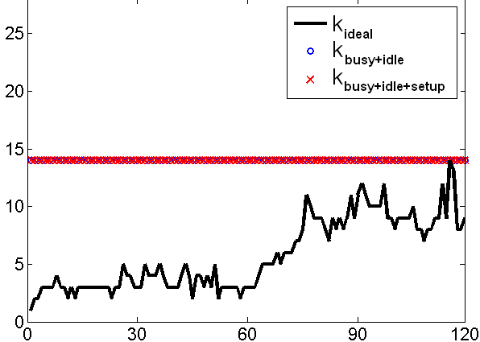
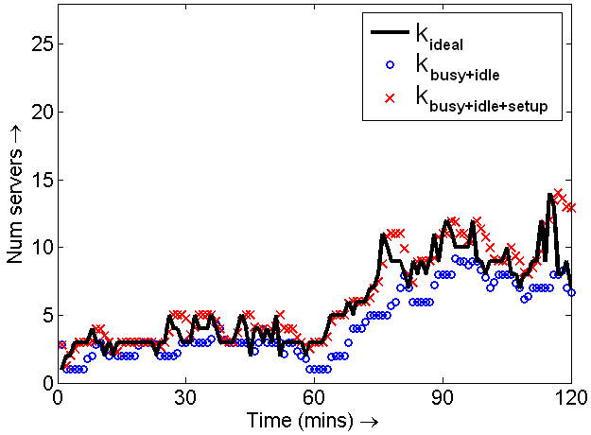
AlwaysOn
ON/OFF
______ load
o k_{busy+idle}
x k_{busy+idle+setup}
______ load
o k_{busy+idle}
x k_{busy+idle+setup}
Num. servers →
Num. servers →
Time (min) →
Time (min) →
T₉₅=291ms, P_{avg}=2,323W
T₉₅=11,003ms, P_{avg}=1,281W
I’m late,
I’m late!
17

Slide 18
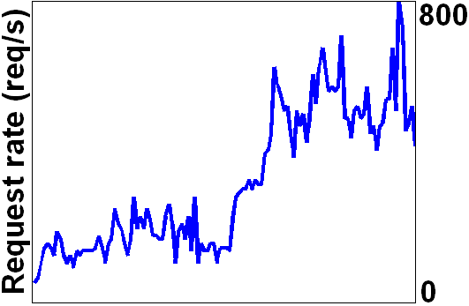
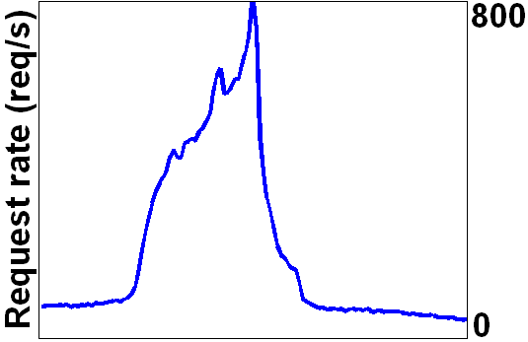
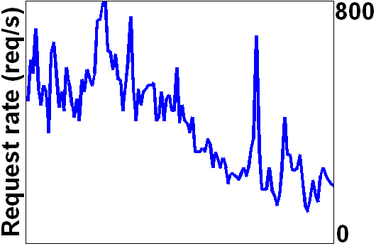
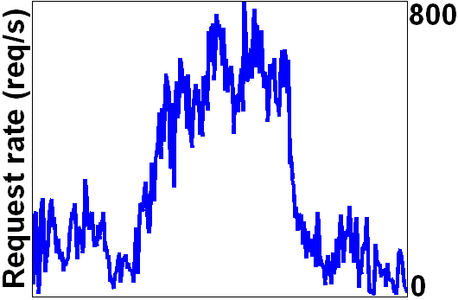
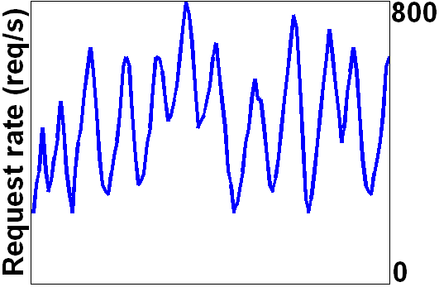
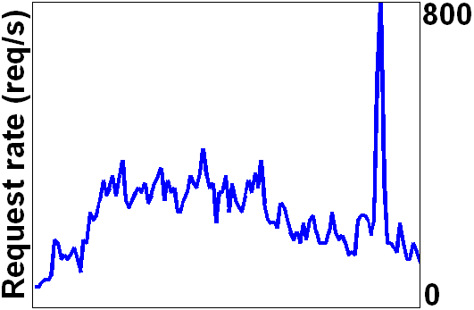
ON/OFF Variants
Reactive
Control-Theoretic
Predictive
[Krioukov, …, Culler, Katz ‘10]
[Castellanos et al. ‘05]
[Horvath, Skadron ’08]
[Urgaonkar, Chandra ‘05]
[Bennani, Menasce ‘05]
[Gmach et al. ‘08]
[Leite, Kusic, Mosse ‘10]
[Nathuji, Kansal, Ghaffarkhah ‘10]
[Fan, Weber, Barroso ‘07]
[Wang, Chen ‘08]
[Wood, Shenoy, … ‘07]
[Chen, He, …, Zhao ’08]
[Chen, Das, …, Gautam ’05]
[Bobroff, Kuchut, Beaty ‘07]
-- All suffer from setup lag.
-- All too quick to shut servers off.
-- All provision based on arrival rate.

Slide 19
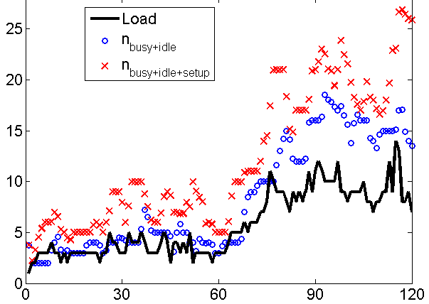
ON/OFF
ON/OFF+padding
______ load
o n_{busy+idle}
x n_{busy+idle+setup}
Num. servers →
Num. servers →
x = 100
Time (min) →
Time (min) →
T₉₅=11,003ms, P_{avg}=1,281W
T₉₅=487ms, P_{avg}=2,218W

Slide 20
A Better Idea: AutoScale
Two new ideas
Wait some time (t_{wait})
before turning
idle server off
Existing ON/OFF policies
are too quick to turn
servers off …
then suffer huge setup lag.
“Un-balance” load: Pack jobs onto
as few servers
as possible
w/o violating SLAs
[Transactions on Computer Systems 2012]
Notes:
I’ll explain AutoScaling in terms of a few key principles. Let’s consider the fundamental problems with the existing ON/OFF type policies.
The first problem has to do with shutting off servers. The existing policies are too quick to shut servers off when the request rate drops, hoping to save power. But then they suffer the huge setup lag to get these servers back on, when the request rate goes back up.
The solution has 2 parts. The first part is to never dictate that the number of servers needs to be reduced. Don’t ever decide that some servers need to be shut down based on the arrival rate. Instead use an *organic* solution. Just wait for server to go idle on its own, and even then, wait a little longer before actually turning it off. Note that this is very different from policies that compute N based on arrival rate and then deem servers as needing to be shut off. Instead we organically let servers turn off whenever they go idle.
But why would a server go idle? If we’ve got hundreds of requests arriving per second and these are being load balanced among all available servers, then every server is working on many requests simultaneously. How would a server ever go idle? The second part of the solution is to use a packing algorithm. The packing algorithm indexes the servers and packs each server with the maximum number of jobs that it can handle while meeting its response time SLA. So you number the servers: 1, 2, 3, etc. Then always send requests to server 1 until it’s fully packed. At that point start sending requests to server 2, but if space frees up on server 1, then send requests there. Always keep the lowest-numbered servers packed. The high-numbered servers will turn off on their own. In fact, it can be proved that combining packing with the idea of waiting for servers to go idle organically converges to the optimal number of servers, without knowing the arrival rate.
Observe that none of these decisions are made based on looking at the incoming request rate. We simply pack and then let servers turn off on their own.
The second problem is has to do with turning servers on. Existing policies all either measure or try to predict arrival rate into the data center and then use that arrival rate to determine the number of servers that they need to have on. It turns out that using the arrival rate is a somewhat poor predictor for provisioning. The problem is that it doesn’t give you instantaneous information about the current state of the system. A much more accurate predictor is using the current number of jobs in the system because that gives us instantaneous information about what’s actually happening in the system. Consider for example that job sizes have high variability (as ours do). Then there could be some really big jobs, clogging up the system. The arrival rate may be low, so we think that we don’t need to turn on more servers. But in reality the situation is bad, which is reflected in the number of jobs in the system being high, and we actually do need to turn on servers. We have a method for using the current number of jobs in the system to assess the true load in the system and convert that to the actual number of needed servers. This method is even robust to situations where jobs suddenly all get bigger, or servers get slower, or whatever.
[This algorithm is described in a paper in submisison.]

Slide 21
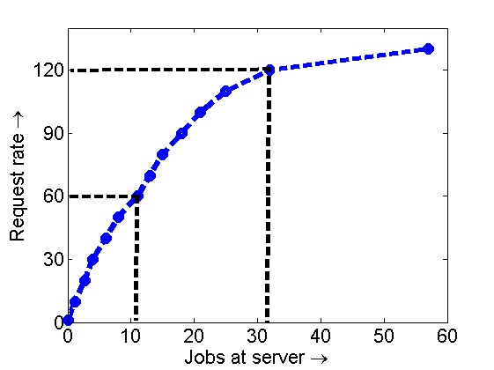
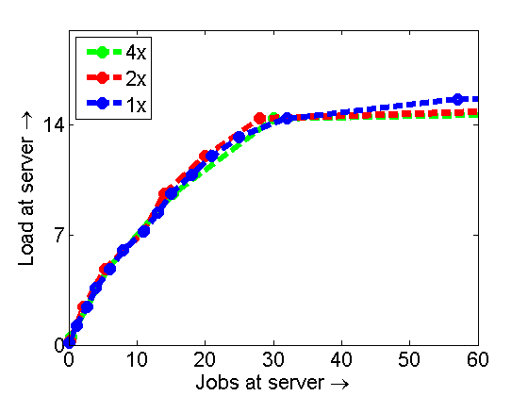
Scaling Up via AutoScale
When scaling up capacity, # jobs/server is a
more robust indicator than current request rate.
But not so obvious how to use # jobs/server …
10 jobs/server ⬄ load ρ
30 jobs/server ⬄ load 2ρ
10 jobs/server ⬄ 60 req/s
30 jobs/server ⬄ 120 req/s
2ρ
ρ
[Transactions on Computer Systems 2012]
21

Slide 22
Why AutoScale works
Theorem (loosely): As k → ∞, AutoScale’s capacity approaches square-root staffing.
Theorem : As k → ∞, M/M/k with DelayedOff + Packing
[ Performance Evaluation, 2010 (b)]

Slide 23
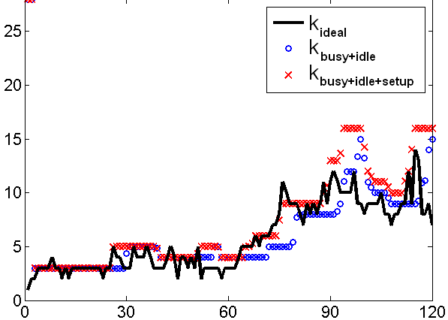
ON/OFF
AutoScale
______ load
o k_{busy+idle}
x k_{busy+idle+setup}
______ load
o n_{busy+idle}
x n_{busy+idle+setup}
Num. servers →
Num. servers →
Time (min) →
Time (min) →
T₉₅=11,003ms, P_{avg}=1,281W
T₉₅=491ms, P_{avg}=1,297W
I’m late,
I’m late!
Within 30% of OPT
power on all our traces!
Facebook cluster-testing AS

Slide 24
Results
 | _{AlwaysOn} |  | _{ON/OFF} |  | _{AutoScale}
 | T₉₅ | P_{avg} | T₉₅ | P_{avg} | T₉₅ | P_{avg}
 | ₂₉₁ _{ms} | ₂₃₂₃ _{W} | _{11,003 ms} | ₁₂₈₁ _{W} | ₄₉₁ _{ms} | ₁₂₉₇ _{W}
 | 271 ms | 2205 W | 3,802 ms | 759 W | 466 ms | 1016 W
 | 289 ms | 2363 W | 4,227 ms | 1,391 W | 470 ms | 1679 W
 | 377 ms | 2263 W | > 1 min | 849 W | 556 ms | 1412 W
[Transactions on Computer Systems 2012]

Slide 25
Conclusion
Dynamic power management ➔ Managing the setup cost
Part I: Effect of setup in M/M/k
First analysis of M/M/k/setup and M/M/∞/setup
Introduced RRR technique for analyzing repeating Markov chains
Effect of setup cost is very high for small k,
but diminishes as k increases
Part II: Managing the setup cost in data centers
Non-Poisson arrival process; load unknown; unpredictable spikes
Leaving servers AlwaysOn wastes power, but setup can be deadly.
Lesson: Don’t want to rush to turn servers off.
Proposed AutoScale with Delayedoff, Packing routing & Non-linear Scaling.
Demonstrated effectiveness of AutoScale in practice.
Proved AutoScale has very good asymptotic behavior.

Slide 26
References
Anshul Gandhi, Sherwin Doroudi, Mor Harchol-Balter, Alan Scheller-Wolf. "Exact Analysis of the M/M/k/setup Class of Markov Chains via Recursive Renewal Reward." Proceedings of ACM SIGMETRICS 2013 Conference, June 2013.
Anshul Gandhi, Mor Harchol-Balter, Ram Raghunathan, and Mike Kozuch. "AutoScale: Dynamic, Robust Capacity Management for Multi-Tier Data Centers." ACM Transactions on Computer Systems, vol. 30, No. 4, Article 14, 2012, pp. 1-26.
Anshul Gandhi, Mor Harchol-Balter, and Ivo Adan. "Server farms with setup costs." Performance Evaluation, vol. 67, no. 11, 2010, pp. 1123-1138.
Anshul Gandhi, Varun Gupta, Mor Harchol-Balter, and Michael Kozuch. "Optimality Analysis of Energy-Performance Trade-off for Server Farm Management." Performance Evaluation vol. 67, no. 11, 2010, pp. 1155-1171.
Thank You!

