Slide 1
Performance Diagnosis and Improvement in Data Center Networks
Minlan Yu
minlanyu@usc.edu
University of Southern California
Notes:
Thanks for the introduction. I’m happy to present the talk to you today.

Slide 2






Data Center Networks
Switches/Routers
(1K - 10K)
….
….
….
….
Servers and Virtual Machines
(100K – 1M)
Applications
(100 - 1K)
Notes:
Virtual machine migration

Slide 3
Multi-Tier Applications
Applications consist of tasks
  Many separate components
  Running on different machines
Commodity computers
  Many general-purpose computers
  Easier scaling
Front end Server
Aggregator
… …
Aggregator
Aggregator
Aggregator
…
…
Worker
Worker
Worker
Worker
Worker

Slide 4
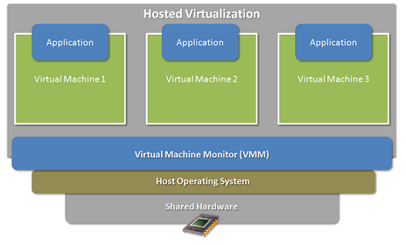
Virtualization
Multiple virtual machines on one physical machine
Applications run unmodified as on real machine
VM can migrate from one computer to another

Slide 5
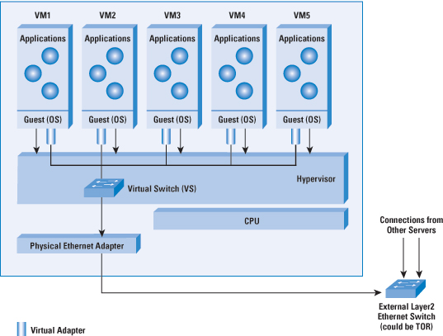
Virtual Switch in Server

Slide 6
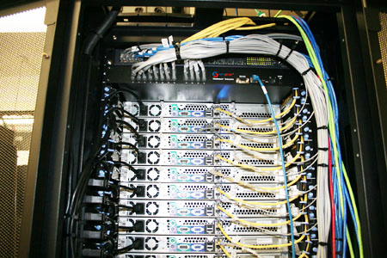
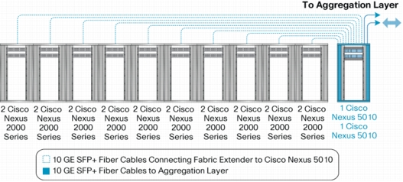
Top-of-Rack Architecture
Rack of servers
  Commodity servers
  And top-of-rack switch
Modular design
  Preconfigured racks
  Power, network, and
  storage cabling
Aggregate to the next level

Slide 7
Traditional Data Center Network
Internet
CR
CR
. . .
AR
AR
AR
AR
S
S
S
S
S
S
. . .
A
A
…
A
A
A
…
A
Key
CR = Core Router
AR = Access Router
S = Ethernet Switch
A = Rack of app. servers
~ 1,000 servers/pod

Slide 8
Over-subscription Ratio
CR
CR
~ 200:1
AR
AR
AR
AR
S
S
S
S
~ 40:1
S
S
S
S
. . .
S
S
S
S
~ 5:1
A
A
…
A
A
A
…
A
A
A
…
A
A
A
…
A
Notes:
For example, servers typically have : over-subscription to
other servers in the same rack — that is, they can communicate at
the full rate of their interfaces (e.g.,  Gbps). We found that up-links
from ToRs are typically : to : oversubscribed (i.e.,  to  Gbps
of up-link for  servers), and paths through the highest layer of
the tree can be : oversubscribed.

Slide 9
Data-Center Routing
Internet
CR
CR
DC-Layer 3
. . .
AR
AR
AR
AR
DC-Layer 2
S
S
S
S
S
S
S
S
. . .
S
S
S
S
Key
CR = Core Router (L3)
AR = Access Router (L3)
S = Ethernet Switch (L2)
A = Rack of app. servers
A
A
…
A
A
A
…
A
~ 1,000 servers/pod == IP subnet
Connect layer-2 islands by IP routers

Slide 10
Layer 2 vs. Layer 3
Ethernet switching (layer 2)
  Cheaper switch equipment
  Fixed addresses and auto-configuration
  Seamless mobility, migration, and failover
IP routing (layer 3)
  Scalability through hierarchical addressing
  Efficiency through shortest-path routing
  Multipath routing through equal-cost multipath

Slide 11
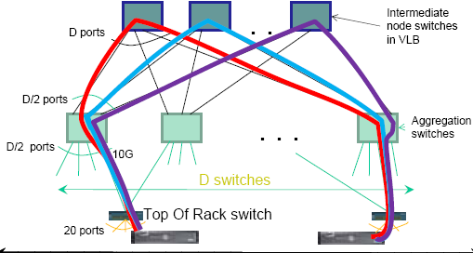
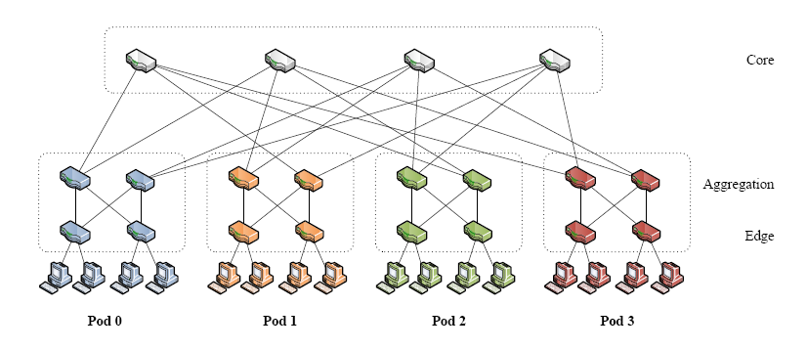
Recent Data Center Architecture
Recent data center network (VL2, FatTree)
  Full bisectional bandwidth to avoid over-subscirption
  Network-wide layer 2 semantics
  Better performance isolation

Slide 12
The Rest of the Talk
Diagnose performance problems
  SNAP: scalable network-application profiler
  Experiences of deploying this tool in a production DC
Improve performance in data center networking
  Achieving low latency for delay-sensitive applications
  Absorbing high bursts for throughput-oriented traffic

Slide 13

Profiling network performance for multi-tier data center applications
(Joint work with Albert Greenberg, Dave Maltz, Jennifer Rexford, Lihua Yuan, Srikanth Kandula, Changhoon Kim)
Notes:
Talk about how SNAP helps developers and auto-adaptation

Slide 14


Applications inside Data Centers
….
….
….
….
Front end Server
Aggregator
Workers
Notes:
A single application(propagated and aggregated), the same server is shared by many more apps, some are delay sensitive while others have high throughput. All these applications inside data centers are already complicated when things are right, but what if something goes wrong?

Slide 15
Challenges of Datacenter Diagnosis
Large complex applications
  Hundreds of application components
  Tens of thousands of servers
New performance problems
  Update code to add features or ﬁx bugs
  Change components while app is still in operation
Old performance problems (Human factors)
  Developers may not understand network well
  Nagle’s algorithm, delayed ACK, etc.
Notes:
We have many low-level protocols such as….that is a mystery to developers without a networking background, but these protocols may have significant performance impact. It could be a disaster for a database expert to work with a TCP stack
- slide 34: audience probably won't know what "Nagle's algorithm" and "delayed ACK" are. you can finesse this out loud, and say that networking protocols have many low-level mechanisms (and view these as examples you don't expect the audience to know).
in practice, I think Microsoft doesn't
really "hot swap" in the new code, but rather brings up new images for a
service and gradually phase out the old ones your point is more that change
in constant.
Just stress the point about constant influx of new developers out loud.
silly window syndrome

Slide 16
Diagnosis in Today’s Data Center
Packet trace:
Filter out trace for long delay req.
App logs:
#Reqs/sec
Response time
1% req. >200ms delay
Host
App
Too expensive
Application-specific
OS
Packet sniffer
SNAP:
Diagnose net-app interactions
Switch logs:
#bytes/pkts per minute
Generic, fine-grained, and lightweight
Too coarse-grained
Notes:
Google and microsoft
100K$ a few monitoring machines monitor two racks of servers

Slide 17
SNAP: A Scalable Net-App Profiler that runs everywhere, all the time

Slide 18
SNAP Architecture
At each host for every connection
Collect data
Notes:
Overview to give sense of what SNAP is
Tuning polling rate to reduce overhead
Input
Topology, routing information
Mapping from connections to processes/apps
Sharing the same switch/link, app code

Slide 19
Collect Data in TCP Stack
TCP understands net-app interactions
  Flow control: How much data apps want to read/write
  Congestion control: Network delay and congestion
Collect TCP-level statistics
  Defined by RFC 4898
  Already exists in today’s Linux and Windows OSes

Slide 20
TCP-level Statistics
Cumulative counters
  Packet loss: #FastRetrans, #Timeout
  RTT estimation: #SampleRTT, #SumRTT
  Receiver: RwinLimitTime
  Calculate the difference between two polls
Instantaneous snapshots
  #Bytes in the send buffer
  Congestion window size, receiver window size
  Representative snapshots based on Poisson sampling
Notes:
Two types: elevate the difference to the beginning of the patter. Some are easier to deal with - cumulative, some are hard - requires being lucky enough to sample at the instant something interesting happens
Counters will catch every event that happens even when the polls are too large
Sampling periodically may miss some value, so we choose Poisson which can guarantee that we can get a statistically accurate overview of these values.
Poisson sampling can make sure the distribution of sampling data is meaningful …
Example variables, there are many others…
PASTA, Independent of underlying statistical distribution
Data are used for classify and to show details for people to …
Why Poisson sampling? – to get meaningful values…

Slide 21
SNAP Architecture
At each host for every connection
Collect data
Performance Classifier
Notes:
Overview to give sense of what SNAP is
Tuning polling rate to reduce overhead
Input
Topology, routing information
Mapping from connections to processes/apps
Sharing the same switch/link, app code

Slide 22
Life of Data Transfer
Sender App
Application generates the data
Copy data to send buffer
TCP sends data to the network
Receiver receives the data and ACK
Send Buffer
Network
Receiver
Notes:
Here we show a simple example on the basic data transfer stages that can help illustrate the problems that come from different stages.
this simple example useful to explain where performance impairments happen. make clear that this is the simple life cycle shown so you can explain the very useful taxonomy that we came up with.

Slide 23
Taxonomy of Network Performance
Sender App
  No network problem
  Send buffer not large enough
  Fast retransmission
  Timeout
  Not reading fast enough (CPU, disk, etc.)
  Not ACKing fast enough (Delayed ACK)
Send Buffer
Network
Receiver
Notes:
Nagle and delayed ack… : small data which trigger Nagle’s algo.

Slide 24
Identifying Performance Problems
Sender App
  Not any other problems
  #bytes in send buffer
  #Fast retransmission
  #Timeout
  RwinLimitTime
  Delayed ACK
  diff(SumRTT) > diff(SampleRTT)*MaxQueuingDelay
Send Buffer
Sampling
Network
Direct
measure
Receiver
Inference
Notes:
Nagle and delayed ack… : small data which trigger Nagle’s algo.
What is the assumptions about why send buffer is full? Maybe recv window/congestion is the cause…

Slide 25
SNAP Architecture
Online, lightweight processing & diagnosis
Offline, cross-conn diagnosis
Management System
Topology, routing
Conn → proc/app
At each host for every connection
Cross-connection correlation
Collect data
Performance Classifier
Offending app,
host, link, or switch
Notes:
Shared resource: host, link, or switch
Overview to give sense of what SNAP is
Tuning polling rate to reduce overhead
Input
Topology, routing information
Mapping from connections to processes/apps
Sharing the same switch/link, app code

Slide 26
SNAP in the Real World
Deployed in a production data center
  8K machines, 700 applications
  Ran SNAP for a week, collected terabytes of data
Diagnosis results
  Identified 15 major performance problems
  21% applications have network performance problems
Notes:
Terabytes , less than 1 GB per machine per day
Read every 500 ms
700 always running, persistent connection
> - summarize that you found 15 serious performance bugs and worked with
developers to fix their code.

Slide 27
Characterizing Perf. Limitations
#Apps that are limited for > 50% of the time
Send Buffer
  Send buffer not large enough
1 App
  Fast retransmission
  Timeout
Network
6 Apps
Receiver
8 Apps
  Not reading fast enough (CPU, disk, etc.)
  Not ACKing fast enough (Delayed ACK)
144 Apps
Notes:
6 apps self inflicted packet loss" "incast
Life of transfer: be sure to talk about ack
One connection is always limited by one component, it’s good for the network, if it’s limited by apps
Nagle and delayed ack… : small data which trigger Nagle’s algo.

Slide 28
Delayed ACK Problem
Delayed ACK affected many delay sensitive apps
  even #pkts per record → 1,000 records/sec
  odd #pkts per record → 5 records/sec
  Delayed ACK was used to reduce bandwidth usage and server interrupts
A
B
Data
ACK every
other packet
ACK
Proposed solutions:
Delayed ACK should be disabled in data centers
….
Data
200 ms
ACK
Notes:
point out 1000s txn/s versus 5, based on parity of number of packets in request. Delayed ack disable cost (at least mention)
configuration-file distribution service
1M connections…
- clarify up front that Delayed ACK is a mechanism in TCP, not something added
by the developers or operators in the data center.

Slide 29
Send Buffer and Delayed ACK
SNAP diagnosis: Delayed ACK and zero-copy send
Application buffer
Application
With Socket Send Buffer
1. Send complete
Socket send buffer
Receiver
Network
Stack
2. ACK
Application buffer
Application
Zero-copy send
2. Send complete
Receiver
Network
Stack
1. ACK
Notes:
Change app if use zero—
Proxy collecting logs from servers
call it zero copy send "windows, of course, supports speed optimizations like zero copy send, but ..."

Slide 30
Problem 2: Timeouts for Low-rate Flows
SNAP diagnosis
  More fast retrans. for high-rate flows (1-10MB/s)
  More timeouts with low-rate flows (10-100KB/s)
Proposed solutions
  Reduce timeout time in TCP stack
  New ways to handle packet loss for small flows
  (Second part of the talk)
Notes:
Problem
Low-rate flows are not the cause of congestion
But suffer more from congestion

Slide 31
Problem 3:
Congestion Window Allows Sudden Bursts
Increase congestion window to reduce delay
  To send 64 KB data with 1 RTT
  Developers intentionally keep congestion window large
  Disable slow start restart in TCP
Drops after an idle time
Window
t
Notes:
At any time, cwd is large enough …. But cwd gets reduced …
Aggregator distributing requests

Slide 32
Slow Start Restart
SNAP diagnosis
  Significant packet loss
  Congestion window is too large after an idle period
Proposed solutions
  Change apps to send less data during congestion
  New design that considers both congestion and delay (Second part of the talk)

Slide 33
SNAP Conclusion
A simple, efficient way to profile data centers
  Passively measure real-time network stack information
  Systematically identify problematic stages
  Correlate problems across connections
Deploying SNAP in production data center
  Diagnose net-app interactions
  A quick way to identify them when problems happen
Notes:
these problems, while known at some level, *do* really occur in practice, and people need to find and resolve these problems efficiently.
SNAP demonstrates that
Help operators improve platform and tune network
Help developers to pinpoint app problems

Slide 34

Don’t Drop, detour!!!!
Just-in-time congestion mitigation for Data Centers
(Joint work with Kyriakos Zarifis, Rui Miao, Matt Calder, Ethan Katz-Basset, Jitendra Padhye)
Notes:
Talk about how SNAP helps developers and auto-adaptation

Slide 35
Virtual Buffer During Congestion
Diverse traffic patterns
  High throughput for long running flows
  Low latency for client-facing applications
Conflicted buffer requirements
  Large buffer to improve throughput and absorb bursts
  Shallow buffer to reduce latency
How to meet both requirements?
  During extreme congestion, use nearby buffers
  Form a large virtual buffer to absorb bursts

Slide 36
DIBS: Detour Induced Buffer Sharing
When a packet arrives at a switch input port
  the switch checks if the buffer for the dst port is full
If full, select one of other ports to forward the pkt
  Instead of dropping the packet
Other switches then buffer and forward the packet
  Either back through the original switch
  Or through an alternative path
Notes:
Output buffer switch

Slide 37
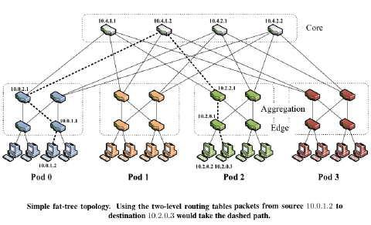
An Example

Slide 38
An Example
Notes:
This is especially true with Partition/Aggregate traffic patterns, when, for example, all of these 15 servers send traffic to...

Slide 39
An Example
Notes:
... this server simultaneously. When that happens, where do you imagine congestion will happen?

Slide 40
An Example
Notes:
When a packet experiences congestions, packet gets dropped
Then the sender retransmit or reduce the congestion window/send less
The nature of incast problem is that if one flow gets delayed, the whole query completion time becomes huge. Therefore, data centers often have low retransmission time, or ask the switch to send signals to the sender to reduce the congestion window to avoid such packet loss
Congestion will happen in this pod, because it has more traffic coming in than it can send down to the server (remember that all these links are 1Gbps).
Specifically, the last edge switch will become a hotspot, and, depending on how heavy the incoming traffic is, maybe also the two aggregate switches above it.
When that happens, one of those switches will drop a packet, and TCP will tell the sender of that packet to a) retransmit it and b) slow down by halving its CWND
This is why that's bad:
When all of these 15 servers send to this one receiver, we have 15 small simultaneous flows sent here. The time it takes for each one of those individual flows to complete is called Flow Completion Time. This is approximately the same for all 15 flows. If one packet gets dropped here, one of those flows will have to suffer a retransmission, and will have to reduce it's sending speed. The problem is that the receiver can't do anything with its task until it has received all data from all servers. This is why in datacenters the retransmission timeout is set really low (and also the initial congestion window is large, in order to try and fit the whole short flow in one window). So what matters here is not the individual Flow Completion Times, but the overall Query Completion Time, which is the time it takes for all the flows to complete. This QCT is determined by the slowest FCT, so it takes only one delayed flow to delay the whole job.

Slide 41
An Example
Notes:
Instead of dropping a packet when a buffer gets overloaded, DIBS suggests sending that packet to a neighboring switch.

Slide 42
An Example
Notes:
So if this switch gets overloaded...

Slide 43
An Example
Notes:
... It can ask for help from these 2 switches.

Slide 44
An Example
Notes:
If these in turn get overloaded...

Slide 45
An Example
Notes:
They can ask for help from these 5 switches, and so on.
So as you can see what's happening here is that effectively a buffer gets extended dynamically as needed, creating a larger virtual buffer of sorts, which is as big as needed in order to absorb the bursts.
In fact, a nice way to look at it is this 'buffer virtualization' view. Similar to other resources like CPU and Storage that get allocated dynamically when an applications needs them, we are saying network buffers are a similar resource, that doesn't need to be tied to specific physical devices, but a applications should be able to use network buffers from several switches if needed.
This is done by temporarily claiming buffer size from a neighboring physical switch, hence DIBS.

Slide 46
An Example
Notes:
Lets walk through an actual example to see how DIBS works. Lets focus on a packet sent by this sender to the receiver, during that congestion in Pod 3.

Slide 47
An Example
Notes:
For simplicity, this figure collapses the aggr and edge switches in Pod1, as well as all the core switches, into logical representations.

Slide 48
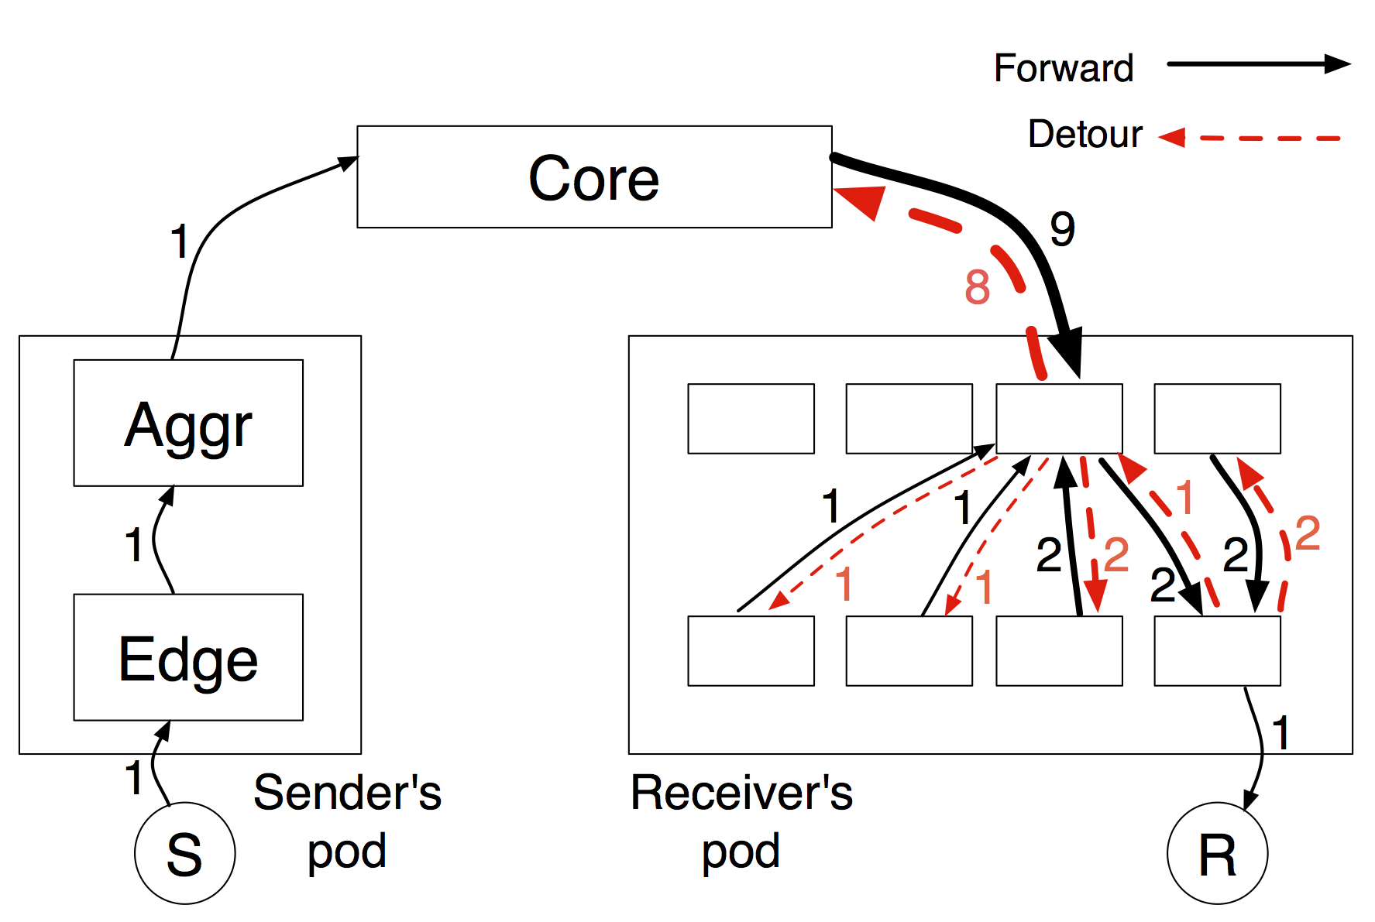
An Example
To reach the destination R,
  the packet get bounced 8 times back to core
  Several times within the pod
Notes:
In this simplified version of the previous picture, black arcs determine a hop of the observed packet in the forward path, and red arcs indicate detours that happen when the packet cannot be forwarded to its destination. This is an actual trace from one of our simulations. The exact order of the hops is not shown here, but we can see how many times the packet visited each switch.
We see that the packet was detoured a total of 14 times before it reached the destination. It is bouncing back and forth between neighboring switches, until the network has enough capacity to forward it downstream.
This example focuses on one sender, but we can imagine that packets arriving the other 14 senders experience a similar path. We would have excessive packets being bounced all over the place in the pod and back to the core. And if the load is high enough all 4 switches in the receivers pod will be overloaded and detour packets.

Slide 49
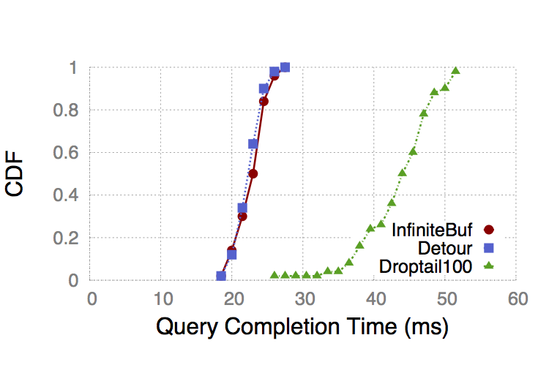
Evaluation with Incast traffic
Click Implementation
  Extend RED to detour instead of dropping (100 LOC)
  Physical test bed with 5 switches and 6 hosts
  5 to 1 incast traffic
  DIBS: 27ms QCT
  Close to optimal 25ms
NetFPGA implementation
  50 LoC, no additional delay

Slide 50
DIBS Requirements
Congestion is transient and localized
  Other switches have spare buffers
  Measurement study shows that 60% of the time, fewer than 10% of links are running hot.
Paired with a congestion control scheme
  To slow down the senders from overloading the network
  Otherwise, dibs would cause congestion collapse

Slide 51
Other DIBS Considerations
Detoured packets increase packet reordering
  Only detour during extreme congestion
  Disable fast retransmission or increase dup-ack thresh.
Longer paths inflate RTT estimation and RTO calc.
  Packet loss is rare because of detouring
  We can afford for a large minRTO and inaccurate RTO
Loops and multiple detours
  Transient and rare, only under extreme congestion
Collateral Damage
  Our evaluation shows that it’s small
Notes:
Spurious retransmission

Slide 52
NS3 Simulation
Topology
  FatTree (k=8), 128 hosts
A wide variety of mixed workloads
  Using traffic distribution from production data centers
  Background traffic (inter-arrival time)
  Query traffic (Queries/second, #senders, response size)
Other settings
  TTL=255, buffer size=100pkts
We compare DCTCP with DCTCP+DIBS
  DCTCP: switches sends signals to slow down the senders

Slide 53
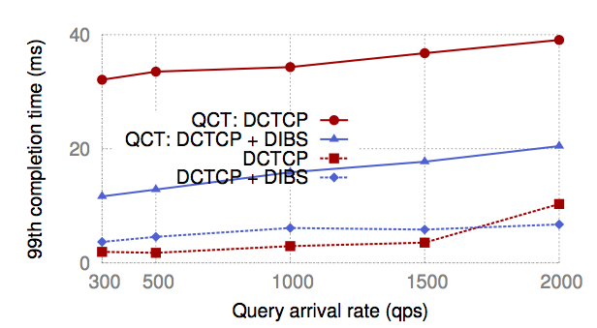
Simulation Results
DIBS improves query completion time
  Across a wide range of traffic settings and configurations
  Without impacting background traffic
  And enabling fair sharing of flows

Slide 54
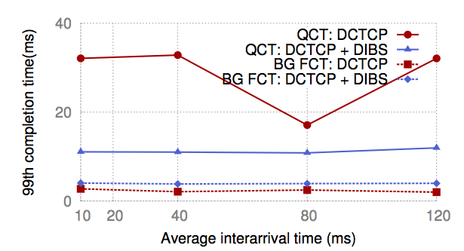
Impact on Background Traffic
  99% query QCT decreases by about 20ms
  99% of background FCT increases by <2ms
  DIBS detours less than 20% of packets
  90% of detoured packets are query traffic

Slide 55
Impact of Buffer Size
  DIBS improves QCT significantly with smaller buffer sizes
  With dynamic shared buffer, DIBS also reduces QCT under extreme congestions
Notes:
Because even with shared buffer, each port still has constraints on the low/high bound of buffer sizes

Slide 56
Impact of TTL
DIBS improves QCT with larger TTL
  because DIBS drops fewer packets
One exception at TTL=12→24
  Extra hops are still not helpful for reaching the destination

Slide 57
When does DIBS break?
DIBS breaks with > 10K queries per second
  Detoured packets do not get a chance to leave the network before the new ones come
  Open Question:understand theoretically when DIBS breaks

Slide 58
DIBS Conclusion
A temporary virtual infinite buffer
  Uses available buffer capacity to absorb bursts
  Enable shallow buffer for low-latency traffic
DIBS (Detour Induced Buffer Sharing)
  Detour packets instead of dropping them
  Reduces query completion time under congestion
  Without affecting background traffic

Slide 59
Summary
Performance problem in data centers
  Important: affects application throughput/delay
  Difficult: Involves many parties in large scale
Diagnose performance problems
  SNAP: scalable network-application profiler
  Experiences of deploying this tool in a production DC
Improve performance in data center networking
  Achieving low latency for delay-sensitive applications
  Absorbing high bursts for throughput-oriented traffic

