Slide 1













SDN: New Approach to Networking
Guru Parulkar
parulkar@stanford.edu
http://onrc.net/

Slide 2
Key Takeaways
SDN is hot and has captured industry’s imagination
SDN is not just a feature but a new way of thinking
  SDN abstractions and what they enable
SDN is in an early stage of development
  Lot of opportunities to shape it
  Our opportunity to impact practice of networking

Slide 3
“OpenFlow and Software Defined Networking (SDN) are not only here to stay, but they will define the future of networking.”
Network World, 10/18/2011
“SDN: Your Next Network
SDN has the potential to bring new levels of automation and efficiency to networks.”
October 2012, Information Week

Slide 4























70+ companies joined ONF in a year
Notes:
More than 65 companies joined ONF in a year.
Let us take a minute to browse the list.

Slide 5





















Slide 6




















70+ companies from across the industry
Notes:
These companies are from across the networking and cloud infrastructure industry.
They are small and large companies
They are Enterprise, carriers, and web service providers
They are chip, equipment and different types of software vendors
Essentially OpenFlow and SDN have captured industry’s imagination and different players across the ecosystem see the value.
Not only that OpenFlow and SDN are becoming more real.

Slide 7











SDN Exhibits by 20+ Companies at ONS-12
SDN Product Awards at Interop (NEC)
Notes:
Another good indication is the set of exhibits by the companies.
There are over 20 companies that are doing exhibits of OpenFlow and SDN technologies, products, and services at ONS.

Slide 8
“HP Advances Software-Defined Networks with Integrated Infrastructure, Controller and Application Solutions,”
HP, October 2, 2012
“Cisco ends the SDN suspense, Unveils Cisco ONE architecture and strategy for instilling programmability into its network gear,” Jim Duffy, Network World, June 13, 2012 11:32 AM ET
“Alcatel-Lucent Joins Cisco, HP, Others in SDN Push,” Jeffrey Burt | Posted 2012-12-01, eWeek
“Brocade bolsters its SDN game, buys Vyatta,”
ZDNet, November 5, 2012
“Big Switch Networks Ships First Open Software-Defined Networking Product Suite to Accelerate Network Transformation,”
Big Switch, November 13, 2012

Slide 9
VMWare acquires Nicira
Brocade acquires Vyatta
Cisco setups Insieme as a spin-in
Cisco acquires Cariden
SDN startups: Big Switch, PlumGrid, Vello, Contrail, …

Slide 10
What is the problem?

Slide 11
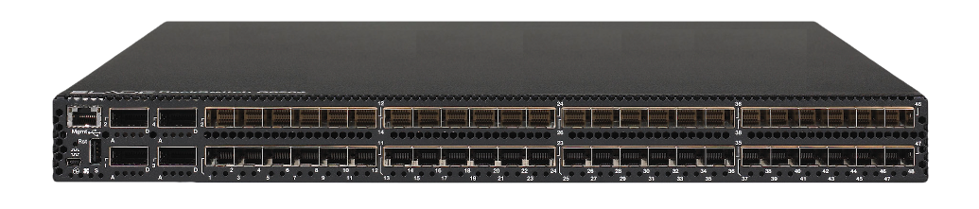
Problem with Internet Infrastructure?
Routing, management, mobility management,
access control, VPNs, …
Feature
Feature
Million of lines
of source code
6000+ RFCs
Operating
System
Specialized Packet Forwarding Hardware
Billions of gates
Bloated
Power Hungry
Vertically integrated, complex, closed, proprietary
Not suitable for experimental ideas
Not good for network owners & users; Not good for researchers.

Slide 12
Problem: No Abstractions for Control Plane
Addition of a new function to the network
  Highly complex distributed system problem
Networks too difficult to program and to reason about
  no good abstractions and interfaces
Distributed
Network Functions
OS
OS
Forwarding
Forwarding
Router/Switch/Appliance
Router/Switch/Appliance
State Distribution Mechanism
OS
Forwarding
Router/Switch/Appliance
Not good for even network vendors

Slide 13
Why Does Verizon Care?
Stu Elby @Open Networking Summit
http://OpenNetSummit.org/
© 2011 Verizon. All Rights Reserved.

Slide 14
Enterprise Networking
Enterprise network operators want..
Firewall and access control
Delegate management to departments
Lots of VLANs that stretch across buildings
By-pass bottlenecks/check points for specific applications
Host web services with load balancing
Easy guest wireless access with security
BYOD (Bring Your Own Device) challenges
And more
How do they do it today?

Slide 15
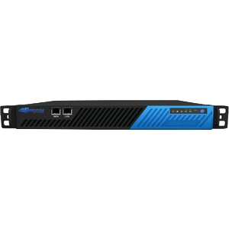
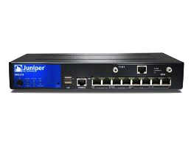
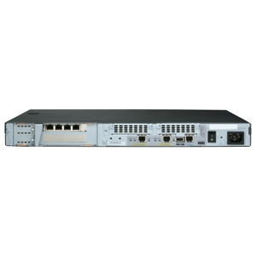
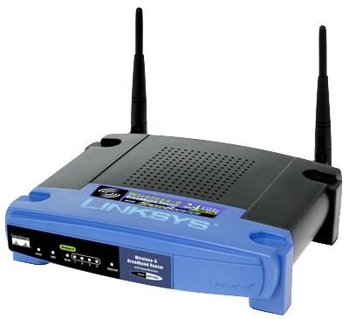
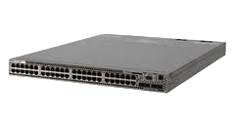
Enterprise Network: Today’s solution
Firewall
Firewall
Load balancer
Load balancer
ACL
ACL
IDS
IDS
ACL
ACL
ACL
Proliferation of appliances
Increased management complexity
  Device oriented management
  Each device type has its own management
High Capex, high Opex
Too much reliance on vendors

Slide 16
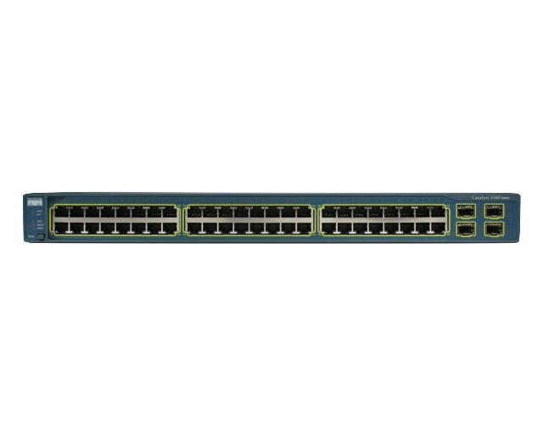
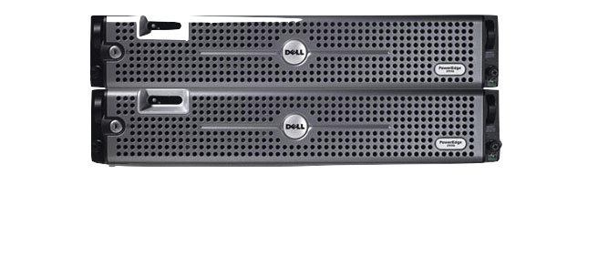
Data Center Provider Today
Assign VMs to any server without considering L2/L3 scalability
Support multiple tenants with lots of VMs interconnected
Support each tenant with its own customized network for VMs: topology, bandwidth, security, load-balancing
And everything is dynamic
Vendors find it hard to develop solutions
Network is the long pole
Tenant-A
Tenant-B
Load balancers
?
Tenant-C
Firewalls
VM
VM
VM
VM
VM
VM
VM
VM
VM
VM
VM
VM
VM
VM
VM
VM
VM
VM
VM
VM
VM
VM
VM
VM
VM
VM
VM
VM
VM
VM
VM
IDS’s
VM
VM
VM
VM
VM
VM
VM
VM
VM
VM
VM
VM
VM
VM
VM
VM
VM
VM
VM
VM
VM
VM
VM
VM
VM
VM
VM
VM
VM
VM
VM

Slide 17
What is SDN? How does it help?

Slide 18

Software-Defined Network with Key Abstractions in the Control Plane
Well-defined open API
Routing
TE
Mobility
Network Map
Abstraction
Network OS
Open interface (OpenFlow) to Forwarding Abstraction: L1/L2/L3
Separation of
Data and Control
Plane
Packet
Forwarding
Programmable
Basestation
Packet
Forwarding
Packet
Forwarding

Slide 19
Software Defined Network with Virtualization
Abstract Network Model
Network Virtualization
Control Program
Global Network View
Network OS

Slide 20
Stanford/Berkeley SDN Activities
With Partners
GEC6
GEC9
GEC3
SIGCOMM09
Interop
2011
SIGCOMM08
Demo
VM Migration
(Best Demo)
Trans-Pacific
VM Migration
SDN Concept
(Best Demo)
Baby GENI
Nation Wide GENI
“The OpenFlow Show”
– IT World
Other countries
Over 68 countries
(Europe, Japan, China, Korea,
Brazil, etc.)
Deployment
US R&E Community
GENI: 8 Universities + Internet2 + NLR
Many other campuses
Stanford University
~45 switch/APs ~25user
In McKeown Group
CIS/EE Building
Production Network
GENI software suite
Expedient/Opt-in Manager/FOAM
Platform
Development
Virtualization
FlowVisor
FlowVisor (Java)
Network OS
NOX
SNAC
Beacon
Tools
Test Suite
oftrace
Measurement tools
Mininet
Ethane
Reference Switch
NetFPGA
Software
+Broadcom
OpenFlow Spec
v0.8.9
v1.0
v1.1
2007
2008
2009
2010
2011

Slide 21










Nation-wide SDN Infrastructure
Part of NSF’s GENI
Notes:
During 2010, we and our partner universities deployed OPEN networks at 8 campuses and interconnected them by OPEN backbone network within NLR and Internet2.

Slide 22
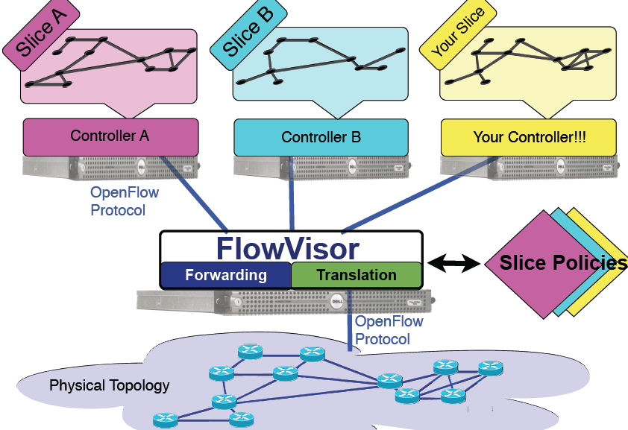
SDN Reference

Slide 23
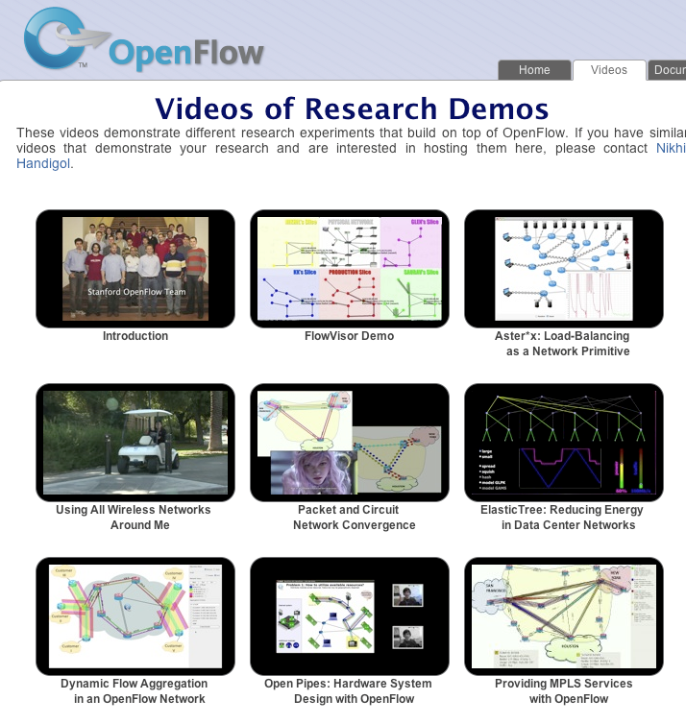
Example Demonstrations
Onrc.stanford.edu/videos.html

Slide 24
Carrier Networks Today
They want to offer
VPN Services
Traffic Engineering
And other value added services
Go to vendors and ask them for solutions:
Distributed Network Functions
each with their own
State Distribution Mechanisms
Vendors find it hard to develop solutions
Providers find it too slow and too expensive to deploy and operate
Providers depend too much on vendors
State Distribution
Mechanisms
Distributed
Network Functions
PE Label Distribution
E-BGP learned Route Advert
VPN-IPv4 Route Advert
TE Label Distribution
IGP- Route Advert, Link-State
LDP
I-BGP + RR
MP-BGP
RSVP-TE
OSPFv2
Router Operating System

Slide 25
Carrier Networks (MPLS) with SDN
~4K vs. ~600k lines of code
Services / Network Applications
(3)
TE 2.0
VPN
Simpler Control Plane
(2)
Routing
Discovery
Label Distribution
Recovery
NETWORK OPERATING SYSTEM
Vendor-agnostic Open Interface
Simpler
Cheaper
Multi-Vendor
Data Plane
(1)
PUSH
SWAP
POP

Slide 26
Urs Hölzle, SVP, Google at ONS 2012
SDN Early Adopters: Google

Slide 27
Cloud Provider with SDN
Tenant-A
Tenant-B
Tenant-C
Load
Balancing
Firewall
Load
Balancing
IDS
Load
Balancing
Firewall
IDS
NETWORK OS
NETWORK OS
NETWORK OS
VM
VM
VM
VM
VM
VM
VM
VM
VM
VM
VM
VM
VM
VM
VM
VM
VM
VM
VM
VM
VM
VM
VM
VM
VM
VM
VM
VM
VM
VM
VM
VM
VM
VM
VM
VM
VM
VM
VM
VM
VM
VM
VM
VM
VM
VM
VM
VM
VM
VM
VM
VM
VM
VM
VM
VM
VM
VM
VM
VM
VM
VM
VM
VM
VM
VM
VM
VM
VM
VM
VM
VM
VM
VM
VM
VM
VM
VM
VM
VM
VM
VM
VM
VM
VM
VM
VM
VM

Slide 28








SDN Early Adopters: Data Center Virtualization

Slide 29
Enterprise Network with SDN
And you can even delegate control to someone else
Research Labs
Financial Department
Centralized
Control Plane
Load
Balancing
IDS
Access
Control
Policy
Routing
IDS
Access
Control
Policy Routing
NETWORK OPERATING SYSTEM
NETWORK OS
NETWORK OS
Vender-agnostic Open Interface
Firewall
Firewall
Load balancer
Load balancer
ACL
ACL
IDS
Simple, Cheaper
Multi-vendor
Data Plane
IDS
ACL
ACL
ACL

Slide 30
SDN is not just a feature but a new way of thinking:
SDN abstractions and what it enables

Slide 31
SDN Origins
Routing
TE
Mobility
OpenFlow Controller: Event Based Interface
Open interface (OpenFlow) to Forwarding Abstraction: L1/L2/L3
Separation of
Data and Control
Plane
Packet
Forwarding
Packet
Forwarding
Packet
Forwarding
Packet
Forwarding

Slide 32
Software Defined Network with Virtualization
Abstract Network Model
Network Virtualization
Control Program
Global Network View
Network OS

Slide 33
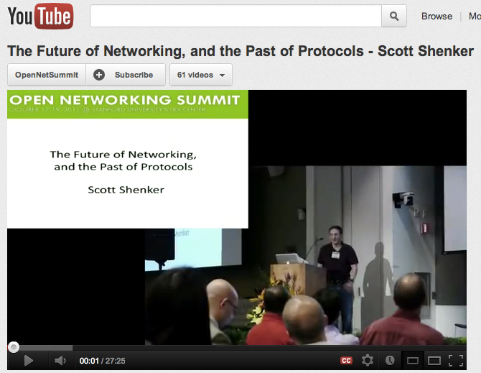
Scott Shenker at 1st ONS in 2011
“The Future of Networking and the Past of Protocols”
Notes:
If you haven't seen Scott's talk, you must.
Scott masterfully described the new SDN abstraction for networking.

Slide 34
How do SDN abstractions help?
Network Virtualization
Automatic Network Trouble Shooting
…

Slide 35

Making SDNs Work
2nd Open Networking Summit
http://OpenNetSummit.org/
Nick McKeown
Stanford University
Thanks to: NSF, GPO, Open Networking Research Center (ONRC)
Cable Labs, Cisco, DoCoMo, DT, Ericsson, Google, HP, Huawei, Intel, Juniper, NEC, Texas Instruments

Slide 36
With SDN we will:
  Formally verify that our networks are behaving correctly.
  Identify bugs, then systematically track down their root cause.

Slide 37
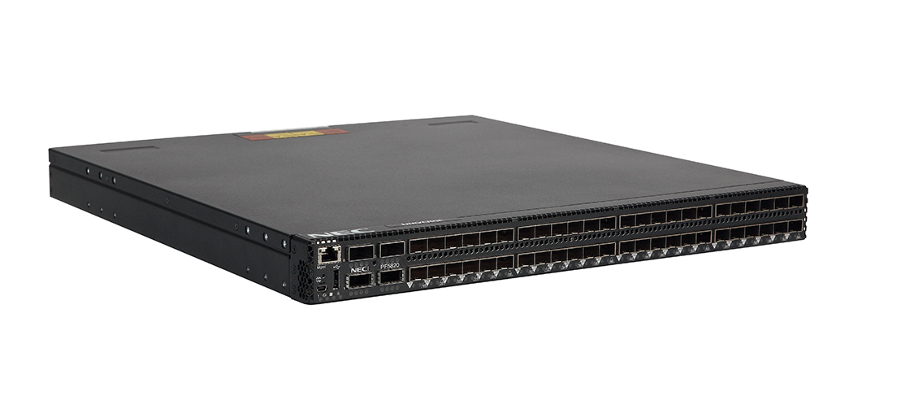
SDN Operation
A can talk to B
B can talk to C
A cannot talk to C
Describe the desired
behavior on the
abstracted network view
App
App
App
App
App
Controller
Controller
Virtual Network
Virtual Network
Abstract Network View
Virtualization Layer
translate it to Global
Network View
Virtualization
Global Network View
Network OS (Dist. State Mgmt)
<Match, Action>
<Match, Action>
<Match, Action>
<Match, Action>
<Match, Action>
…
…
<Match, Action>
<Match, Action>
<Match, Action>
<Match, Action>
<Match, Action>
…
…
Network OS makes sure the flow entries are installed properly
<Match, Action>
<Match, Action>
<Match, Action>
<Match, Action>
<Match, Action>
…
…
Physical Network
<Match, Action>
<Match, Action>
<Match, Action>
<Match, Action>
<Match, Action>
…
…

Slide 38
Network Troubleshooting Enabled by SDN
Control
Programs
Control
Programs
Control
Programs
(1) Static Checking
Is the “policy”
correctly compiled
to the forwarding rules?
Abstract Network View
(3) Network Debugger
Finding bugs, and their root cause,
in an operational network
Network Virtualization
Global Network View
Network OS
(2) Automatic Checking
Is the datapath working
as specified?
<Match, Action>
<Match, Action>
<Port == 22, Drop>
<Match, Action>
<Match, Action>
<Match, Action>
<Match, Action>
<Match, Action>
<Match, Action>
<Match, Action>
<Match, Action>
…
<Match, Action>
<Match, Action>
<Match, Action>
<Match, Action>
<Match, Action>
…
<Match, Action>
<Match, Action>
<Match, Action>
<Match, Action>
<Match, Action>
…
Packet
Forwarding
Packet
Forwarding
Packet
Forwarding
<Match, Action>
<Match, Action>
<Match, Action>
<Match, Action>
<Match, Action>
…
Packet
Forwarding
Packet
Forwarding

Slide 39
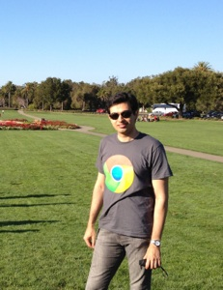

Header Space Analysis Based Tools
Peyman Kazemian
Policy
Policy
Policy
Control Plane Logic
Hassel,NetPlumber: verify equivalence of policy
and expected end-to-end network behavior.
Rules
Rules
Rules
Rules
Rules
Rules
Rules
Rules
Header Space Analysis: models forwarding
behavior of network based on these rules.
ATPG: verify correctness of actual data plane behavior by generating test packets based on network rules.
Notes:
Before concluding my talk, I want to zoom out a little bit to see the bigger picture of all these tools and how they are related.

Slide 40
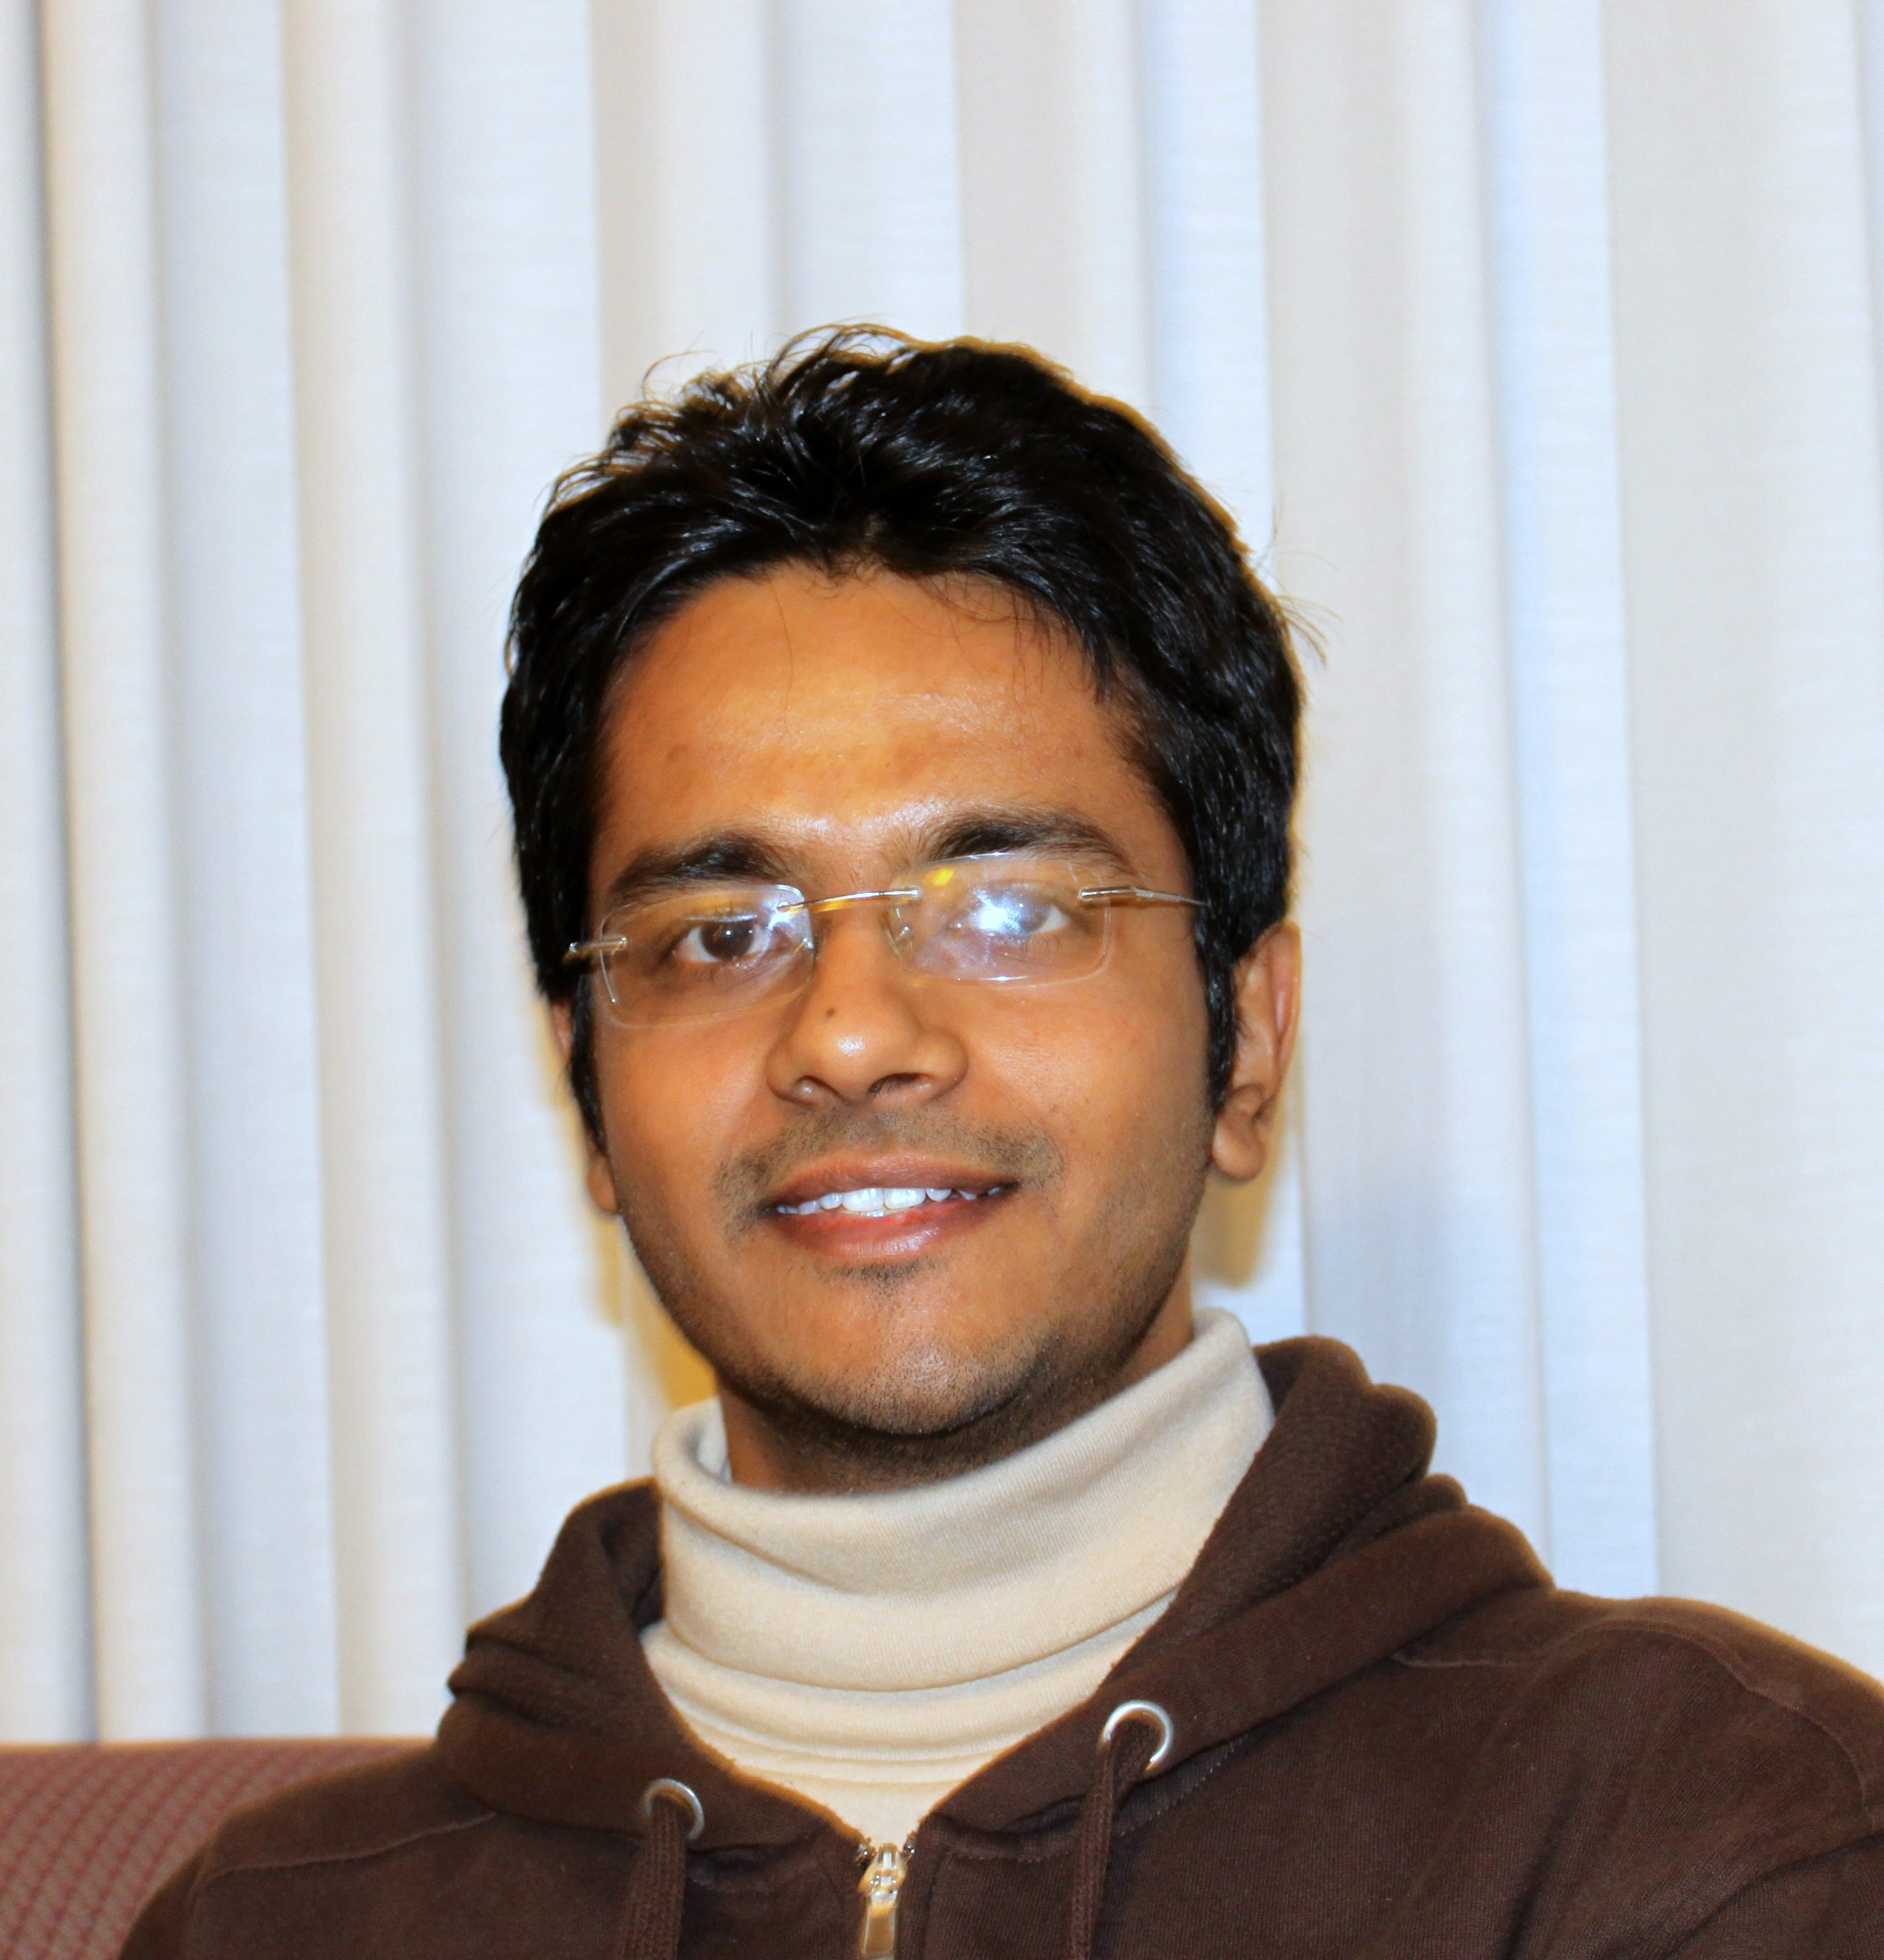
Control Plane
Nikhil Handigol
Flow Table State Recorder
Incorrect packet modification
Isolation violation
Black holes
Waypoint routing violation
Path length violation
Troubleshooting Application
Packet
Histories
Troubleshooting Application
Troubleshooting Application
Troubleshooting App
NetSight API
add_filter(packet_history_filter, callback)

Slide 41
Troubleshooting Applications
ndb
Interactive Network Debugger
netwatch
Live Invariant Monitor
nprof
Hierarchical Network Profiler
netdump
Network-wide Logger
Notes:
Nprof – hierarchically shows the sources of congestion causing traffic in the network.
netdump – Advanced tcpdump that lets you log packets anywhere in the network, with filters on the packet history

Slide 42
SDN is at the early stage of development
Lot of opportunities to shape it

Slide 43
SDN Opportunities
Abstractions
Big Connector
Virtual Network
Feature
Feature
Feature
Big Connector
Programming System/Tools
Network Map
Virtual Network
Network HyperVisor
Logical Map of Network
Network OS
Flow Space
Systems
Scalability
OF
Switch
Reliability
OF
Switch
Mininet
& Tools
Open
Radio
Network
OS
Network
OS-wireless
VIrtualization
Prog/Debug
Systems
OpenRadio
OF
Switch
Security
OF
Switch
OF
Switch
Xlities

Slide 44
SDN Opportunities Cont.
Domains of Use
Abstractions
Enterprise Networks
Big Connector
Virtual Network
Datacenter Networks
Network Map
OF
Switch
Flow Space
Service Provider Networks
Systems
Scalability
Network
OS-wireless
Reliability
OF
Switch
Mininet
& Tools
Open
Radio
Network
OS
FlowVisor
Prog
Systems
Security
Cellular Networks
Xlities
Home Networks

Slide 45
Key Takeaways
SDN is hot and has captured industry’s imagination
SDN is not just a feature but a new way of thinking
  SDN abstractions and what they enable
SDN is in an early stage of development
  Lot of opportunities to shape it
  Our opportunity to impact practice of networking

Slide 46

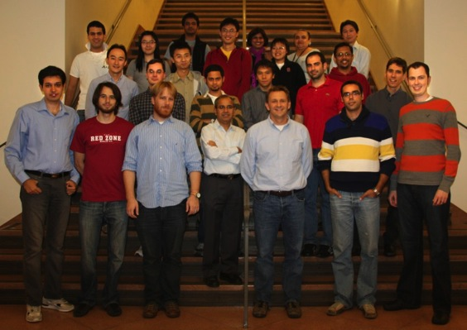
Team at Stanford
Nick McKeown, Guido Appenzeller, Nick Bastin, David Erickson, Glen Gibb, Nikhil Handigol, Brandon Heller, TY Huang, Peyman Kazemian, Masayoshi Kobayashi, Jad Naous, Johan van Reijendam, Srini Seetharaman, Rob Sherwood, Dan Talayco, Paul Weissman, Tatsuya Yabe, KK Yap, Yiannis Yiakoumis and many more.
With Scott Shenker and team at Berkeley and Martin Casado at Nicira
Notes:
We have a great team… a team of great graduate students, engineers, and post docs. These people deserve all the credit for what I am going to talk about.
We also collaborate with Scott and his team at Berkeley and Martin from Nicira among other people.

