Slide 1
Using Historical and Real-Time Data to Optimize Reliability for Power Distribution
David Waltz
Ansaf Salleb-Aouissi
Phillip Gross
Albert Boulanger
Haimonti Dutta
Roger Anderson

Slide 2

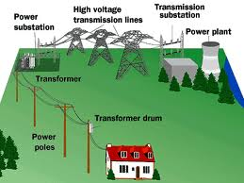
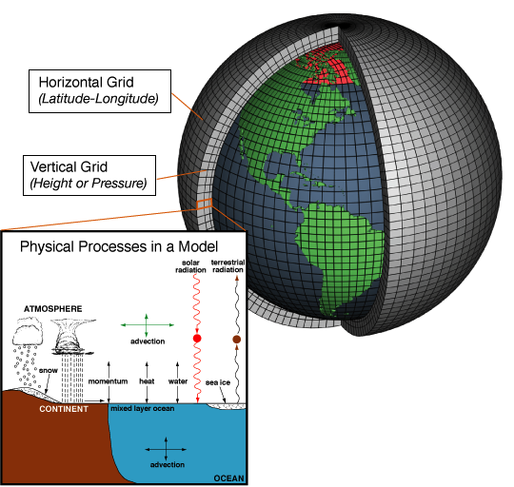

CCLS Research focuses
CCLS
Natural Language Processing
Power Grid
Medical Informatics
Climate Informatics
ML Theory

Slide 3
Project History 1 -- Origins
2004 – Roger Anderson & Albert Boulanger spent ~6 months talking with Con Edison engineers, managers, operators, with support of Artie Kressner, Director of R&D
      Looking for ML opportunities
      Found 10 possibilities
  Topic selected: improving feeder reliability
      But more outages each year
      More $ spent each of 5 previous years
      Why? Bad policies? System aging too fast?

Slide 4
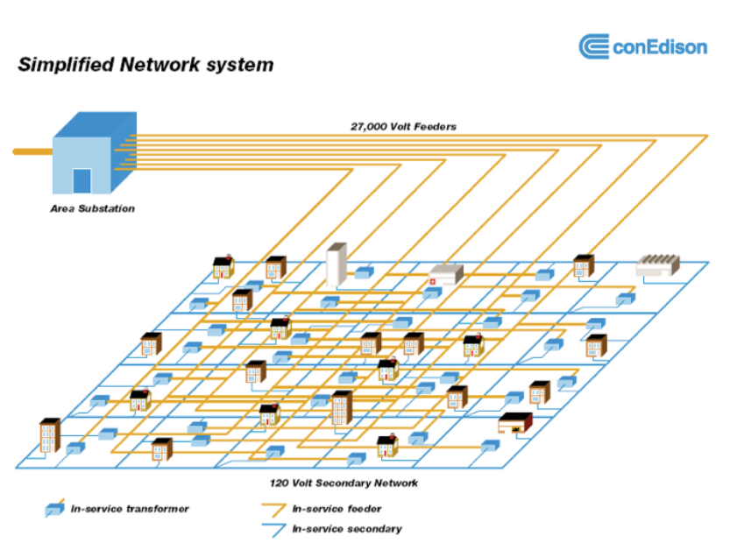
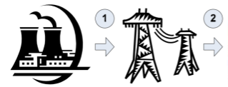




Electrical Infrastructure
Generation
Transmission
Primary distribution
Secondary distribution
Notes:
1 Generation: a generating station produces large amounts of electrical current,
2 Transmission: the current is sent at hundreds of thousands of volts from the generating station to sub- stations closer to the customers,
3 Primary Distribution: electricity is sent at tens of thousands of volts from substations to local trans- formers, over cables called feeders,
4 Secondary Distribution: sends electricity at normal household voltages from local transformers to individual customers.
There are over 50 networks in NYC.

Slide 5
NYC Power Grid
2nd Generation system designed & built 1945-1960
  1st Generation was Edison and Tesla
About 1000 feeders
  Highly redundant network
  Some cables >80 years old
  Some have paper insulation in oil-filled lead casings – an ecological disaster
  Selectively tested (“HiPot tests”) spring and fall
  Largest number of failures in summer, esp. during heat waves
  “Largest copper deposit in the world” – designed to meet peak load
  Needed to make system smarter, not larger
Goal: replace on planned schedule, avoiding emergency replacements
Large amounts of data collected, starting long ago, with more and more recently
However, unable to predict which feeders would fail with better than random probability
  Probably replacing sound feeders
  Not replacing weak feeders
  Reactive, not proactive
  Incurring big costs (e.g. overtime wages) and big risks (of another failure)

Slide 6
Feeder data
Static
  Compositional/structural
  Electrical
Dynamic
  Outage history (updated daily)
  Load measurements LPW (updated every 5 minutes)
  PQ data
  Derived
  Labels: Feeders can go offline for various reasons
About 300+ features for each feeder
Notes:
Application needs to integrate different types of data
Physical characteristics: a typical feeder is composed ~100 of cable sections connected by joints and terminating in a few tens of transformers → component aggregation.
Electrical characteristics: e.g. how much current a feeder is expected to carry under various network conditions → imprecision.
Dynamic data: from real-time telemetry attached to the feeder → time aggregation.
Derived attributes: computed from formula developed by domain experts.
Labels: Feeders can go offline for various reasons → we focus on the most serious failure type.

Slide 7
Project History 2 – Tasks & Data
Task 1 – Rank feeders from worst to best, to prioritize replacements/repairs/testing
Historical data available – a big plus, but data not in immediately usable form
  Data preparation a major problem & time sink. More later in talk.
    First attempt to rank (Yoav Freund) used boosting, but yielded poor results
Second attempt (Phil Long) used “MartiRank” (Martingale Ranking) and showed considerable promise

Slide 8
MartiRank
100%
0%
1: Select highest ROC attribute and sort list
Sum Load Pocket Weights
0 20% 40% 60% 80% 100%
2: Split list and select ROC for each …
FOT
Same Month
Prev 3 Yrs
FOT
Same Season
Previous Year
0 20% 40% 60% 80% 100%
3: Select ROC for each …
CIOA
Same Month
Prev 3 Yrs
Monitor
2005
Other Outages
SCH, WR, OOE
0 20% 40% 60% 80% 100%
4: Select ROC for each …
FOTs
Same Mo
Prev 3 Yrs
Emergency
Rating
Emergency
Normal
Avg LPW
0 20% 40% 60% 80% 100%

Slide 9
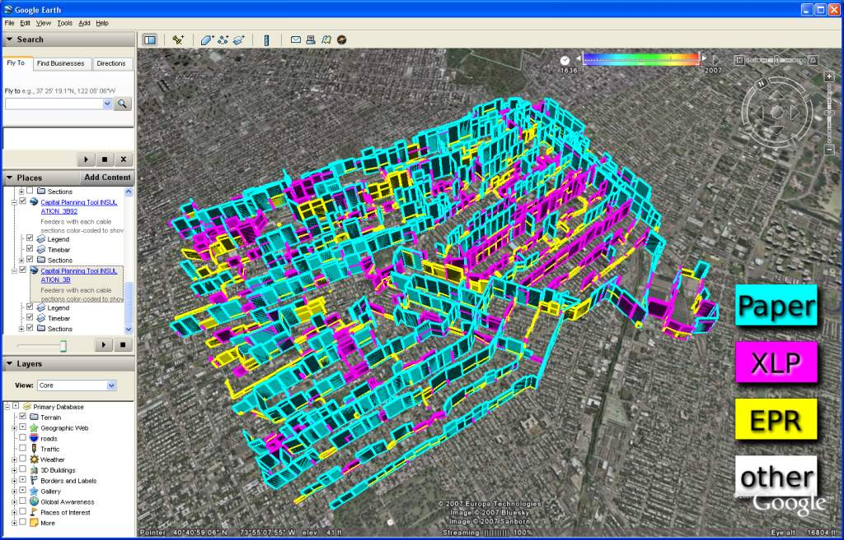
Crown Heights Network 3B
Color is Composition
Height is Risk

Slide 10
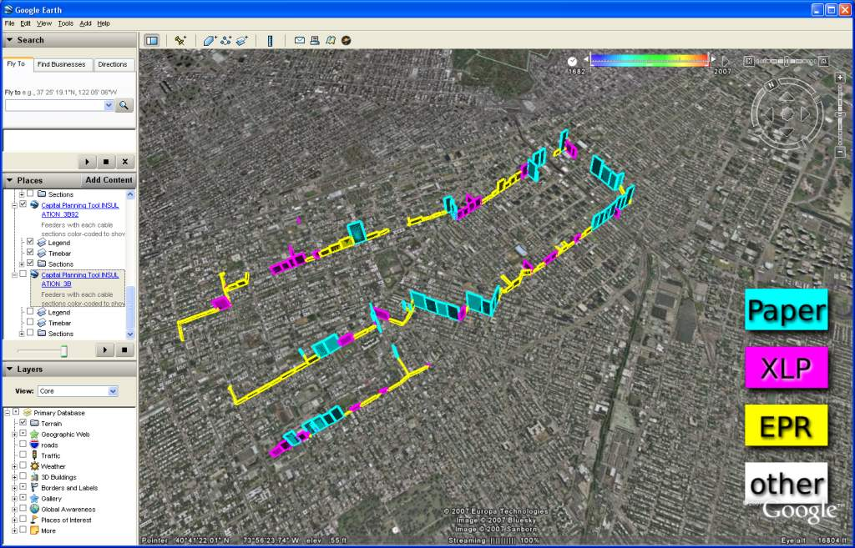
3B92

Slide 11
Using results of learning to answer long-standing questions
Question: is it better to use $X replace PILC (Paper Insulated Lead Cable) in feeders with many PILC sections, or to create “backbone” feeders with little or no PILC?
Question: Is it worthwhile to test and repair (at-risk) feeders, or to only test and repair after failures or engineering work has been completed?
Answered via medical analogy: statistical analysis of sick “patients” treated vs. untreated control group
  Control groups formed by matching feeders with very similar values for attributes shown to be important for ranking

Slide 12
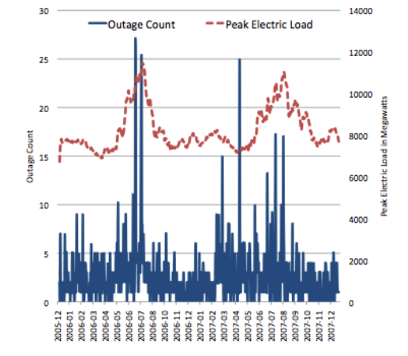
Problem – “Concept Drift” over Time
Notes:
Few failures per day, most failures in the summer
Number of Feeder Outages per Day, 2006- 2007, below with axis at left, and Normalized System-wide Peak System Load above with axis at right

Slide 13
Dynamic setting
Courtesy Marta Arias
-
+
-
-
-
+
+
-
+
-
+
+
-
+
time
Notes:
Over time, the distribution change and so should the model which need to reflect the new distribution
Application needs to react and adapt to incoming dynamic data
Train models based on past data
Re-rank frequently using model on current data

Slide 14
Project History 3 – Dynamic Attributes
MartiRank quite successful
    But accuracy varied over seasons, heat waves
New method -- MartaRank -- (named for Marta Arias, who did the original work)
  MartaRank retrained regularly (daily, later every four hours)
  Used multiple models/training periods, picked model(s) most accurate over last few days, assumed “momentum” going forward
Eventually MartaRank replaced with ODDS (Ansaf Salleb-Aouissi, Phil Gross)

Slide 15
ODDS: Outage Derived Data Sets
Problem: Rarity and Quality of positive examples + capture short-term precursors!
Include examples of all past outages within some time window,
Consider dynamic data from the moment before a failure,
Additionally, include the current snapshot of all feeders in the system,
Study regions separately.
Notes:
For example

Slide 16
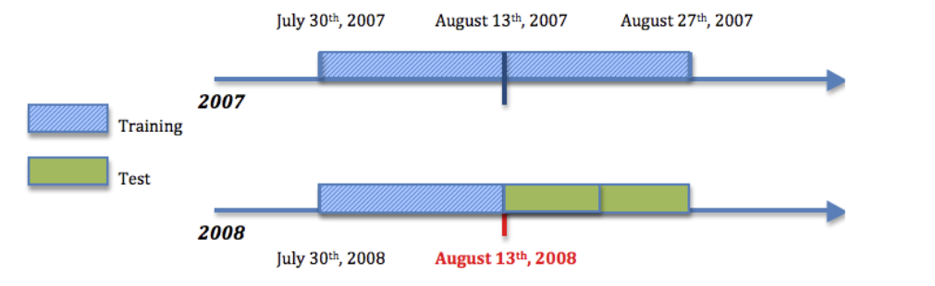
Ranking Feeders
Training Data: an ODDS, 300+ features, 45 days time window.
Test Data: 7 or 15 days.
Label: 1 if the feeder had an OA, -1 otherwise.

Slide 17
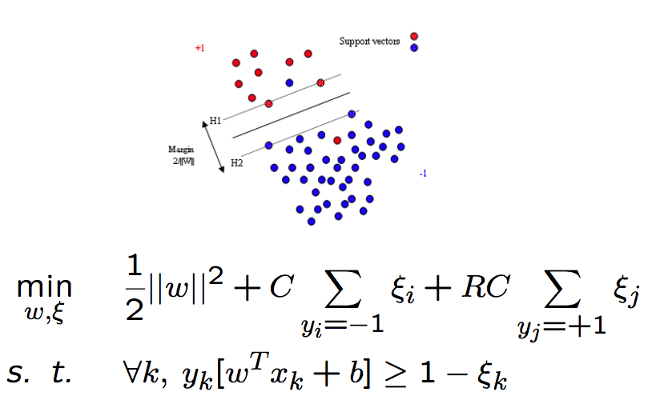

Ranking Feeders
We use linear SVMs
We penalize mislabeling of an example by the proportion of the total population of the class:
R= number of true negatives/number of true positives
We use the Area Under the ROC Curves (AUC) to evaluate the ranking performance.
Notes:
We use linear to get the weights. Other kernels didn’t really show improved results.
solving the problem of maintaining up-to-date models by regenerating the ODDS every four hours, using the freshest available data and regenerating the model.

Slide 18
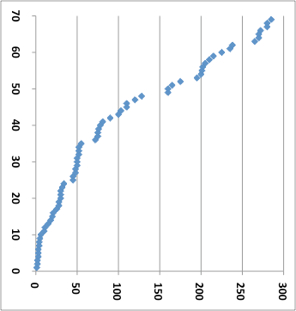
ROC for Crown Heights feeders 3B81-96 (BLUE) May, 2008 thru Jan, 2009
ODDS is successfully
predicting the
susceptibility to
impending failure of
feeders within 2/3 of the
Networks in BQ, such as 3B
CAP RED= 50% of OA’s
AUC = .75
CUM # OF OA’S IN 3B SINCE MAY, 2008
ODD’s Susceptibility just before each OA

Slide 19
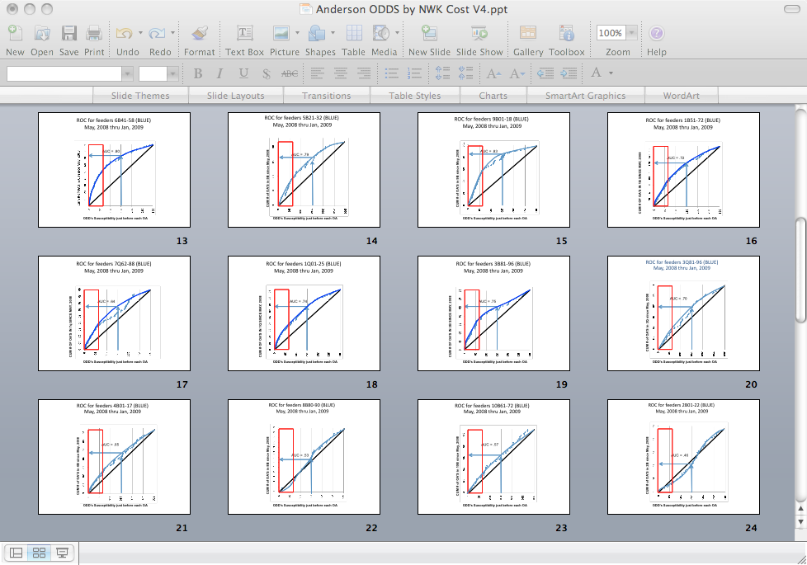
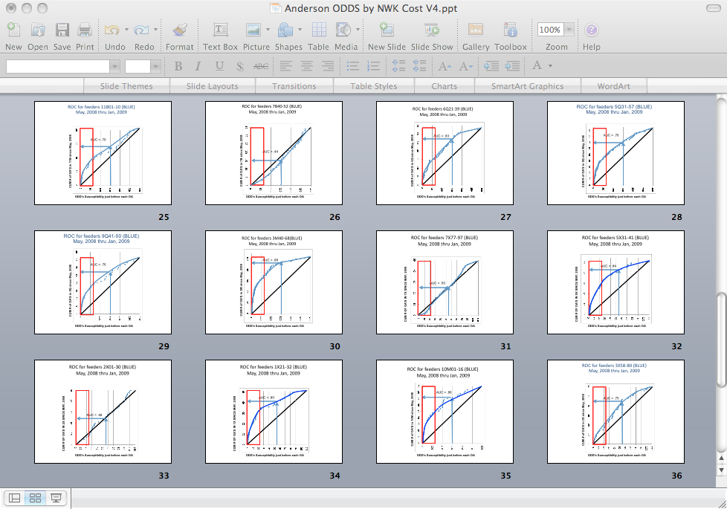
ODDS BLIND TEST BY NETWORK
.80
6B
.79
5B
.83
9B
.72
1B
.64
7Q
.74
1Q
.75
3B
.70
3Q
.65
4B
.53
8B
.57
10B
.46
2B
.70
11B
.44
7B
.83
6Q
.76
5Q

Slide 20
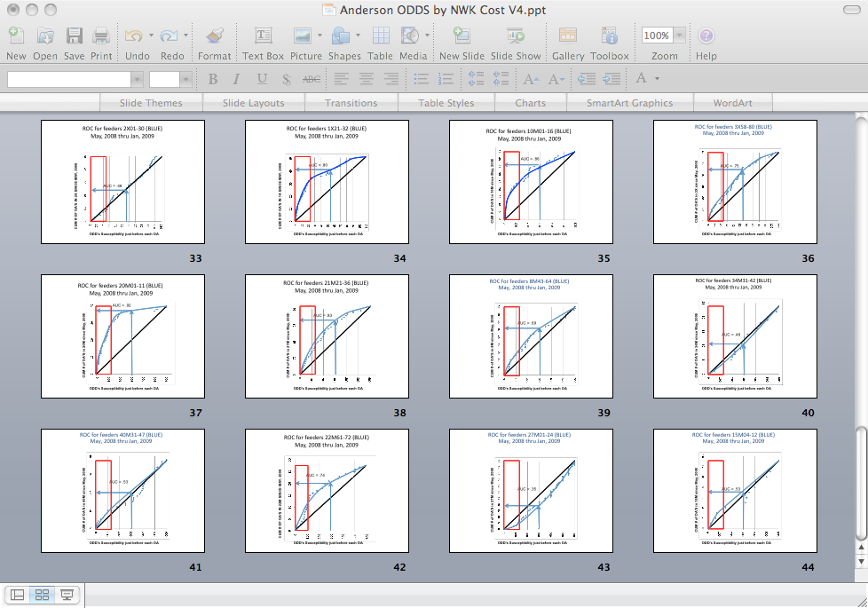
ODDS BLIND TEST BY NETWORK
.75
9Q
.88
3M
.50
7X
.84
5X
.48
2X
.80
1X
.86
10M
.75
3X
.92
20M
.83
21M
.69
8M
.48
34M
.53
40M
.74
22M
.35
27M
.53
15M

Slide 21
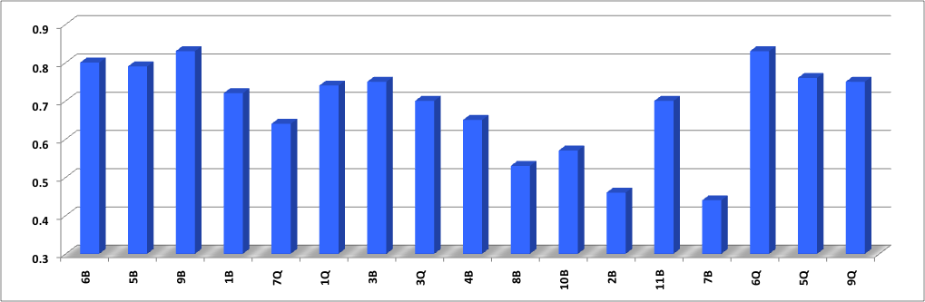
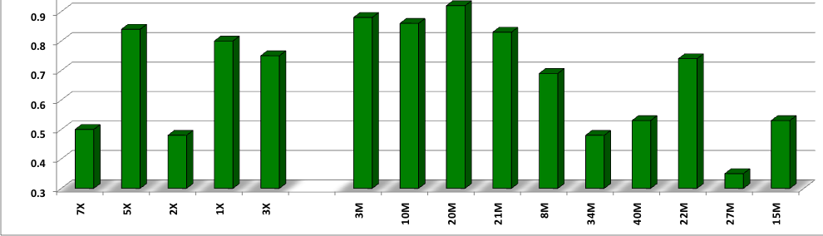
ODDS training in BQ resulted in Predictive Failures in 75% of the 27KV BQ Networks, best in worst NRI Networks
PREDICTIVE FAILURES
ODDS AREA-UNDER-THE-CURVE FOR NETWORK ROC
RANDOM
60% of the 13KV XM Networks
PREDICTIVE FAILURES
ODDS AREA-UNDER-THE-CURVE FOR NETWORK ROC
RANDOM

Slide 22
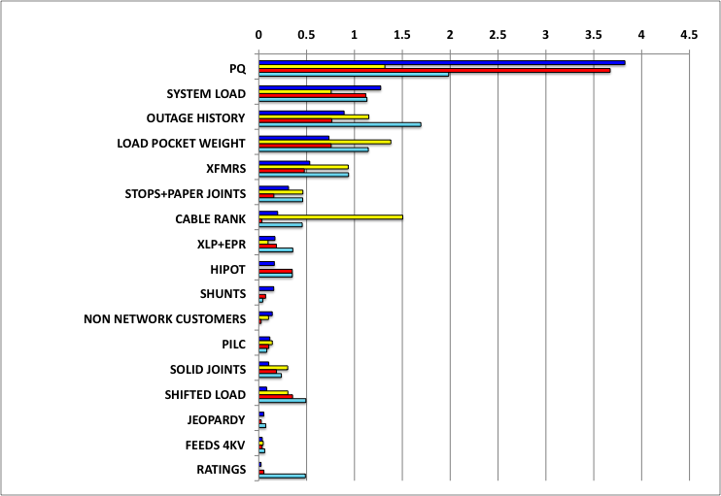
ODDS Attributes for BQ vary from Summer, 2009, to Winter 2010
Blue = February, 2010
Yellow = January,2010
Red = August, 2009
Turquoise = October, 2009
Hot
Snow & Salt
Actionable Root Cause Attributes for a Hot August, 2009 (Red), compared to a Snowy and Salty February, 2010 (Blue), a Rainy January, 2010 (Yellow), and a typical Fall (Turquoise)
Rain
Fall

Slide 23
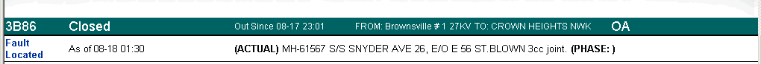
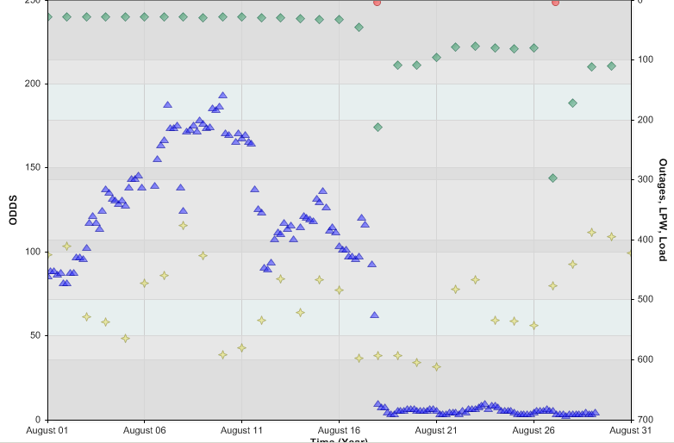
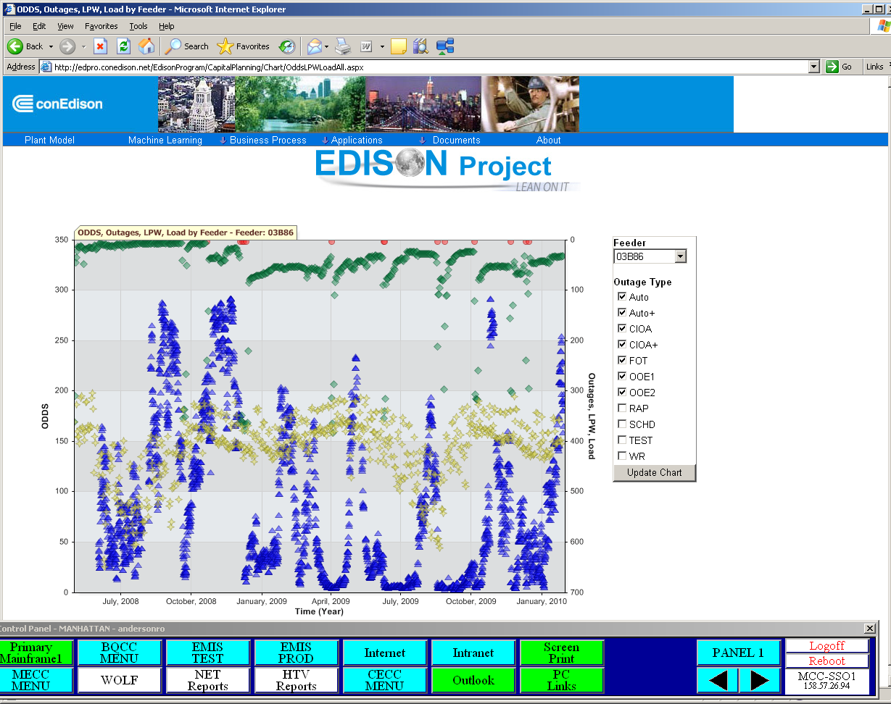
Least at Risk
Emergency Outages
Load Pocket Weight
Load
ODDS
Most at Risk
Red Alert sent to CAP Tool

Slide 24
Project History 4 – MTBF, CAPT and CAP
Fruit, after 6 years of R&D with Con Ed
  Ranking & MTBF for primary feeders & all components plus secondary grid
  CAPT system: Optimal engineering and maintenance -- ”bang for the buck” (change in MTBF/$ spent)
  CAP system: Operator aid – showing assets at risk in real time
  These and other systems installed & in daily use

Slide 25
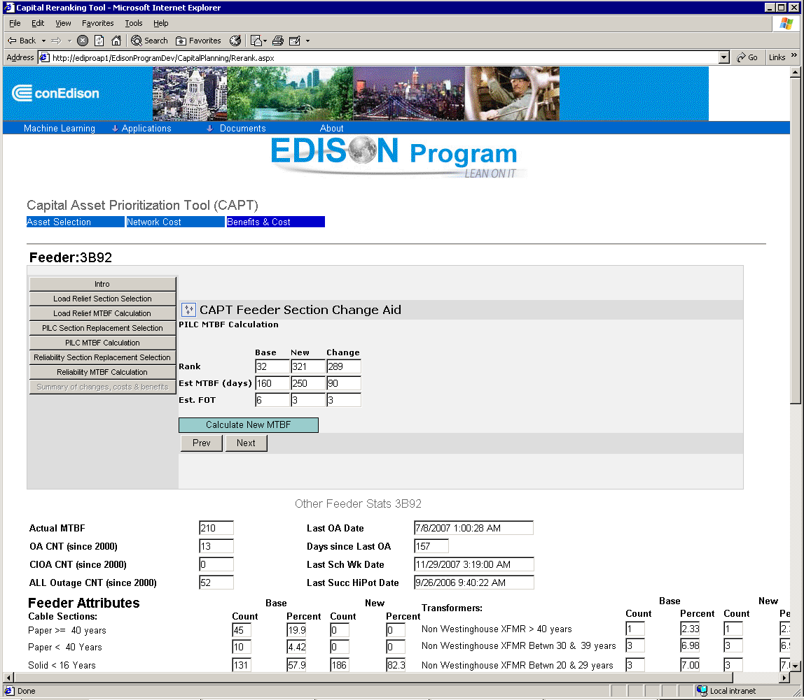

Slide 26
MTBF
Needed for CAPT
Difficult to estimate MTBF
  Imbalanced data: small numbers of outages
  “Censored data”
Tried several methods
  SVM-R
  Random Forests
  Regression methods (used in CAPT)
  Waibull models
  Cox Proportional Hazards

Slide 27
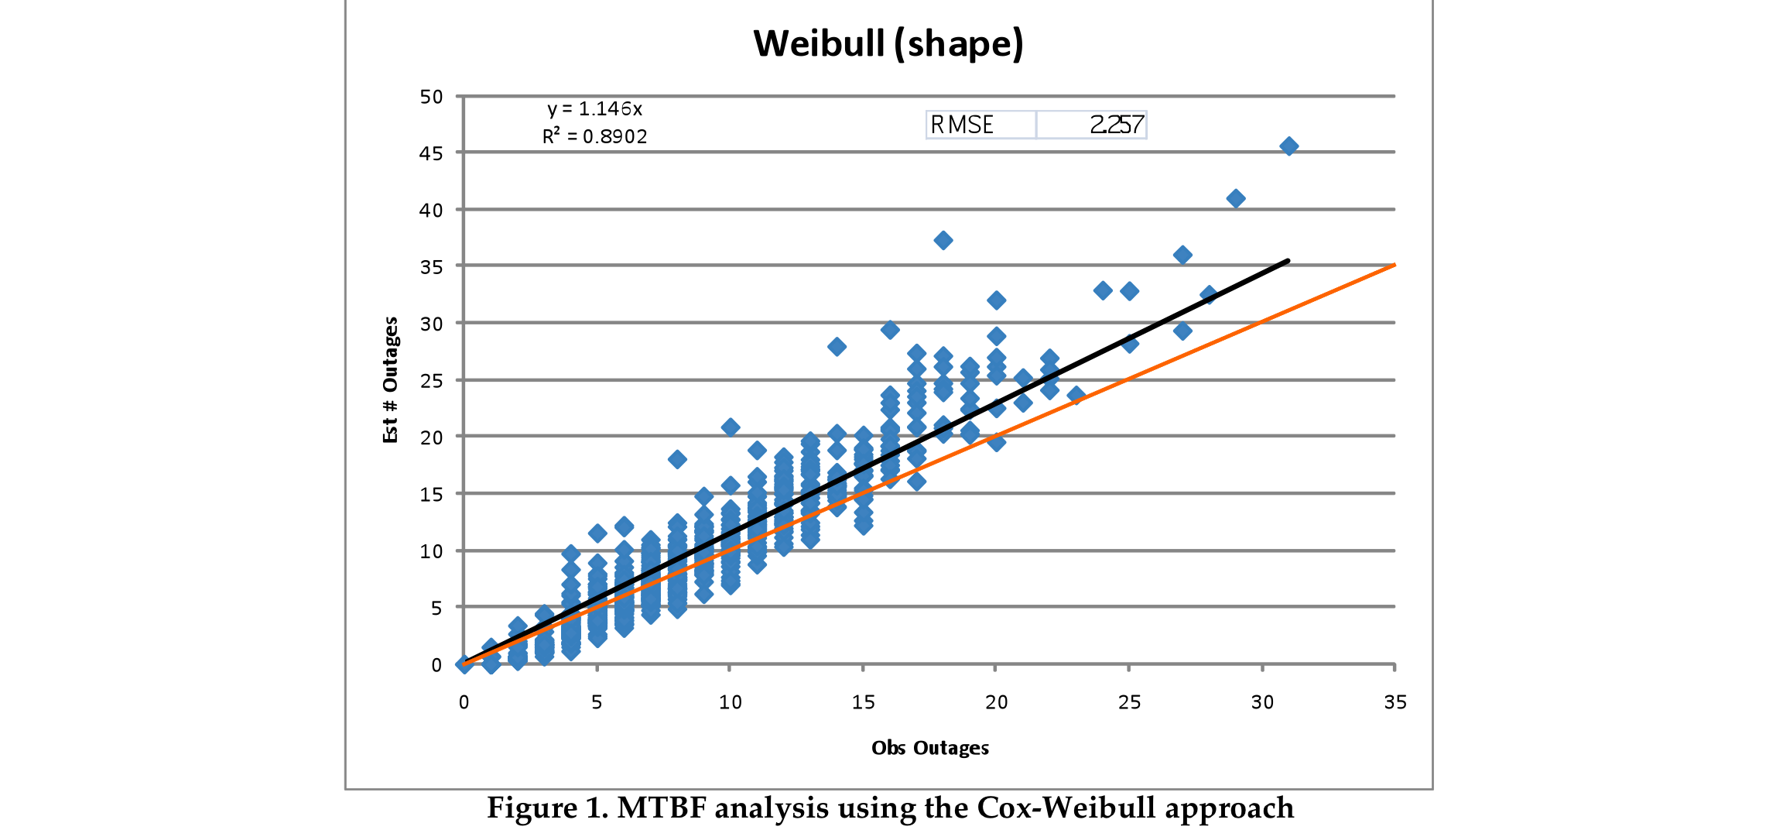
Weibull and Cox Proportional Hazards
Focus on failure rates and elevated risk after events instead of failure intervals

Slide 28
Data Preparation
Required much more time than ML R&D
Tables were hard to join
  Different formats
  Different levels of detail
  Different identifiers for same objects
  Some parts of system not tracked (e.g. secondary system)
  Different time stamps
    (EST, EDT, GMT),
    time marked when data entered vs. when event occurred
  Different update cycles
  Some data overwritten, so only current state represented
    Needed to “reverse engineer” system from repair records
  Noise, errors, missing data,….

Slide 29
Summary of solutions/advances
Optimal repair and reengineering plans
Ranking of >100,000s items, each with 400-3000 attributes
Dealing with “concept drift” using ensemble models
Learning scalar values (MTBFs)
Dealing with censored data
Showing that testing used by Con Edison caused more failures than it prevented (and at significant cost)
Distributed detection of power quality and load transfer deviations
LOTS of data cleaning!
  Creation of DBs from tables, including inferential joins
  Learning to create DBs from unstructured text
  Dealing with missing values, bad values, etc., etc.

Slide 30
From CFD to Discrete Data Structures
For future we will need to deal with worlds that are represented not as 3-D systems through time, but instead as discrete data structures and programs:
  Graphs
    For the smart grid and consumer networks, including sensors, communication,
    Simulating addition of geothermal, wind, solar, tidal, hydro, cogeneration
  Market transactions, auctions and databases
    Planning and running carbon cap-and-trade markets
    Understanding the effects of tax and economic policies
  Data structures (e.g. trees and martingales)
    Optimal planning for environmental remediation of nuclear waste sites
    Planning and operating fossil fuel extraction operations
    Planning conversion to the smart grid –”replacing all parts of a 747 – while it’s in the air!”
  Simulations coupled to sensors and effectors to control
    The power grid,
    Power generation facilities,
    Refineries and oil field extraction systems
  Simulations coupled to machine learning systems to provide
    anticipatory error detection, and
    what-if modeling of possible actions to prevent or correct problems
These new uses will require new discrete algorithms, and scaling to very large computing facilities and datasets.

Slide 31
Acknowledgements (incomplete)
Funding: Consolidated Edison Company of New York, NYSTAR, DOE, NSF.
CCLS: Cynthia Rudin, Becky Passonneau, Axinia Radeva, Bert Huang,, Wei Chu, Jiang Chen, Marta Arias, Hatim Diab, Sam Lee, Leon Wu, Rafi Pelossof, Ilia Vovsha, Manoj Pooleery, Phil Long, Tim Teravainen, Alessandro Moschitti, Daniel Pighin, Gail Kaiser, Fred Seibel, Hubert Delaney,….
Con Ed: Artie Kressner, Serena Lee, Troy Devries, Frank Doherty, Maggie Chow,….
Princeton: Warren Powell, Hugo Simao
Thorsten Joachims for SVMLight.
Notes:
Our special and worm thanks to Thorsten Joachims for SVMLight.

Slide 32
References
[1] P. Gross, A. Salleb-Aouissi, H. Dutta, A. Boulanger. Ranking Electrical Feeders of the New York Power Grid. In ICMLA 2009.
[2] A. P. Bradley. The use of the area under the ROC curve in the evaluation of machine learning algorithms. Pattern Recognition, 30(7):1145–1159, July 1997.
[3] V. N. Vapnik. The nature of statistical learning theory. Springer-Verlag New York, Inc., New York, NY, USA, 1995.
[4] Y. Freund, R. D. Iyer, R. E. Schapire, and Y. Singer. An efficient boosting algorithm for combining preferences. In ICML ’98: Proceedings of the Fifteenth International Conference on Machine Learning, pages 170–178, San Francisco, CA, USA, 1998. Morgan Kaufmann Publishers Inc.
[5] P. M. Long and R. A. Servedio. Martingale boosting. In 18th Annual Conference on Learning Theory, Bertinoro, Italy, June 27-30, 2005, pages 79–94. Springer, 2005.
[6] P. Gross et al. Predicting electricity distribution feeder failures using machine learning susceptibility analysis. In The Eighteenth Conference on Innovative Applications of Artificial Intelligence IAAI-06, Boston, Massachusetts.

