Slide 1
Some New Methodologies for Numerical Analysis of Network Data
Peter Jones (Yale)
Joint Work with Devasis Bassu (Telcordia), Linda Ness (Telcordia), and Vladimir Rokhlin (Yale)
DIMACS Workshop on Algorithmic Decision Theory for the Smart Grid
Oct. 25 – 27, 2010

Slide 2
Outline of the Talk
Representation of Positive Functions
The Product Formula
Coefficients in the product representation and statistical properties
Some background from Analysis, Geometry, and Mathematical Physics
Visual Displays
Several Sources
Diffusion Geometry
Preprocessing Tools and the Nearest Neighbor Problem

Slide 3
Value to Power Grid Operations
Timely identification of operational data patterns
Characterization of operational regimes
Real-time detection of regime change and anomalies
Early indication of onset of spatio-temporal events
  E.g. Early indications of undesired islanding
Early indication enables proactive remediation
  E.g. Early Indication would enable proactive islanding
Regime characterization enables better planning

Slide 4
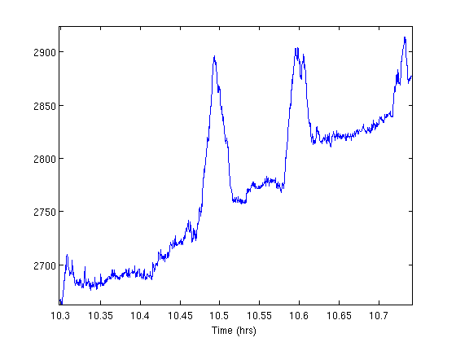
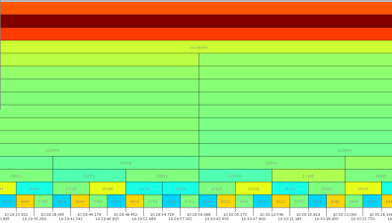
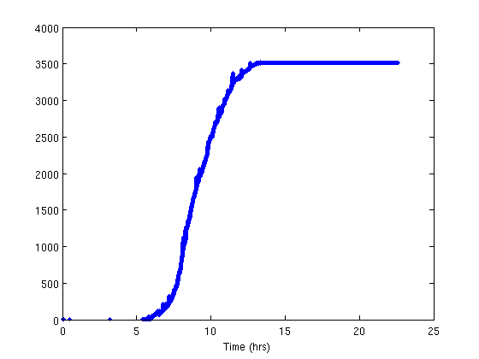
Multiscale Analysis of Streaming Data Reveals Subtle Patterns
Network alerts over the span of ~24 hours from ~65k devices
Overall ramping behavior
Inherent bursty behavior revealed at select scales
scale
time
Note: Colors represents amount of function variation (JET colormap: -1 is dark red, 0 is green, +1 is dark blue)

Slide 5
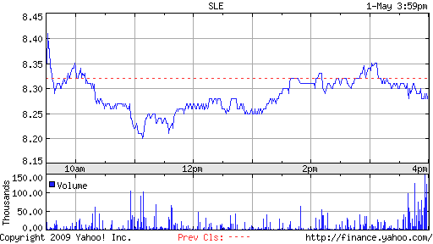
SLE Price Chart and “Bursty” Volume from May, 2009
How would we best represent the volume?

Slide 6
Some Haar-like functions
“The Theory of Weights and the Dirichlet Problem for Elliptic Equations” by R. Fefferman, C. Kenig, and J.Pipher (Annals of Math., 1991). We first define the “L∞ normalized Haar function” h_{I} for an interval I of form [j2^{-n},(j+1)2^{-n}] to be of form
h_{I} = +1 on [j2^{-n},(j+1/2)2^{-n})
and
h_{I} = -1 on [(j+1/2)2^{-n},(j+1)2^{-n}).
The only exception to this rule is if the right hand endpoint of I is 1. Then we define
h_{I} (1) = -1.

Slide 7
The Product Formula
Theorem (F,K,P): A Borel probability measure μ on [0,1] has a unique representation as
∏(1 + a_{I} h_{I}) ,
where the coefficients a_{I} are∈ [-1,+1]. Conversely, if we choose any sequence of coefficients a_{I} ∈ [-1,+1], the resulting product is a Borel probability measure on [0,1].
Note: For general positive measures, just multiply by a constant. Similar result on [0,1]^{d}.
Note: See “The Theory of Weights and the Dirichlet Problem for Elliptic Equations” by R. Fefferman, C. Kenig, and J.Pipher (Annals of Math., 1991)

Slide 8
Relative “Volume”
The coefficients a_{I} are computed simply by computing relative measure (“volume”) on the two halves of each interval I. Let L and R = left (resp. right) halves of I. Solve:
μ(L) = ½ (1 + a_{I}) μ(I)
μ(R) = ½ (1 - a_{I}) μ(I)
Then -1 ≤ a_{I} ≤ +1 because μ is nonnegative.

Slide 9
Why Use It Instead of Wavelets?
The coefficients measure relative measure instead of measure. All scales and locations are counted as “equal”.
Allows another method to represent the signal, where one immediately detects large changes in relative volume. (Anomaly detection)
Multiple channels are immediately normalized if one looks just at the coefficients instead of absolute volume.
One cannot easily synthesize using Haar wavelets and the “usual” expansion”. (How to keep the function positive?)

Slide 10
History in Analysis
This method and its “cousins” have been around for a while for analysis of various classes of weight functions on Euclidean space. See e.g.
(P. Jones, J. Garnett) BMO from dyadic BMO. Pacific J. Math. (1982)
One idea is to use the dyadic setting, analyze functions or weights, and average over translations of the dyadic grid.

Slide 11
Support of Measures and Information Dimension
An Example of use. Suppose a probability measure is obtained in the previous manner by using the same PDF for every coefficient.
Entropy: Σ p_{k}log₂(p_{k}) = - nh,
Here we sum over intervals of length 2^{-n}. The (expectation of the) entropy, h, is derived from the PDF, and is independent of n (so set n = 1).
Theorem: The information dimension h
( = dimension of the support of the measure) is (a.s.) given by the expectation for n = 1. Here p₁ = 1 + a_{[0,1]} and
p₂ = 1 - a_{[0,1]} . (Just average over the PDF.)
Remark: Small h means the signal is more “bursty”. Can calculate the full “multifractal spectrum”.

Slide 12
More on Dimension
The box-counting, information, and correlation dimensions, can be seen as special cases of a continuous spectrum of Generalized or Rényi Dimensions of order α, defined by
Lim ε → 0 ((1-α) log(1/ε))⁻¹ log{∑_{k} p_{k}^{α}}
where the numerator in the limit is the Rényi entropy of order α. In our case, ε = 2^{-n} and the p_{k} are the weights put on the ith interval of that length.

Slide 13
Synthesis
Fix a Probability Density Function on
[-1,+1]. Choose the coefficients a_{I} independently from that PDF. In the following we show a simulated signal, followed by a color chart (using “Jet”) of the coefficients.
This allows one to simulate for purposes of training. Similar (but also different!) from other methods (e.g. Barral and Mandelbrot). They need to normalize measure “at every step”.

Slide 14
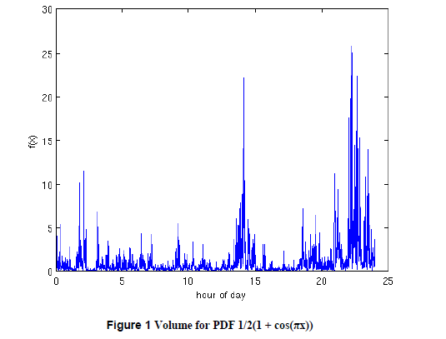

Slide 15
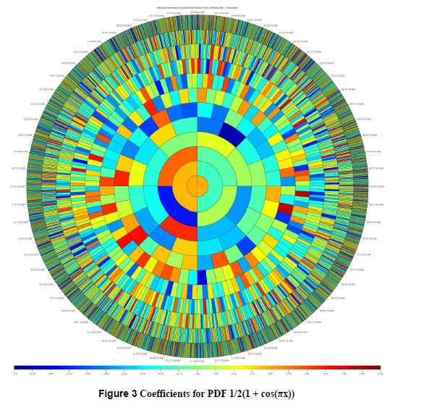

Slide 16
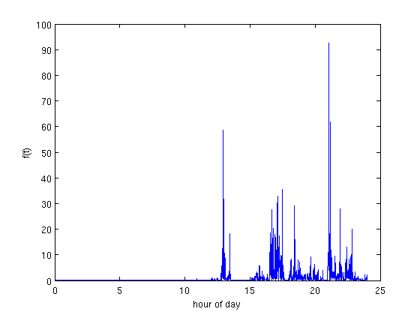
Synthesized signal
Here all the coefficients have been chosen from one PDF for the intervals in the “second half of the day”.

Slide 17
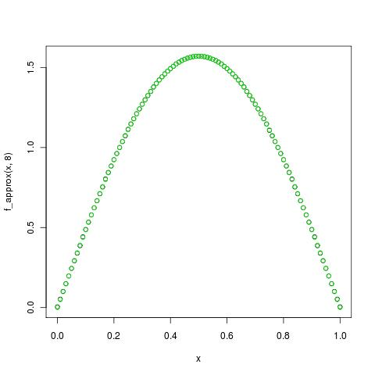
PDPM – An Example (scale 8)
Function
  f(x) = (π/2).sin(π.x) defined on [0,1]
Legend
  True function (green)
  Approximation using PDPM (black)

Slide 18
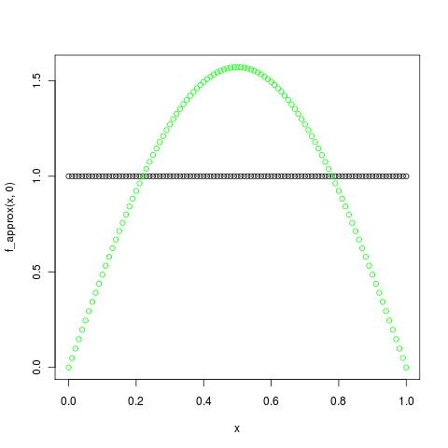
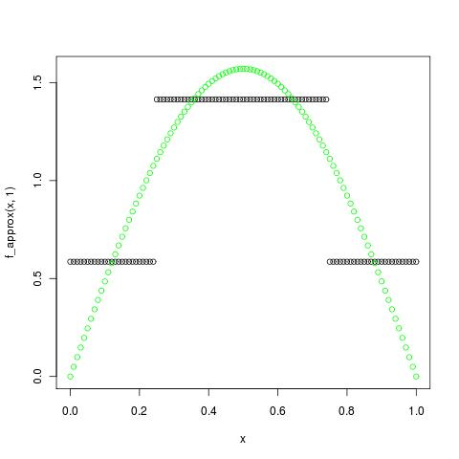
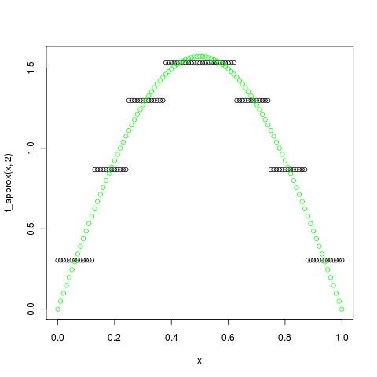
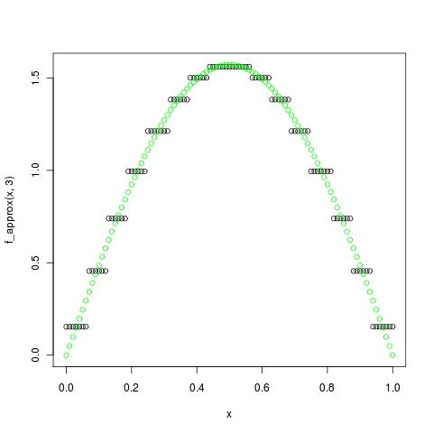
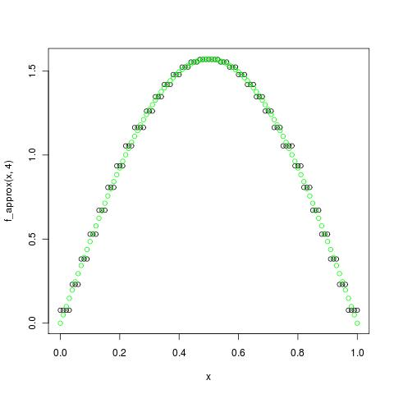
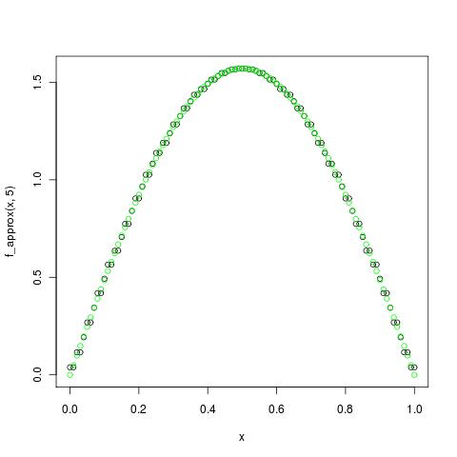
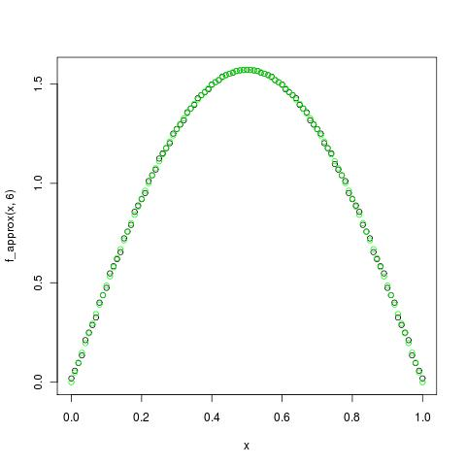
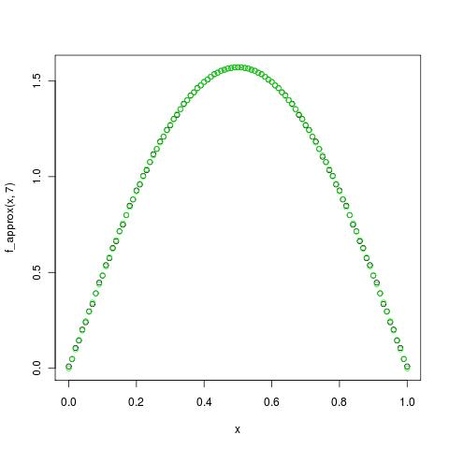
PDPM – An Example (scales 0 to 7)

Slide 19
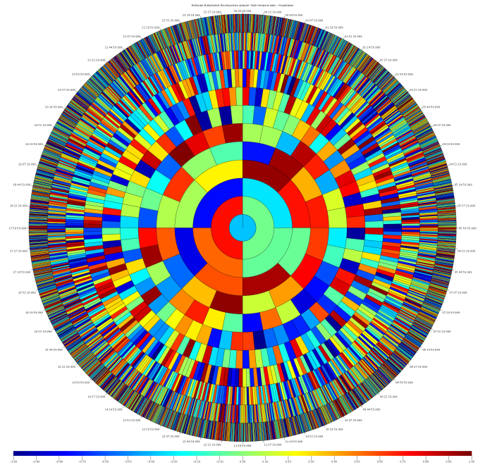
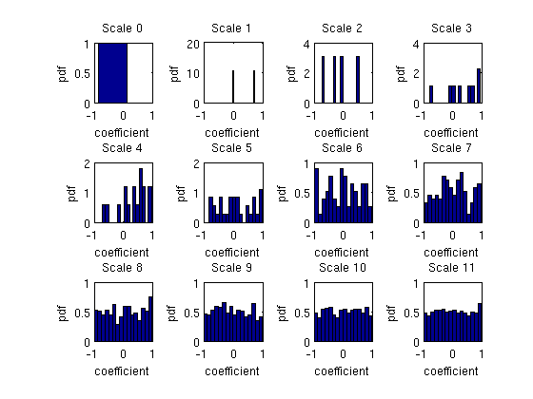
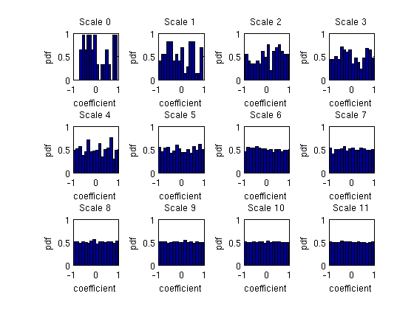
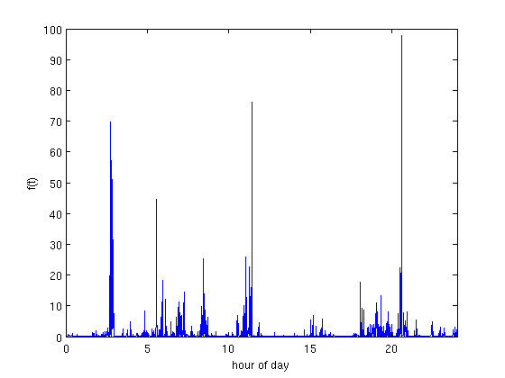
PDPM Synthesis/Visualization – Uniform

Slide 20
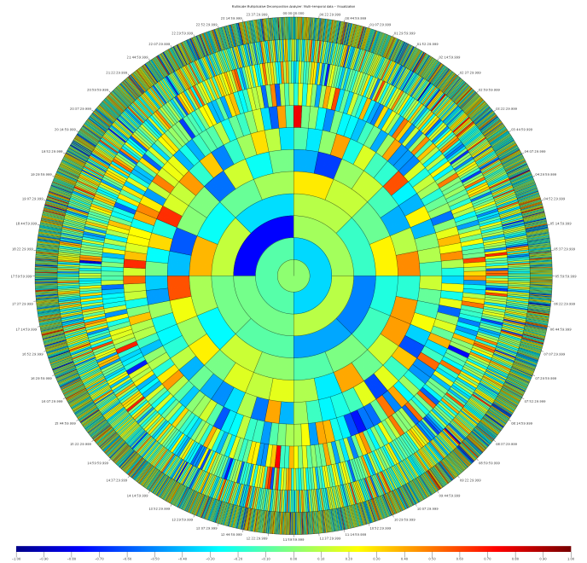
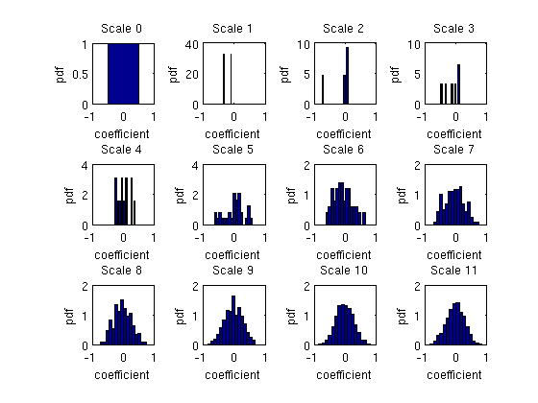
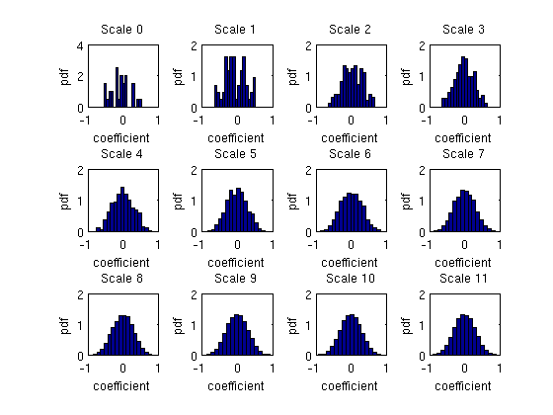
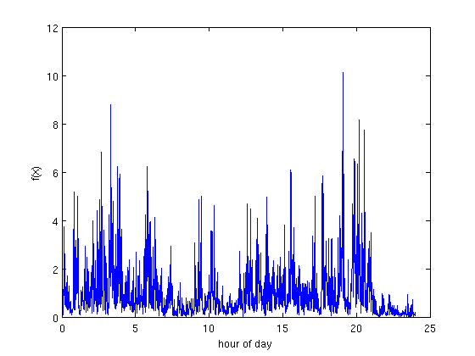
PDPM Synthesis/Visualization – Bell

Slide 21
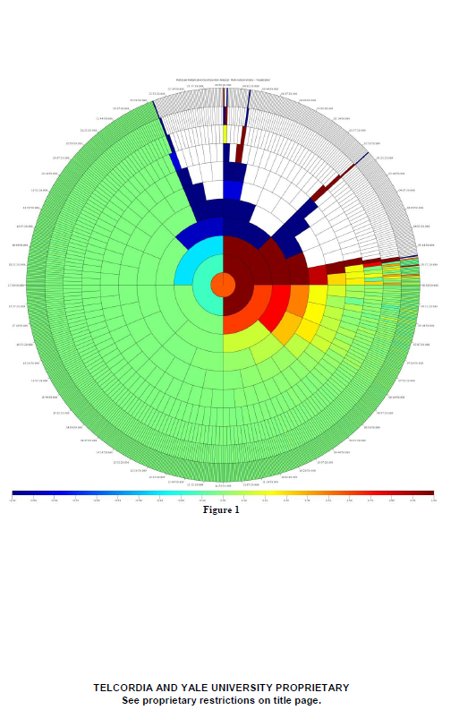
Real Data from Weather Event

Slide 22
Dataset I: Local Information
Network measurements over the span of ~24 hours; ~65k sources
Overall ramping behavior
Inherent bursty behavior revealed at select scales
scale
Note: Colors represents amount of function variation

Slide 23
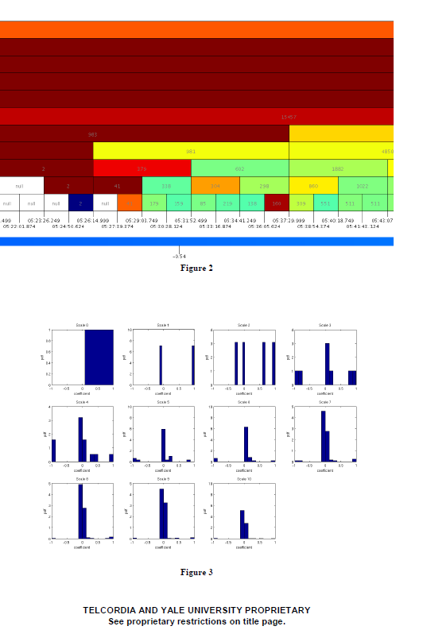

Slide 24
Measures and Curves
Take a positive measure μ on the circle and normalize its mass to be 2π. Let Φ’ = μ. If μ puts positive mass on each open interval and has no Dirac masses, Φ is a homeo of the circle.
Amazing Fact: Under mild hypotheses, there is a curve corresponding to μ (the “welding curve”). An example is on the next page.

Slide 25
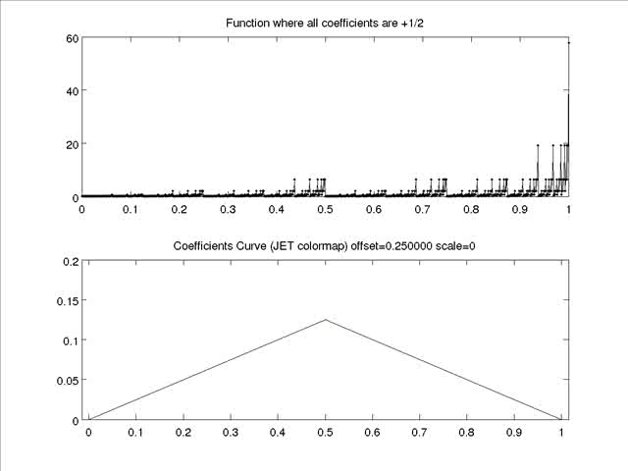

Slide 26
Analysis of Another Data Set
In the first analysis to follow we will simply use the actual volume. A data point will be the volume at times t, t -1, t -2, t -3 (for each source). We then examine the data using first PCA (“Data Set 2: 1 and 2 of 2”), then Diffusion geometry (“Data Set 2: Diffusion Map”). Here there is no apparent advantage (over SVD) in using Diffusion Geometry.
In the second analysis we instead take a data point to be the coefficients of the product expansion of the day’s volume (from each source), and display only the results from DG. Notice the excellent clustering that happened automatically (Data Set 2: PDPM + Diffusion Map”).

Slide 27
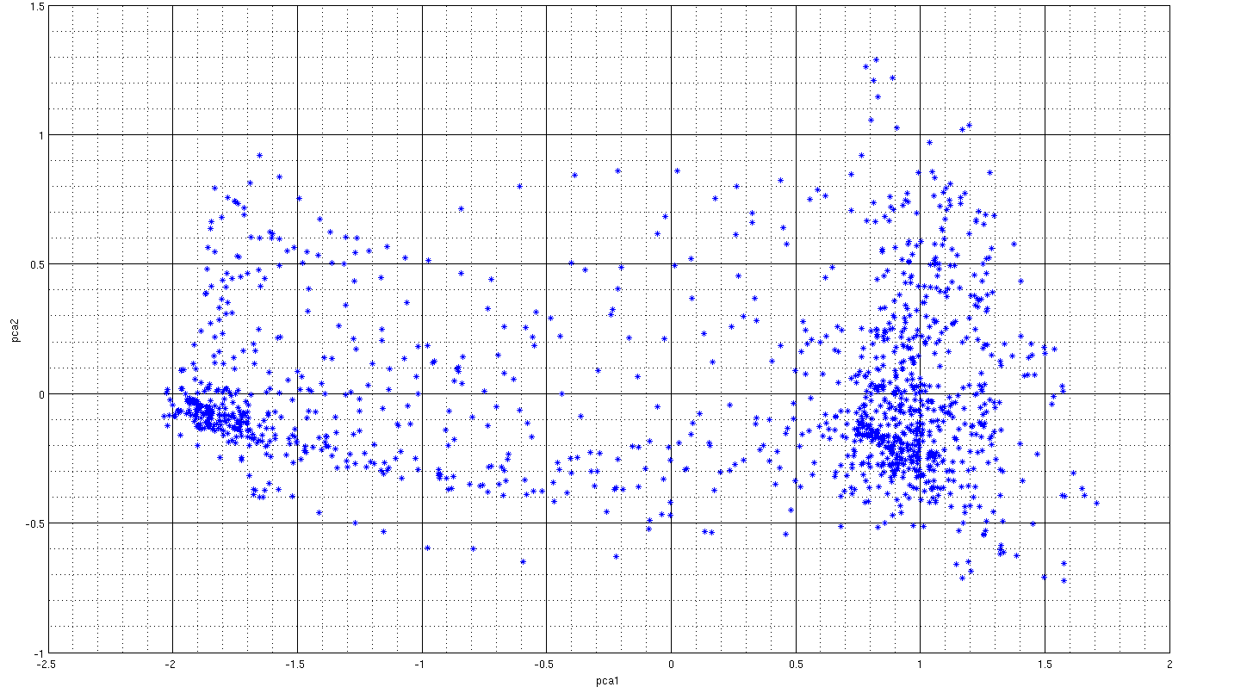
Dataset II: SVD (1 of 2)
Measurement data
  182 network entities
  ~ 2 weeks of data @ 15 min intervals
  1315 data points
PCA analysis
  Window size: 1 hour
  Dimensions: 728 (reduced 2-dim. representation above)

Slide 28
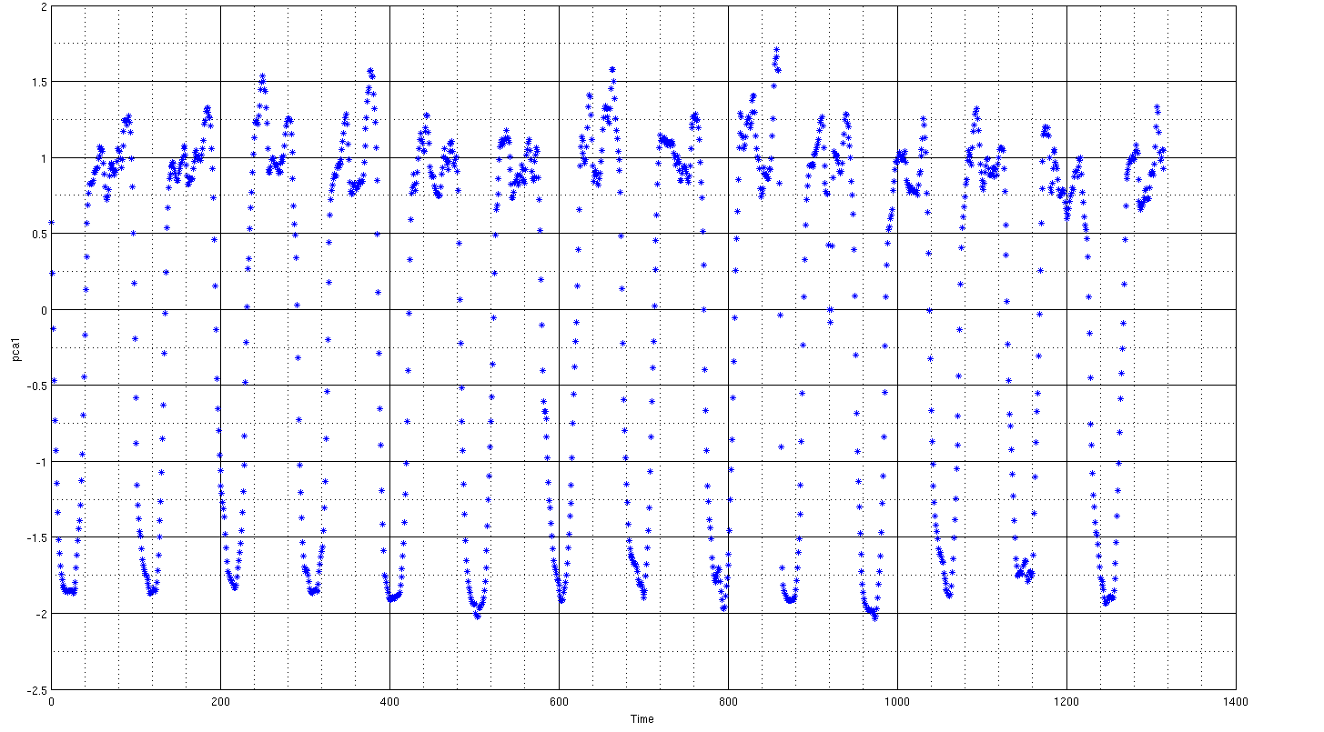
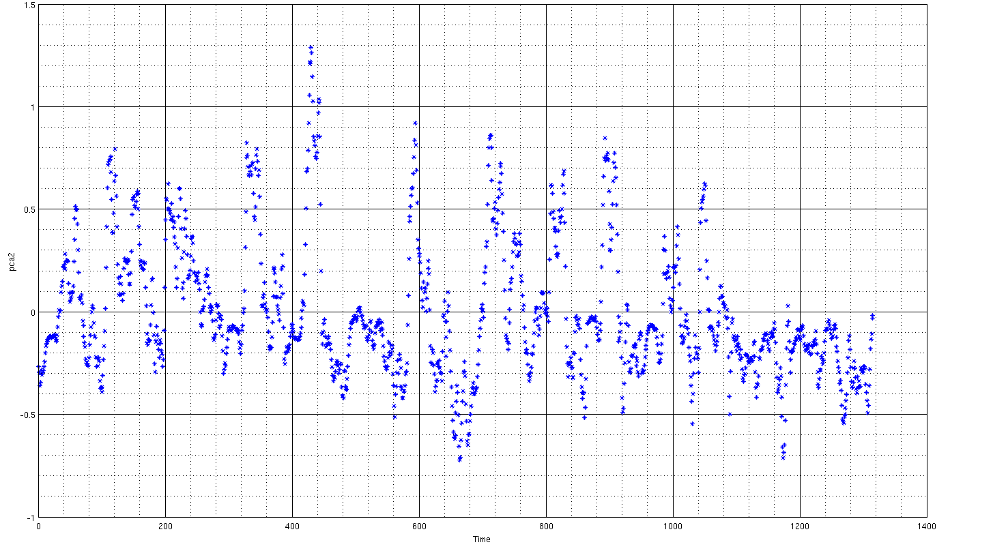
Dataset II: SVD (2 of 2)
PCA analysis
  major discriminator is time of day
  minor discriminator is day of week
  Legend: morning, night, weekend

Slide 29
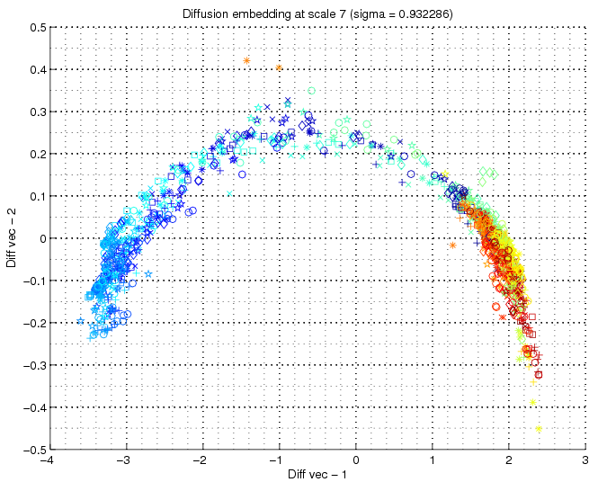
Dataset II: Diffusion Map
Time of day
  JET color map
1 hr window

Slide 30
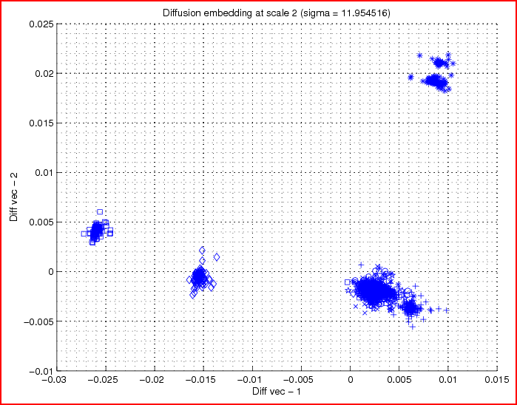
Dataset II: PDPM + Diffusion Map
Daily profile
  182 antennas
  14 days
  @ 15 mins
Analysis
  ~2550 points
  96 dim.
  PDPM
  Diffusion Map
Wed
Thu
Fri
Sat/Sun/Mon
Tue

Slide 31
Diffusion Geometry
The idea behind Diffusion Geometry is to put a new, nonlinearly defined representation af the data set. “Cartoon Version”:
Step 1. Embed the data set in ℝ^{d}.
Step 2. Choose a value of σ to define a length scale. Build the data matrix
M = (exp{ - |x_{i} – x_{j}|²/σ})
Step 3. Compute the Eigenvectors {Φ_{k}}.

Slide 32
DG Continued
4. Carefully choose a small number of eigenfunctions, e.g. Φ₃ , Φ₄ , Φ₇ . The new data set representation is given by the image
x_{i} → {Φ₃(x_{i}), Φ₄(x_{i}), Φ₇(x_{i})}
5. Why do it? It could be helpful where PCA works poorly. It computes “local affinities” and builds coordinates from that information.

Slide 33
References
For a tutorial see: Mauro Maggioni’s Homepage. Click on “Diffusion Geometry”.
Why can it work? See:
“Manifold parametrizations by eigenfunctions of the Laplacian and heat kernels”. (Joint with Mauro Maggioni and Raanan Schul)
PNAS, vol. 105 no. 6 (2008), pages 1803-1808
(Plus full paper on Raanan Schul’s Homepage)

Slide 34
Some Algorithms and Software
Fast SVD’s (V. Rokhlin et al.)
A Randomized Approximate Nearest Neighbor Algorithm
by P. Jones, A. Osipov, V. Rokhlin
Yale CS Technical Report (http://www.cs.yale.edu/publications/techreports.html#2010)
Why Needed? Building the transition matrix is costly. (O(N²) for naïve algorithm.)

Slide 35
Idea Behind Algorithm
Transform the data set by a (fast) random rotation.
If # data points ~ 2^{D}, pick first D coordinates.
Divide set in ½ by finding median in 1st coordinate. Get two collections.
Divide each of preceding collections into two collections. Repeat total of ~ D times.
Each collection has O(1) (say 15) elements. Save these as possible NN’s of each other.
Repeat L times, get ~ 15L suspects for each point.
Technicalities: perform various tree and graph searches.

Slide 36
What this allows you to do
Rapidly build (thresholded) self-adjoint transition matrices.
Use fast SVD’s to compute approx. eigenvectors, apply methods of diffusion geometry.
This allows rapid updating of the matrix to account for changing scenario.
Next slide courtesy of Neta Rabin (Asst. Prof., Yale Applied Math Program): Her earlier work on
Electricity Pricing and Diffusion Geometry

Slide 37
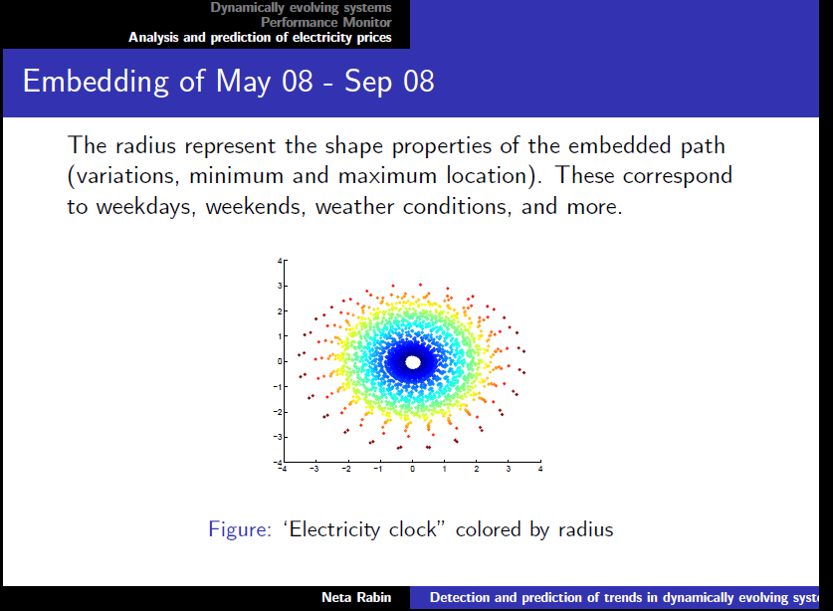

Slide 38
Proposed Next Steps
Feasibility demonstration on power grid data
Proposal for larger scale demonstration

