Slide 1



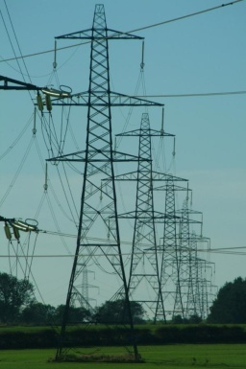



Smart Grid Challenges: Standards, Measurements and Security
  David Wollman
  Smart Grid Team
  Physical Measurement Laboratory
  National Institute of Standards and Technology
  U.S. Department of Commerce
  October 25, 2010

Slide 2
Smart Grid Challenges – Outline
Introduction
  Documentary Standards and Measurements
NIST Three Phase Plan
  NIST Smart Grid Interoperability Framework, Release 1.0
  NIST Smart Grid Interoperability Panel
  How best to include research needs?
NIST Smart Grid Research
Smart Grid Challenges
  Research areas
  Outreach, potential partnerships

Slide 3
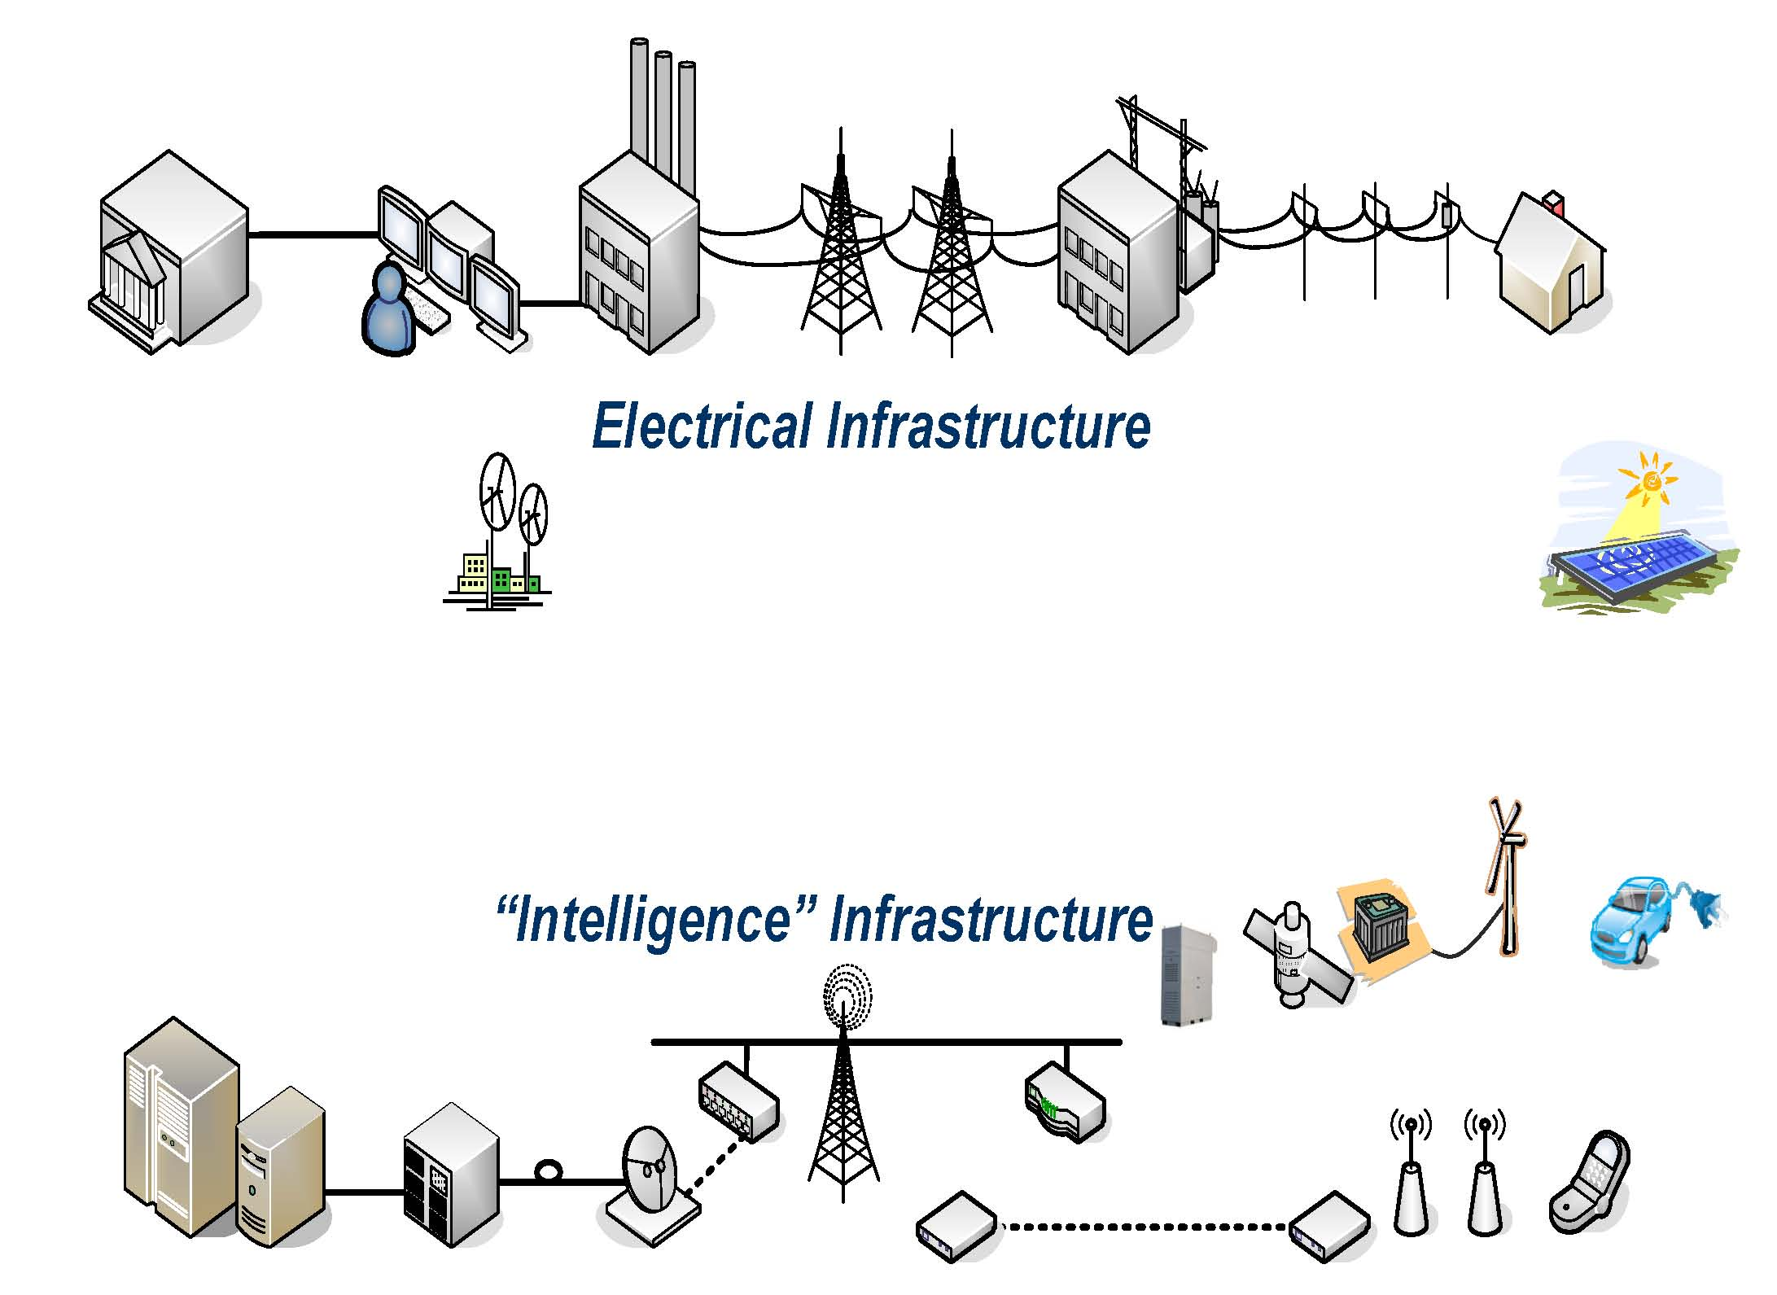
Smart Grid: The “Energy Internet”
2-way flow of electricity and information
Standards Provide a Critical Foundation
Graphics courtesy of EPRI
Notes:
3

Slide 4






Smart Grid – A National Priority
“We’ll fund a better, smarter electricity grid and train workers to build it…” President Obama
“To meet the energy challenge and create a 21st century energy economy, we need a 21st century electric grid…”
Secretary of Energy Steven Chu
“A smart electricity grid will revolutionize the way we use energy, but we need standards …” Secretary of Commerce Gary Locke
Smart Grid Enables:
Higher Penetration of Renewables
Smart Charging of Electric Vehicles
Consumers to Control Energy Bills
Efficient Grid Operations & Reduced Losses
Reduced Distribution Outages
Improved System Reliability & Security
4

Slide 5




US Government Roles in Smart Grid
Federal
Office of Science & Technology
Policy; National Economic Council;
& Council on Environmental Quality
Smart Grid Task Force /
National Science &
Technology Council
Smart Grid
Subcommittee
Other Federal
Agencies (EPA, …)
Federal
Energy
Regulatory
Commission
State
FERC – NARUC
Smart Response Collaborative
Public Utility Commissions
5
Notes:
5

Slide 6
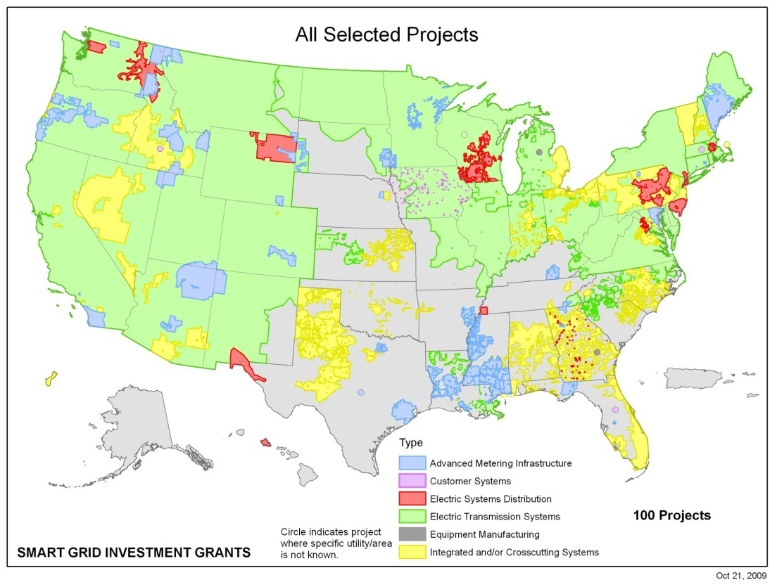
US Smart Grid Investment Grants
Category | $ Million
Integrated/Crosscutting | 2,150
AMI | 818
Distribution | 254
Transmission | 148
Customer Systems | 32
Manufacturing | 26
Total | 3,429
Geographic Coverage of Selected Projects
18 million smart meters
1.2 million in-home display units
206,000 smart transformers
177,000 load control devices
170,000 smart thermostats
877 networked phasor measurement units
671 automated substations
100 PEV charging stations
SGIG Topic Areas
6

Slide 7
NIST Role: Coordination of Interoperability Standards
Under Title XIII, Section 1305 of the Energy Independence and Security Act (EISA), NIST has
    “primary responsibility to coordinate development of a framework that includes protocols and model standards for information management to achieve interoperability of smart grid devices and systems…”
Input to Federal Energy Regulatory Commission (and State Public Utility Commissions)
    “…after [NIST]’s work has led to sufficient consensus in [FERC]’s judgment, [FERC] shall institute a rulemaking proceeding to adopt such standards and protocols…”
Use of these standards is a criteria for Department of Energy Smart Grid Investment Grants
7
Notes:
7

Slide 8
Smart Grid Interoperability
Interoperability: The ability of 2 or more networks, systems, devices, applications, or components to communicate & operate together effectively, securely, & without significant user intervention
  Communication requires agreement on a physical interface & communication protocols
  Exchanging meaningful & actionable information requires common definitions of terms & agreed upon responses
  Consistent performance requires standards for the reliability, integrity, and security of communications
  Interoperability may include:
    “Plug and play”: connect them & they work together
    Interchangeability: Ability to readily substitute components
8
Notes:
8

Slide 9











Standards Come from Many Developers
International
Global
Consortia
Regional and
National

Slide 10
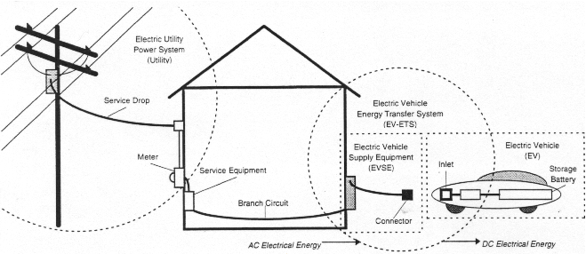



Example: Electric Vehicles Require Many Standards
J2293 (Communication)
Smart Energy 2.0
National Electric
Code
National
Electric
Safety Code
(Enclosures)
(Battery)
C12 (Meter)
J1772 (Connector)
1547 (Distributed energy interconnection)
61850 and 61970/61968 Information models
Demand response
& price signaling
10

Slide 11
NIST Support of Measurements and Standards
Measurements
Documentary Standards

Slide 12
NIST Support of Measurements and Standards
Measurements
Documentary Standards
Community Engagement

Slide 13
NIST Support of Measurements and Standards
Measurements
Documentary Standards
NIST
Community Engagement

Slide 14
NIST Support of Smart Grid
Smart Grid Documentary Standards
Measurements
Energy Independence and Security Act (EISA) December 2007
NIST
National Need

Slide 15
NIST Support of Smart Grid
Smart Grid Documentary Standards
Measurements
NIST Three Phase Plan
To Engage
Smart Grid Community
NIST
National Need
Smart Grid Community Engagement

Slide 16
NIST Support of Smart Grid
Smart Grid Documentary Standards
Smart Grid Measurements
NIST Three Phase Plan
Fully Engages
Smart Grid Community
NIST
National Need
Smart Grid Community Engagement

Slide 17
NIST Support of Smart Grid into Future
Smart Grid Measurements
Smart Grid Documentary Standards
Smart Grid Research Aligned w/DOE+
NIST
Community
Input
Supports Balanced Smart Grid R&D Portfolio
NIST Framework
National Need
NIST Smart Grid Interoperability Panel
Smart Grid Community Engagement

Slide 18
Smart Grid Challenges – Outline
Introduction
  Documentary Standards and Measurements
NIST Three Phase Plan
  NIST Smart Grid Interoperability Framework, Release 1.0
  NIST Smart Grid Interoperability Panel
  How best to include research needs?
NIST Smart Grid Research
Smart Grid Challenges
  Research areas
  Outreach, potential partnerships

Slide 19



NIST Three Phase Plan for Smart Grid Interoperability
PHASE 1
Identify an initial set of existing consensus standards and develop a roadmap to fill gaps
PHASE 2
Establish Smart Grid Interoperability Panel (SGIP) public-private forum with governance for ongoing efforts
PHASE 3
Conformity Framework (includes Testing and Certification)
Summer 2009 Workshops
Draft Framework Sept 2009
Smart Grid Interoperability Panel Established Nov 2009
Technical information to support regulators
NIST Interoperability Framework 1.0
Released Jan 2010
SGIP
meetings
2009
2010
today

Slide 20
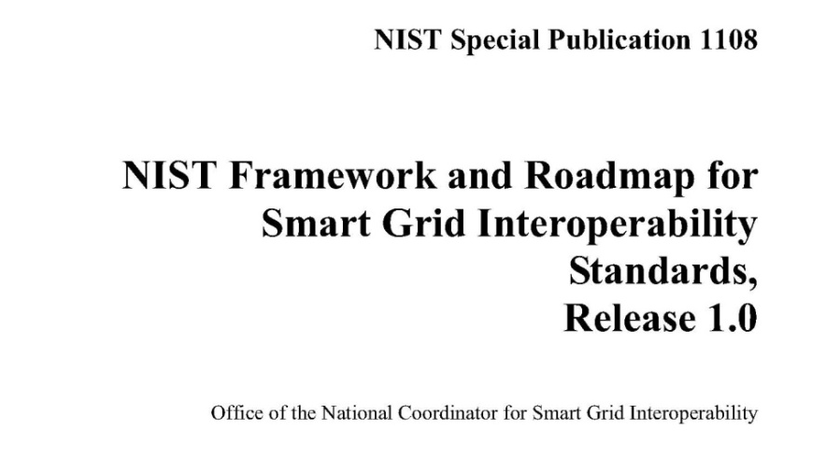
NIST Framework and Roadmap, Release 1.0
Final version January 2010
  Public comments on draft
  reviewed and addressed
Smart Grid Vision / Model
75 key standards identified
  IEC, IEEE, …
16 Priority Action Plans to
fill gaps (one completed, new one)
Includes cyber security,
companion document
NISTIR 7628, Guidelines for
Smart Grid Cyber Security
recently published
http://www.nist.gov/smartgrid/
Conceptual Model
http://www.nist.gov/smartgrid/

Slide 21
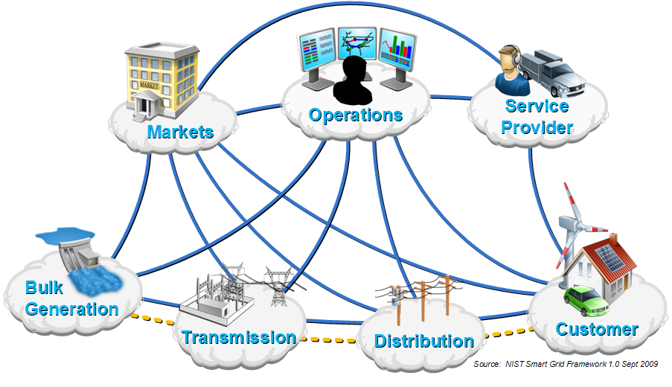
NIST Smart Grid Conceptual Model

Slide 22
NIST Smart Grid Conceptual Model
Cybersecurity (everywhere)
Wide Area Situational Awareness (WASA)
Electromagnetic compatibility
(everywhere)
Networks
Building Automation
Intelligent sensors
Industrial Control Systems
Electric
Power Metering
Power Electronics

Slide 23
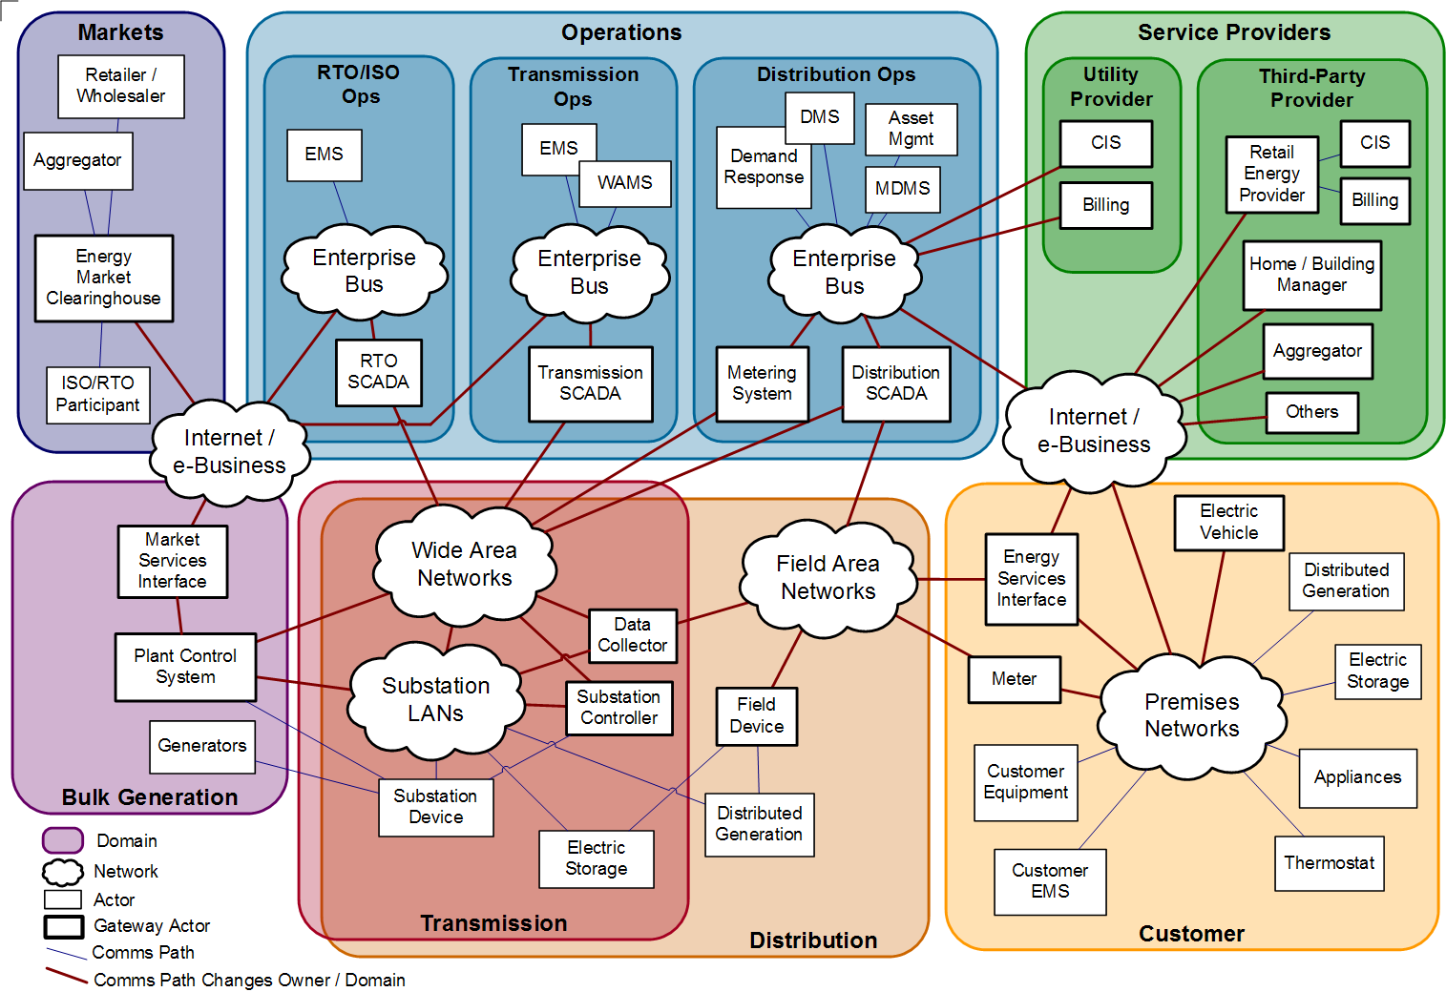
Smart Grid Reference Model
23

Slide 24

Filling Gaps in the Standards
Priority Action Plans (led by NIST staff)
# | Priority Action Plan | # | Priority Action Plan
0 | Meter Upgradeability Standard | 9 | Standard DR and DER Signals
1 | Role of IP in the Smart Grid | 10 | Standard Energy Usage Information
2 | Wireless Communication for the Smart Grid | 11 | Common Object Models for Electric Transportation
3 | Common Price Communication Model | 12 | IEC 61850 Objects/DNP3 Mapping
4 | Common Scheduling Mechanism | 13 | Time Synchronization, IEC 61850 Objects/ IEEE C37.118 Harmonization
5 | Standard Meter Data Profiles | 14 | Transmission and Distribution Power Systems Model Mapping
6 | Common Semantic Model for Meter Data tables | 15 | Harmonize Power Line Carrier Standards for Appliance Communications in the Home
7 | Electric Storage Interconnection Guidelines | 16 | Wind Plant Communications
8 | CIM for Distribution Grid Management | 17 | Facility Smart Grid Information
24
Notes:
24

Slide 25

NIST Smart Grid Interoperability Panel
Public-private partnership created in Nov. 2009
Over 600 member organizations
Open, public process with international participation
Coordinates standards developed by Standards Development Organizations (SDOs)
  Identifies Requirements
  Prioritizes standards development programs
  Works with over 20 SDOs including IEC, ISO, ITU, IEEE, …
Web-based participation
SGIP Twiki:
http://collaborate.nist.gov/twiki-sggrid/bin/view/SmartGrid/SGIP
25

Slide 26
NIST SGIP Standing Committees
Smart Grid Architecture Committee (SGAC)
  Creates & refines SG Conceptual Reference Model, including input to lists of the standards and profiles necessary to implement the Smart Grid.
Testing & Certification Committee (SGTCC)
  Creates and maintains the documentation and organizational framework for compliance, interoperability and cyber security testing and certification related to Smart Grid standards
  Develops & implements certification criteria by which compliance can be verified through testing of vendor products and services
Cyber Security Working Group (permanent working group)
26
Notes:
26

Slide 27
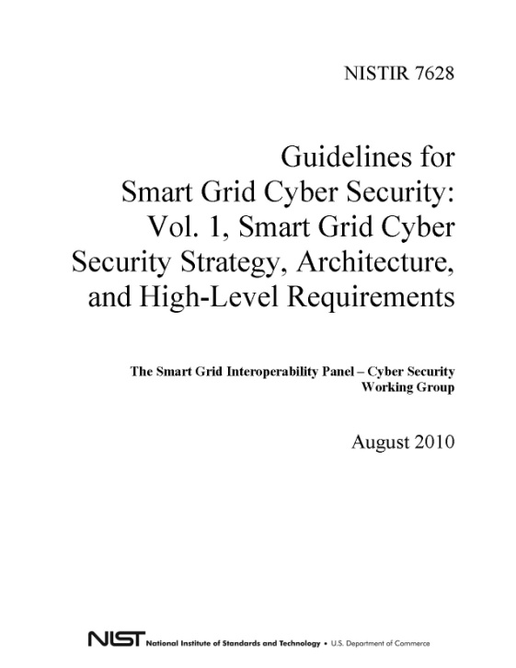
Cyber Security Working Group
Building cyber security in from the start has been a paramount concern
Permanent Working Group
  Over 460 public and private sector participants
August 2010 NIST publishes: Guidelines for Smart Grid Cyber Security
  Reflects Comments on Sept 2009 and Feb 2010 Draft Smart Grid Cyber Security Strategy and Requirements
Guideline includes:
  Risk assessment guidance for implementers
  Recommended security requirements
  Privacy recommendations
27
Notes:
27

Slide 28


SGIP Organization
Governing Board
SGIP Officers
NIST
SGIP Administrator
Priority Action Plan Teams
Test & Certification
Architecture
PAP 1
PAP 2
PAP 3
Committee
Committee
(SGTCC)
(SGAC)
PAP 4
PAP …
PAP 17
Cyber Security
Working Group
(CSWG)
Standing Committees &
Domain Expert Working Groups
Working Groups
BnP
H2G
B2G
TnD
I2G
PEV2G
Program
Comm.
Bylaws &
Mgmt
Marketing
Operating
Electromagnetic Interoperability Issues
Office
Education
Procedures
(PMO)
(CME)
(BOP)
Coordination Functions
SGIP Membership
Notes:
28

Slide 29
SGIP Organization
Governing Board
SGIP Officers
NIST
SGIP Administrator
Priority Action Plan Teams
Test & Certification
Architecture
PAP 1
PAP 2
PAP 3
Committee
Committee
(SGTCC)
(SGAC)
PAP 4
PAP …
PAP 17
Cyber Security
Working Group
Research
?
(CSWG)
Standing Committees &
Domain Expert Working Groups
Working Groups
BnP
H2G
B2G
TnD
I2G
PEV2G
Program
Comm.
Bylaws &
Mgmt
Marketing
Operating
Electromagnetic Interoperability Issues
Office
Education
Procedures
(PMO)
(CME)
(BOP)
Coordination Functions
SGIP Membership
Notes:
29

Slide 30
NIST Smart Grid Program Plan
Program Management
  Office of the National Coordinator for Smart Grid Interoperability
Architecture and Standards
  NIST Framework
  Priority Action Plans
  Smart Grid Interoperability Panel
Testing and Certification
  Initial Framework
  Smart Grid Interoperability Panel
Supporting Research
  Power Systems
  Building Interfaces
  Industrial Interfaces
  Cyber Security
  Communications

Slide 31
NIST Smart Grid Program Plan
Program Management
  Office of the National Coordinator for Smart Grid Interoperability
Architecture and Standards
  NIST Framework
  Priority Action Plans
  Smart Grid Interoperability Panel
Testing and Certification
  Initial Framework
  Smart Grid Interoperability Panel
Supporting Research
  Power Systems
  Building Interfaces
  Industrial Interfaces
  Cyber Security
  Communications
Algorithmic Decision Theory?

Slide 32
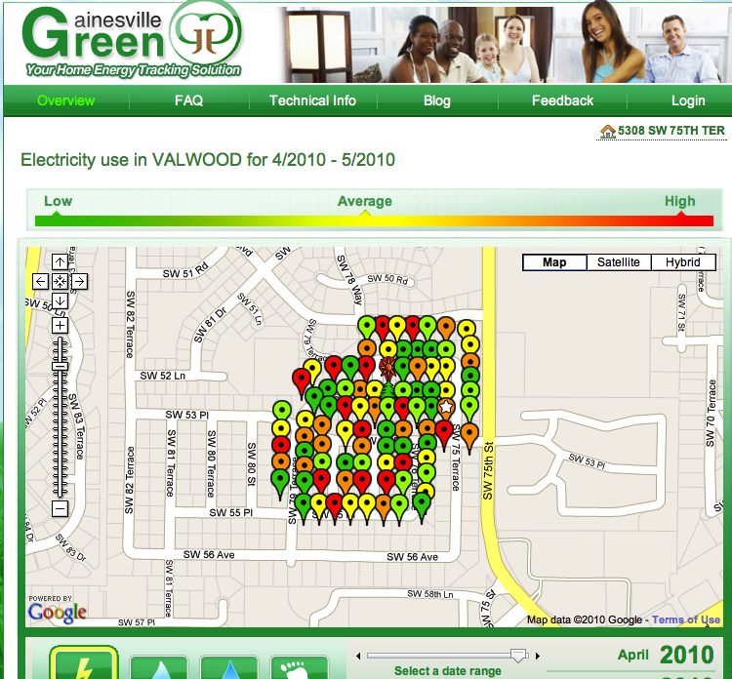
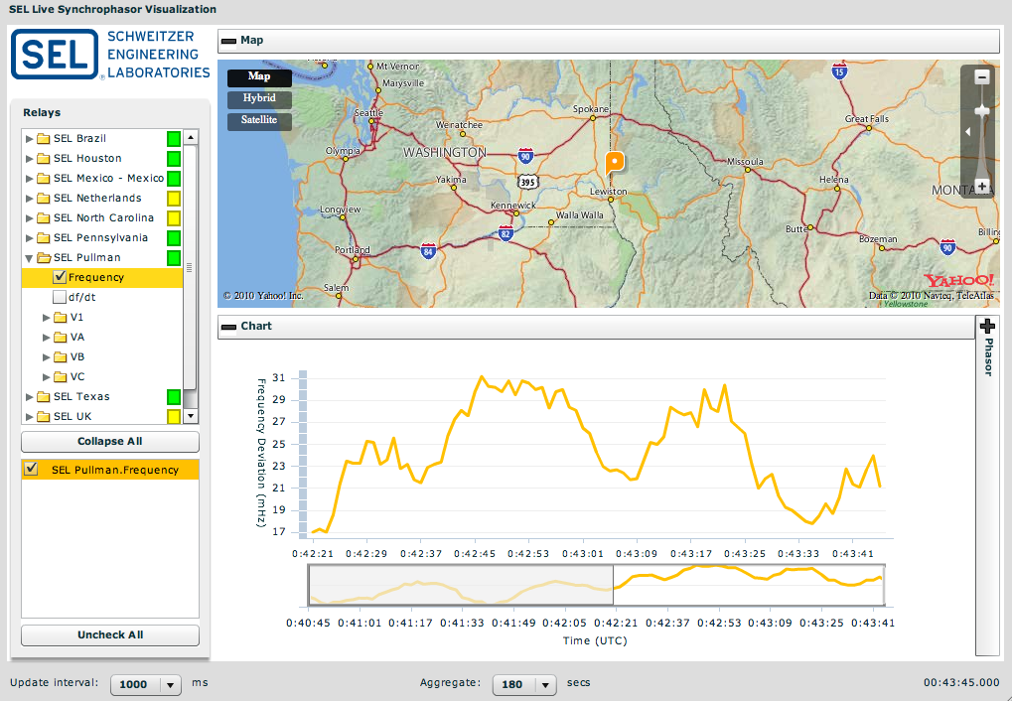
Real-time Data Management Needs
Smart Meters
Synchro Phasors
Embedded Sensors
Distributed Generation Output
Building Automation
32

Slide 33
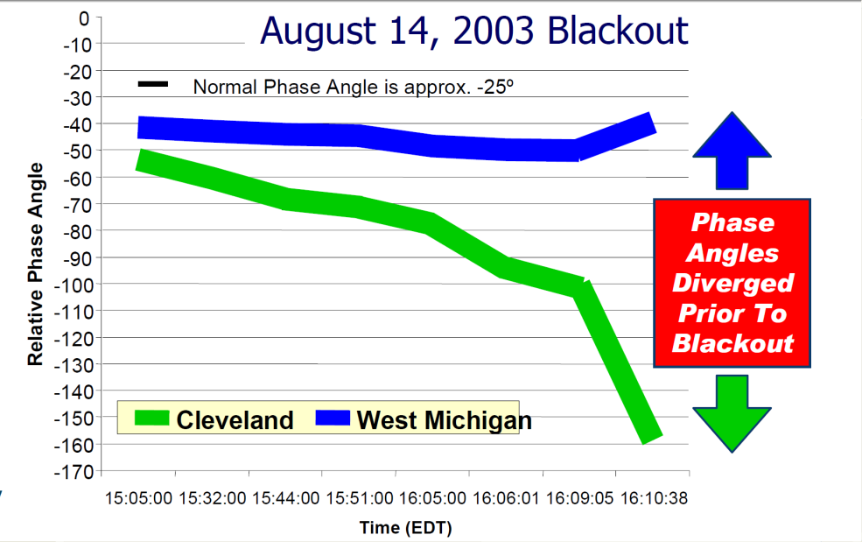
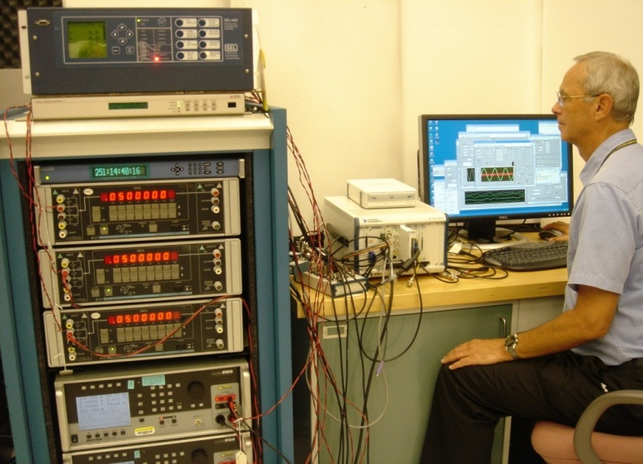
NIST Research: SynchroMetrology Laboratory
Phasor Measurement Units (PMUs) provide situational awareness and advance warning for grid operations
NIST has unique PMU calibration special test service
NIST has provided measurement assistance to manufacturers and utilities on design, testing and use of PMUs, and has helped to evaluate and improve standards.
Example: Mandatory testing of PMUs to be used in Brazil

Slide 34
NIST Research: SynchroMetrology Laboratory
Technical input to IEEE C37.118 standard
North American SynchroPhasor Initiative (NASPInet)
Priority Action Plan (PAP 13 Time Synchronization, IEC 61850 Objects/ IEEE C37.118 Harmonization)
NIST ARRA Contract to support PAP13 and further developments; ARRA Grant supporting PMU calibrators
Future research: Additional dynamic measurements, sensors

Slide 35
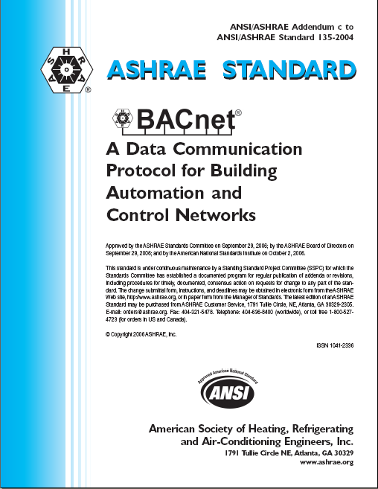
NIST Research: Building Automation Control
Addressing the role of the building in the smart grid:
  72% of all electricity is consumed by building system loads.
  NIST building smart grid research is focused on grid-aware energy management in complex facilities.
  Research leads to information models that enable communication standards for the Smart Grid
  Building systems control strategies for load, generation and storage management
  Net-zero residential building testbed
  Islanding strategies for graceful degradation of building system performance during grid outages
NIST Virtual Cybernetic
Building Testbed

Slide 36
Smart Grid Research Challenges and Opportunities
Metering
  Bidirectional metering, testbeds…
Sensors and automated control
  PMUs, time synchronization, distributed sensors…
Smart Grid architecture and operations
  Research/modeling of grid stability (load/generation)
  Microgrids, …
Power Electronics
Electromagnetic Compatibility/Interference
Energy Efficiency
Integration with Net-Zero Buildings
Cybersecurity
Electric Vehicles/Storage
Communication protocols
Testing and certification activities, many others …

Slide 37
Computational Applications for Today’s Grid
Forecasting load
  Short, mid and long-term
  Used for capacity planning, market operations, dispatching, demand response
  Based on historical patterns and variables such as weather
  Well understood
Forecasting variable generation
  Utility-owned wind and solar PV
  Localized weather models
Situational awareness
  Phasor Measurement Units
Control
  Visualization and decision support tools

Slide 38
New Computational Applications for the Smart Grid
Forecasting load
  New models needed to reflect effects of dynamic prices, smart appliances, customer energy management systems, electric vehicles
Forecasting variable generation
  Distributed generation sources owned by customers
Situational awareness and data management
  Management and utilization of data from networked Phasor Measurement Units, smart meters, and embedded sensors in transmission and distribution networks
Control
  Automated control systems utilizing real time data

Slide 39
Further Information
Web portal: http://www.nist.gov/smartgrid
Contact:
  George Arnold, National Coordinator for Smart Grid Interoperability
  Email: george.arnold@nist.gov
  Telephone: +1.301.975.2232
  David Wollman, Leader, Electrical Metrology Groups
  Email: david.wollman@nist.gov
  Telephone: +1.301.975.2433
39

Slide 40
Backup slides

Slide 41

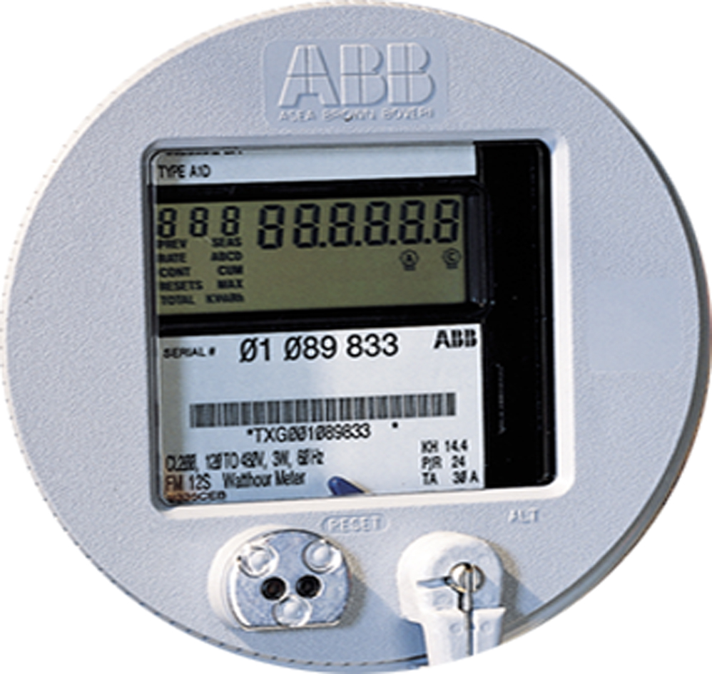
Today’s Grid
Supply Side
Base Load
Generation
+
Load Following
Generation
+/–
Bulk Energy
Storage
=
Built-in
Demand
–
Interruptible
Load DR
Demand Side
Notes:
41

Slide 42
Tomorrow’s Grid
Supply Side
Base Load
Generation
+
Load Following
Generation
+/–
Bulk Energy
Storage
+
Centralized
Wind & Solar
Balance Variable Generation with Unpredictable Demand-side Resources
Operating Closer to the Edge?
Early Warning Signs?
Variable
+/–
Price
Responsive DR
–
Distributed
Generation
Built-in
Demand
–
Interruptible
Load DR
“Demand-side” Resources
Electric Vehicles and
Battery Storage Systems
+/–
Demand Side
Notes:
42

Slide 43
Outreach and Engagement
DOE R&D Strategic Plan
  Office of Electricity Delivery and Energy Reliability (OE)
  Office of Energy Efficiency and Renewable Energy (EERE)
  PNNL, Sandia, INL, NREL, Brookhaven …
Other Federal Agencies (EPA, DOD, GSA, NSF, FERC, …)
Academia
  Texas A&M, Virginia Tech, Georgia Tech, MIT, UCLA, CU-Boulder, CMU, U. Illinois, NC State, USF, UT-Austin, U.Minn, PSU, …
  Smart Grid Research Centers
Industry
  Utilities (including testing labs), EPRI, …
  Wide range, including SGIP members, consortia, …
International
  European Electricity Grids Initiative, …
  Other National Metrology Institutes (NRC Canada, NPL, …)

Slide 44
DOE: Benefits from Smart Grid R&D Investments
Investments
Transformation
Results
Standards and Best Practices
Technology Development
Modeling
Analysis
Evaluation and Demonstrations
Demand
response and
customer
participation
Job Creation and Marketplace Innovation
Reduced Peak Load and Consumption
Operational Efficiency
Grid Reliability and Resilience
More Distributed and Renewable Energy
Lower Carbon Dioxide Emissions
Dynamic
optimization of
grid operations
and resources
Figure 2.1 from DOE’s Smart Grid R&D: 2010-2014 Multiyear Program Plan

Slide 45
Characteristics of a Smart Grid
Modern Grid Strategy project of the National Energy Technology Laboratory (NETL)
  Self-healing from power disturbance events
  Enabling active participation by consumers in demand response
  Operating resiliently against physical and cyber attack
  Providing power quality for 21st century needs
  Accommodating all generation and storage options
  Enabling new products, services, and markets
  Optimizing assets and operating efficiently

Slide 46
Where does the power go?
Generation
Transmission
Distribution
Markets and Operations
Customer Use
Approximately one third each to residential, commercial, and industrial sectors.
Notes:
46
You know that power is generated in real time, and that the grid is getting smarter, with more renewables that produce intermittent power that needs to be backed up with controllable generation. But where does the power go? What causes the typical summer afternoon peak load or winter peak morning load?

