Slide 1

Optimal Power Flow Problems
Steven Low
CMS, EE, Caltech
Collaborators:
Mani Chandy, Javad Lavaei, Ufuk Topcu, Mumu Xu
Notes:
Economic Dispatch in Power Networks with Storage
March 10-12, 2010: Workshop on Distributed Decisions via Games and Price Mechanisms, Lund University, Sweden (Anders Rantzer)
Aug 24, 2010: Lund University, Sweden
Sept 28, 2010: Complexity workshop, Caltech, CA (John Doyle)
Oct 5, 2010: Southern California Smart Grid Symposium
Oct 25, 2010: DIMACS workshop on Algorithmic Decision Theory for Smart Grids

Slide 2
Outline
Renewable energy and smart grid challenges
Optimal power flow problems
  Zero duality gap: Javad Lavaei, SL
  OPF with storage: M. Chandy, SL, U. Topcu, M. Xu

Slide 3
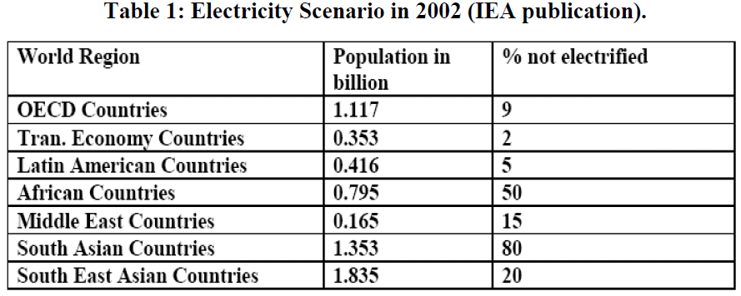
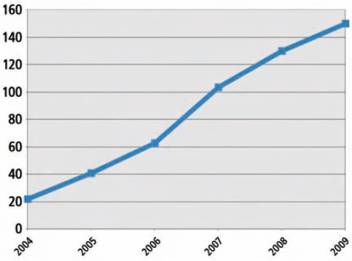
Renewable energy is exploding
... driven by sustainability
... enabled by investment & policy
Global investment in renewables
average : 2B people not electrified
Source: Renewable Energy GRS, Sept 2010

Slide 4
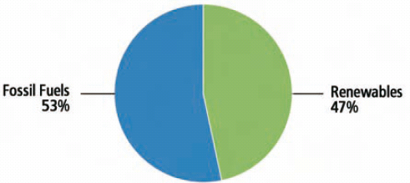
Renewable energy is exploding
... driven by sustainability
... enabled by investment & policy
Global capacity growth
2008, 09
fossil fuels
53%
renewables
47%
average : 2B people not electrified
Source: Renewable Energy Global Status
Report, Sept 2010

Slide 5
Summary
Renewables in 2009
  Account for 26% of global electricity capacity
  Generate 18% of global electricity
  Developing countries have >50% of world’s renewable capacity
  World: +80GW renewable capacity (31GW hydro, 48GW non-hydro)
  China: +37GW to a total renewable of 226 GW
  In both US & Europe, more than 50% of added capacity is renewable

Slide 6
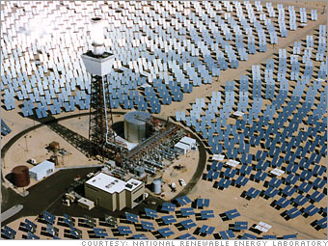

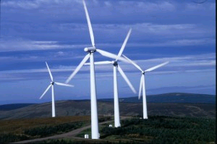
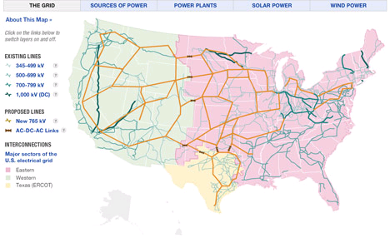
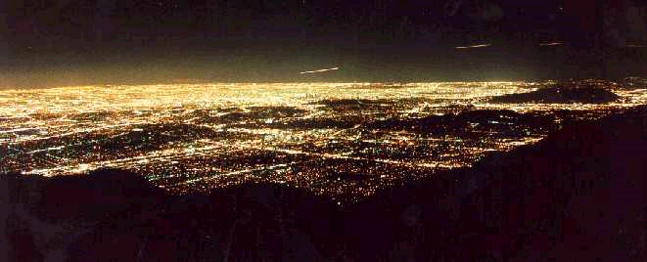
Generation
Transmission
Distribution
Load

Slide 7
Some challenges
Increase grid efficiency
Manage distributed generation
Integrate renewables & storage
Reduce peak load through DR
Technical issues
Wide range of timescales
Uncertainty in demand and supply
SoS architecture and algorithms

Slide 8
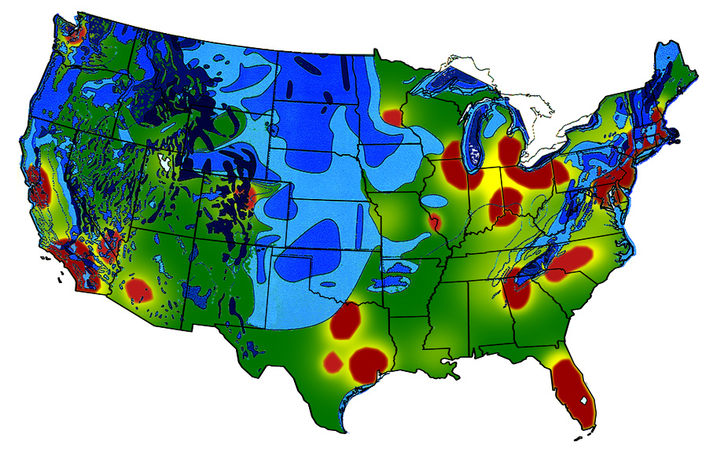
Challenge 1: Wind & Solar are Far from People
Need transmission lines
Legend:
Wind
People
Source: Rosa Yang

Slide 9
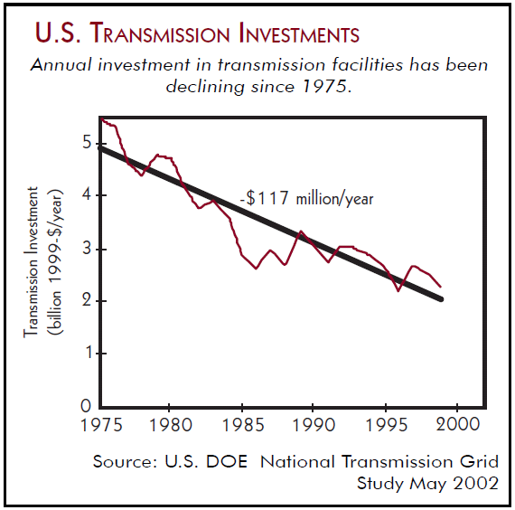

Slide 10
Challenge 1: grid efficiency
Must increase grid efficiency
5% higher grid efficiency = 53M cars
Real-time dynamic visibility of power system
  Now: measurements at 2-4 s timescale offers steady-state behavior
  Future: GPS-synchronized measurement at ms timescale offers dynamic behavior
  But: lack theory on how to control
Source: DoE, Smart Grid Intro, 2008

Slide 11
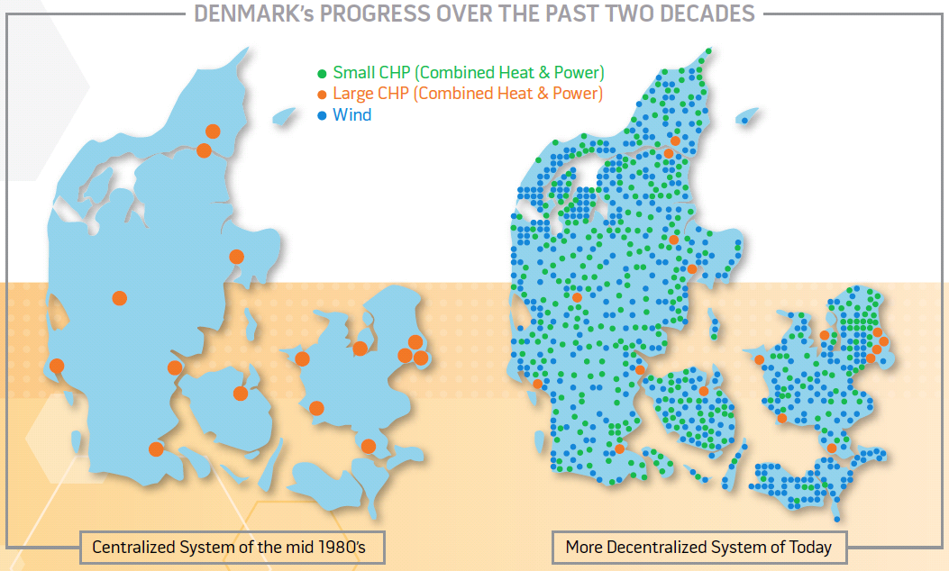
Challenge 2: distributed gen
2-3x more efficiency, less load on trans/distr
Source: DoE, Smart Grid Intro, 2008

Slide 12
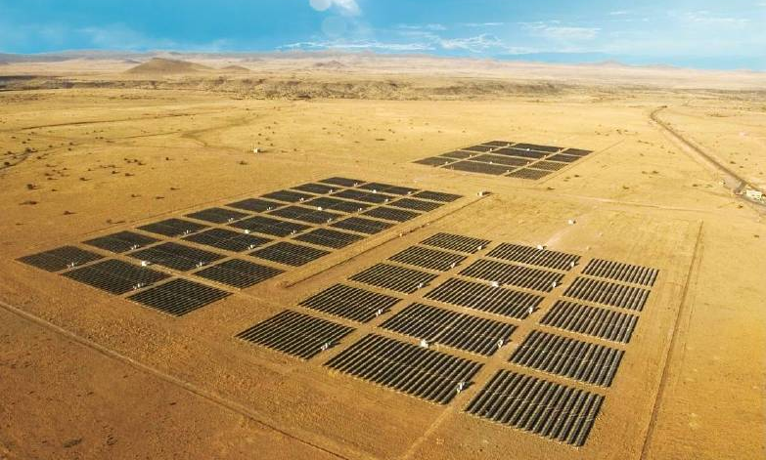
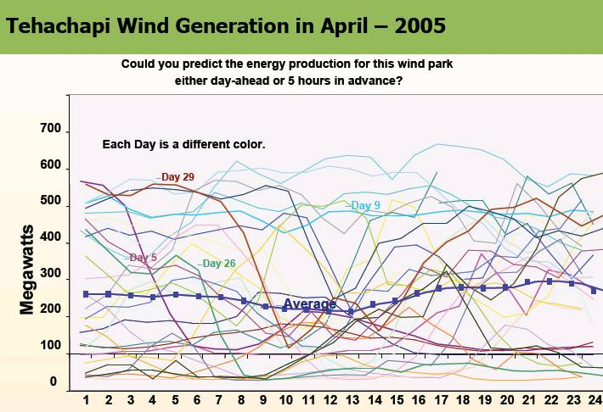
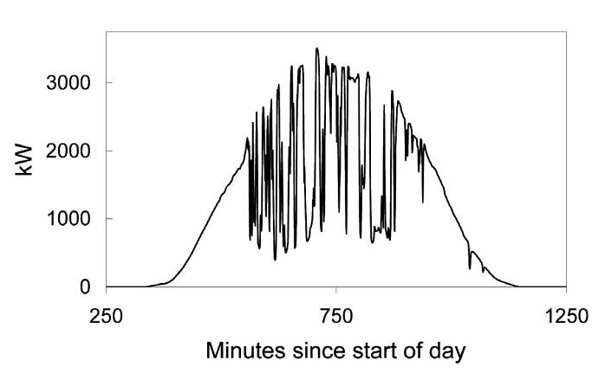
Challenge 3: uncertainty of renewables
High Levels of Wind and Solar PV Will Present an Operating Challenge!
Source: Rosa Yang

Slide 13
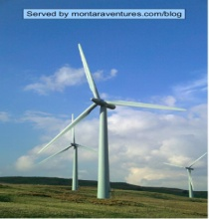

Challenge 3: storage integration
Customer
Transmission & Sub-transmission
Customer
Generation
Storage
Transmission & Sub-transmission
Storage
Where to place storage systems?
How to size them?
How to optimally schedule them?
Source: Mani Chandy

Slide 14
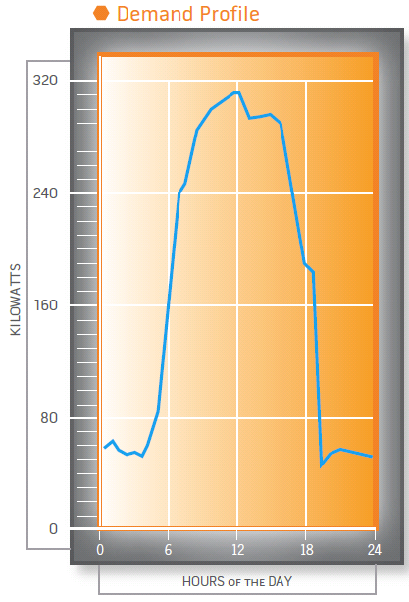
Challenge 4: High peak
National load factor: 55%
10% of generation and 25% of distribution facilities are used less than 400 hrs per year, i.e. ~5% of time
Demand response can reduce peak
  Feedback interaction between supply & demand
Source: DoE, Smart Grid Intro, 2008

Slide 15
Issue a: wide range of timescales
Faults PV Wind Backup Gen
Markets Demand/Response
Milliseconds
Seconds
Minutes
Tens of minutes
Hours
Days
Years
Decades
EV uptake
C credits
Mani Chandy, Caltech

Slide 16
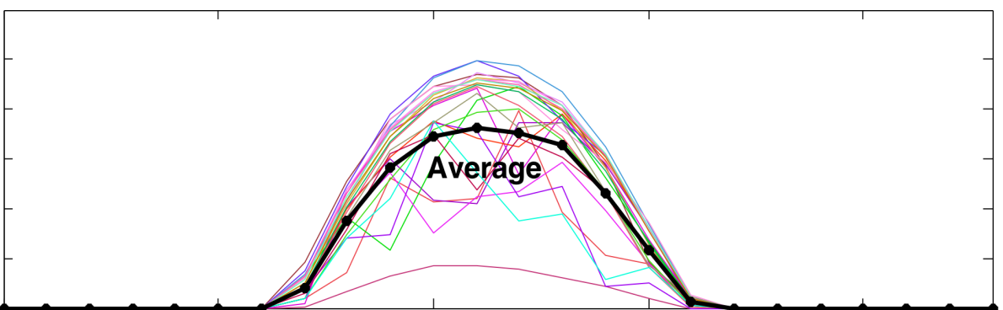
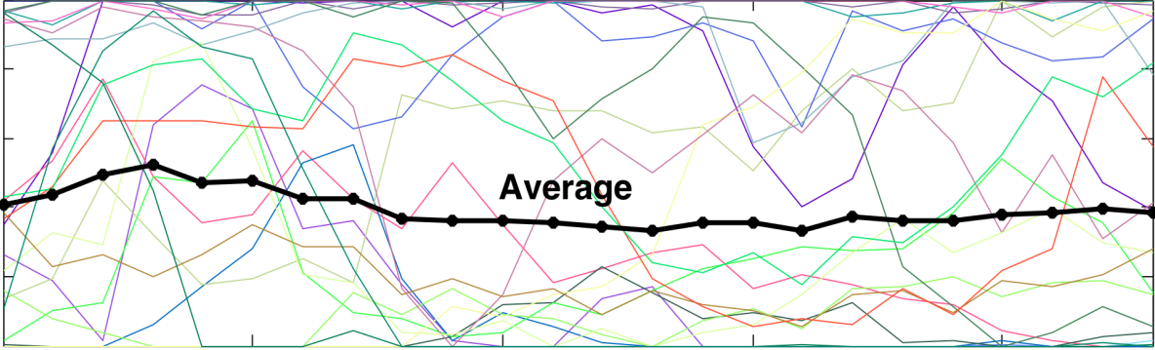
Issue b: Uncertainty
Increased uncertainty in demand
  e.g., Charging electric vehicles
  Demand response
Increased uncertainty in supply
  Variability in solar and wind generation
Solar: energy/unit area
Daily variation
Wind energy/unit turbine
Daily variation
Mani Chandy, Caltech

Slide 17
Issue c: SoS architecture
Power network will go through similar
architectural transformation in the next couple
decades that phone network is going through now
?
Deregulation
started
Tesla: multi-phase AC
Enron, blackouts
1888
Both started as natural monopolies
Both provided a single commodity
Both grew rapidly through two WWs
1980-90s
2000s
1876
1980-90s
Bell: telephone
Deregulation
started
1969:
DARPAnet
Convergence
to Internet

Slide 18
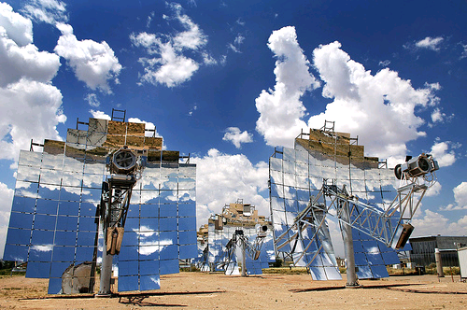
Issue c: SoS architecture
... to become more interactive, more distributed,
more open, more autonomous, and with greater
user participation
What is an architecture theory to help guide the transformation?
... while maintaining security & reliability

Slide 19
Outline
Renewable energy and smart grid challenges
Optimal power flow problems
  Zero duality gap: Javad Lavaei, SL
  OPF with storage: M. Chandy, SL, U. Topcu, M. Xu

Slide 20
Optimal power flow (OPF)
OPF is solved routinely to determine
  How much power to generate where
  Pricing
  Parameter setting, e.g. taps, VARs
Non-convex and hard to solve
  Huge literature since 1962
  In practice, operators often use heuristics to find a feasible operating point
  Or solve the (primal) problem to find a local minimum

Slide 21
Optimal power flow (OPF)
Quadratic generation cost
supply = demand
Kirchoff Law

Slide 22
Our proposal
Solve a convex dual problem (SDP)
  Very efficient
Recover a primal solution
Check if the solution is primal feasible
  If so, it is globally optimal
A sufficient condition (on the dual optimal solution) for this to work

Slide 23
Our proposal
All IEEE benchmark systems turn out to (essentially) satisfy the sufficient condition
  14, 30, 57, 118, 300 buses
All can be solved efficiently for global optimal

Slide 24

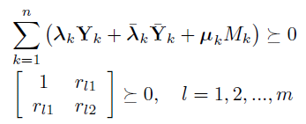
Dual OPF : SDP
Linear function
subject to

Slide 25


Our proposal
Solve Dual OPF for
If dual optimal value is , OPF is infeasible
Compute in the null space of
Compute a primal solution
If it is primal feasible, it is globally optimal

Slide 26
Sufficient condition
Theorem
Suppose the positive definite matrix
has a zero eigenvalue of multiplicity 2.
The duality gap is zero
is globally optimal

Slide 27
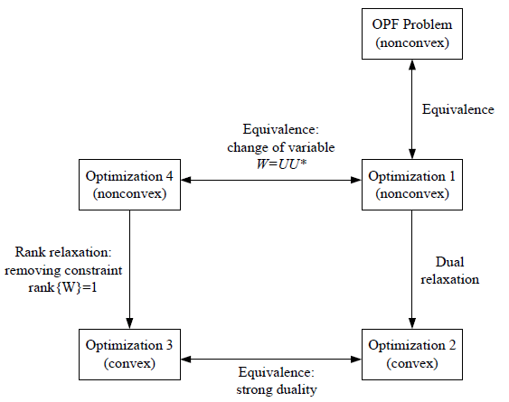
Proof idea

Slide 28

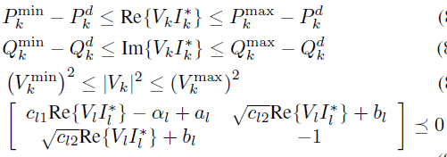
Proof idea

Slide 29
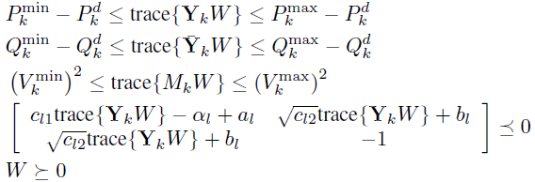
Proof idea
Semidefinite program
(convex)

Slide 30
Proof idea

Slide 31
Outline
Renewable energy and smart grid challenges
Optimal power flow problems
  Zero duality gap: Javad Lavaei, SL
  OPF with storage: M. Chandy, SL, U. Topcu, M. Xu

Slide 32
OPF + storage
Without battery: optimization in each period in isolation
  Grid allows optimization across space
With storage: optimal control over finite horizon
  Battery allows optimization across time
  Static optimization → optimal control
How to optimally integrate utility-scale storage with OPF?

Slide 33
Simplest case
Single generator single load (SGSL)
Main simplification
SGSL problem
all the complications

Slide 34
Example: time-invariant
If battery constraint inactive
Optimal generation decreases linearly in time
Optimality:
“nominal generation”
marginal cost
of generation
unit-cost-to-go
of storage

Slide 35
SGSL case
With battery constraint
Optimal policy anticipates future starvation and saturation
Optimal generation has 3 phases
  Phase 1: Charge battery, generation decreases linearly, battery increases quadratically
  Phase 2: Generation = d (phase 2 may not exist)
  Phase 3: Discharge battery, generation decreases linearly, battery decreases quadratically

Slide 36
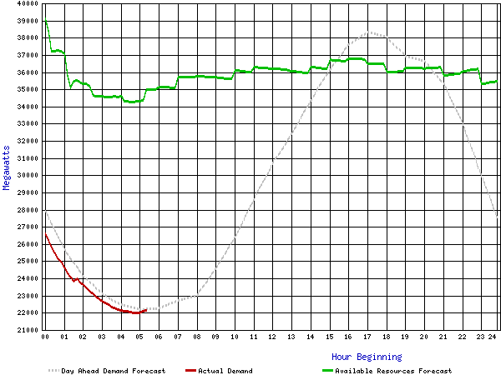
Key assumption
Forecast for Cal ISO, 27 September, 2009

Slide 37
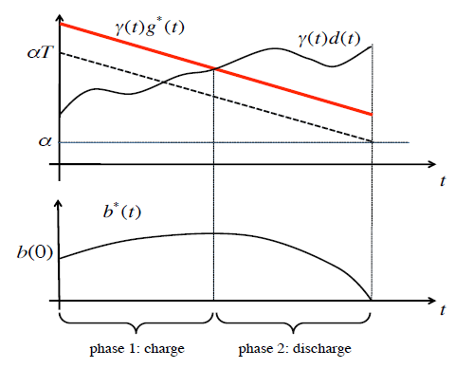
Optimal solution: case 1
Optimal generation cross demand curve at most once, from above

Slide 38
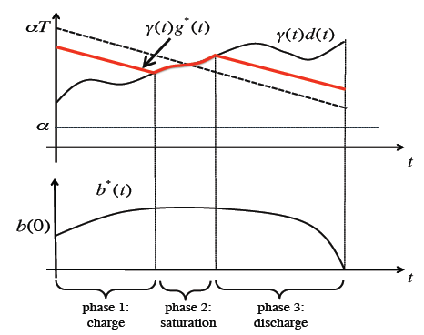
Optimal solution: case 2
Optimal generation cross demand curve at most once, from above

Slide 39
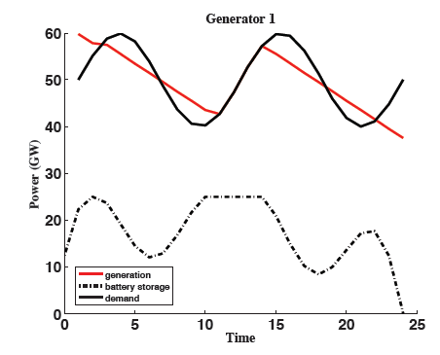
Assumption violated

