Slide 1
Declarative Techniques for Secure Network Routing
Boon Thau Loo
University of Pennsylvania
http://netdb.cis.upenn.edu
DIMACS Workshop on Secure Routing, 10 March 2010
This work is partially supported by NSF grant s IIS-0812270, CNS-0831376, and CAREER-0845552

Slide 2
Outline of Talk
Overview of declarative networking
Connections between Distributed Datalog and network routing
Unifying networking and security specifications
Use case: Application-aware Anonymity
Network provenance

Slide 3
Declarative Networking
A declarative framework for networks:
  Declarative language: “ask for what you want, not how to implement it”
  Declarative specifications of networks, compiled to distributed dataflows
  Runtime engine to execute distributed dataflows
Observation: Recursive queries are a natural fit for routing
Recursive queries:
  Traditionally for querying graph data structures stored in databases
  Uses the Datalog language. Designed to be processed using database operators with set semantics.
  Classic examples: Airline flight reservations, “Bill-of-Materials”, typically transitive closure queries

Slide 4
A Declarative Network
messages
Dataflow
Dataflow
messages
Dataflow
messages
Dataflow
Dataflow
Distributed recursive query
Dataflow
Traditional Networks
Declarative Networks
Network State
Distributed database
Network protocol
Recursive Query Execution
Network messages
Distributed Dataflow

Slide 5
Traditional Router
Routing
Protocol
Neighbor Table updates
Forwarding Table updates
Control Plane
Forwarding Plane
Packets
Packets
Traditional Router

Slide 6
Declarative Router
SIGCOMM’05
Query Engine
Declarative Queries
Control Plane
Neighbor Table updates
Forwarding Table updates
Forwarding Plane
Packets
Packets
Declarative Router

Slide 7
The Case for Declarative
Ease of programming:
  Compact and high-level representation of protocols
  Orders of magnitude reduction in code size
  Easy customization and rapid prototyping
Safety:
  Queries are “sandboxed” within query processor
  Potential for static analysis and theorem proving techniques on safety
What about efficiency?
  No fundamental overhead when executing standard routing protocols
  Application of well-studied query optimizations

Slide 8
Large Library of Declarative Protocols
Example implementations to date:
  Wired routing protocols: DV, LS [SIGMOD’05]
  Wireless DSR, AODV, OLSR, HSLS [ICNP’09]
  Overlay networks: Distributed Hash Tables, Resilient overlay network (RON), Internet Indirection Infrastructure (i3), P2P query processing, multicast trees/meshes, etc. [SOSP’05]
  Network composition: Chord over RON, i3+RON [CoNEXT’08]
  Secure distributed systems [ICDE’09, NDSS’10, SIGMOD’10]
  Hybrid protocols: Combining LS and HSLS, epidemic and LS, routing + channel selection [ICNP’09]
  Others: sensor networking protocols [Sensys’07], replication [NSDI’09], fault tolerance protocols [NSDI’08]

Slide 9
Outline of Talk
Overview of declarative networking
Connections between Distributed Datalog and network routing
Unifying networking and security specifications
Use case: Application-aware Anonymity
Network provenance

Slide 10
Introduction to Datalog
Datalog rule syntax:
<result> ← <condition1>, <condition2>, … , <conditionN>.
Head
Body
Types of conditions in body:
  Input tables: link(src,dst) predicate
  Arithmetic and list operations
Head is an output table
  Recursive rules: result of head in rule body

Slide 11
Recap: All-Pairs Reachability
R1: reachable(S,D) ← link(S,D)
R2: reachable(S,D) ← link(S,Z), reachable(Z,D)
“For all nodes S,D,
If there is a link from S to D, then S can reach D”.
link(a,b) – “there is a link from node a to node b”
reachable(a,b) – “node a can reach node b”
Input: link(source, destination)
Output: reachable(source, destination)

Slide 12
All-Pairs Reachability
R1: reachable(S,D) ← link(S,D)
R2: reachable(S,D) ← link(S,Z), reachable(Z,D)
“For all nodes S,D and Z,
If there is a link from S to Z, AND Z can reach D, then S can reach D”.
Input: link(source, destination)
Output: reachable(source, destination)

Slide 13
Network Datalog
Location Specifier “@S”
R1: reachable(@S,D) ← link(@S,D)
R2: reachable(@S,D) ← link(@S,Z), reachable(@Z,D)
Query: reachable(@M,N)
Query: reachable(@a,N)
All-Pairs Reachability
link
link
link
link
Input table:
@S | D
@a | b
@S | D
@b | c
@b | a
@S | D
@c | b
@c | d
@S | D
@d | c
a
b
c
d
reachable
reachable
reachable
reachable
Output table:
@S | D
@a | b
@a | c
@a | d
@S | D
@b | a
@b | c
@b | d
@S | D
@c | a
@c | b
@c | d
@S | D
@d | a
@d | b
@d | c
Query: reachable(@a,N)

Slide 14
Implicit Communication
A networking language with no explicit communication:
R2: reachable(@S,D) ← link(@S,Z), reachable(@Z,D)
Data placement induces communication

Slide 15
Path Vector Protocol Example
Advertisement: entire path to a destination
Each node receives advertisement, add itself to path and forward to neighbors
path=[a,b,c,d]
path=[b,c,d]
path=[c,d]
a
b
c
d
b advertises [b,c,d]
c advertises [c,d]

Slide 16
Path Vector in Network Datalog
R1: path(@S,D,P) ← link(@S,D), P=(S,D).
R2:
path(@S,D,P)
←
link(@Z,S),
path(@Z,D,P₂),
P=S•P₂.
Query: path(@S,D,P)
Add S to front of P₂
Input: link(@source, destination)
Query output: path(@source, destination, pathVector)

Slide 17
Datalog ➔ Execution Plan
R1: path(@S,D,P) ← link(@S,D), P=(S,D).
←
link(@Z,S),
path(@Z,D,P₂),
P=S • P₂.
R2:
path(@S,D,P)
Matching variable Z = “Join”
Recursion
R2
Send path.S
link.Z=path.Z
R1
link(@Z,S)
path(@Z,D,P)

Slide 18
Query Execution
R1: path(@S,D,P) ← link(@S,D), P=(S,D).
R2: path(@S,D,P) ← link(@Z,S), path(@Z,D,P₂), P=S•P₂.
Query: path(@a,d,P)
link
link
link
link
Neighbor table:
@S | D
@a | b
@S | D
@b | c
@b | a
@S | D
@c | b
@c | d
@S | D
@d | c
a
b
c
d
path
path
path
@S | D | P
@S | D | P
@S | D | P
@c | d | [c,d]
Forwarding table:
@S | D | P

Slide 19
Query Execution
R1: path(@S,D,P) ← link(@S,D), P=(S,D).
R2: path(@S,D,P) ← link(@Z,S), path(@Z,D,P₂), P=S•P₂.
Query: path(@a,d,P)
Matching variable Z = “Join”
link
link
link
link
Neighbor table:
@S | D
@b | c
@b | a
Communication patterns are identical to those in the actual path vector protocol
@S | D
@a | b
@S | D
@c | b
@c | d
@S | D
@d | c
a
b
c
d
path(@a,d,[a,b,c,d])
path(@b,d,[b,c,d])
path
path
path
@S | D | P
@S | D | P
@a | d | [a,b,c,d]
@S | D | P
@b | d | [b,c,d]
Forwarding table:
@S | D | P
@S | D | P
@c | d | [c,d]

Slide 20
Outline of Talk
Overview of declarative networking
Connections between Distributed Datalog and network routing
Unifying networking and security specifications (http://netdb.cis.upenn.edu/ds2)
Use case: Application-aware Anonymity
Network provenance
Unified Declarative Platform for Secure Networked Information Systems.
Wenchao Zhou, Yun Mao, Boon Thau Loo, and Martín Abadi.
25th International Conference on Data Engineering (ICDE), Apr 2009.
SecureBlox: Customizable Secure Distributed Data Processing
William R. Marczak, Shan Shan Huang, Martin Bravenboer, Micah Sherr, Boon Thau Loo, and Molham Aref.
ACM SIGMOD International Conference on Management of Data, 2010.
Declarative Reconfigurable Trust Management.
William R. Marczak, David Zook, Wenchao Zhou, Molham Aref, and Boon Thau Loo.
4th Biennial Conference on Innovative Data Systems Research (CIDR), Jan 2009.

Slide 21
Background: Access Control
Central to security, pervasive in computer systems
    Broadly defined as:
  Enforce security policies in a multi-user environment
  Assigning credentials to principals to perform actions
  Commonly known as trust management
Model:
  objects, resources
  requests for operations on objects
  sources for requests, called principals
  a reference monitor to decide on requests
Principal
Do operation
Reference Monitor
Object
“guard”

Slide 22
Background: Access Control
    Access control languages:
  Analyzing and implementing security policies
  Several runtime systems based on distributed Datalog/Prolog
    Binder [Oakland 02]: a simple representative language
  Context: each principal has its own context where its rules and data reside
  Authentication: “says” construct (digital signatures)
  At alice:
  b1: access(P,O,read) :- good(P).
  b2: access(P,O,read) :- bob says access(P,O,read).
  “In alice's context, any principal P may access object O in read mode if P is good (b1) or, bob says P may do so (b2 - delegation)”
  Several languages and systems: Keynote [RFC-2704], SD3 [Oakland 01], Delegation Logic [TISSEC 03], etc.

Slide 23
Comparing the two
Declarative networking and access control languages are based on logic and Datalog
Similar observation:
  Martín Abadi. “On Access Control, Data Integration, and Their Languages.”
  Comparing data-integration and trust management languages
Both extend Datalog in surprisingly similar ways
  Notion of context (location) to identify components (nodes) in a distributed system
  Suggests possibility to unify both languages
  Leverage ideas from database community (e.g. efficient query processing and optimizations) to enforce access control policies
Differences
  Top-down vs bottom-up evaluation
  Trust assumptions

Slide 24
Secure Network Datalog (SeNDlog)
Rules within a context
  Untrusted network
  Predicates in rule body in local context
Authenticated communication
  “says” construct
  Export predicate: “X says p@Y”
    X exports the predicate p to Y.
  Import predicate: “X says p”
    X asserts the predicate p.
r1: reachable(@S,D) :- link(@S,D).
r2: reachable(@S,D) :- link(@S,Z),
reachable(@Z,D).
localization rewrite
At S:
s1: reachable(@S,D) :- link(@S,D).
s2: linkD(D,S)@D :- link(S,D).
s3: reachable(Z,D)@Z :- linkD(S,Z),
reachable(S,D).
authenticated communication
At S:
s1: reachable(S,D) :- link(S,D).
s2: S says linkD(D,S)@D :- link(S,D).
s3: S says reachable(Z,D)@Z :-
Z says linkD(S,Z),
W says reachable(S,D).

Slide 25
Authenticated Path Vector Protocol
Import and export policies
Basis for Secure BGP
  Authenticated advertisements
  Authenticated subpaths (provenance)
  Encryption (for secrecy) with cryptographic functions
At Z,
z1 route(Z,X,P) :- neighbor(Z,X), P=f_initPath(Z,X).
z2 route(Z,Y,P) :- X says advertise(Y,P), acceptRoute(Z,X,Y).
z3 advertise(Y,P1)@X :- neighbor(Z,X), route(Z,Y,P), carryTraffic(Z,X,Y), P1=f_concat(X,P).

Slide 26
Authenticated Path Vector Protocol
At Z,
z1 route(Z,X,P) :- neighbor(Z,X), P=f_initPath(Z,X).
z2 route(Z,Y,P) :- X says advertise(Y,P), acceptRoute(Z,X,Y).
z3 advertise(Y,P1)@X :- neighbor(Z,X), route(Z,Y,P), carryTraffic(Z,X,Y), P1=f_concat(X,P).
route(@a,d,[a,b,c,d])
route(@b,d,[b,c,d])
route(@c,d,[c,d])
a
b
c
d
b says advertise(d,[a,b,c,d])
c says advertise(d,[b,c,d])

Slide 27
Example Protocols in SeNDlog
Secure network routing
  Nodes import/export signed route advertisements from neighbors
  Advertisements include signed sub-paths (authenticated provenance)
  Building blocks for secure BGP
Secure packet forwarding
Customizable anonymous routing
  Path selection and setting up “onion paths” with layered encryption [NDSS’10]
  Application-aware Anonymity (http://a3.cis.upenn.edu)
Secure DHTs
  Chord DHT – authenticate the node-join process
  Signed node identifiers to prevent malicious nodes from joining the DHT
Customizable distributed data processing
  Secure DHT-joins, authenticated map-reduce operation
  Integration with LogicBlox (http://www.logicblox.com) [SIGMOD’10]

Slide 28
Authenticated Query Processing
    Semi-naïve Evaluation
  Standard technique for processing recursive queries
  Synchronous rounds of computation
Pipelined Semi-naïve Evaluation [SIGMOD 06]
  Asynchronous communication in distributed setting
  No requirement on expensive synchronous computation
Authenticated Semi-naïve Evaluation
  Modification for “says” construct, in p’s context:
  a :- d₁, ..., d_{n}, b₁, ..., b_{m}, p₁ says a₁, ..., p_{k} says a_{k}, ..., p_{o} says a_{o}.
  for kth import predicate, an authenticated delta rules is generated:
  p says ∆a :- d₁, ..., d_{n}, b₁, ..., b_{m}, p₁ says a₁, ..., p_{k} says ∆a_{k}, ..., p_{o} says a_{o}.

Slide 29
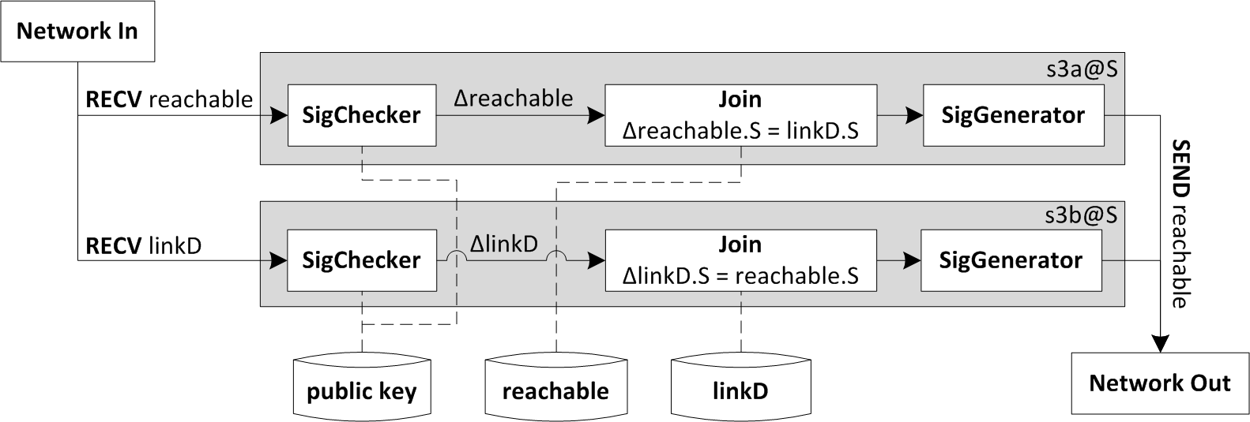
Execution Plan
    Each delta rule corresponds to a “rule strand”
    Additional modules to support authenticated communication
RapidNet declarative networking system (http://netdb.cis.upenn.edu/rapidnet)
S says reachable(Z,D)@Z :- Z says linkD(S,Z),
W says reachable(S,D).
Notes:
Use real examples, another figure in the paper
Verify the signature, Based on the owner of the tuple, make sure the tuple is really sent by the owner
Ndlog - > SeNDlog rule

Slide 30
Outline of Talk
Overview of declarative networking
Connections between Distributed Datalog and network routing
Unifying networking and security specifications
Use case: Application-aware Anonymity (http://a3.cis.upenn.edu)
Network provenance
A3: An Extensible Platform for Application-Aware Anonymity.
Micah Sherr, Andrew Mao, William R. Marczak, Wenchao Zhou, Boon Thau Loo, and Matt Blaze
17th Annual Network & Distributed System Security Symposium (NDSS), 2010.
Scalable Link-Based Relay Selection for Anonymous Routing.
Micah Sherr, Matt Blaze, and Boon Thau Loo.
9th Privacy Enhancing Technologies Symposium (PETS), Aug 2009.
Veracity: Practical Secure Network Coordinates via Vote-based Agreements.
Micah Sherr, Matt Blaze, and Boon Thau Loo.
USENIX Annual Technical Conference, San Diego, CA, June 2009.

Slide 31
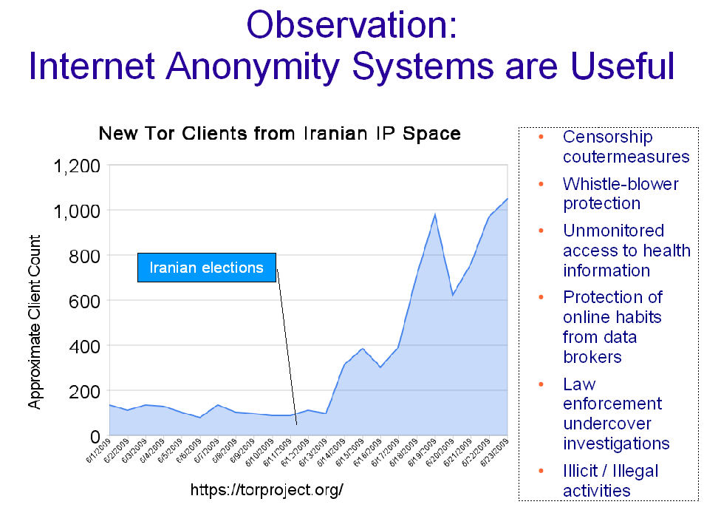
Next few slides courtesy of Micah Sherr

Slide 32
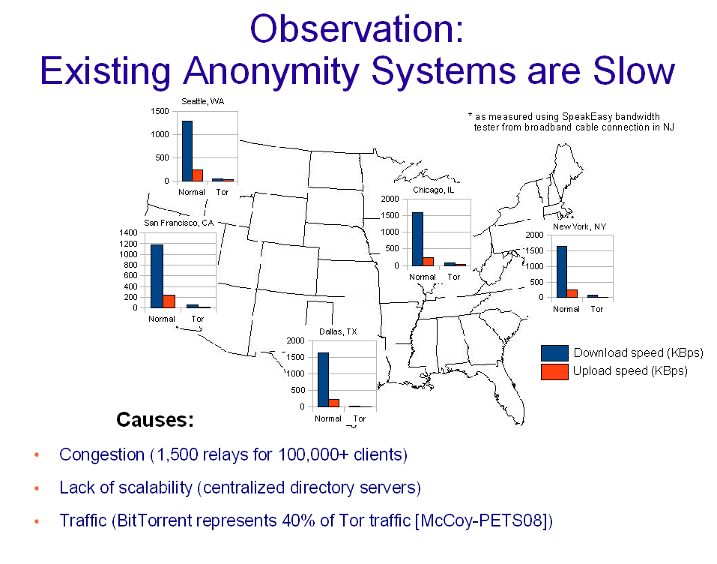

Slide 33
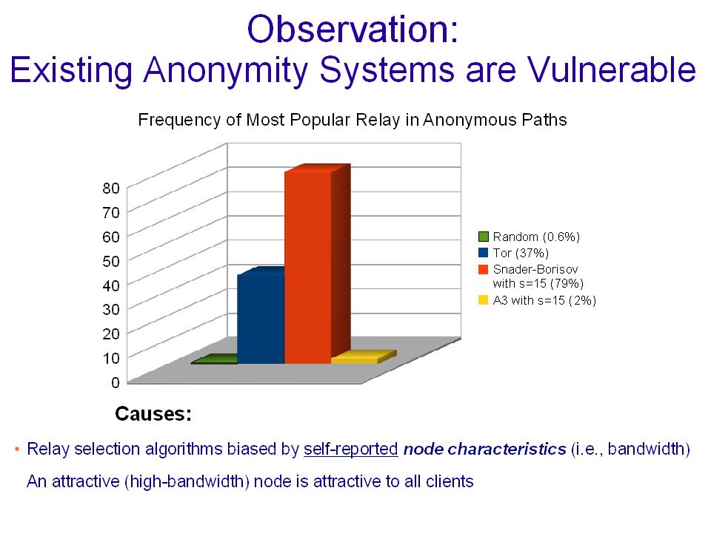

Slide 34
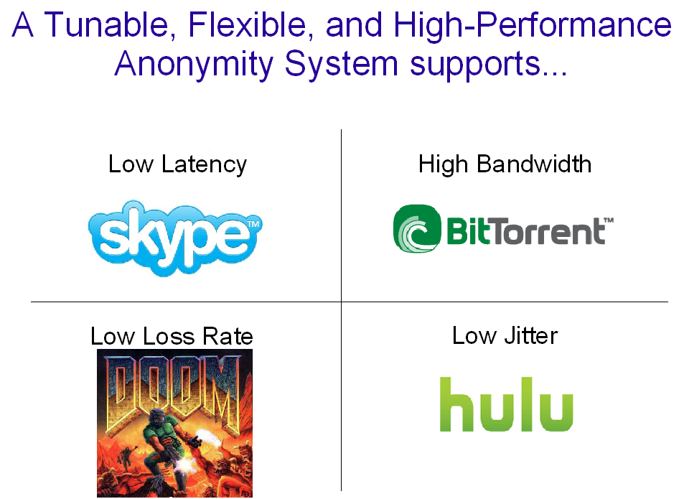

Slide 35
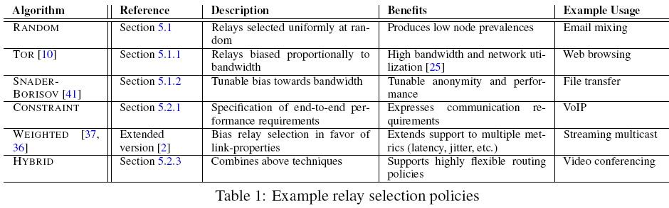
Declarative Relay Selection and Path Instantiation
Path instantiation policies: Onion routing, Tor incremental telescoping strategy, Crowds

Slide 36
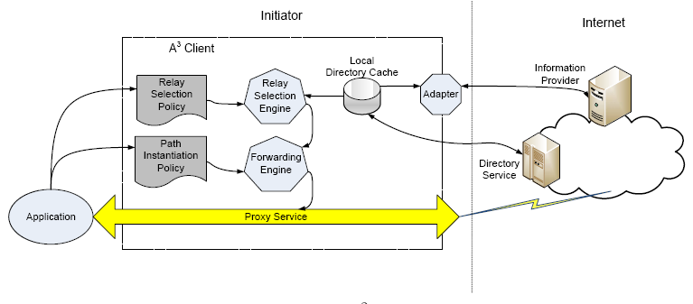
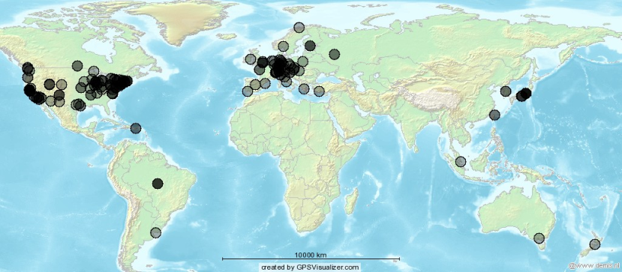
A3 on PlanetLab
http://a3.cis.upenn.edu
A3: An Extensible Platform for Application-Aware Anonymity. NDSS’09
202 PlanetLab nodes

Slide 37
Outline of Talk
Overview of declarative networking
Connections between Distributed Datalog and network routing
Unifying networking and security specifications
Use case: Application-aware Anonymity (http://a3.cis.upenn.edu)
Network provenance
Efficient Querying and Maintenance of Network Provenance at Internet-Scale
Wenchao Zhou, Micah Sherr, Tao Tao, Xiaozhou Li, Boon Thau Loo, and Yun Mao
ACM SIGMOD International Conference on Management of Data, 2010.
Recursive Computation of Regions and Connectivity in Networks.
Mengmeng Liu, Nicholas E. Taylor, Wenchao Zhou, Zachary Ives, and Boon Thau Loo.
25th International Conference on Data Engineering (ICDE), Apr 2009.

Slide 38
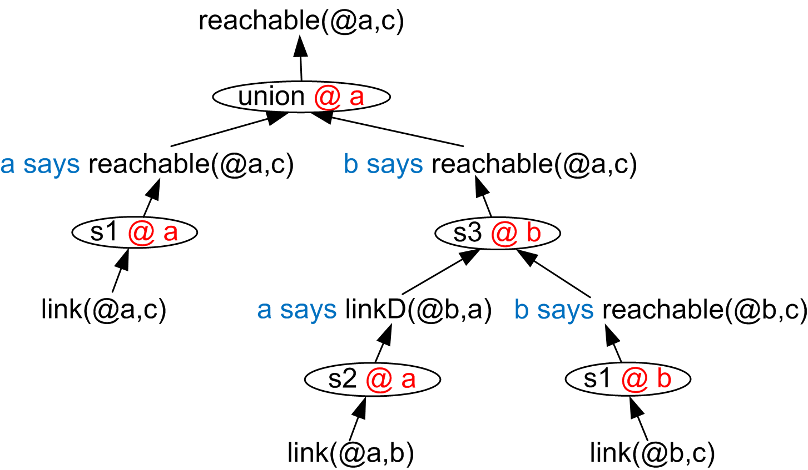
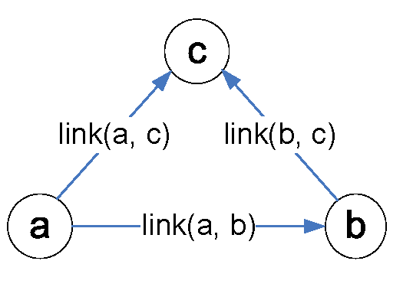
What is “Network Provenance”?
Naturally captured within declarative framework
Explain the existence of any network state
Similar notion in security community: proof-trees

Slide 39
Types of Network Provenance
Representation
  Graph: relations between base tuples, intermediate results and output
  Algebraic representations
    Semi-ring: algebraic structure with “+” and “*” (representing union and join)
    E.g. polynomial, Set, BDD, etc.
Distribution
  Centralized: maintain provenance at a centralized server.
    Single bottleneck, not feasible in large-scale distributed systems
  Distributed value-based: entire provenance information with each tuple
    Expensive to maintain, relatively cheap to query
  Distributed reference-based: markers to direct contributing derivations
    Expensive to query, cheap to maintain

Slide 40
Networking Applications
Application Scenarios | Representation | Distribution
Distributed Debugging | Graph | Distributed Ref-based
Accountability | Graph / Algebraic | Distributed Ref-based / Value-based
Trust Management | Algebraic | Centralized / Distributed Value-based
Distributed Debugging: IP Traceback [SIGCOMM 00], PIP [NSDI 06], FRIDAY [NSDI 07]
Accountability: IP Forensics [ICNP 06], PeerReview [SOSP 07], AIP [SIGCOMM 08]
Distributed Trust Management: SD3 [Oakland 01], Delegation Logic [TISSEC 03]
Provenance-aware Secure Networks. Zhou, Cronin and Loo. 4th International Workshop on Networking meets Databases (NetDB), 2008

Slide 41
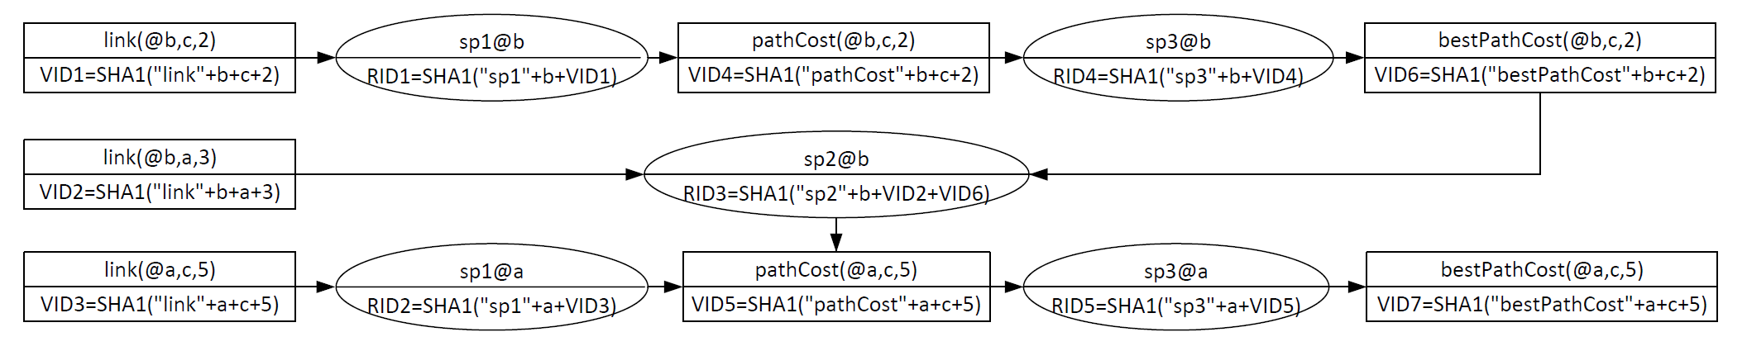
Distributed Provenance Maintenance
Given a declarative networking program:
  Automatically generate rules for distributed provenance maintenance
  Minimize cross-node communication – piggyback tuples with lightweight cryptographic digests (“markers”) for traceback
  Materialize provenance information in distributed tables

Slide 42
Distributed Query Optimizations
Query Results Caching
  “Sweet-spot” between value-based and ref-based provenance
  Queries are rare: ref-based provenance for low bandwidth consumption
  Queries are frequent: subsequent queries benefit from caches
Query Traversal Order
  Breadth First Search (BFS)
    Flood throughout the whole provenance graph
    Low latency, yet, high bandwidth consumption
  Depth First Search (DFS)
    Alternative derivations are explored in order
    Query evaluation at a node “stalls” before a sub-result is received.
    High latency, yet, allows threshold-based pruning to save bandwidth.
Notes:
Details
- Sub-graph caching: query results also stored at intermediate nodes
- Any further queries that require a sub-graph can benefit
- Invalidation propagation: similar to value-based prov, yet, instead of full provenance, only a flag is sent.

Slide 43
Summary
Key ideas:
  Declarative framework for networks and security specifications
  Authenticated query processing techniques for distributed settings
  Use cases: Application-aware Anonymity, secure distributed data processing (LogicBlox)
  Network provenance: usage in networking, maintenance and optimizations
Ongoing work
  Securing network provenance and more use cases
  Formally Verifiable Networking (http://netdb.cis.upenn.edu/fvn)

Slide 44
Thank You …
Visit us at http://netdb.cis.upenn.edu

Slide 45
Brief Introduction
Assistant professor at the University of Pennsylvania
Research interests:
  NetDB@Penn (http://netdb.cis.upenn.edu)
  Distributed data management, Internet-scale query processing, data-centric techniques in networking.
  Software methodologies and platforms for developing secure and formally verifiable distributed systems

Slide 46
Papers on Declarative Networking
Declarative Routing: Extensible Routing with Declarative Queries. Loo, Hellerstein, Stoica, and Ramakrishnan. SIGCOMM’05.
Implementing Declarative Overlays. Loo, Condie, Hellerstein, Maniatis, Roscoe, and Stoica. SOSP’05.
Declarative Networking: Language, Execution and Optimization. Loo, Condie, Garofalakis, Gay, Hellerstein, Maniatis, Ramakrishnan, Roscoe, and Stoica, SIGMOD’06.
See http://netdb.cis.upenn.edu for more recent papers related to network composition, security, verification, and policy-based adaptation in wireless mesh networks.

