Slide 1
Codes with local decoding procedures
Sergey Yekhanin
Microsoft Research

Slide 2


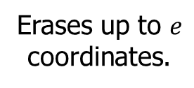


Error-correcting codes: paradigm
Sender
Receiver
$$X∈F_{2}^{k}$$
$$E(X)∈F_{2}^{n}$$
$E(X)$+noise
$$X$$
0110001
011000100101
01*00*10010*
0110001
Encoder
Channel
Decoder
Erases up to $e$
coordinates.
The paradigm dates back to 1940s (Shannon / Hamming)
One limitation: recovering a single message coordinate requires processing all corrupted codeword

Slide 3

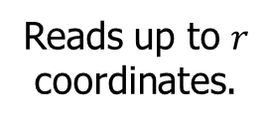

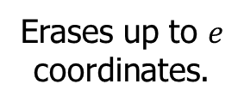


Local decoding: paradigm
$$X∈F_{2}^{k}$$
$$E(X)∈F_{2}^{n}$$
$E(X)$+noise
$${ X}_{i}$$
0110001
011000100101
01*00*10010*
1
Encoder
Channel
Local Decoder
Erases up to $e$
coordinates.
Reads up to $r$
coordinates.
Local decoder runs in time much smaller than the message length!
First account: Reed’s decoder for Muller’s codes (1954)
Implicit use: (1950s-1990s)
  Formal definition and systematic study (late 1990s) [Levin’95, STV’98, KT’00]
  Original applications in computational complexity theory
  Cryptography
  Most recently used in practice to provide reliability in distributed storage
  (Microsoft Azure, Windows Server, Windows, Hadoop, etc.)

Slide 4
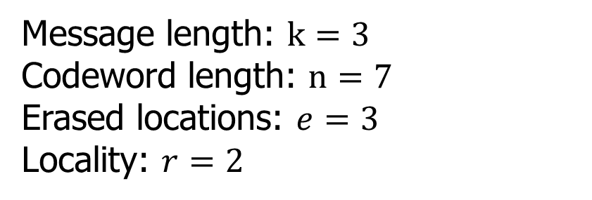
Local decoding: example
E(X)
X₁
X₂
X₃
X
X₁
X₂
X₃
X₁X₂
X₁X₃
X₂X₃
X₁X₂X₃
Message length: $k=3$
Codeword length: $n=7$
Erased locations: $e=3$
Locality: $r=2$

Slide 5
Local decoding: example
E(X)
X₁
X₂
X₃
X
X₁
X₂
X₃
X₁X₂
X₁X₃
X₂X₃
X₁X₂X₃
Message length: $k=3$
Codeword length: $n=7$
Erased locations: $e=3$
Locality: $r=2$

Slide 6
Local decoding: Decoding tuples for X₁
E(X)
X₁
X₂
X₃
X
X₁
X₂
X₃
X₁⊕X₂
X₁⊕X₃
X₂⊕X₃
X₁⊕X₂⊕X₃

Slide 7
Local decoding: Decoding tuples for X₂
E(X)
X₁
X₂
X₃
X
X₁
X₂
X₃
X₁⊕X₂
X₁⊕X₃
X₂⊕X₃
X₁⊕X₂⊕X₃

Slide 8








Codes with local decoding
Setting: Encode $k$ dimensional messages to $n$ dimensional codewords.
Main parameters: Redundancy $n−k,$locality $r$, and noise level$e$.
Goal: Understand the true shape of the tradeoff between redundancy and locality, for different settings of noise. (e.g., $e=δn, { n}^{ε}, O\left(1\right).$)
Applications to
data storage
Applications in
crypto / complexity
$$r$$
$$k^{ε}$$
Multiplicity
codes
Local
reconst-
ruction
codes
$$({\log{k)}}^{c}$$
Projective
geometry
codes
Reed Muller
codes
Locally decodable codes
Matching
vector
codes
$$O(1)$$
$$O(1)$$
$$n^{ε}$$
$$δn$$
$$e$$
Taxonomy of known families of codes

Slide 9
Plan
Part I: (Locally decodable codes)
  Private Information Retrieval (PIR) schemes
  PIR schemes from smooth codes
  Reed Muller codes
Part II: (Codes with locality for distributed data storage)
  Erasure coding for data storage
  Local reconstruction codes for data storage
  Constructions and limitations

Slide 10
Part I: Locally decodable codes

Slide 11
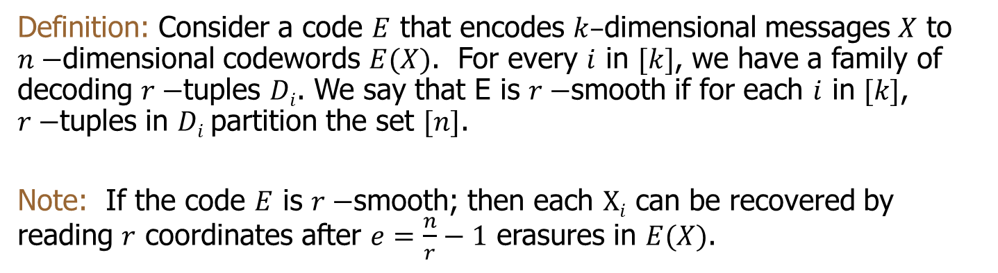
Smooth codes
E(X)
c₁
c₂
c₃
c₄
X
…
X₁
X₂
…
X_{k}
c₁
c_{i}
c_{j}
c_{n}
c₅
c₆
c₇
c₈
Definition: Consider a code $E$ that encodes $k–$dimensional messages $X$ to $n−$dimensional codewords $E(X)$. For every $i$ in $[k]$, we have a family of decoding $r−$tuples $Di$. We say that E is $r−$smooth if for each $i$ in $[k]$, $r−$tuples in $Di$partition the set $[n]$.
Note: If the code $E$ is $r−$smooth; then each $Xi$ can be recovered by reading $r$ coordinates after $e=\frac{n}{r}−1$ erasures in $E(X)$.

Slide 12
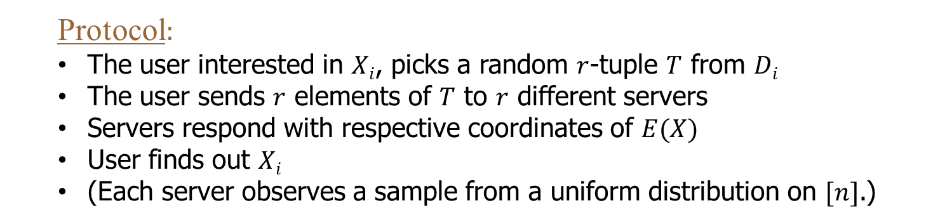
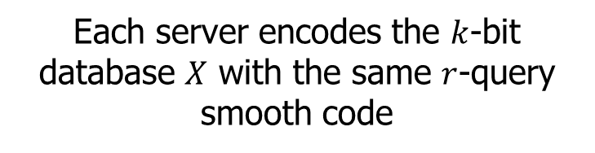
Private information retrieval [CGKS]
Protocols that allow users to privately retrieve items from replicated DBs
X→E(X)
X→E(X)
…
Each server encodes the $k$-bit database $X$ with the same $r$-query smooth code
  Protocol:
  The user interested in $Xi$, picks a random $r$-tuple $T$ from $Di$
  The user sends $r$ elements of $T$ to $r$ different servers
  Servers respond with respective coordinates of $E(X)$
  User finds out $Xi$
  (Each server observes a sample from a uniform distribution on $[n]$.)

Slide 13
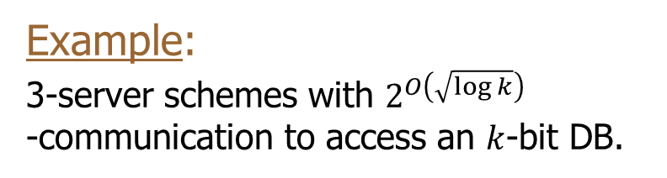
Private information retrieval
  Properties of the protocol:
  Information theoretic privacy ↔ smoothness
  Number of DB replicas needed ↔ locality
  Communication complexity ↔ codeword length
Short smooth codes with low query
complexity yield efficient PIR schemes.
Example:
3-server schemes with $2^{O\left(\sqrt{\log{k}}\right)}$
-communication to access an $k$-bit DB.
[Dvir Gopi’ 2014]: 2-server scheme
with the same communication.

Slide 14
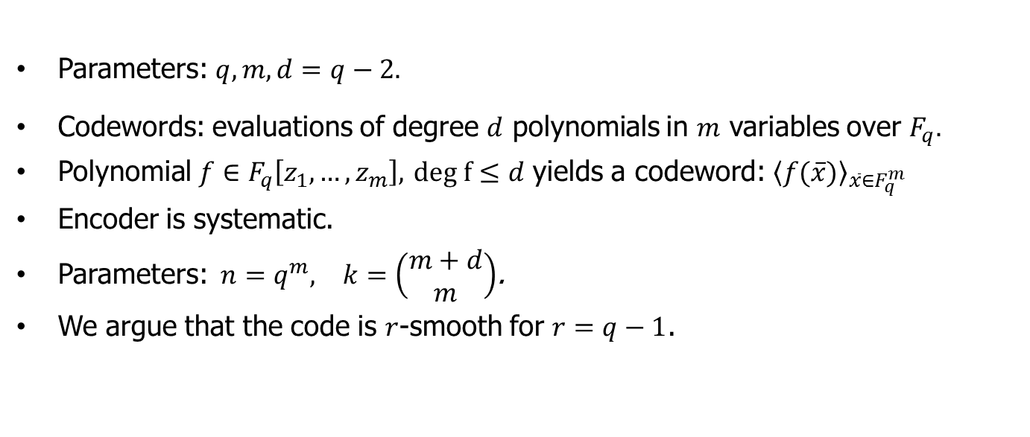
Reed Muller codes
Parameters: $q,m,d=q−2.$
Codewords: evaluations of degree $d$ polynomials in $m$ variables over $F_{q}.$
Polynomial $f∈F_{q}\left[z_{1},…,z_{m}\right],$ $deg f≤d$ yields a codeword: ${\left\langle f(\overline{x})\right\rangle }_{\overline{x}∈F_{q}^{m}}$
Encoder is systematic.
Parameters:$n=q^{m}, k=\left(\begin{matrix}m+d \\ m\end{matrix}\right)$.
We argue that the code is $r$-smooth for $r=q−1$.

Slide 15


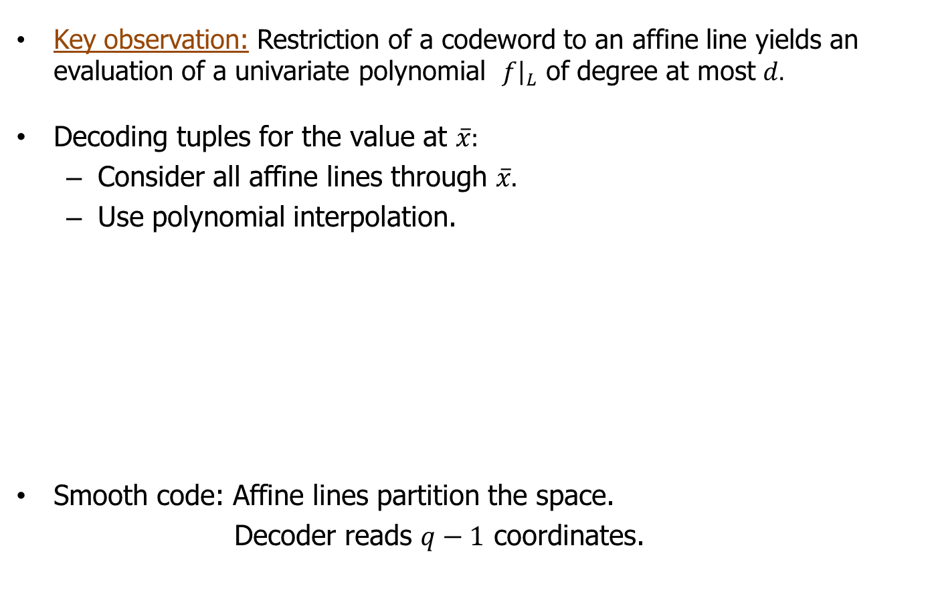
Reed Muller codes: local decoding
Key observation: Restriction of a codeword to an affine line yields an evaluation of a univariate polynomial ${\left.f\right|}_{L}$ of degree at most $d.$
Decoding tuples for the value at $\overline{x}:$
  Consider all affine lines through $\overline{x}.$
  Use polynomial interpolation.
Smooth code: Affine lines partition the space.
Decoder reads $q−1$ coordinates.
$$F_{q}^{m}$$
$$\overline{x}$$

Slide 16
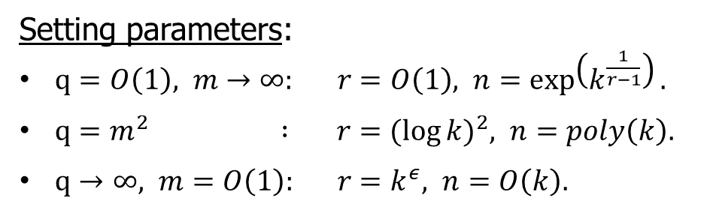
Reed Muller codes: parameters
$$n=q^{m}, k=\left(\begin{matrix}m+d \\ m\end{matrix}\right), d=q−2, r=q−1, e=δn.$$
Setting parameters:
$q=O\left(1\right), m→∞: r=O\left(1\right), n=\exp\left(k^{\frac{1}{r−1}}\right).$
$q=m^{2} : r={(\log{k})}^{2}, n=poly\left(k\right).$
$q→∞, m=O\left(1\right): r=k^{ε}, n=O\left(k\right).$
Matching vector codes [Y,E]
Multiplicity codes [KSY]
Better
codes are
known
Reducing codeword length of locally decodable codes is a major open problem.

Slide 17
Part II: Distributed storage

Slide 18
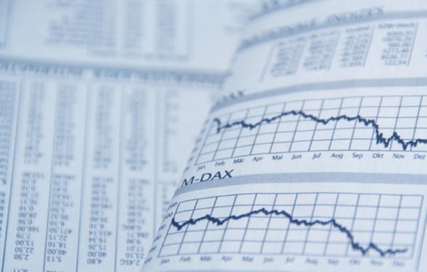
Data storage
Store data reliably
Keep it readily available for users

Slide 19


Data storage: Replication
Store data reliably
Keep it readily available for users
Very large overhead
Moderate reliability
Local recovery:
Lose one machine, access one

Slide 20
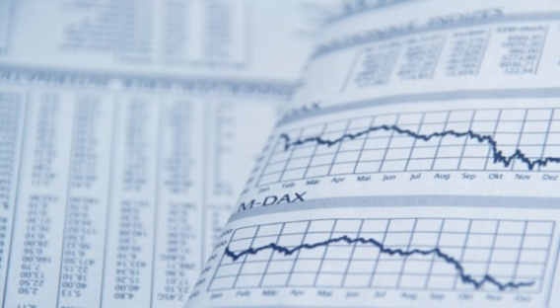


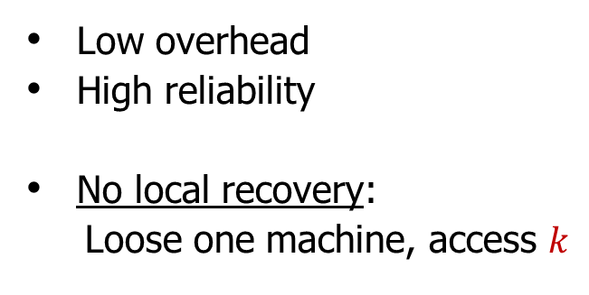
Data storage: Erasure coding
Store data reliably
Keep it readily available for users
…
Low overhead
High reliability
No local recovery:
Loose one machine, access $k$
…
…
$k$ data chunks
$n−k$ parity chunks
Need: Erasure codes with local decoding

Slide 21
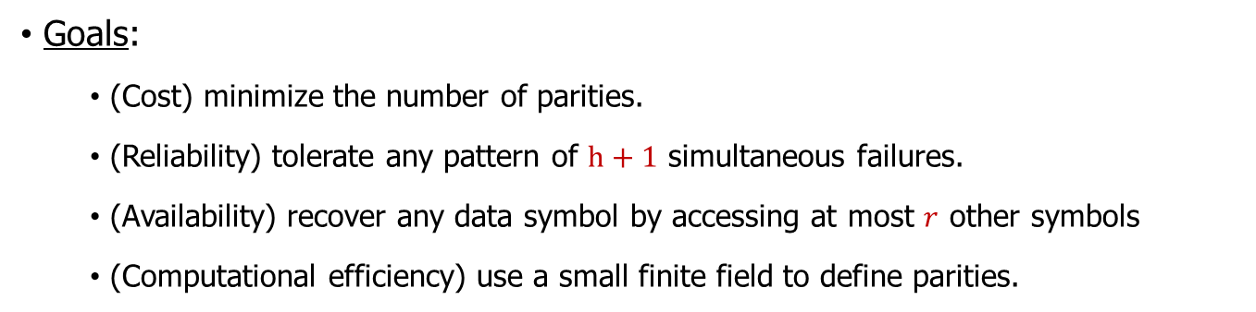
Codes for data storage
X₁
X₂
…
X_{k}
P₁
…
P_{n-k}
Goals:
  (Cost) minimize the number of parities.
  (Reliability) tolerate any pattern of $h+1$ simultaneous failures.
  (Availability) recover any data symbol by accessing at most $r$ other symbols
  (Computational efficiency) use a small finite field to define parities.
Notes:
Multiple ways to implement GF arithmetic: discrete log tables, specialized processor instructions, careful choice of the irreducible polynomial, matrix representations. In all these field size – is the key.

Slide 22
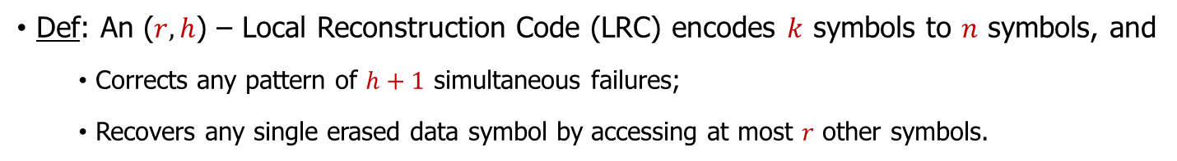
Local reconstruction codes
Def: An ($r,h$) – Local Reconstruction Code (LRC) encodes $k$ symbols to $n$ symbols, and
  Corrects any pattern of $h+1$ simultaneous failures;
  Recovers any single erased data symbol by accessing at most $r$ other symbols.

Slide 23
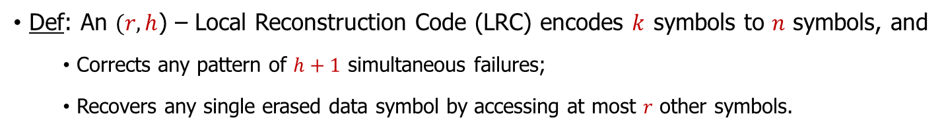
Local reconstruction codes
Def: An $(r,h$) – Local Reconstruction Code (LRC) encodes $k$ symbols to $n$ symbols, and
  Corrects any pattern of $h+1$ simultaneous failures;
  Recovers any single erased data symbol by accessing at most $r$ other symbols.
Theorem[GHSY]: In any ($r,h$) – (LRC), redundancy $n−k$ satisfies $n−k≥\left\lceil \frac{k}{r}\right\rceil +h.$

Slide 24

Local reconstruction codes
Def: An ($r,h$) – Local Reconstruction Code (LRC) encodes $k$ symbols to $n$ symbols, and
  Corrects any pattern of $h+1$ simultaneous failures;
  Recovers any single erased data symbol by accessing at most $r$ other symbols.
Theorem[GHSY]: In any ($r,h$) – (LRC), redundancy $n−k$ satisfies $n−k≥\left\lceil \frac{k}{r}\right\rceil +h.$
Theorem[GHSY]: If $r | k$and $h<r+1$; then any ($r,h$) – LRC has the following topology:
Light
parities
L₁
…
L_{g}
Local
group
X₁
…
X_{r}
…
X_{k-r}
…
X_{k}
Data symbols
Heavy
parities
H₁
…
H_{h}

Slide 25

Local reconstruction codes
Def: An ($r,h$) – Local Reconstruction Code (LRC) encodes $k$ symbols to $n$ symbols, and
  Corrects any pattern of $h+1$ simultaneous failures;
  Recovers any single erased data symbol by accessing at most $r$ other symbols.
Theorem[GHSY]: In any ($r,h$) – (LRC), redundancy $n−k$ satisfies $n−k≥\left\lceil \frac{k}{r}\right\rceil +h.$
Theorem[GHSY]: If $r | k$and $h<r+1$; then any ($r,h$) – LRC has the following topology:
Light
parities
L₁
…
L_{g}
Local
group
X₁
…
X_{r}
…
X_{k-r}
…
X_{k}
Data symbols
Heavy
parities
H₁
…
H_{h}
Fact: [HCL] There exist ($r,h$) – LRCs with optimal redundancy over a field of size $k+h$.

Slide 26
Reliability
Set $k=8$, $r=4$, and $h=3$.
L₁
L₂
X₁
X₂
X₃
X₄
X₅
X₆
X₇
X₈
H₁
H₂
H₃

Slide 27

Reliability
Set $k=8$, $r=4$, and $h=3$.
L₁
L₂
X₁
X₂
X₃
X₄
X₅
X₆
X₇
X₈
H₁
H₂
H₃
All 4-failure patterns are correctable.

Slide 28
Reliability
Set $k=8$, $r=4$, and $h=3$.
L₁
L₂
X₁
X₂
X₃
X₄
X₅
X₆
X₇
X₈
H₁
H₂
H₃
All 4-failure patterns are correctable.
Some 5-failure patterns are not correctable.

Slide 29
Reliability
Set $k=8$, $r=4$, and $h=3$.
L₁
L₂
X₁
X₂
X₃
X₄
X₅
X₆
X₇
X₈
H₁
H₂
H₃
All 4-failure patterns are correctable.
Some 5-failure patterns are not correctable.
Other 5-failure patterns might be correctable.

Slide 30
Reliability
Set $k=8,$ $r=4$, and $h=3$.
L₁
L₂
X₁
X₂
X₃
X₄
X₅
X₆
X₇
X₈
H₁
H₂
H₃
All 4-failure patterns are correctable.
Some 5-failure patterns are not correctable.
Other 5-failure patterns might be correctable.

Slide 31
Combinatorics of correctable failure patterns
Def: A regular failure pattern for a ($r,h$)-LRC is a pattern that can be obtained by failing at most one symbol in each local group and $h$ extra symbols.
L₁
L₂
L₁
L₂
X₁
X₂
X₃
X₄
X₅
X₆
X₇
X₈
X₁
X₂
X₃
X₄
X₅
X₆
X₇
X₈
H₁
H₂
H₃
H₁
H₂
H₃
Theorem:
If a failure pattern that is not regular; then it is not correctable by any LRC.
There exist LRCs that correct all regular failure patterns.

Slide 32
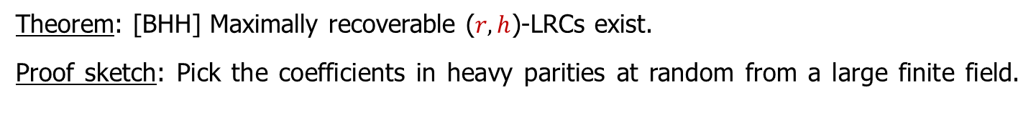
Maximally recoverable codes
Def: An ($r,h$)-LRC is maximally recoverable if it corrects all regular failure patterns.
Theorem: [BHH] Maximally recoverable ($r,h$)-LRCs exist.
Proof sketch: Pick the coefficients in heavy parities at random from a large finite field.
Asymptotic setting: $h=O\left(1\right), r=O\left(1\right), k→∞.$
Random choice needs a field of size at least [KM]: $Ω\left(k^{h−1}\right).$
The tradeoff: Larger fields allow for more reliable codes up to maximal recoverability.
We want both: small field size (efficiency) and maximal recoverability.
Notes:
While (r,h)-LRC exist over a field of size k+h, to get maximal recoverability one needs a much larger field!
The tradeoff thus far is empirical.

Slide 33
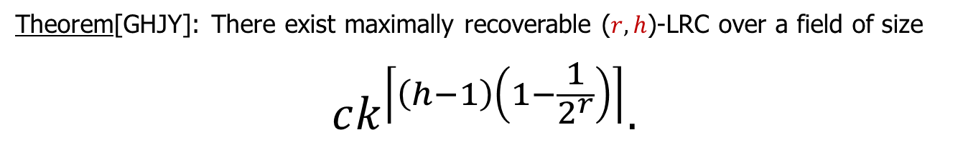
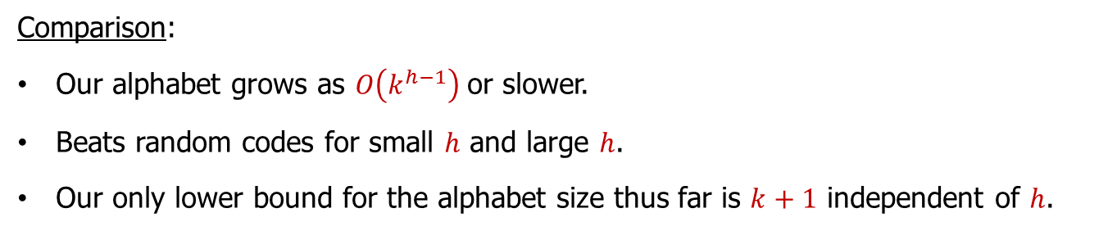
Explicit maximally recoverable codes
Theorem[GHJY]: There exist maximally recoverable ($r,h$)-LRC over a field of size
$$ck^{\left\lceil \left(h−1\right)\left(1−\frac{1}{2^{r}}\right)\right\rceil }.$$
Comparison:
Our alphabet grows as $O\left(k^{h−1}\right)$or slower.
Beats random codes for small $h$ and large $h$.
Our only lower bound for the alphabet size thus far is $k+1$ independent of $h$.

Slide 34
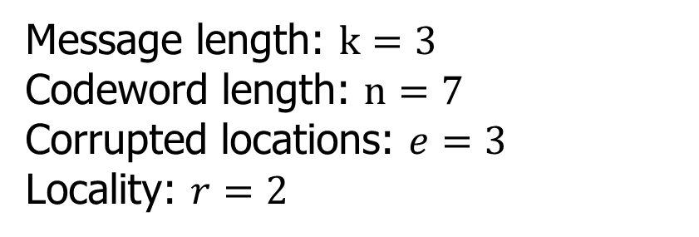
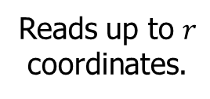

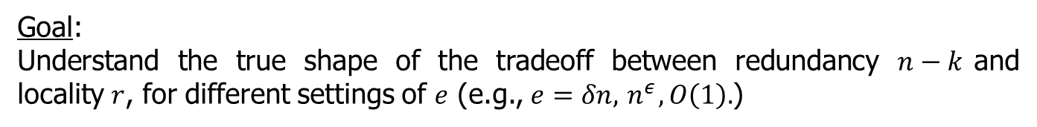
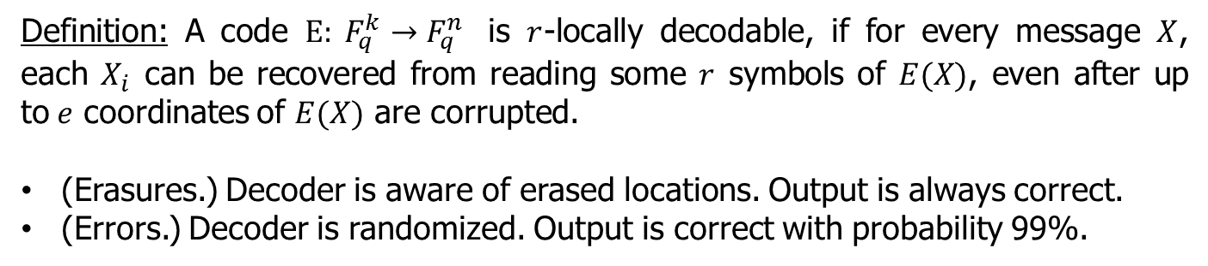
Code construction
We use dual constraints to specify the code.
$\frac{k}{r}+1$ local groups.
$$x_{1}$$ | $$x_{2}$$ | … | $$x_{r}$$ | $$L_{1}$$ | … | $$x_{k−r}$$ | $$x_{k−r+1}$$ | … | $$x_{k}$$ | $$L_{k/r}$$ | $$H_{1}$$ | $$H_{2}$$ | … | $$H_{h}$$
1 | 1 | … | 1 | 1
 |  |  |  |  |  | 1 | 1 | … | 1 | 1
$$\frac{k}{r}$$
h
$$α_{ij}$$
$$α_{ij}^{2}$$
…
$$α_{ij}^{2^{h−1}}$$
Element $α_{ij}$ appears in the j-th column of the i-th group.
We consider a sequence field extensions $F_{2}⊆F_{2^{a}}⊆F_{2^{b}}$.
{$ξ_{j}$} $⊆F_{2^{a}}$ form a basis over $F_{2}$.
{$λ_{i}$} $⊆F_{2^{b}}$ are $h$-independent over $F_{2^{a}}$.
$α_{ij}$=$ξ_{j}{×λ}_{i}$.

Slide 35






Erasure correction
k=8, r=4, h=2.
$$x_{1}$$ | $$x_{2}$$ | $$x_{3}$$ | $$x_{4}$$ | $$L_{1}$$ | $$x_{5}$$ | $$x_{6}$$ | $$x_{7}$$ | $$x_{8}$$ | $$L_{2}$$ | $$H_{1}$$ | $$H_{2}$$ | $$H_{3}$$
1 | 1 | 1 | 1 | 1
 |  |  |  |  | 1 | 1 | 1 | 1 | 1
$$α_{11}$$ | $$α_{12}$$ |  |  |  | $$α_{21}$$ | $$α_{22}$$ |  |  |  | $$α_{31}$$
$$α_{11}^{2}$$ | $$α_{12}^{2}$$ |  |  |  | $$α_{21}^{2}$$ | $$α_{22}^{2}$$ |  |  |  | $$α_{31}^{2}$$
$$α_{11}^{4}$$ | $$α_{12}^{4}$$ |  |  |  | $$α_{21}^{4}$$ | $$α_{22}^{4}$$ |  |  |  | $$α_{31}^{4}$$
1 | 1
 |  | 1 | 1
$$α_{11}$$ | $$α_{12}$$ | $$α_{21}$$ | $$α_{22}$$ | $$α_{31}$$
$$α_{11}^{2}$$ | $$α_{12}^{2}$$ | $$α_{21}^{2}$$ | $$α_{22}^{2}$$ | $$α_{31}^{2}$$
$$α_{11}^{4}$$ | $$α_{12}^{4}$$ | $$α_{21}^{4}$$ | $$α_{22}^{4}$$ | $$α_{31}^{4}$$
$α_{11}$+$α_{12}$ | $α_{21}$+$α_{22}$ | $$α_{31}$$
$α_{11}^{2}$+$α_{12}^{2}$ | $α_{21}^{2}$+$α_{22}^{2}$ | $$α_{31}^{2}$$
$α_{11}^{4}$+$α_{12}^{4}$ | $α_{21}^{4}$+$α_{22}^{4}$ | $$α_{31}^{4}$$
${(α}_{11}$+$α_{12})$ | ($α_{21}$+$α_{22})$ | $$α_{31}$$
$${(α_{11}\text{+}α_{12}) }^{2}$$ | $${(α_{21}\text{+}α_{22} )}^{2}$$ | $$α_{31}^{2}$$
$${(α_{11}\text{+}α_{12}) }^{4}$$ | $${(α_{21}\text{+}α_{22} )}^{4}$$ | $$α_{31}^{4}$$
${(α}_{11}$+$α_{12})$ | ${(α}_{21}$+$α_{22}$) | $$α_{31}$$
($ξ_{1}+ξ_{2}$) ${×λ}_{1}$ | ($ξ_{1}+ξ_{2}$) ${×λ}_{2}$ | $$ξ_{1}{×λ}_{3}$$

Slide 36
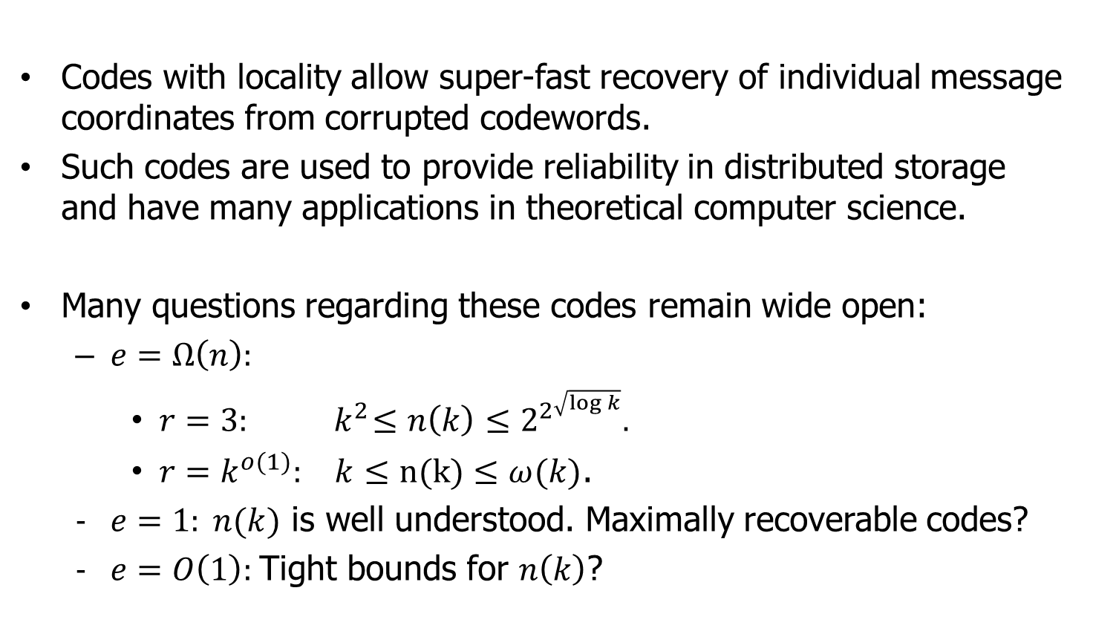
Looking forward
Codes with locality allow super-fast recovery of individual message coordinates from corrupted codewords.
Such codes are used to provide reliability in distributed storage and have many applications in theoretical computer science.
Many questions regarding these codes remain wide open:
  $e=Ω\left(n\right):$
    $r=3:{ k}^{2}≤n\left(k\right)≤2^{2^{\sqrt{\log{k}}}}.$
    $r=k^{o(1)}:{ k}≤n(k)≤ω(k)$.
  $e=1: n(k)$ is well understood. Maximally recoverable codes?
  $e=O\left(1\right):$Tight bounds for $n\left(k\right)$?

