Slide 1
“Super Storm Sandy:
Risk Redefinition, Response and Recovery on the Jersey Shore”
James K. Mitchell
Rutgers University
Presentation to the Workshop on Science and Technology Innovations in Hurricane Sandy Research, organized by the
Center for Discrete Mathematics and Theoretical Computer Science, and the Homeland Security Center for Command, Control and Interoperability Center for Advanced Data Analysis, Rutgers University. June 5.

Slide 2
PLEASE NOTE
This research is ongoing. Findings are tentative, pending completion of data analysis.
Project personnel can be contacted via Professor Mitchell at: <jmitchel@rci.rutgers.edu> His mailing address is: Department of Geography, Rutgers University, 54 Joyce Kilmer Avenue, Piscataway, NJ 08854-8045.

Slide 3
“Post-Disaster Risk Redefinition In Small New Jersey Municipalities During The Initial Recovery Period Following Super Storm Sandy”
A National Science Foundation RAPID research project
Began: December 2012; Ends: February 2014
Principal Investigators:
James K. Mitchell (Rutgers U., geographer)
Karen O’Neill (Rutgers U., sociologist)
Melanie McDermott (Rutgers U., interdisciplinary social scientist)
Mariana Leckner (American Military U., geographer)
Main objective:
To identify how experts and non-experts reassess storm surge flood risks that affect small municipalities following a record-setting disaster.
Municipalities of less than 10,000 are the norm for much of coastal America.
Research contributions to literature on disaster recovery and risk governance.

Slide 4
4 target populations & 4 techniques
Statewide (DATA COLLECTION & ANALYSIS COMPLETED)
NJ Eagleton Poll (public opinion questions, sample of c. 800 NJ residents)
Statewide and regional (DATA COLLECTION COMPLETED)
Online survey, c. 350 managers Solicited; 102 Completed
NJ Association for Floodplain Management (NJAFM)
Emergency Managers of NJ coastal counties
Local (DATA COLLECTION COMPLETED)
Interviews with public officials in 3 case study municipalities
4 in each municipality
Mayors, Council Presidents, City Managers, Engineers, Code Officials, Emergency Managers
Focus groups of residents in 3 case study municipalities
2 groups of 8 residents in each municipality (45 total)

Slide 5
Public Opinion Polling: Statewide Population - Support For Alternative Policy Measures (%)
ALTERNATIVE | STRONG SUPPORT | SOMEWHAT SUPPORT | COMBINED SUPPORT
Revert to pre-Sandy status | 24 | 24 | 48
Abandon areas with excessive rebuilding costs | 30 | 25 | 55
Convert high risk areas to open space | 36 | 35 | 71
Replenish beaches | 37 | 34 | 71
Relocate further from shore | 57 | 27 | 84
Build dunes and seawalls | 64 | 23 | 87
Elevate buildings | 64 | 23 | 87
Source: NJ Eagleton Poll, April 25, 2013
Shore county residents display similar preferences; most opt for dunes and seawalls (84% combined); Reversion to pre-Sandy status, without other changes, is least popular (47% combined)

Slide 6
Online Survey of Experts: State and Local Floodplain And Emergency Managers (conducted January 2013; 104 respondents)
Years to recovery
Tourism industry 2.8
Damaged Properties 4.8
Mitigation of future floods 18.1
Sandy is likely to force significant improvements in flood loss reduction
88% report “very likely” or “somewhat likely”
More Sandy-like events are likely:
57% say they will occur 2 or more times in next 30 years
Worsening storms perceived as leading driver of increased risks (30%), followed by increased development in flood prone areas (22%)
Strong reliance on ABFEs as chief source of information about future flood risks (identified by 62% of respondents), followed by Hazard Mitigation Plans (25%)
Needed improvements (selected from a list of 29 possible adjustment alternatives):
Public information and education programs (68%)
Hazard Mitigation Plans (46%)
Dune Conservation Ordinances (46%)

Slide 7
Characteristics Of Sandy-impacted Municipalities In Coastal New Jersey
NJ is NOT New York City in scale, composition, functions, resources
NYC >8 million people in one municipality
NJ >8 million people in 565 municipalities
Approximately 100 NJ municipalities affected by Sandy
Typical characteristics:
Metropolitan edge location
Small in area and population with a limited governmental bureaucracy
Often “built out” with few natural open spaces
Primarily residential with many homeowners (often second homeowners)
Usually ethnically homogeneous
High levels of employment in the service economy
Residents conscious of wealth/status differences among different municipalities
Strongly protective of “home rule” privileges

Slide 8
CASE STUDY COMMUNITIES
 | POPULATION | MEDIAN HOUSEHOLD INCOME | ETHNICITY | BELOW POVERTY LINE
Manasquan | 5,897 | $89,074 | 96% White | 5.0%
Oceanport | 5,832 | $88,080 | 93% White | 4.0%
Union Beach | 6,245 | $65,654 | 91% White | 5.0%
NJ Average | 8,791,894 | $71,180 | 69% White | 9.4%
Different levels of exposure to physical risks
Oceanfront – Manasquan
Bay front – Union Beach
Riverside - Oceanport

Slide 9
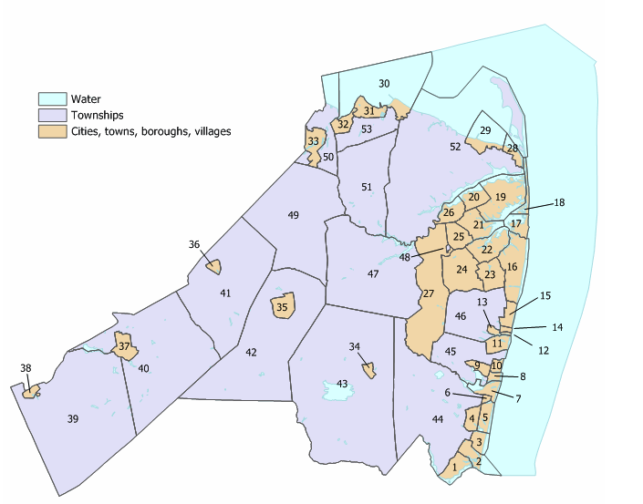
Union Beach
Oceanport
Manasquan

Slide 10
Focus Groups: Knowledge Of Flooding Pre-Sandy
Well acquainted with flood risks before Sandy
Knowledge derived:
Past personal or neighbor experience (‘92 storm, Irene)
Shared community wisdom (“High Tide, Full Moon; N.E. Wind”)
Common sense (“I live on the water!”)
Limited awareness of climate change as flood forcing factor
Public officials, insurance agents and property sellers are main institutional sources of local flood information
Believe public institutions understate flood risks
Technical issues
Short flood history; confusion over meaning of 100 year flood
Issues of trust
Non-disclosure by real estate agents; municipal officials seen as having vested interest in stability

Slide 11
Focus Groups: Many Uncertainties Affect Decisions To Rebuild (partial list)
Assessed value of damaged property and cost of repairs
Amount of flood insurance reimbursements
Costs of future flood insurance premiums
Eligibility for SBA loans
Eligibility for ICC grants
Eligibility for Community Development Block grants
Waiting periods before funds are received
Blocking role of banks and mortgage companies (failing to release insurance or loan monies)
Degree to which new state and local guidelines for recovery are legally binding
Degree to which ABFEs and FIRMs will be relaxed when permanent rules are adopted
Market for damaged homes
Availability of alternative accommodations (rental or purchase)

Slide 12
Effect of new policy intervention
Advisory Base Flood Elevations and flood risk maps
Intended to improve resilience of coastal communities by elevating structures and improving building standards combined with adoption of actuarial flood insurance rates
Reduced attention to some potential adjustments
Preparedness and warnings, buyouts and relocation, ecosystem restoration and management, beach nourishment, holistic recovery
Acts as a socio-ecological differentiation mechanism
Potential unintended effects
Stretching the recovery period
Winnowing out the less affluent from the local population
Increasing the proportion of rental units
Confusion, frustration, disgruntlement

Slide 13
Differentiation
Emergence of three tiers of responses
1st Tier: Elevating homes to ABFEs
Sometimes sustained >50% loss and eligible for ICC grants
Sometimes did not sustain >50% loss and opting to elevate without ICC grant
Able to rebuild using own resources
Will seek available reimbursement later
2nd Tier: Waiting for clarification of uncertainties and payments
Some may eventually elevate to ABFE levels
Others may decide to pay higher flood insurance costs without elevating
Will wait until insurance payments, SBA loans and/or ICC grants received before rebuilding/repairing
3rd Tier: Not repairing; walking away from damaged property
Perceived future: “We will either become a rich town or a welfare town.”

Slide 14
Small Scale Governance Units Have Fewer Recovery Choices
Constrained range of alternative hazard adaptations:
Focus on housing elevation, flood insurance, dune restoration
Local governments incur costs and receive no benefits for encouraging wider (CRS) range of measures
Holistic recovery strategies fail to emerge:
Environment: Lack of significant “natural” spaces
Economy: Service economies that serve residents’ basic needs
Society: Ethnic and socioeconomic homogeneity narrows the action space for diversity-based initiatives
Larger (regional?) units offer more scope for environmental management, economic rejuvenation and social engineering

Slide 15
Future Research Directions
Explore the role of scale in the framing and interpretation of storm surge risks by exposed populations
Investigate relationships between site level assessments made by individuals and families, community level assessments prepared by governance institutions, and large scale (global/regional) risk assessments developed by climate scientists.
Transformation of existing uncertainties about storm surge risks during the long term recovery period
Revisit the impacted communities for follow up studies at periodic intervals; focus on the processes by which current identified uncertainties are accommodated, resolved, ignored or persist at different stages of the recovery process.
Comparative study of the fate of new risk information in active disasters
Christchurch, New Zealand: Geotechnical information used in rebuilding program
Climate adaptation plans’ effects on post-Sandy rebuilding
Permanent adoption of ABFEs?
Options for pursuing holistic recovery strategies in small municipalities

