Slide 1
On Scheduling in Map-Reduce and Flow-Shops
Tamás Sarlós
Yahoo! Research
Joint work with:
Ben Moseley, Anirban Dasgupta, Ravi Kumar

Slide 2
Overview
Model
Related work in scheduling
Results
Proof
Open problems

Slide 3
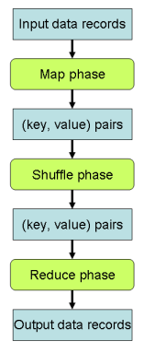
Map-Reduce
A Map-Reduce job
is a set of map and reduce tasks

Slide 4
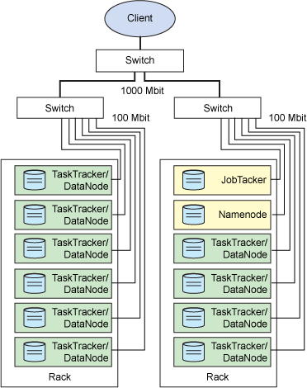
A Typical Cluster

Slide 5
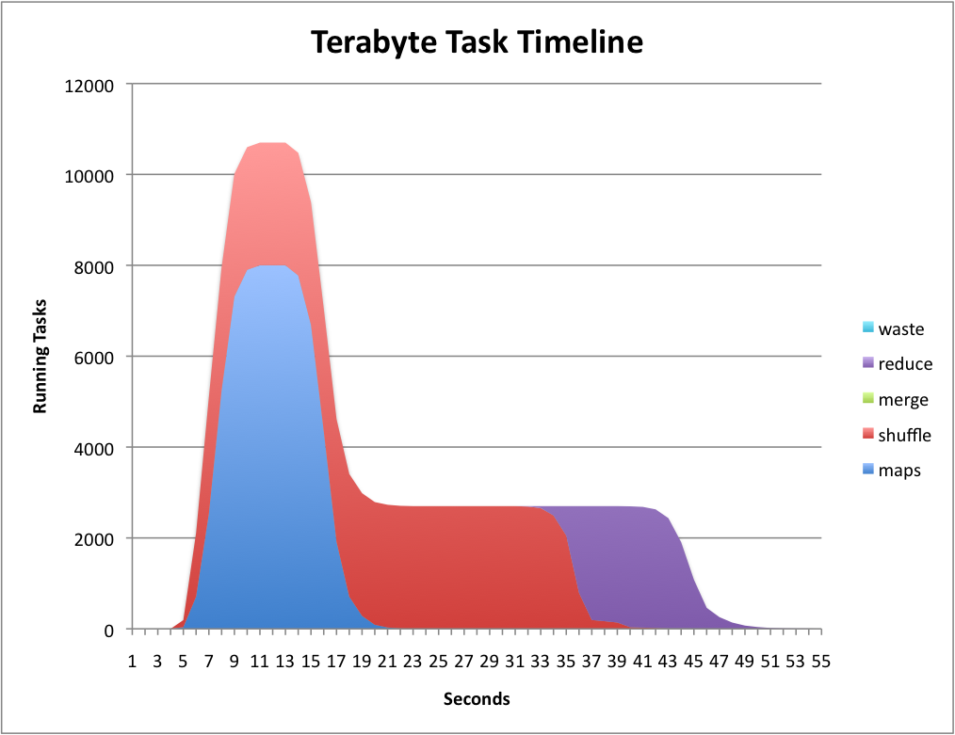
Life of a Job

Slide 6
Model
A Map-Reduce job
is a set of map and reduce tasks
may have an arrival time
Schedule
Map tasks run on map machines
Reduce tasks run on reduce machines
Reduce tasks of a job J are scheduled after all maps of J are completed
Each task runs on one machine
Jobs are independent

Slide 7
Simplifications
We ignore
The shuffle phase
The network topology
Data locality
stylized unrelated machines instead
Space usage of intermediate data emitted by maps
Machine, network, and task failures
Dependencies between jobs
Strategic behavior of users, etc.
Task run times are assumed to be known in advance
No speculative execution

Slide 8
Background - Scheduling Objectives
Metrics of interest in a shared cluster
Total completion time of jobs
Total flow (= completion – arrival) time
Not makespan
Known:
Shortest Remaining Processing Time is optimal for flow time on a single machine with preemption
Flow time on identical parallel machines with or without preemption is NP hard, no O(1) approx [GK 07, LR 07]
Notes:
Thus flow time is hopeless? No, we show 2 approaches to work it around

Slide 9
Background - Online Identical Machines
We allow preemption
Competitive ratio: flow time of online schedule / offline schedule
Strong lower bound for competitive ratio for flow time
log( min{P, n/N} ) N machines, n jobs, 1 task/job, P = max/min runtime [LR ‘07]
Resource augmentation
Our machines have 1+ε speed
1+ε speed O(1) competitive algorithm for flow time [AA ‘07]

Slide 10
Background - Flow Shops
Flow shop = Map-Reduce with 1 map and 1 reduce task / job
Our model = Generalized 2 stage flexible flow shop
Makespan in flow shops
Johnson’s algorithm for 1 map & 1 reduce machine
PTAS by Schuurman & Woeginger for multiple machines (flexible FS)
Prior results on total completion time in flow shops
Trivial 2 approximation for 1 map & 1 reduce machine [GS ‘78]
None for multiple machines
Flow time is still hard

Slide 11
Results – Offline Identical Machines
All jobs arrive at time 0
12 approx for total completion time
Simulate shortest job first for map tasks on a single N_{M} speed machine
Simulate SJF for reduce task on a single N_{R} speed machine
Width of a job := max { map finish time, reduce finish time, length of longest task }
Run map tasks by width increasing
For each job delay reduce tasks till time 2 * width
Run reduces by width increasing

Slide 12
Proof Sketch
All tasks finish by availability + 2 * width
➔ Reduce finishes by 4 * width
Σ width ≤ Σ map completion time +
Σ reduce completion time +
Σ length of longest task
≤ 3 * OPT
Notes:
Just mention busy schedule argument

Slide 13
Results – Online Identical Machines
Simulate shortest remaining processing time for map and reduce tasks on a single N_{M} and N_{R} speed machine
If all simulated maps and reduces of job J are finished then
Job width := max { length of longest task, max{map finish time, reduce finish time} – arrival time }
k := log of width // Online load balancing Assign map tasks to minimize imbalance in class k map work
else if all maps finished in the new schedule
Assign reduce tasks to minimize imbalance in class k work
end if
On each map and reduce machine run the tasks whose job has minimum width
Notes:
Note that this is an online schedule

Slide 14
Results – Online Identical Machines
Theorem:
The previous slide is an 1+ε speed competitive online algorithm for total flow time
Remark:
Note that ε appears in the analysis only

Slide 15
Results – QPTAS for flow shops
1 map and reduce task / job
Offline, arrival times, total completion time
Techniques are based on Afrati et al. ’99
Main ideas
Time intervals of size (1+ε)^{t}
Round processing times to (1+ε) powers
Structural modifications let us schedule most jobs when they are small compared to the interval
Guess the order of the rest
Dynamic program indexed by count vectors of arrived, partially, and completely done jobs in an interval
Use an algorithm for makespan as a subroutine for testing feasibility of scheduling an interval
Notes:
Tell that QPTAS comes from the number of distinct jobs types

Slide 16
Open Problems 1
Evaluation
Rent or buy a cluster
Discrete event simulation Hadoop src/contrib/mumak
We lose a factor 2 if there is no distinction between map and reduce machines. Can we do better?
PTAS for flow shops irrespective of processing times?
Is there a PTAS for multiple map and reduce tasks / job for identical machines?
Is there an (1+ε) speed 1/ε or O(1) competitive online algorithm?
Notes:
Evaluation is TODO, not open

Slide 17
Open Problems 2 – Unrelated Machines
Run time of a task varies per machine arbitrarily
Standard in scheduling, this can model
Minimum memory requirements
“Data locality”
Theorem: Assuming 1 map and 1 reduce task per job
There is a 6 competitive offline algorithm for total completion time
There exists a (1+ε) speed competitive online algorithm
for total flow time with arrival times
Hard with multiple tasks / jobs
We need a more realistic model, undo simplifications
Notes:
Challenge the audience for an easier and more realistic model

Slide 18
Thank you!

