Slide 1
Information Fusion on Human Disease Network in Taiwan
Kuang-Chi Chen, Ph.D.
Dept. of Medical Informatics, Tzu Chi University, Taiwan
DIMACS WAIF, Nov. 8-9, 2012

Slide 2
Outline
Introduction
Material and method
- Measure of co-morbidity
- Taiwan health insurance dataset
- Rank-combination method
Result and conclusion

Slide 3
Introduction
In organisms, most cellular components exert their functions through interactions with other cellular components. In human, the totality of these interactions representing the human interactome.
Network-based approach is promising to explore the interaction of cellular components, such as genes, proteins, metabolites, SNPs. [References below]
References:
Barabási A-L. Network Medicine - From Obesity to the “Diseasome”. NEJM. 2007; 357:404.
Duarte NC, et al. Global reconstruction of the human metabolic network based on genomic and bibliomic data. PNAS. 2007; 104:1777.
Goh K-I, et al. The human disease network. PNAS. 2007; 104:8685–90.
Ideker T, Sharan R. Protein networks in disease. Genome Research. 2008; 18:644–52.
Jeong H, et al. The large-scale organization of metabolic networks. Nature. 2000; 407:651–4.
Oti M, et al. Predicting disease genes using protein-protein interactions. J Med Genet. 2006; 43:691–698.
Rual J-F, et al. Towards a proteome-scale map of the human protein–protein interaction network. Nature. 2005; 437:1173–8.
Stelzl U, et al. A Human Protein-Protein Interaction Network: A Resource for Annotating the Proteome. Cell. 2005; 122:957–68.
Xu J, Li Y. Discovering disease-genes by topological features in human protein–protein interaction network. Bioinformatics. 2006; 22.

Slide 4
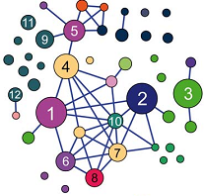
Examples of cellular network
For example,
- protein interaction networks, whose nodes are proteins linked to each other via physical (binding) interactions;
- metabolic networks, whose nodes are metabolites linked if they participate in the same biochemical reactions;
- genetic networks, in which two genes are linked if the phenotype of a double mutant differs from the expected phenotype of two single mutants.

Slide 5
Human disease network
Network-based approaches to human disease can have multiple biological and clinical applications, offering a quantitative platform to address the complexity of human disease. In addition, network is also used to explore the relations among diseases by analyzing high-throughput clinical records.
Hidalgo et al. (2009) used 32-million US Medicare records of 65+ elders to build the human disease network (HDN).
In their HDN, nodes are diseases; links are correlations between a pair of diseases.
Reference: Hidalgo CA et al. A dynamic network approach for the study of human phenotypes. PLoS Comp Biol. 2009; e1000353

Slide 6
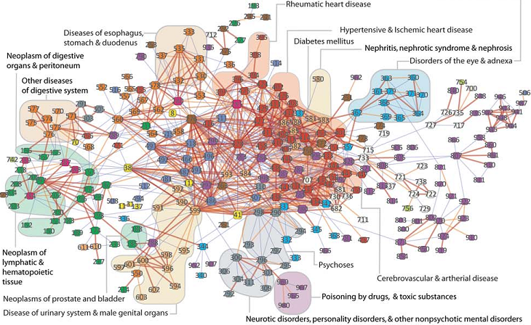
Human disease network
Node color identifies the disease category; node size is proportional to disease prevalence. Link color and weight indicate correlation strength. [Hidalgo et al., PLoS Comp Biol, 2009]

Slide 7
Correlation between diseases
A co-morbidity relationship exists between two diseases whenever they affect the same individual substantially more than chance alone.
Co-morbidity is measured by either φ-correlation or relative risk (RR).
Patient clinical histories contain information on disease associations and progression. The HDN is built by summarizing associations obtained from medical records of millions patients.

Slide 8
Co-morbidity: φ-correlation
Two measures: φ-correlation and Relative Risk (RR).
For a pair of diseases i and j,
 | w/ D_{i} | w/o D_{i} | Sum
w/ D_{j} | C_{ij} | P_{j} - C_{ij} | P_{j}
w/o D_{j} | P_{i} - C_{ij} | N-P_{i}-P_{j}+C_{ij} | N - P_{j}
Sum | P_{i} | N - P_{i} | N
where C_{ij} is the number of patients affected by both i and j,
N is the total number of patients in the data,
P_{i} is the prevalence of disease i (# of patients affected by i),
P_{j} is the prevalence of disease j.

Slide 9
Co-morbidity: RR
Relative Risk (RR; denoted by R_{ij})
For a pair of diseases i and j,
 | w/ D_{i} | w/o D_{i} | Sum
w/ D_{j} | C_{ij} | P_{j} - C_{ij} | P_{j}
w/o D_{j} | P_{i} - C_{ij} | N-P_{i}-P_{j}+C_{ij} | N - P_{j}
Sum | P_{i} | N - P_{i} | N
R_{ij} = 1 imply no co-morbidity;
R_{ij} > 1 imply positive co-morbidity;
0 < R_{ij} < 1 imply negative co-morbidity.
Similarly, φ_{ij} = 0 imply no co-morbidity;
0 < φ_{ij} < 1 imply positive co-morbidity;
-1 < φ_{ij} < 0 imply negative co-morbidity.

Slide 10
Taiwan Health Insurance database (I)
Taiwan launched a single-payer National Health Insurance program on March 1, 1995. As of 2007, 22.60 million of Taiwan’s 22.96 million population were enrolled in this program. (coverage = 98.4%)
Large computerized databases derived from this system by the Bureau of National Health Insurance, Taiwan (BNHI).
The database of this program contains registration files and original claim data for reimbursement.
http://w3.nhri.org.tw/nhird/en/Data_Files.html

Slide 11
Taiwan Health Insurance database (II)
These data files are de-identified by scrambling the identification codes of both patients and medical facilities.
The data can be applied for research purpose only. They are data subsets extracted by systematic sampling method of 0.2% (outpatient records) or 5% (inpatient records) on a monthly basis.
There was no significant difference in the gender distribution between the data subsets and the original claim data.

Slide 12
Inpatient data subset
We use Taiwan inpatient data subset to measure co-morbidity and build the HDN.
A primary diagnosis and up to 4 secondary diagnoses are specified by ICD-9-CM codes.
ICD-9-CM (International Classification of Diseases, Ninth Revision, Clinical Modification) is set up by the WHO (World Health Organization). ICD-9-CM is the official system of assigning 5-digit codes to diagnoses and procedures associated with hospital utilization in many countries.
http://www.cdc.gov/nchs/icd/icd9cm.htm

Slide 13
ICD-9-CM
The first three digits specify the main disease category while the last two provide additional information about the disease.
In total, ICD-9-CM classification consists of 17 chapters, 657 categories of diseases at the 3 digit level and 16,459 categories at 5 digits.
Disregard of complications of pregnancy, childbirth, and the puerperium (630-679), congenital anomalies (740-759), newborn perinatal guidelines (760-779), and injury and poisoning (800-999), 635 disease categories are considered.

Slide 14
Descriptive statistics of inpatient data
There are 4,287,191 individuals with 8,927,522 hospitalization claims during 3 years are used in our study.
The mean age is 45.10 years old, and the percentage of female is 52.17%.
To measure association resulting in disease co-occurrence, we use φ-correlation and Relative Risk (RR) to quantify the strength of co-morbidity based on Taiwan inpatient data subset.

Slide 15
Taiwan human disease network
There are 635 disease nodes, and C⁶³⁵₂ = 201,295 possible links are considered in the HDN. (huge # of edges)
Two nodes are linked if the association measure > threshold (preconceived or decided by statistical testing)
For example,
φ –correlation: two diseases are associated if φ > 0.06
RR: two diseases are associated if R > 20
where 0.06 and 20 are suggested by Hidalgo et al. (2009)

Slide 16
Problem and goal
However, these measures have biases that over- or under-estimate the co-morbidity involving rare or prevalent diseases (i.e., low or high prevalence).
- φ-correlation under-estimates the strength of co-morbidity between rare and prevalent diseases,
- RR under-estimates the co-morbidity strength between two prevalent diseases,
- RR over-estimates the co-morbidity involving rare diseases.
We propose a rank-combination method to reduce the biases regarding prevalence.

Slide 17
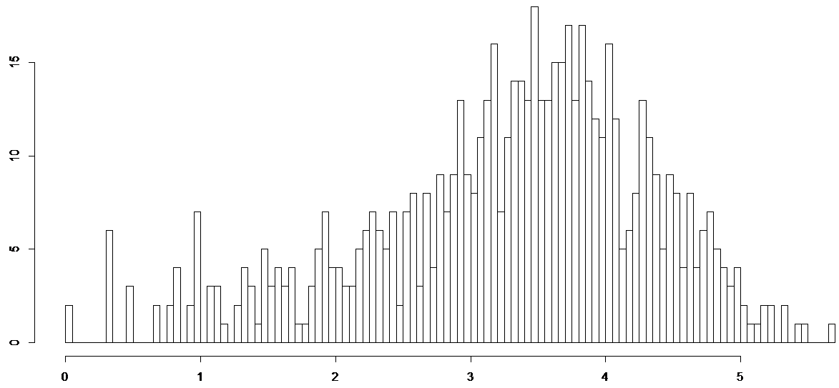
Distribution of prevalence of 635 disease categories
Low
13.23%
(rare disease)
Middle
61.57%
High
25.20%
(prevalent disease)
# diseases
0 10 10² 10³ 10⁴ 10⁵
Prevalence
Notes:
84/635 = 13.23%, 391/635 = 61.57%, 160/635 = 25.20%

Slide 18
Distribution of φ-correlation
Cons: under-estimation between rare and prevalent diseases
# of pairs
high vs. high
low vs. low
high vs. low
φ
φ
φ
φ tends to be small for rare disease vs. prevalence disease

Slide 19
Distribution of RR
Cons: under-estimation between prevalent diseases
over-estimation when involving rare diseases
mid. vs. mid.
high vs. high
high vs. low
low vs. low
# of pairs
log₁₀(R)
log₁₀(R)
log₁₀(R)
log₁₀(R)
skewed to the left
skewed to the right
extremely high

Slide 20
Rank-score functions
Normalized φ
Normalized log₁₀(R)
1
.5
0
1
.5
0
Two measures (φ and RR) look quite diverse.
Rank
Rank
The score is normalized into [0, 1] by (score - min)/(max – min)

Slide 21
Rank-combination method
Two diseases are associated if
[Rank(φ) + Rank(R)]/2 < threshold-rank
The threshold-rank is decided as follows:
There are 1,230 significant associations with Φ > 0.06, and 2,749 significant associations with R > 20. Among 201,295 possible links from 635 disease nodes, the significant levels are 0.61% and 1.37%.
Choose (1230 + 2749)/2 ≒ 1990 as the threshold-rank. (0.99% significant level)
Two diseases are associated if
[Rank(φ) + Rank(R)]/2 < 1990

Slide 22
Rank-combination vs. φ-correlation
Since φ-correlation under-estimates the co-morbidity between rare and prevalent diseases, there are 0% significant associations.
φ | low | high
low | 0.2% | 0%
high |  | 6.2%
Rank | low | high
low | 0.6% | 0.1%
high |  | 1.7%
Rank-combination reduces the biases by raising the significant rate to 0.1%.
In addition, the variation of significant percentages (0.6%, 0.1%, and 1.7%) is smaller than that of 0.2%, 0%, and 6.2%.
Rank-combination method is robust to different prevalence.

Slide 23
Rank-combination vs. RR
RR under-estimates the co-morbidity between two prevalent diseases,
but over-estimates the co-morbidity involving rare diseases.
RR | low | middle | high
low | 0.6% | 3.1% | 1.2%
middle |  | 1.8% | 0.3%
high |  |  | 0.2%
Rank | low | middle | high
low | 0.6% | 0.4% | 0.1%
middle |  | 1.2% | 1.0.%
high |  |  | 1.7.%
Rank-combination reduces the biases, and the variation of significant percentages becomes smaller.
Rank-combination method is robust to extreme prevalence.

Slide 24
Disease network by rank-combination
red link – strong association
pink link – middle association
grey link – low association
Node color identifies the disease category; node size is proportional to disease prevalence. Link color and weight indicate correlation strength.

Slide 25
Conclusion
No best measure for co-morbidity.
No true answer for link or not between diseases.
Both φ-correlation and RR are good at measuring co-morbidity and have limitation in measuring co-morbidity. They are complementary to each other.
Rank-combination method by combining two ranks of measures overcomes the disadvantages of φ-correlation as well as RR.
The links of disease network decided by rank-combination method are more reliable.

Slide 26
Acknowledgements
Thanks to funders:
- National Science Council (NSC) in Taiwan
- Tzu-Chi University, Hualien, Taiwan
Data Providers:
- National Health Research Institute (NHRI), Taiwan
- Bureau of National Health Insurance (BNHI),Taiwan
Collaborators:
- Dr. Tse-Yi Wang, Ma-Kai Memorial Hospital, Taipei
- Dr. Chen-hsuiang Chan, Tzu-Chi University, Hualien
- Mr. Yao-Hung Hsaio, Ms. Sin-Yi Wang, Ms. Yi-Ro Lin

