Slide 1


DIMACS/RUCIA Workshop on Information Assurance in the Era of Big Data
Opportunities and Challenges for Internet-derived Big Data
February 6, 2014
John-Francis Mergen
Raytheon, BBN Technologies
jfmergen at bbn.com

Slide 2
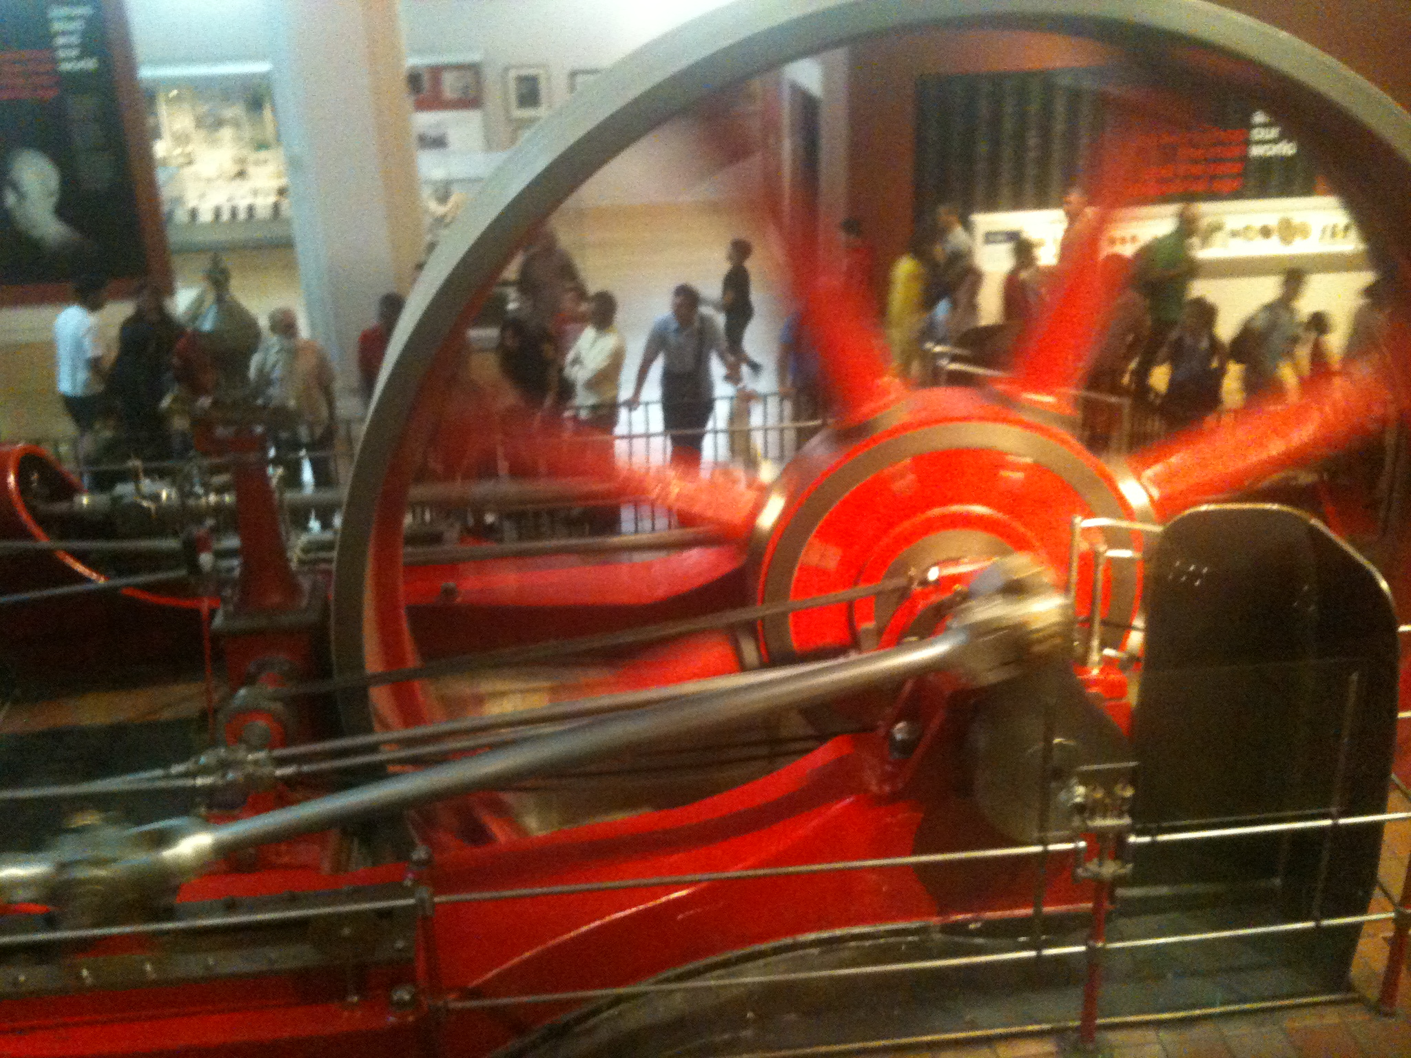
Where we are – one view
Well Developed (examples):
  Commercialization of Big Data techniques
    Advertising - Google
    Internet Commerce - Amazon
    Product management and development - Apple
  Scientific exploration
    Physics - CERN, ISC analytical operations
    Astronomy - Hubble – deep field images, GALEX
    Medicine – Epidemiology, Drug development
Emerging
  System control
    Energy - Smart Grid
    Industrial Control – Petrochemicals
  Transportation
    Air Traffic Management - ADS-B analytics
    Public Transit – CTA open data
  Internet of Things
    Edge Automation - Nest
Industrialization is the emerging opportunity

Slide 3

Industrialized Big Data
Practical Considerations
  Reliability
    Imperfect data
  Actuators
    Imperfect operation, poor time synchronization, loss of control
  Closed Loop
Non-technical Drivers Considerations
  Safety
    Mistakes cause illness, death and destruction
  Longevity
    Big in Time
  Supported by CapEx vs OpEx
The ecosystem rules for industrial operations are different from commercial operations

Slide 4
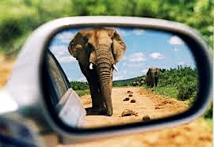
Change: Individuals & Groups to Systems
Commercial
  Social networks
    Shared information, collective action, constant contact
    Group action and crowd sourcing
      Foursquare, Grupons, Urban Spoon, OpenTable
  Workplace/home-office
  Flash mobs, Facebook campaigns
Industrial
  Network Analytics
    Carrier, Inter Exchange Carriers, Subscribers, Content Providers, Content Delivery Networks
  Smart Grid
    Generators, Distribution, Consumers
  Transportation
    Air Traffic Management - ADS-B, NextGen
    Logistics – FedEx, UPS
Creative Commons: happytellus.com
Large systems have long term memory, hysteresis

Slide 5
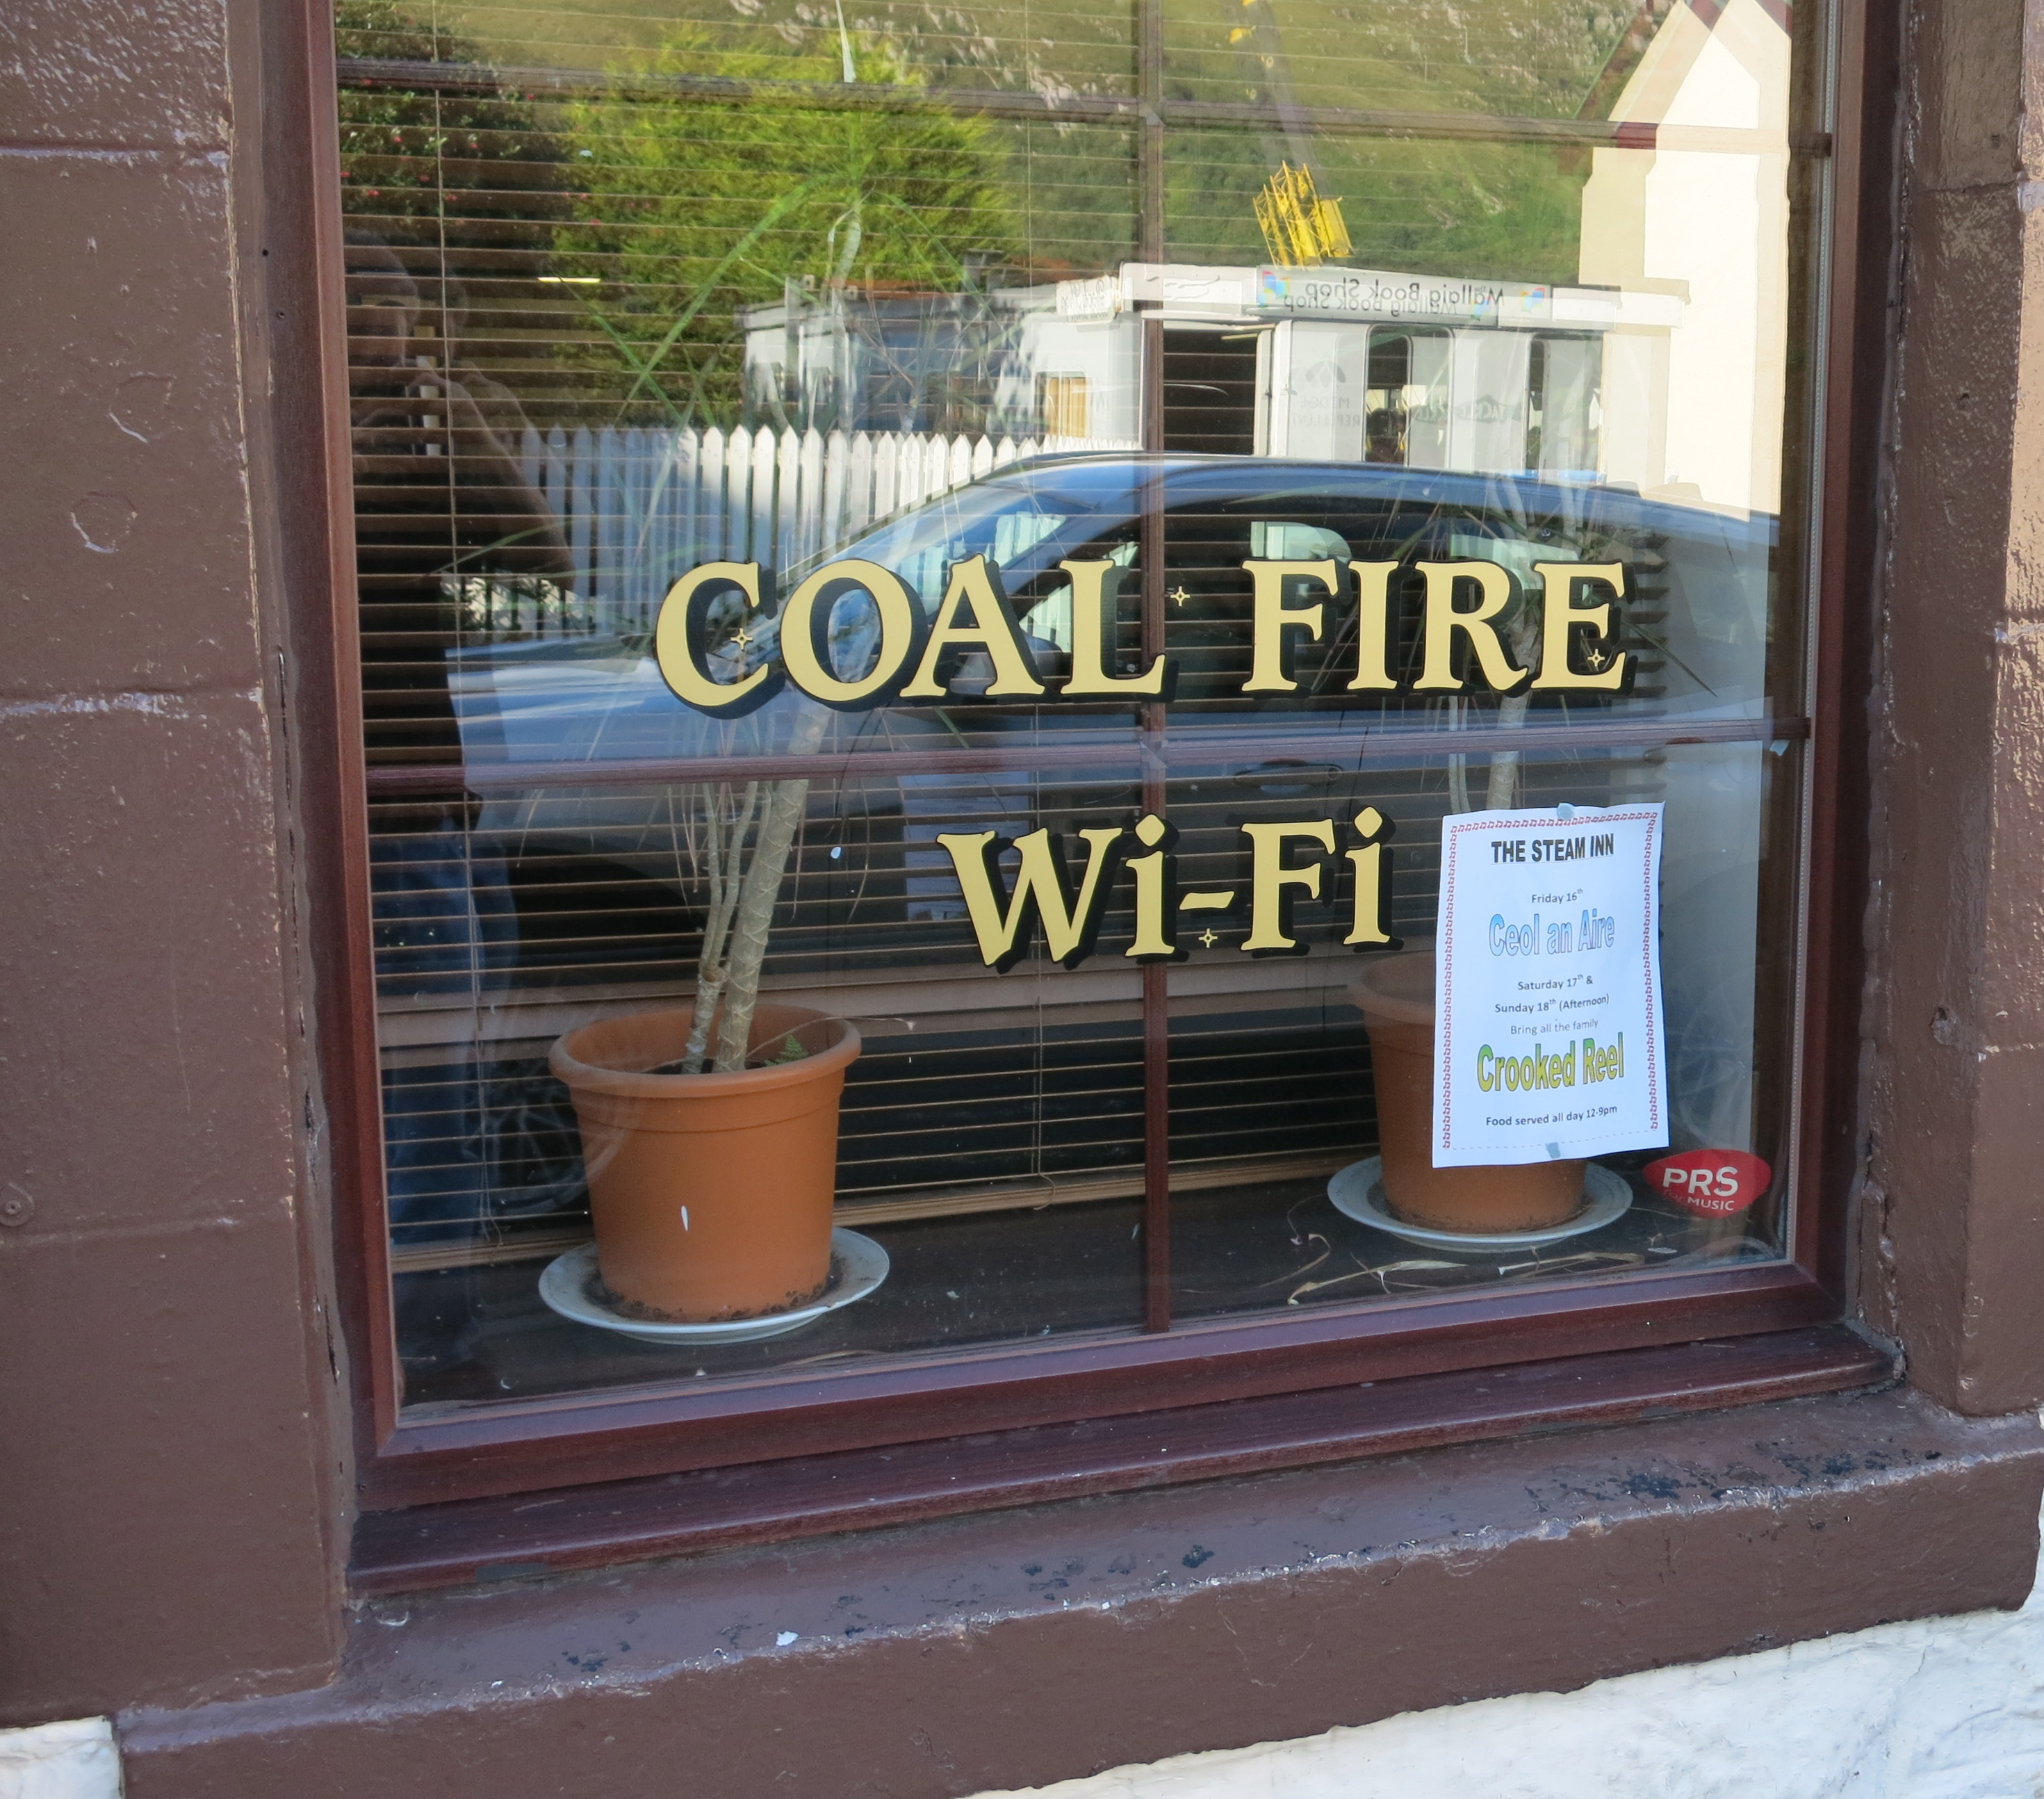
Industrialization of Big Data
Use big data sources for more than just informing business decisions or customer service
Enhance internal value chain by using big data sources and technologies to streamline internal processes
Integrate internal process information to optimize, automate, or eliminate redundant, manual processes
Analyze Current Industrial Process
Identify Gates for Data Ingress and Egress
Map to Available Big Data Sources
Automate Collection, Dissemination, and Application of Data

Slide 6

Example: Industrialized IoT code
Fleet / Business Unit
Embedded Sensors
System
Embedded Computing
Communications
Facility / Platform
Management
Optimization
Security
Analytics

Slide 7
“The Internet” vs. “The Internet of Things”
The Internet, has been about people interacting with data (consuming, creating) and with each other (sharing, collaborating, doing business).
The Internet of Things, is machines interacting with data (sensing, responding, learning) and with each other, … and with people.
Growth is driven by efficiencies in operational expense & time through a highly-instrumented industrial base integrated with big data analytics
The Internet and Internet of Things are fusing:
  Common supply chains
  Common operating systems and processors
  Open source software
  Most IoT networks connect to the traditional Internet
Source: CISCO systems

Slide 8
Bottom Line: There is always a defect
A defect is an oversight in design or error in coding that has the potential to produce unintended behavior
907 different types of defects are documented in MITRE’s Common Weakness Enumeration list
A vulnerability is a weakness that when exploited allows an attacker to gain advantage
All software of any complexity has vulnerabilities
Defect density for well-developed code ranges between 1 and 7 per 1,000 SLOC
(Source: Software Engineering Institute)
1 - 10 % of defects are exploitable (Source: Raytheon SI)
10 to 700 exploitable defects would be expected per MSLOC
Vulnerabilities exist in every computing system
System | M SLOC | Vulnerabilities?
Linux kernel 3.2 | 15 | 150 – 10,500
Windows 7 | >50 | 500 – 35,000
Mac OS X 10.4 | 86 | 860 – 60,200
Airbus 380 | 100 | 1000 – 70,000
Luxury Auto | 100 | 1000 – 70,000
FOSS* | 23,500 | Likely > 2 million
*As of 6 July 2013, the Ohloh public directory of free and open source software (FOSS) site lists 590,310 projects, 538,806 source control repositories, 2,373,936 contributors and 23,457,982,058 lines of code (Wikipedia)

Slide 9
Supporting the Industrial Internet:Big Code
Preventing the introduction of malicious apps to app stores
    Outliers and anomalies in apps at scale
    Analyzing obfuscated code
    Finding malicious cross-app data flows
Provide real-time feedback of software quality based on similarity to mined data from open source
    Leverage metadata about defects, errors, and resolutions
    IDE gives real-time feedback based on code similarity
Mining programs with graph rewriting
    Find common software design patterns in open source repositories
    Identify design/architecture flaws in code and suggest repairs

Slide 10
BigCode, quality analysis from OS mining
Code repositories provide a rich corpus of bugs, issues, defects, errors and noise
Problem: The “Patch and Pray” model of software development is non linear with respect to the quantity of software in production. The advantage is on the side of the attacker, with imperfections being easier to find than solutions and is only getting worse as the amount of software and our reliance on software systems increase.
Impact: Invert the strategic advantage by changing the detection function from fragile expert systems (e.g. lint, valgrind) to non deterministic GDS analysis
Why Now? Tipping point in the quantity of open source. Advances in distributed graph databases (e.g. Titan, Neo4j, Dex). Advances in non expert system program analysis and cross applications of BigData techniques.
What’s Hard? Understanding unstructured code metadata, GDS similarity metrics, scale, normalization of GDS functions for cross application, meaningful metrics

Slide 11
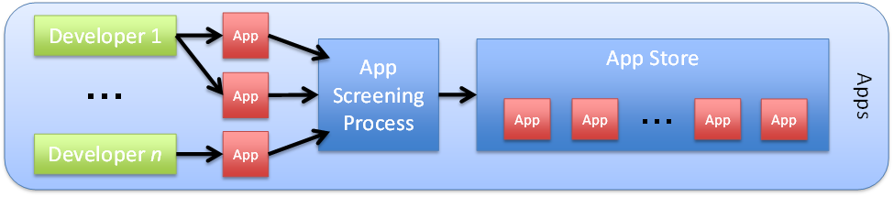
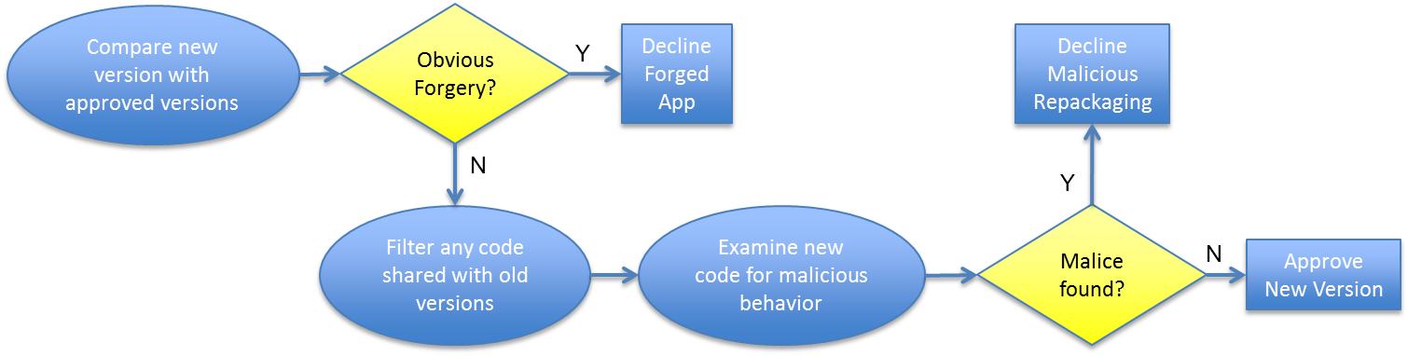
App Characterization
Problem: Screening of apps for commercial or enterprise app stores largely manual, expertise intensive
New capability: Automated mining of app code to detect forgeries, track repackaging and shared library usage, find common vulnerabilities

Slide 12
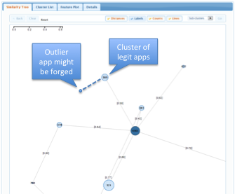
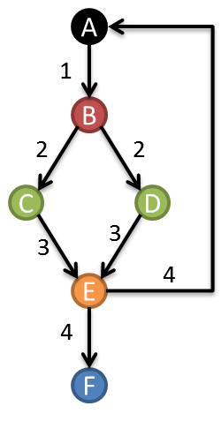
Mobile App Characterization (2)
Initial capabilities technologies are already applicable
  Static analysis fingerprinting (easier with Java byte-code than x86)
  Large-scale similarity comparisons and clustering of apps
  Large-scale code subset comparisons (shared subroutines or “components” with many subroutines; “diff” to identify new code)
App clustering
Control Flow Graph comparisons

Slide 13
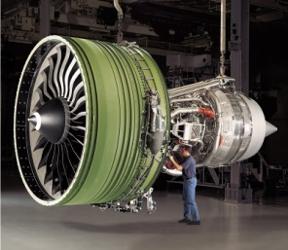

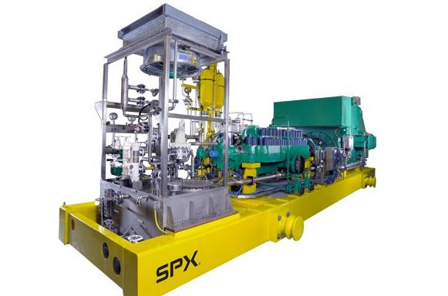
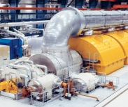
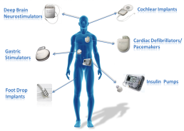


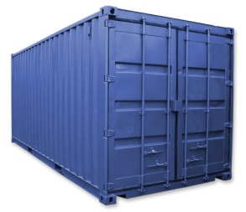
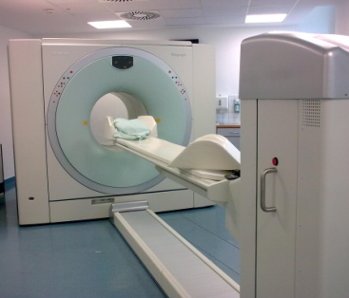



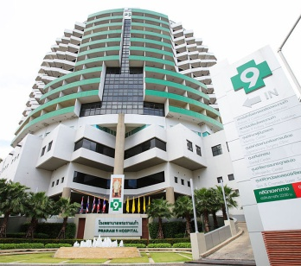
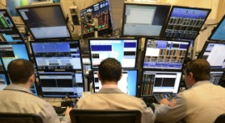
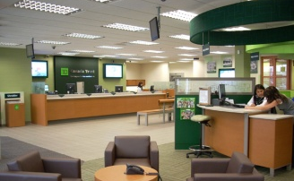

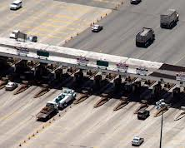

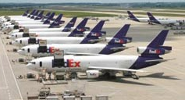
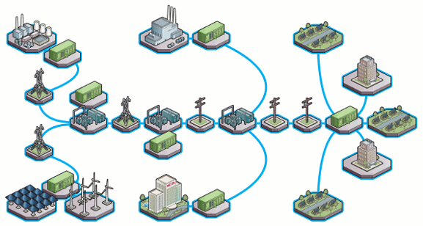



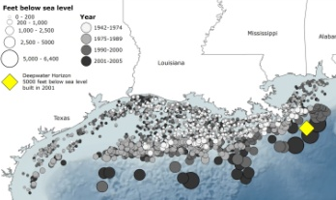
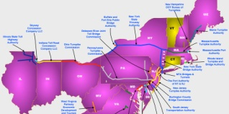

Focus on what’s important
Use NIST’s term, “Industrial Internet of Things” and this working definition:
Processing and networks
Embedded into systems and business processes
Which are important to key critical infrastructure sectors
Transportation
Energy
Health/
Medicine
Banking & Finance
Systems
Facilities/ Platforms
Fleets / Enterprises

Slide 14
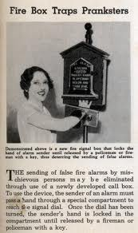
Collaborative Ideas
Improving Software through crowd knowledge
Reduce exploitable vulnerabilities in IoT
Avoid mistakes that are obvious after the fact
Modern Mechanix, Feb 1938

Slide 15
Thank you

