Slide 1
LocalFlow: Simple, Local Flow Routing in Data Centers
Siddhartha Sen, DIMACS 2011
Joint work with Sunghwan Ihm, Kay Ousterhout, and Mike Freedman
Princeton University

Slide 2
Routing flows in data center networks
A
B

Slide 3
Network utilization suffers when flows collide…
[ECMP, VLB]
A
B
E
D
F
C

Slide 4
… but there is available capacity!
A
B
E
D
F
C

Slide 5
… but there is available capacity!
Must compute routes repeatedly:
real workloads are dynamic (∼ms)!
A
B
E
D
F
C

Slide 6
Multi-commodity flow problem
Input: Network G = (V,E) of switches and links Flows K = {(s_{i},t_{i},d_{i})} of source, target, demand tuples
Goal: Compute flow that maximizes minimum fraction of any d_{i} routed
Requires fractionally splitting flows, otherwise no O(1)-factor approximation

Slide 7
Prior solutions
Sequential model
Theory: [Vaidya89, PlotkinST95, GargK07, …]
Practice: [BertsekasG87, BurnsOKM03, Hedera10, …]
Billboard model
Theory: [AwerbuchKR07, AwerbuchK09, …]
Practice: [MATE01, TeXCP05, MPTCP11, ...]
Routers model
Theory: [AwerbuchL93, AwerbuchL94, AwerbuchK07, …]
Practice: [REPLEX06, COPE06, FLARE07, …]
more decentralized

Slide 8
Prior solutions
Sequential model
Theory: [Vaidya89, PlotkinST95, GargK07, …]
Practice: [BertsekasG87, BurnsOKM03, Hedera10, …]
Billboard model
Theory: [AwerbuchKR07, AwerbuchK09, …]
Practice: [MATE01, TeXCP05, MPTCP11, ...]
Routers model
Theory: [AwerbuchL93, AwerbuchL94, AwerbuchK07, …]
Practice: [REPLEX06, COPE06, FLARE07, …]

Slide 9
Prior solutions
Sequential model
Theory: [Vaidya89, PlotkinST95, GargK07, …]
Practice: [BertsekasG87, BurnsOKM03, Hedera10, …]
Billboard model
Theory: [AwerbuchKR07, AwerbuchK09, …]
Practice: [MATE01, TeXCP05, MPTCP11, ...]
Routers model
Theory: [AwerbuchL93, AwerbuchL94, AwerbuchK07, …]
Practice: [REPLEX06, COPE06, FLARE07, …]
Theory-practice gap:
Models unsuitable for dynamic workloads
Splitting flows difficult in practice

Slide 10
Goal: Provably optimal + practical
multi-commodity flow routing

Slide 11
Problems
Solutions
Dynamic workloads
Fractionally splitting flows
Switch ≠ end host
Limited processing, high-speed matching on packet headers
Routers Plus Preprocessing (RPP) model
Poly-time preprocessing is free
In-band messages are free
Splitting technique
Group flows by target, split aggregate flow
Group contiguous packets into flowlets to reduce reordering
Add forwarding table rules to programmable switches
Match TCP seq num header, use bit tricks to create flowlets

Slide 12
Sequential solutions don’t scale
[Hedera10]
Controller

Slide 13
Sequential solutions don’t scale
[Hedera10]
Controller

Slide 14
Billboard solutions require link utilization information…
[MPTCP11]
in-band message
(ECN, 3-dup ACK)
A
B

Slide 15
… and react to congestion optimistically…
[MPTCP11]
A
B

Slide 16
… or model paths explicitly (exponential)
A
B

Slide 17
Routers solutions are local and scalable…
[REPLEX06]

Slide 18
… but lack global knowledge
But in practice we can:
Compute valid routes via preprocessing (e.g., RIP)
Get congestion info via in-band messages (like Billboard model)
A
B

Slide 19
Problems
Solutions
Dynamic workloads
Fractionally splitting flows
Switch ≠ end host
Limited processing, high-speed matching on packet headers
Routers Plus Preprocessing (RPP) model
Poly-time preprocessing is free
In-band messages are free
Splitting technique
Group flows by target, split aggregate flow
Group contiguous packets into flowlets to reduce reordering
Add forwarding table rules to programmable switches
Match TCP seq num header, use bit tricks to create flowlets

Slide 20
RPP model: Embrace locality…
A
B
E
D
F
C

Slide 21
… by proactively splitting flows
A
B
E
D
F
C

Slide 22
… by proactively splitting flows
Problems:
Split every flow?
What granularity to split at?
A
B
E
D
F
C

Slide 23
Frequency of splitting
switch

Slide 24
Frequency of splitting
switch

Slide 25
Frequency of splitting
switch
one flow split!

Slide 26
Granularity of splitting
Optimal routing
High reordering
Suboptimal routing
Low reordering
flowlets
Per-Packet
Per-Flow

Slide 27
Problems
Solutions
Dynamic workloads
Splitting flows
Switch ≠ end host
Limited processing, high-speed matching on packet headers
Routers Plus Preprocessing (RPP) model
Poly-time preprocessing is free
In-band messages are free
Splitting technique
Group flows by target, split aggregate flow
Group contiguous packets into flowlets to reduce reordering
Add forwarding table rules to programmable switches
Match TCP seq num header, use bit tricks to create flowlets

Slide 28
Line rate splitting (simplified)
Flow | TCP seq num | Link
A → B | *…0***** | 1
A → B | *…10**** | 2
A → B | *…11**** | 3
1/2
1/4
1/4
flowlet =
16 packets

Slide 29
Summary
LocalFlow is simple and local
No central control (unlike Hedera) or per-source control (unlike MPTCP)
No avoidable collisions (unlike ECMP/VLB/MPTCP)
Relies on symmetry of data center networks (unlike MPTCP)
RPP model bridges theory-practice gap

Slide 30
Preliminary simulations
Ran LocalFlow on packet trace from university data center switch
3914 secs, ∼260,000 unique flows
Measured effect of grouping flows by target on frequency of splitting
Ran LocalFlow on simulated 16-host fat-tree network running TCP
Delayed 5% of packets at each switch by norm(x,x)
Measured effect of flowlet size on reordering

Slide 31
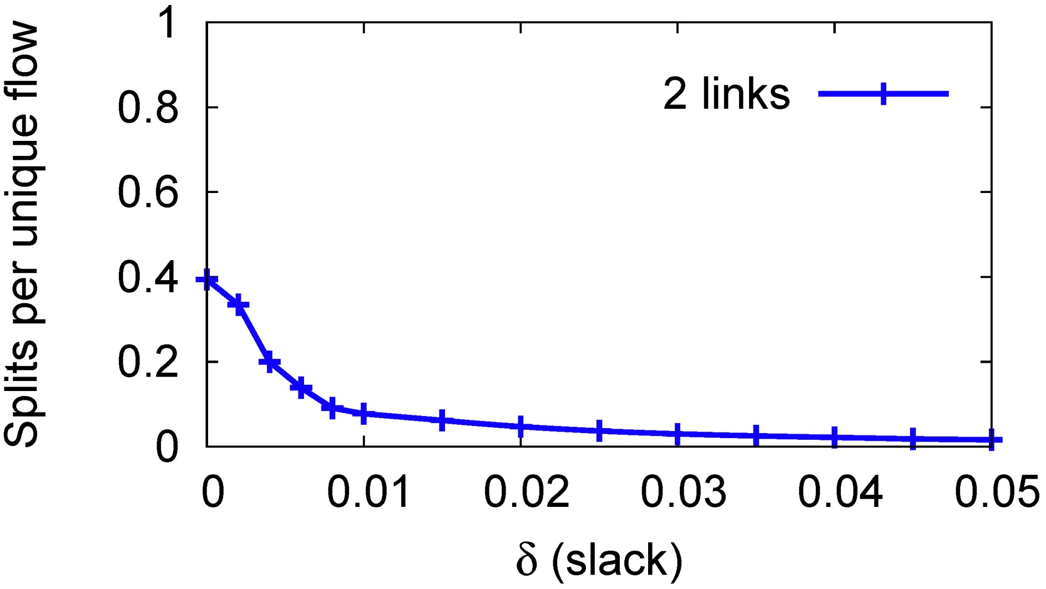
Splitting is infrequent
Group flows by target

Slide 32
Splitting is infrequent
δ-approximate splitting

Slide 33
Preliminary simulations
Ran LocalFlow on packet trace from university data center switch
3914 secs, ∼260,000 unique flows
Measured effect of grouping flows by target on frequency of splitting
Ran LocalFlow on simulated 16-host fat-tree network running TCP
Delayed 5% of packets at each switch by norm(x,x)
Measured effect of flowlet size on reordering

Slide 34
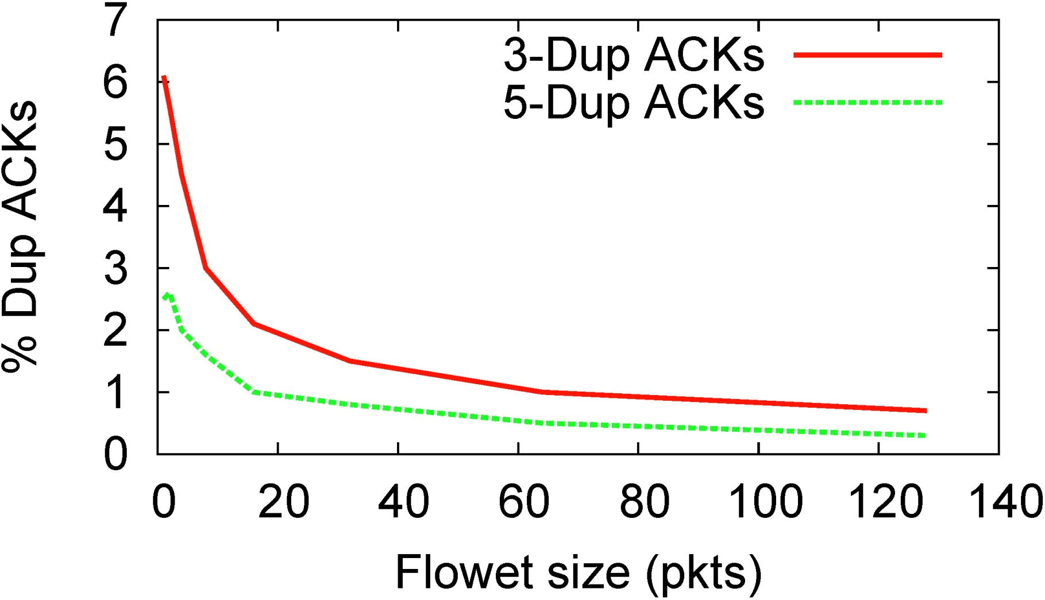
Reordering is low

